Slide 1



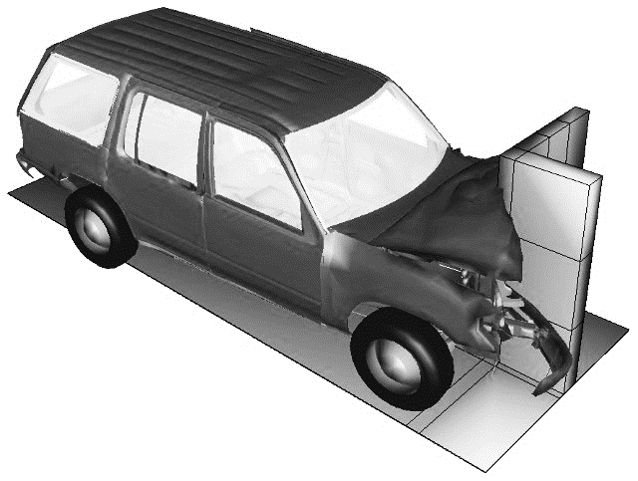
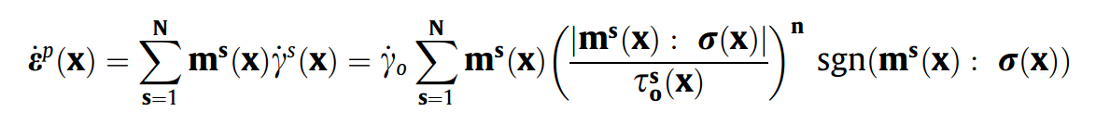
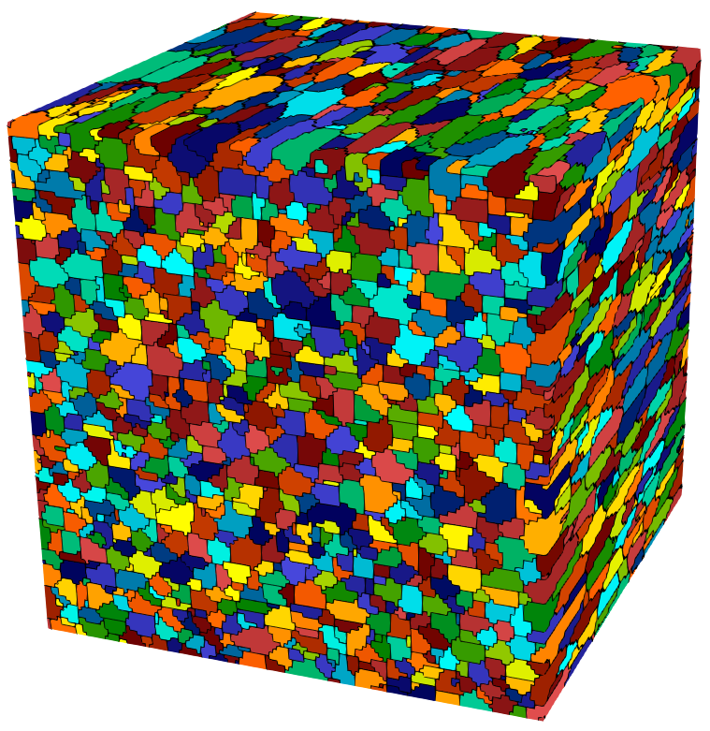

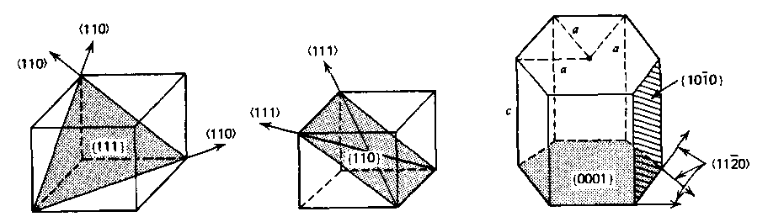
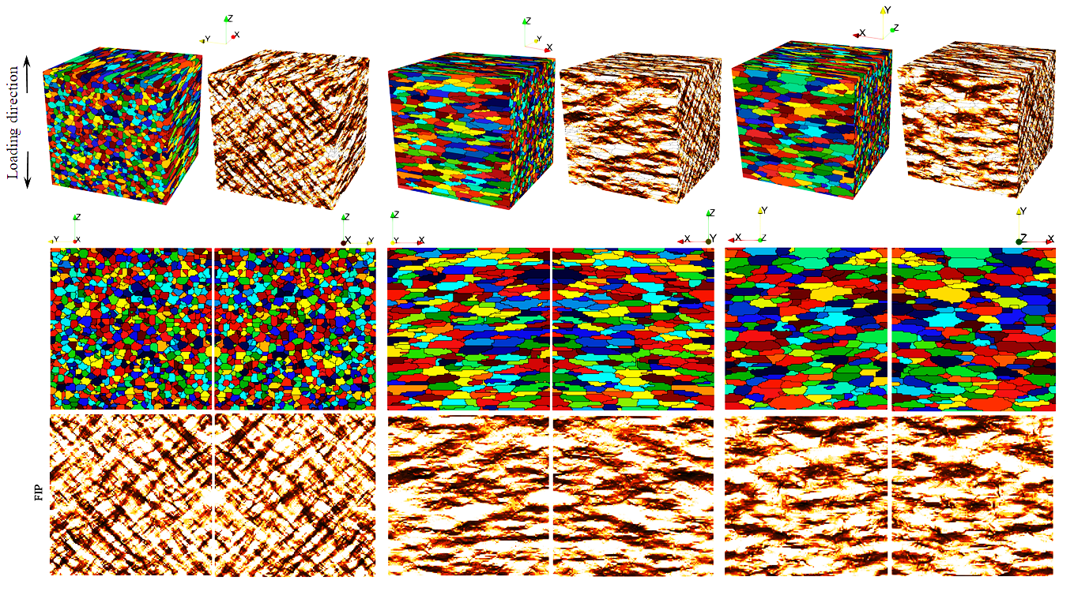
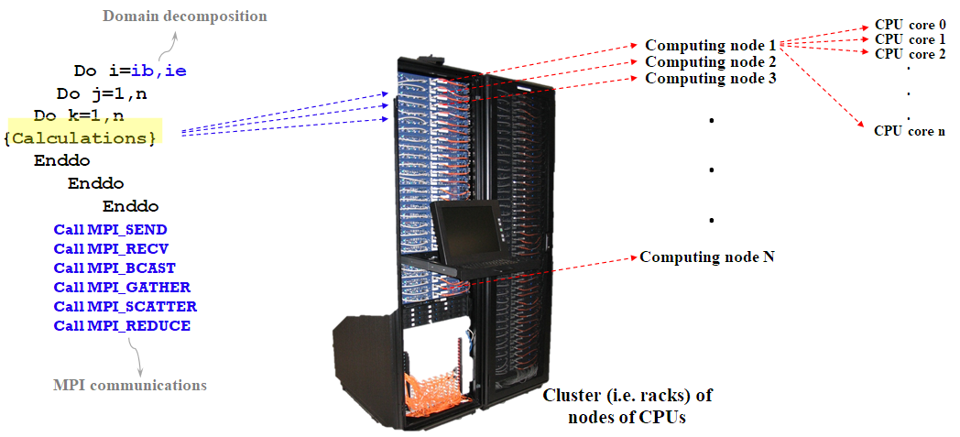
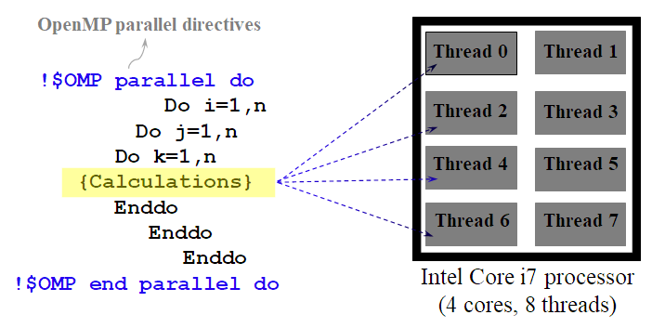
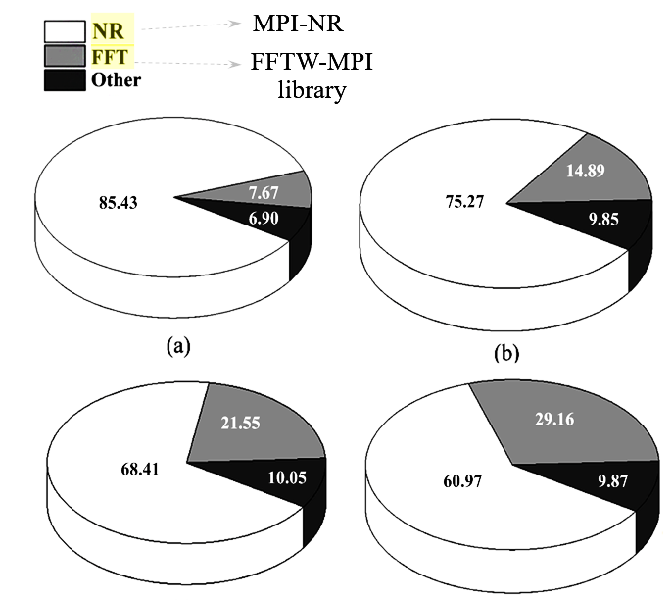
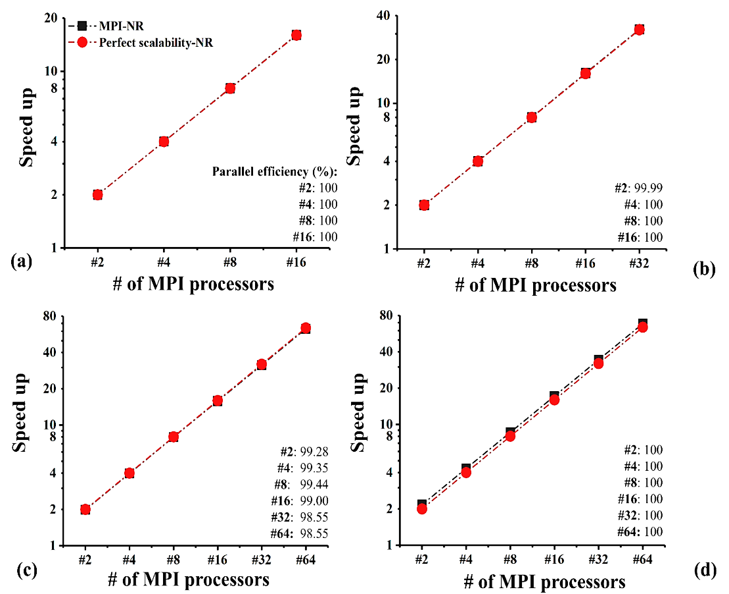
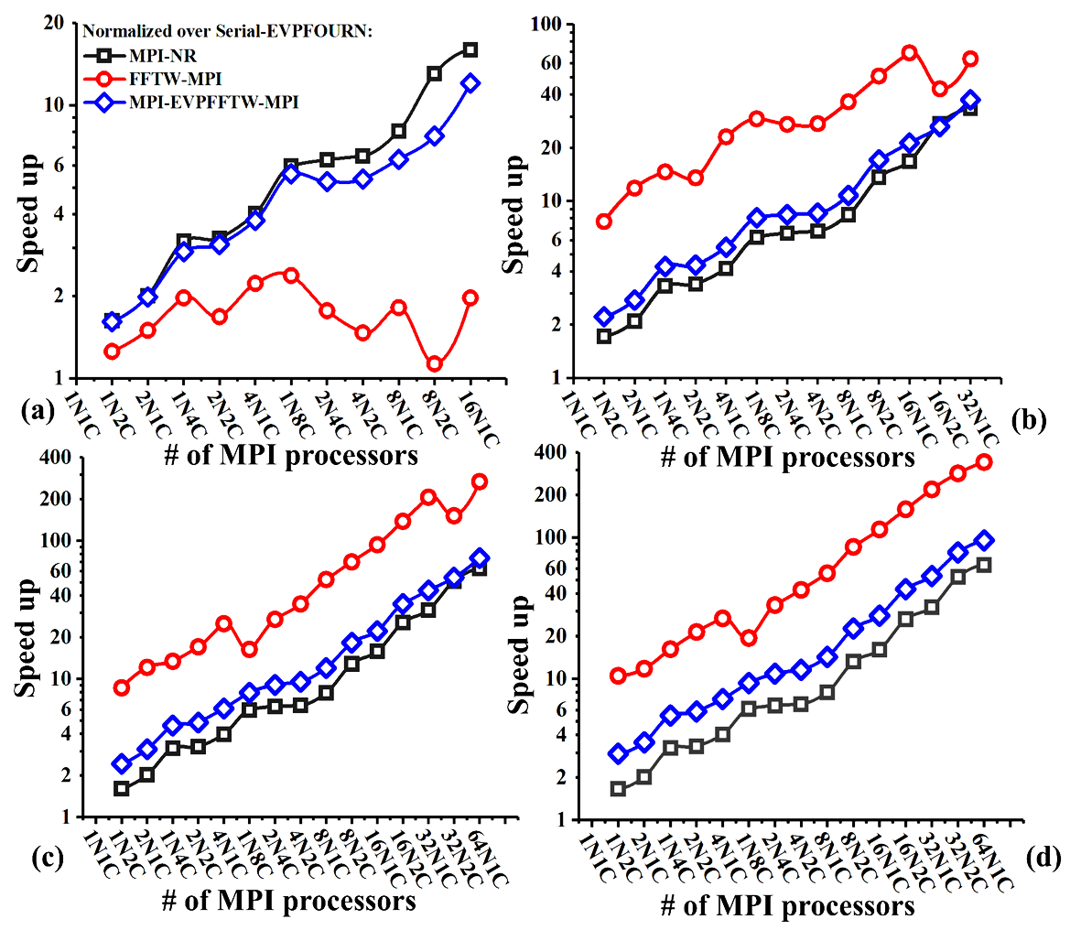
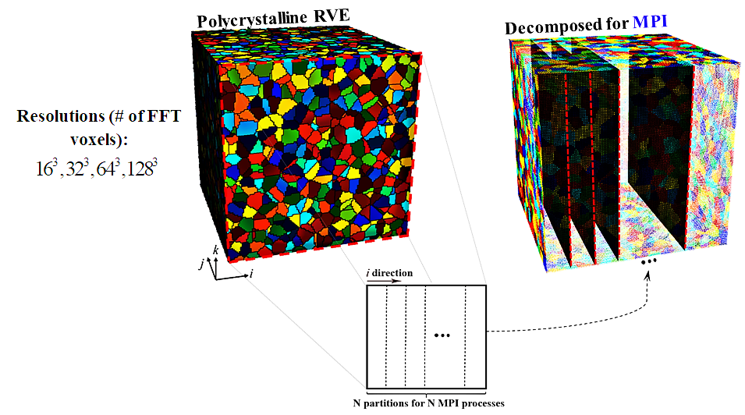
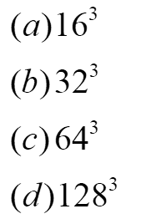
A Domain Decomposition Parallel Implementation of an Elasto-viscoplasticCoupled elasto-plastic Fast Fourier Transform Micromechanical Solver with Spectral Database Constitutive Representation
Adnan Eghtesad, Timothy Barret, Kai Germaschewski, Ricardo A. Lebensohn, Rodney J. Mcabe, and Marko Knezevic
Department of Mechanical Engineering, University of New Hampshire, Durham, NH 03824, USA
Department of Physics, University of New Hampshire, Durham, NH 03824, USA
Materials Science and Technology Division, Los Alamos National Laboratory, Los Alamos, NM 87544, USA
1
What is crystal plasticity?
2
Computational crystal plasticity
3
High Performance Computing (HPC)
Nasa advanced super computing (NAS) cluster with 29,368 computing cores
A multiscale plasticity approach which explicitly models discrete grains and slip systems to capture the microstructure anisotropy of material
Crystal plasticity simulations are more accurate, predictive and robust comparing to macroscale plasticity but slow! One needs to accelerate them to facilitate further efficient research into this field
Fast CP simulations
Parallel run on cluster of CPUs (Domain decomposition)
Texture compaction
Parallel run on multiple GPUs
Non-iterative spectral solvers (Pre-computed databases)
Macroscale homogenized model
Crystal plasticity constitutive framework
Tools for Parallel computing on CPUs
OpenMP
MPI
Hybrid OpenMP-MPI
https://www.hec.nasa.gov/news/features/2011/sbus_042111.html
Microstructure RVE
(Polycrystalline)
Grain
Slip systems
OpenMP (Shared memory parallel programming)
5
6
4
MPI (Message Passing Interface)
EVPFFT (Elasto-viscoplasticCoupled elasto-plastic Fast Fourier Transform)
* Supports multi-threaded parallel programming on shared memory *
* Uses directives around loops to parallelize them *
* Facilitates communication among nodes of a cluster connected through high speed network *
* MPI uses domain decomposition for parallelization *
EVPFFT domain decomposition
Profile the code (Performance Profiler)
Up to 95x Speedup on only 64 CPUs!
7
8
9

