Slide 1
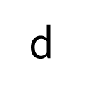
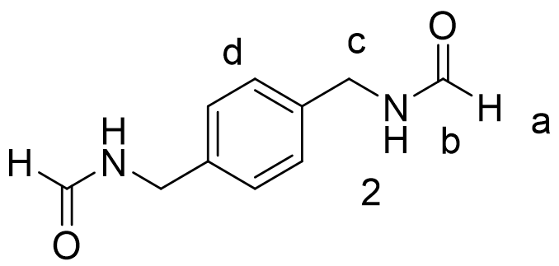



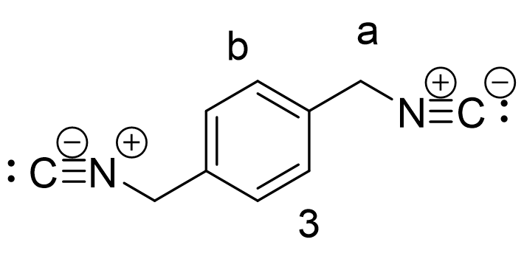


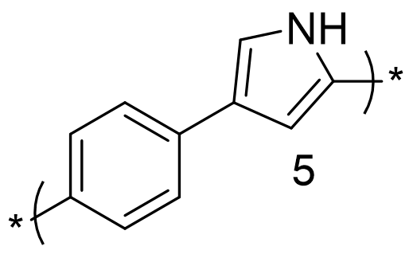
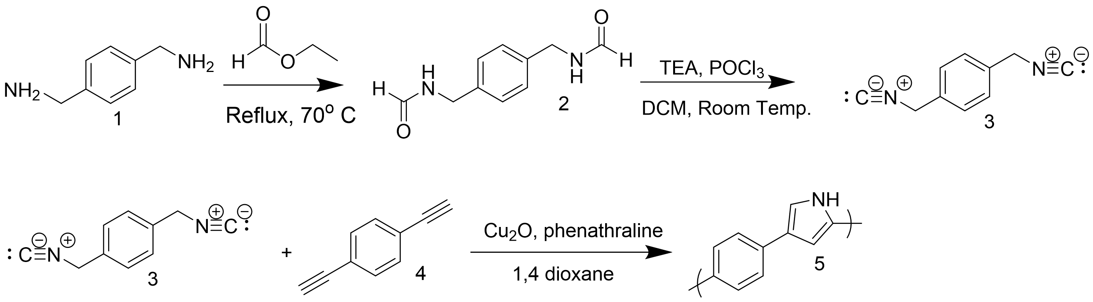
Synthesis of p-xylene diisocyanide and Polymerization
to Form Poly(2,4-pyrrole-alt-p-phenylene)
Joseph Mancinelli, Justin Cole, and Erik Berda; Department of Chemistry, University of New Hampshire
jpm2006@wildcats.unh.edu
Introduction
Results & Discussion
Conclusion
Polypyrrole is a conjugated organic polymer that has many practical applications, including use in organic solar cells, batteries, and chemical sensors¹. The scope of the research is the promise of new organo-electronics that will replace archaic, outdated materials. This experiment used a novel synthetic route to a new 2,4 substituted polypyrrole (Figure 1a).
There are many reported ways of making 2,5 substituted polypyrroles, however synthetic routes to achieve 2,4 substituted polypyrrole have not been reported in the literature. The classic structure of polypyrrole is shown in the 2,5 substituted conformer (Figure 1b). This experiment utilized an efficient two-step synthesis to synthesize the monomer p-xylene diisocyanide. The monomer was synthesized by first formylating p-xylene diiamine to p-xylene diformamide and then dehydrating to afford p-xylene diisocyanide. The p-xylene diisocyanide would then be polymerized using cycloaddition polymerization to afford the target polypyrrole (Scheme 1).
Step 1: The formylation of p-xylene diiamine to p-xylene diformamide was conclusive based on ¹H NMR (Figure 2 below).
Step 2: The dehydration of p-xylene diformamide to p-xylene diisocyanide was conclusive based on ¹H NMR (Figure 3 below).
Step 3: The cycloaddition polymerization of p-xylene diisocyanide and diethynlbenzene was attempted, however ¹H NMR data (Figure 4 below) was inconclusive due to an absence of broadening in the spectrum.
Synthesis of p-xylene diformamide was conclusive based on ¹H NMR spectroscopy and was isolated in considerable yield. Synthesis of p-xylene diisocyanide was also conclusive by ¹H NMR spectroscopy; however, it is was isolated in considerably low yields (2.2%). Further experimentation is needed to synthesize the target polypyrrole, Poly(2,4-pyrrole-alt-p-phenylene). ¹H NMR data showed no broadening of the peaks between the monomer spectrum and the spectrum taken 24 hours into the polymerization. This indicated no conversion of monomer into polymer.
1a.
1b.
Figure 2: ¹H NMR of isolated p-xylene diformamide.
Future Work
Figure 1a . Structure of the target polypyrrole, Poly(2,4-pyrrole-alt-p-phenylene). Figure 1b. Typical 2,5 structure for polypyrrole.
The two-step synthesis used to make p-xylene diisocyanide will continue to be used as it was proven to be efficient and successful. The cycloaddition polymerization of diethynyl benzene and p-xylene diisocyanide to afford poly(2,4-pyrrole-alt-p-phenylene) will continue to be used for future polymerizations with hopefully better results. Characteristics of the polymerization can be altered that could potentially increase the success rate of the reaction. For example, a ligand other than phenanthroline (Figure 5a.) can be used, such as 2,2-bipyridine (Figure 5b.)
Both of these ligands are bidentate nitrogen ligands, and as such will have similar complexing characteristics. However, the slight difference in structure for 2,2-bipyridine could make the reaction a success. Another alteration is the addition of an electron-withdrawing group to the monomer. The presence of an electron-withdrawing group (for example, an NO₂ group) increases the favorability of annulation of the isocyanide group³.
Figure 3: ¹H NMR of isolated p-xylene diisocyanide.
5a.
5b.
Figure 5a. Structure of phenanthroline.
Figure 5b. Structure of 2,2-bipyridine.
Experimental Design
Figure 4: ¹H NMR of cycloaddition polymerization of p-xylene diisocyanide and diethynlbenzene. No broadening is present, indicating no conversion to polymer.
References
1. Lange, U.; Roznyatovskaya, N. V.; Mirsky, V. M. Conducting polymers in chemical sensors and arrays. Analytica Chimica Acta. 2008, 614, 1-26.
2. Daniel G. Rivera, DGR.; and Ludger A. Wessjohann, LAW. J. Am. Chem. Soc. 2006, 128, 7122-7123.
Hironaga, H.; Kuwano, K.; Ogawa, T.; Ono, K.; Ono, N.; and Simizu, K.; Synthesis of Pyrroles annulated with Polycyclic Aromatic Compounds; Precursor Molecules for Low Band Gap Polymers. J. Chem. Soc. Chem. Commun. 1994, 0, 1019-1020.
Acknowledgements
Scheme 1. Proposed synthetic route to synthesize Poly(2,4-pyrrole-alt-p-phenylene²).
I would like to thank the University of New Hampshire Chemistry Department, Dr. Justin Cole, Dr. Erik Berda, and the Berda Research Group. I would also like to extend a special thank you to Matthew Currier for letting me use his poster format.

