Slide 1
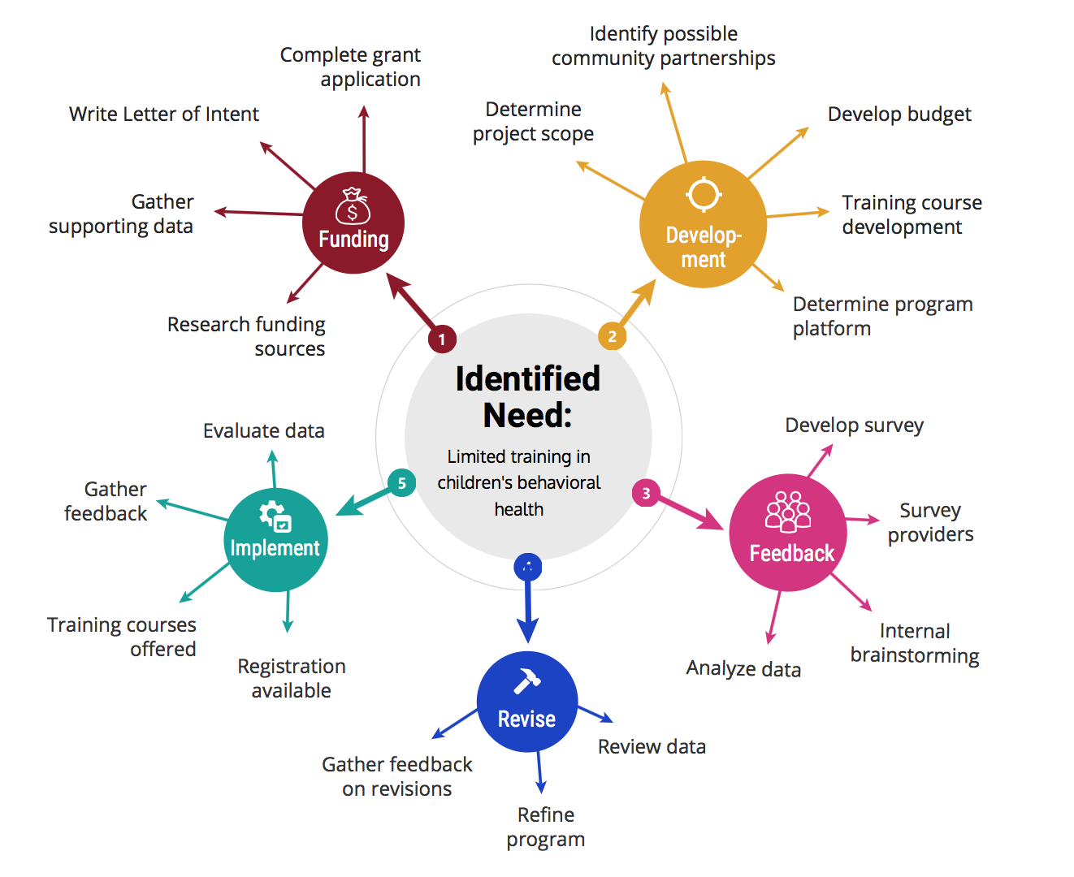
Children’s Behavioral Health Training
Institute on Disability
NH currently faces a workforce crisis including limited mental health providers trained in Evidenced Based Practices in children’s behavioral health.
Letters of Intent have been submitted to various funding sources including the Healthy NH Foundation to support the development of online training courses
The IOD is working to develop Evidence Based Practice training courses specifically in the area of children’s behavioral health to address the current need.
Providers across the state are going to be surveyed with some of the follow objectives:
  Identify barriers to receiving training
  Identify areas of interest for training
  Assess interest to engage in online training
  Assist in the development of trainings
The data collected will be analyzed and used to guide the final development of each course once funding has been secured.
Rebecca Searles, BS
MSW LEND Trainee

