Slide 1




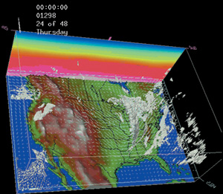
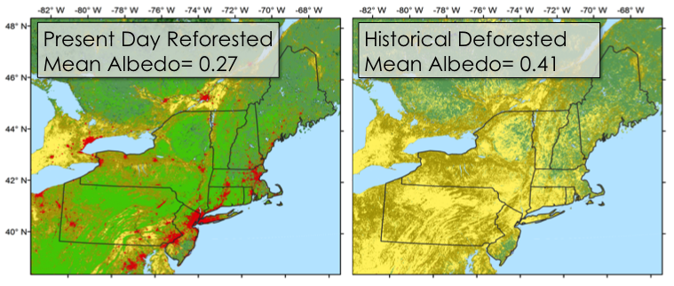
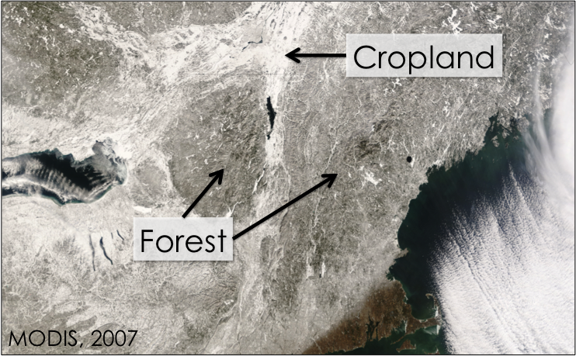
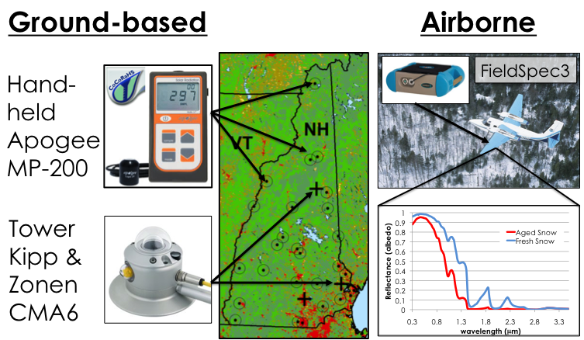
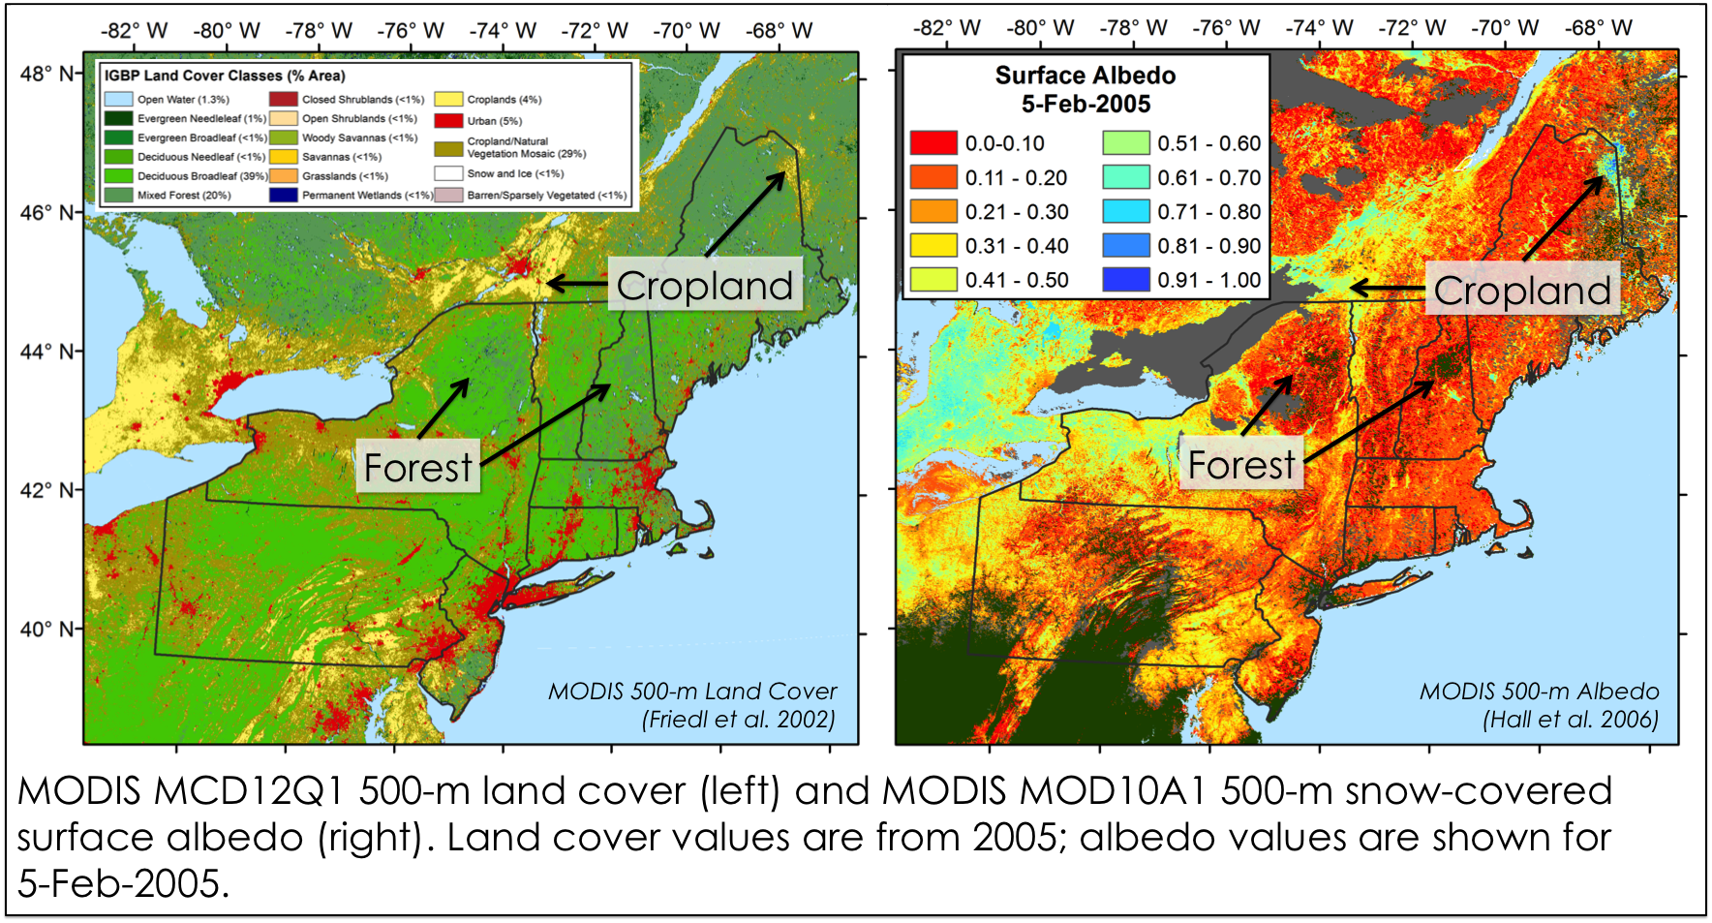
The Impacts of Colonial-Era Deforestation on
Wintertime Albedo and Climate
Elizabeth Burakowski (ean2@unh.edu)
Advisor: Dr. Cameron Wake
University of New Hampshire, Durham, NH
22nd National NSF EPSCoR Conference
Coeur d’Alene, ID, October 24-27, 2011
Student Poster Competition
Research Objectives
Preliminary Results
Methods & Timeline
    Primary research question:
    What were the climate impacts of colonial-era deforestation?
    Hypothesis:
    Winter climate was colder as a result of the higher surface albedo of deforested landscapes.
Albedo Network (2011/2012)
Background
High Albedo
Low albedo
heat
in
out
heat
in
out
abs
abs
Climate Modeling (2012/2013)
Albedo (reflectivity) affects surface climate through changes in surface radiation.
Weather Research and Forecasting (WRF3.3) & Community Land Model (CLM4.0)
Lower albedo forests appear darker than higher albedo fields due to canopy shading.
Compare observed ground-based and airborne measurements to modeled albedo
Evaluate climate response to land cover scenarios
Broader Impacts
Evaluate the impact of historical land cover trends on local to regional climate
Compare land surface albedo forcing with other climate forcings (e.g., greenhouse gases)
Validate MODIS albedo over heterogeneous land cover types
MODIS mean winter (Dec-Feb) snow-covered surface albedo in the Northeastern US, averaged by International Geosphere Biosphere land cover classes over the period 2001-2009. Surface albedo values with ‘good’ data quality flags are included in the 10-year averages. Error bars represent one standard deviation.
Foster et al. 2010
Acknowledgements
Forested area in New Hampshire dropped below 50% by 1860, increasing surface albedo during periods of snow cover.
Foster et al. 2010. Wildland and Woodlands: A Vision for the New England Landscape, Harvard
University, Cambridge, MA, USA.
Friedl et al. 2002. Global land cover mapping from MODIS: Algorithms and early results, Remote Sensing of Environment, vol. 83: 287–302.
Hall et al. 2006. MODIS/Terra Snow Cover Daily L3 Global 500m Grid V005, [24Feb2000 – present], Boulder, CO, USA: NSIDC, Digital media.
Funding provided by NSF EPSCoR Grant #EPS-1101245

