Slide 1

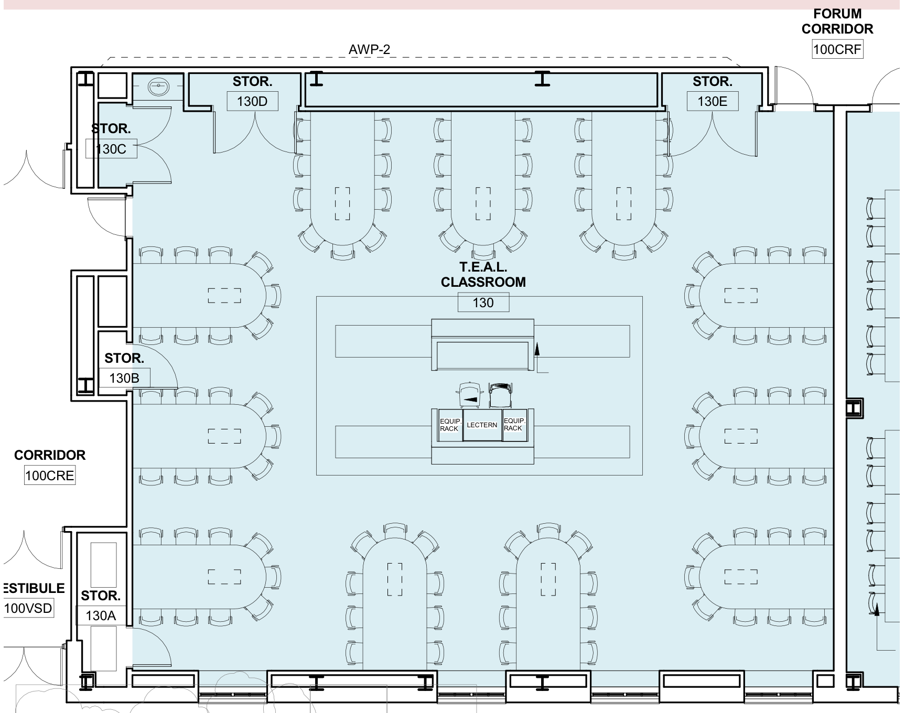
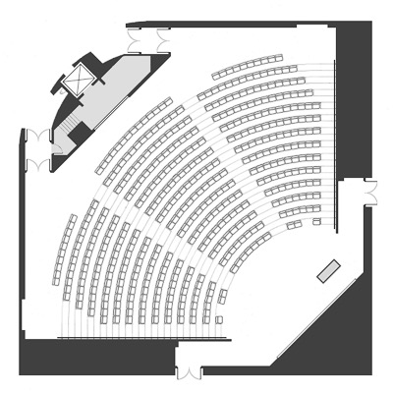
The Role of Classroom Design in Facilitating Student
Engagement in Recreation and Leisure Education
Samantha L. Powers, Sean McLaughlin, M.S., Robert J. Barcelona, Ph.D., Nate E. Trauntvein, Ph.D.
Department of Recreation Management & Policy, University of New Hampshire
Background
methodology
Group work & Classroom Design
Classrooms intentionally designed to incorporate technology have a unique advantage when it comes to active learning, and may be able to better meet Chickering and Ehrman’s Seven Principles for Good Practice in Undergraduate Education (1996). Some classrooms, such as Technology Enabled Active Learning (TEAL) classrooms, are specifically designed to incorporate technology and support an environment of active learning. Previous research suggests that intentionally designed active learning spaces can play an important role in the overall effectiveness of education (Temple, 2008). The purpose of this study was to evaluate the effectiveness of an intentionally designed, technology classroom through the measurement of student perception of active engagement.
Quantitative, retrospective web-based survey to collect students’ self-reported data on classroom engagement in a recreation management course
Modified version of Wiggins et al.’s (2017) ASPECT
  24 Likert scale items
Distributed to students in 2 sections of the course: 1 section TEAL and 1 section traditional lecture
Instructor and content kept consistent
TEAL students were asked to respond to additional statements regarding role of classroom design in facilitating their learning experience as well as an open-ended question for general comments about experience in the TEAL classroom
TEAL vs. traditional lecture
Differences in Classroom engagement
The sections were similarly distributed by gender, class standing, and major option. Students were asked to self-report their GPA, and there were slight differences in self-reported GPA between the sections, with the students in the traditional classroom averaging a higher GPA compared to those in the TEAL classroom (M = 3.27, SD = .34; M = 3.09, SD = .43, respectively)
Personal Effort, Central Position of Instructor, and Instructor Contribution explained over 70% of the variance in TEAL student perception of group work
Discussion
Overall positive perceptions of the classroom among TEAL students
Open-ended comments suggest general satisfaction with the TEAL classroom
  Although students identified the awkwardness of having lectures in the classroom
  Emphasis on TEAL being designed for group work
Significant differences between TEAL and traditional classrooms on Value of Group Work and Personal Effort
TEAL classroom could be used in conjunction with traditional classrooms, ideal for flipped classroom
Future research
  Seek to control for increased effort of instructor to teach in the TEAL room
  Examine possible other factors besides classroom design
ASPECT Factors | N | TEAL Meanª (SD) | Traditional Meanª (SD) | F Value | Sig.
Value of Group Work | 86 | 5.16 (.58) | 4.80 (.78) | 7.634 | .007
Personal Effort | 86 | 5.32 (.56) | 5.08 (.49) | 4.326 | .041
Instructor Contribution | 85 | 5.52 (.50) | 5.43 (.56) | .651 | .422
ª For Traditional Lecture respondents, n = 38, For TEAL respondents, n = 51
Research Questions
Is there a significant difference in student perception of classroom engagement (ASPECT: Value of Group Work, Personal Effort, and Instructor Contribution) between students who are taught in a TEAL classroom and those who are taught in a traditional classroom?
Is there a significant relationship between student perception of Value of Group Work and various aspects of the classroom design while controlling for the Contribution of the Instructor and the Personal Effort of the student?
Students in the TEAL classroom scored significantly higher in Value of Group Work and Personal Effort
It is important to note there were no significant differences in Instructor Contribution, which was used as a control measure in this study, suggesting consistency of instructor
Contact: sld225@wildcats.unh.edu

