Slide 1

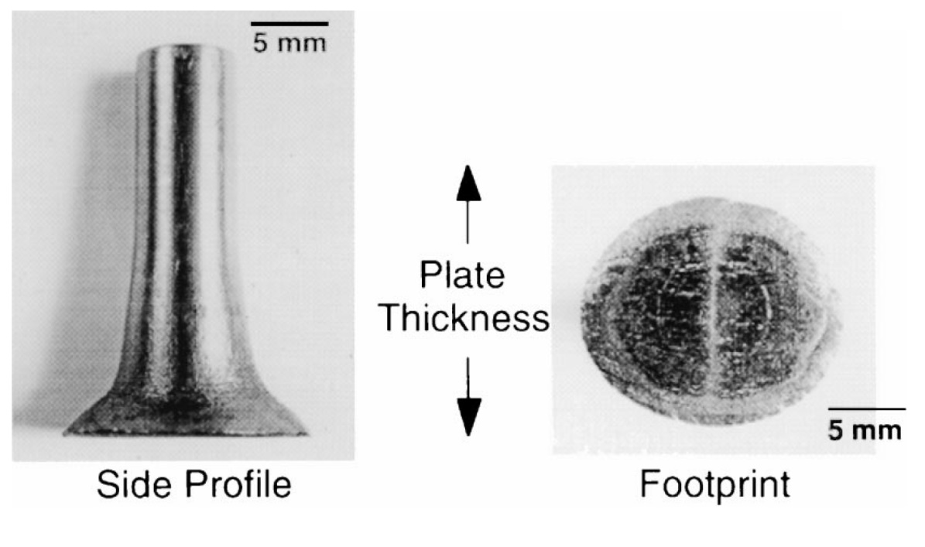
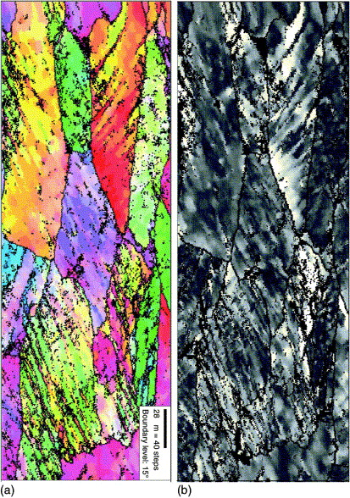
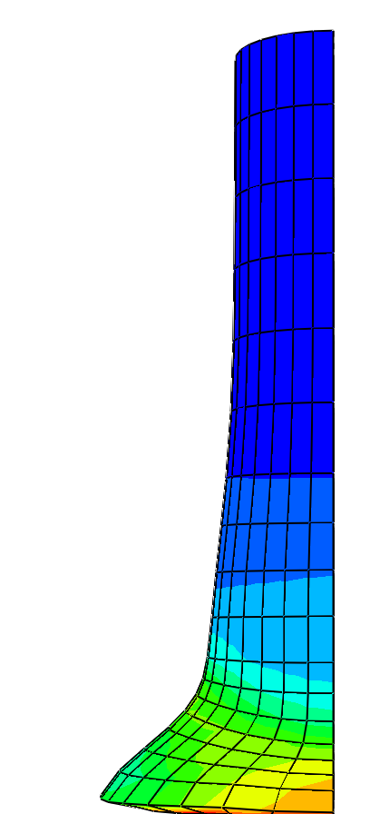
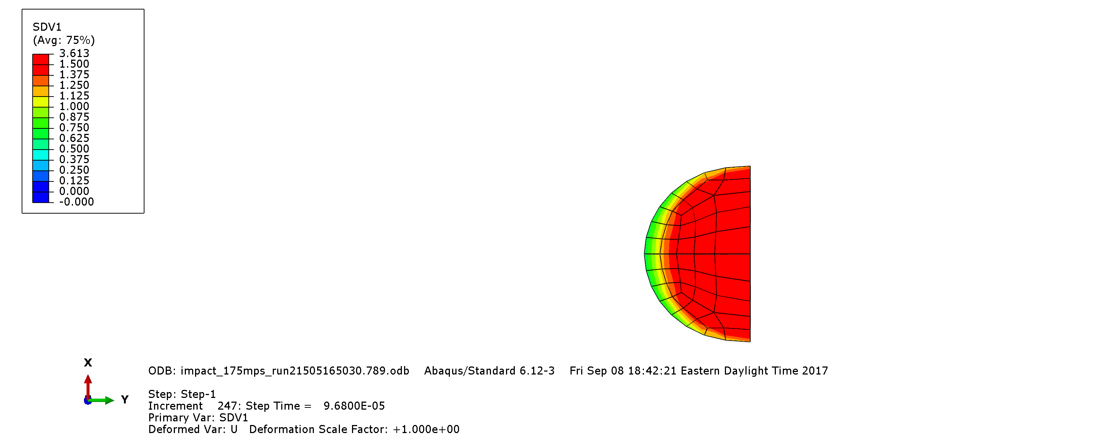
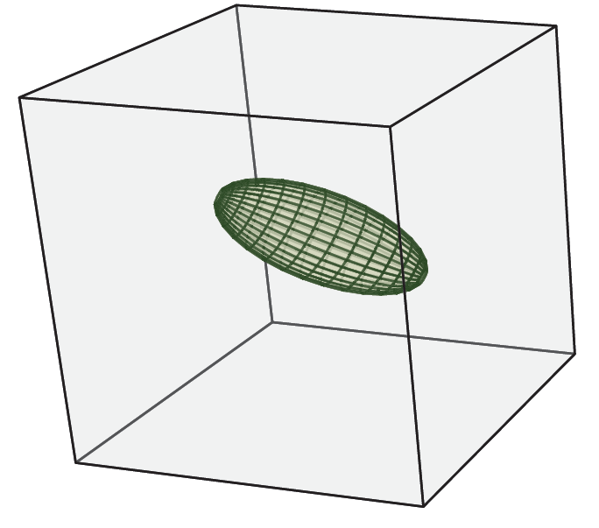
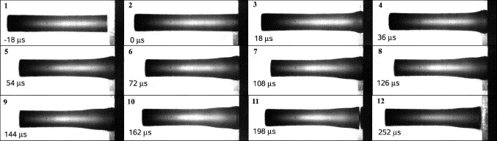
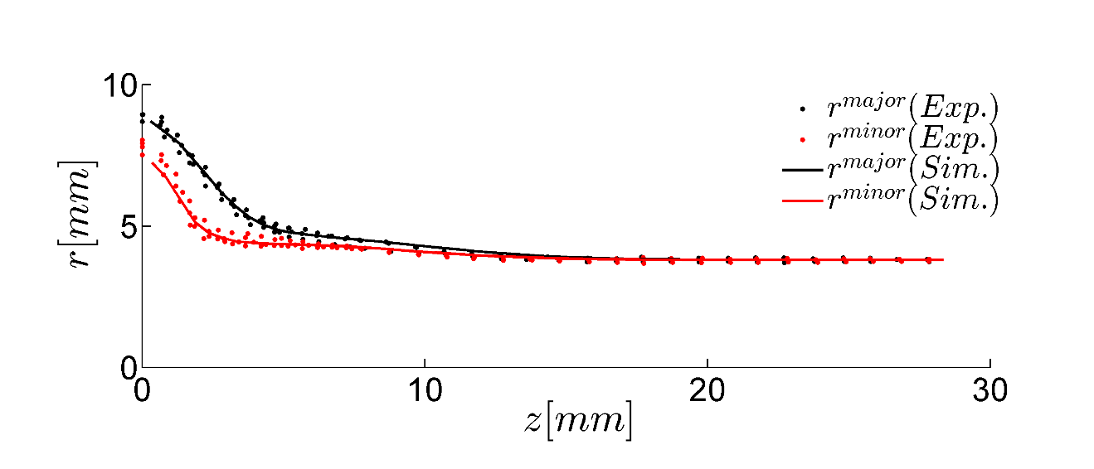
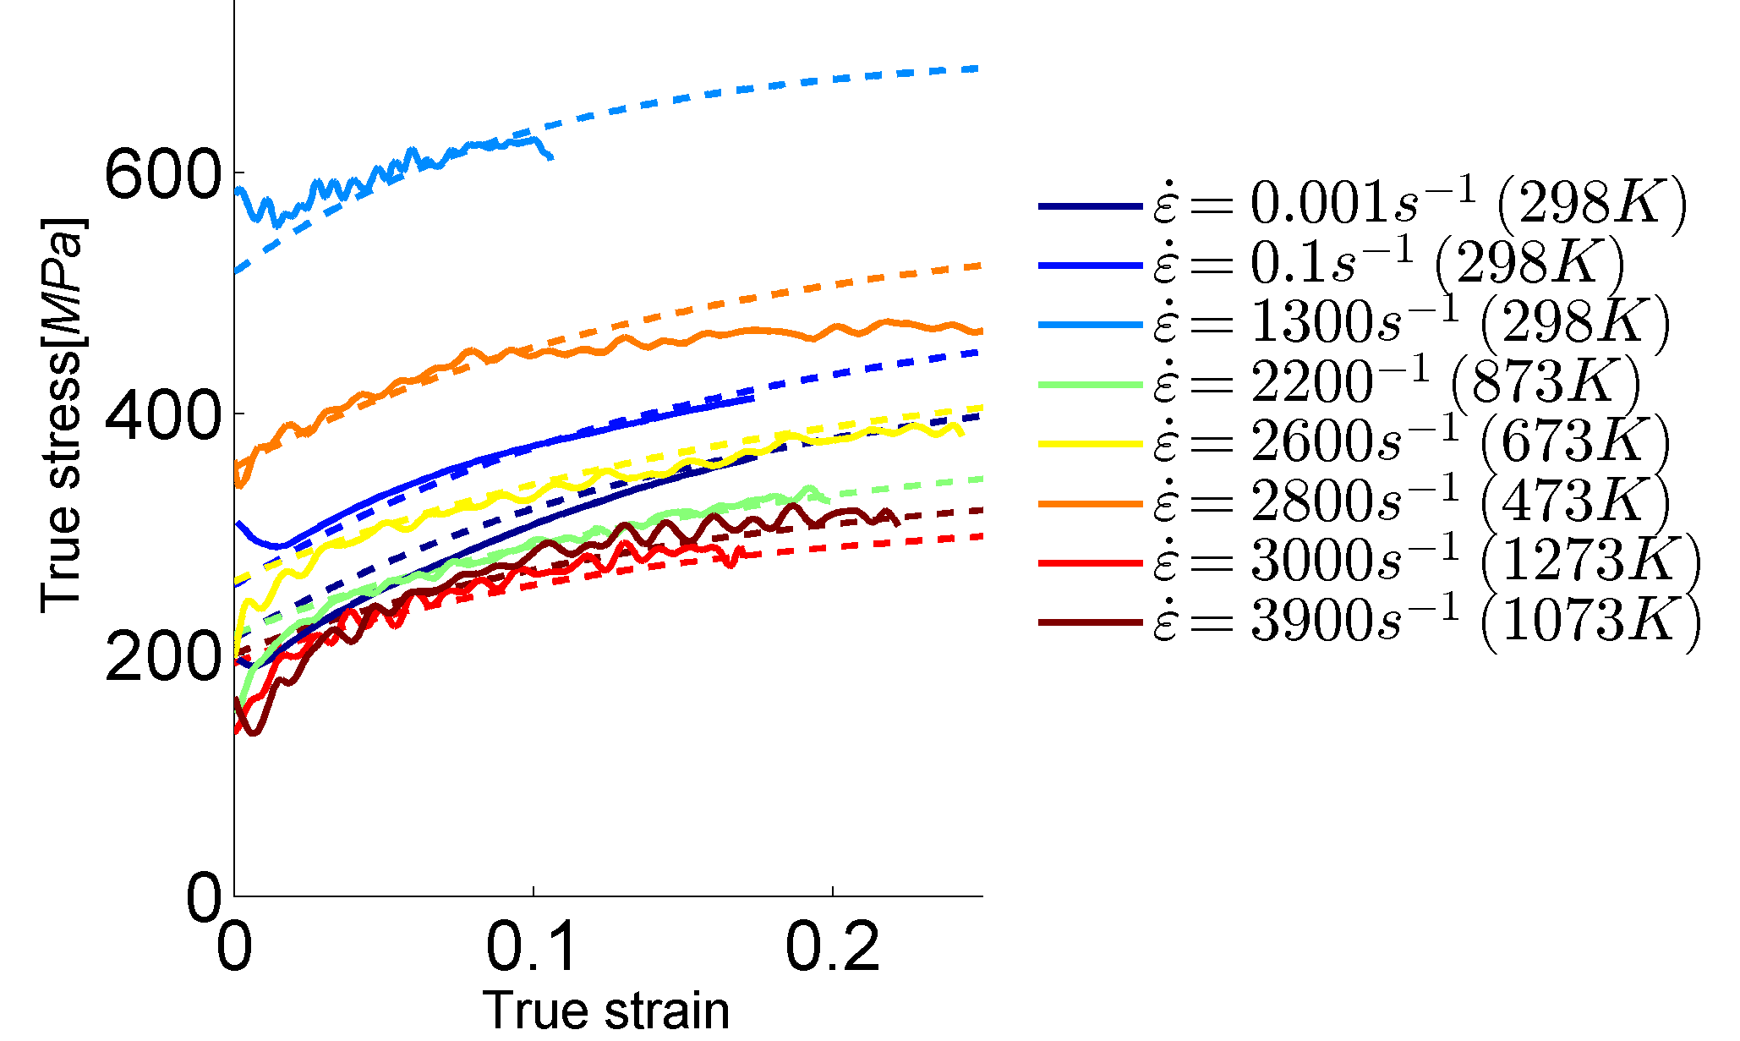
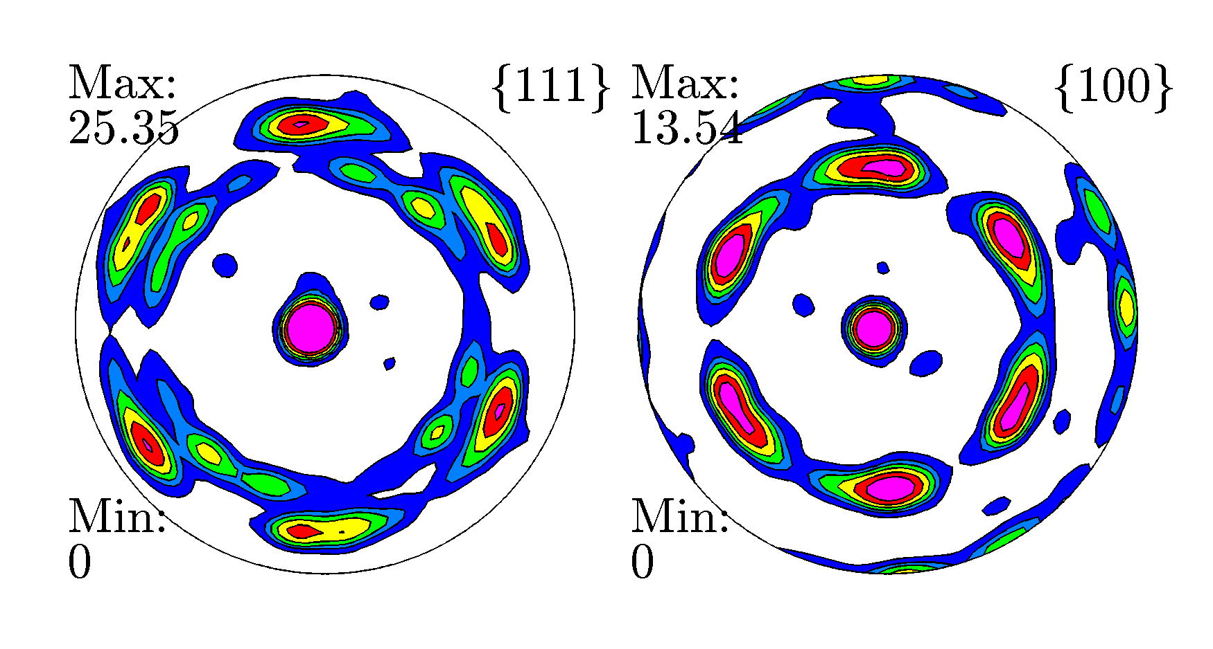
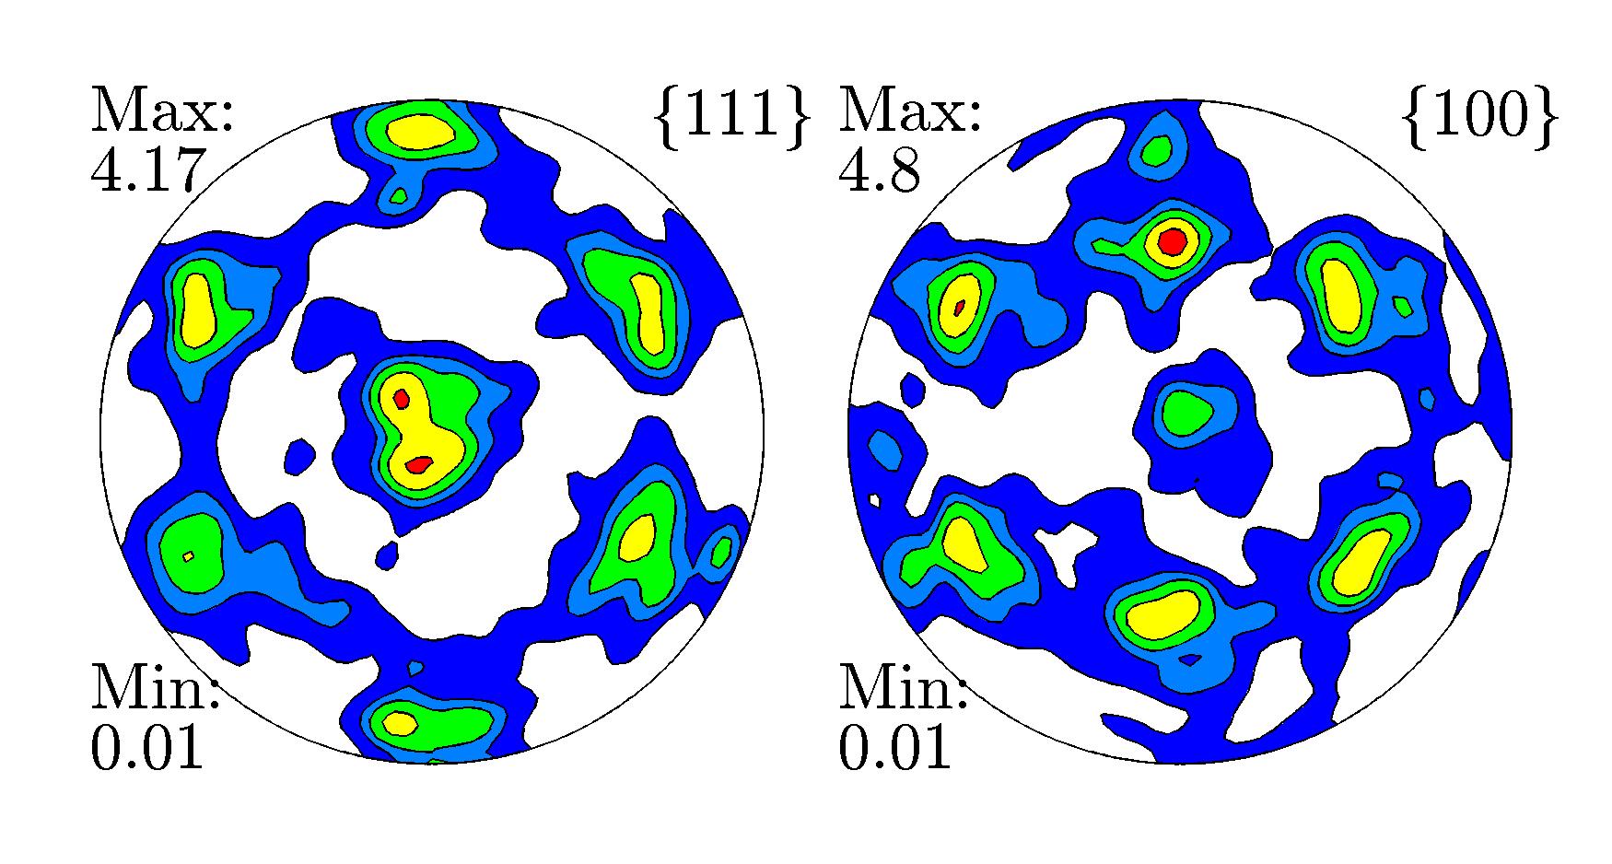
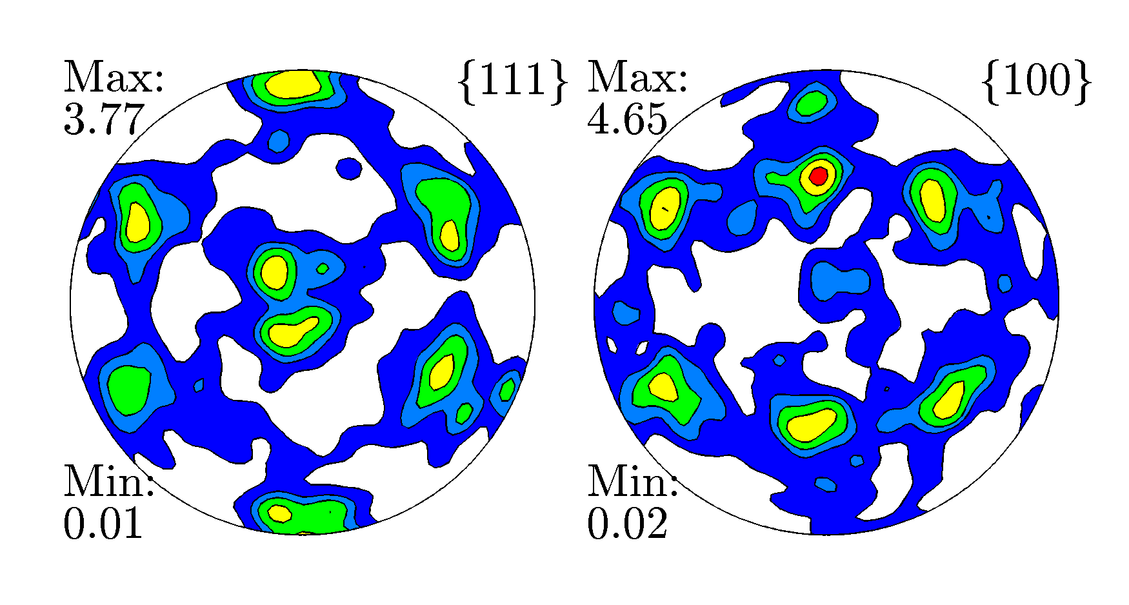
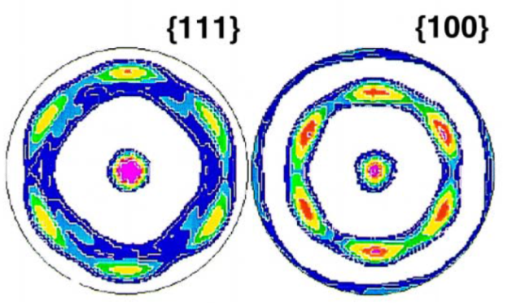
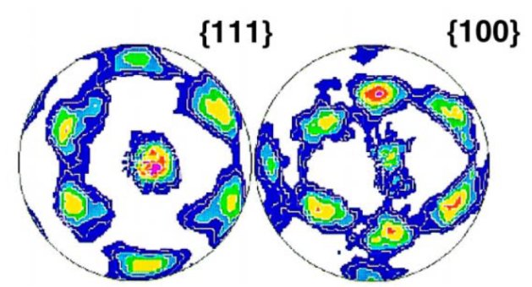
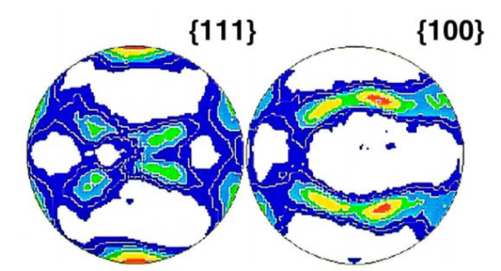
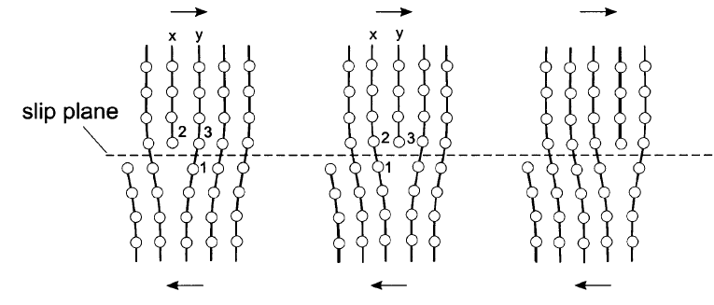
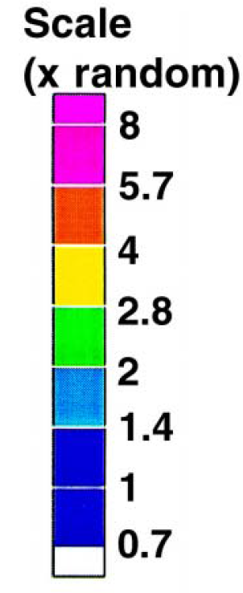
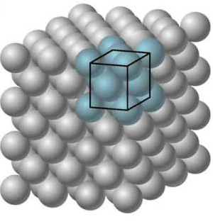
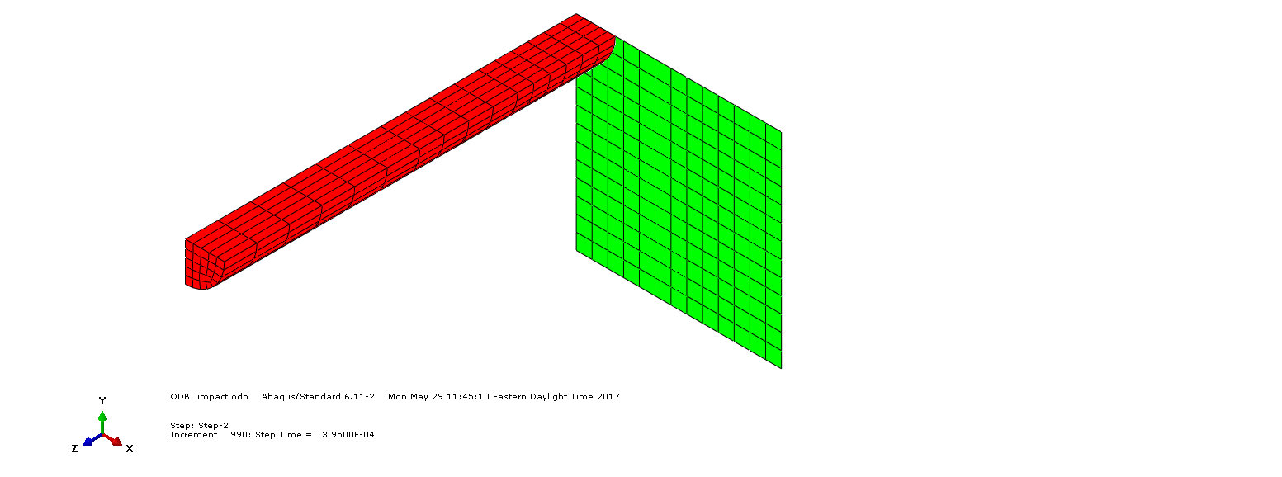
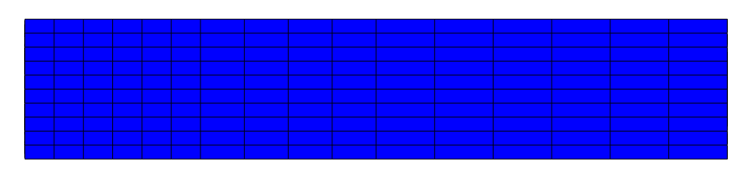
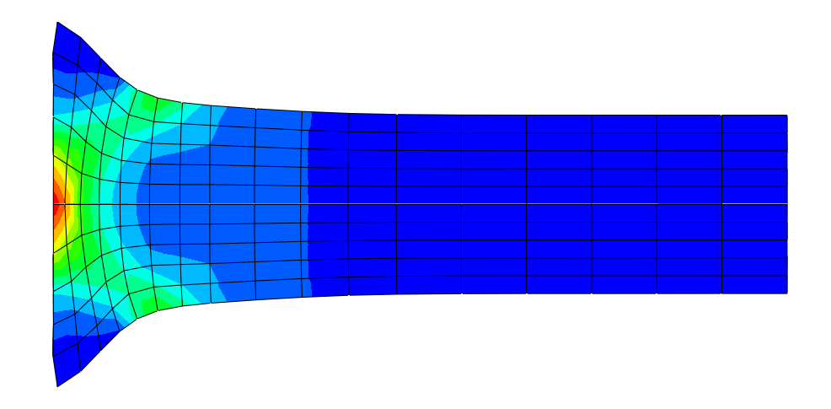
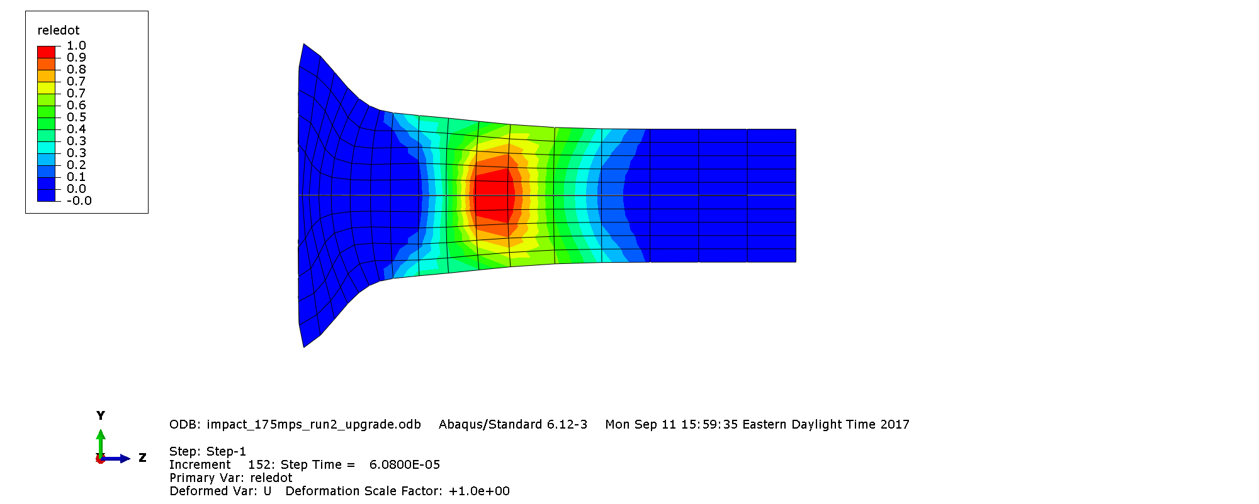
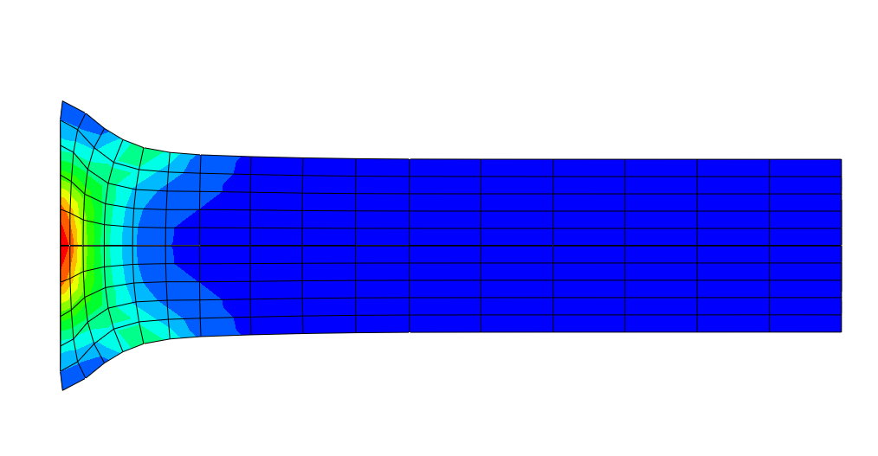
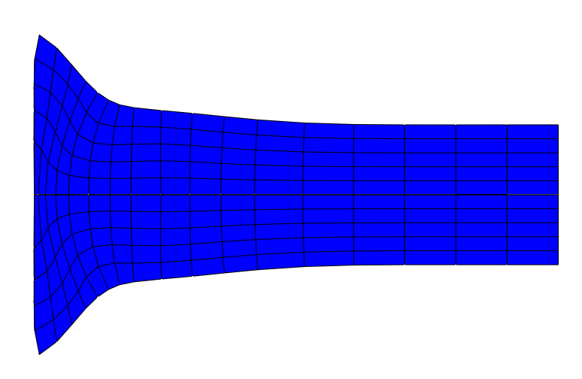
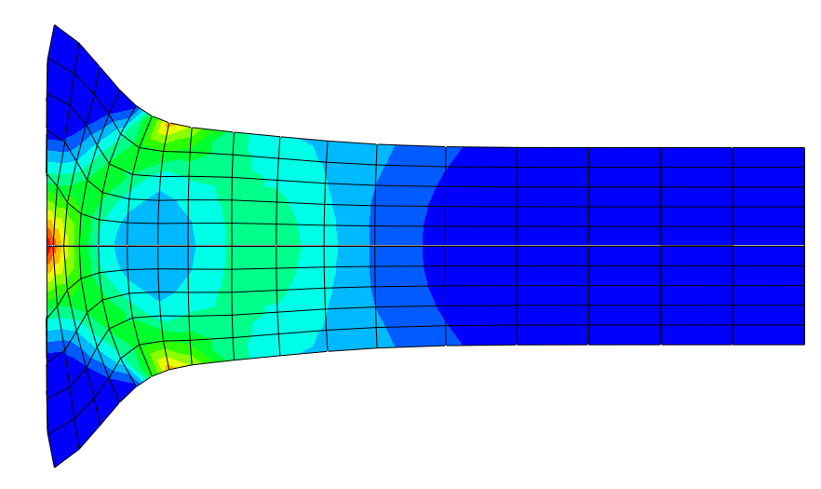

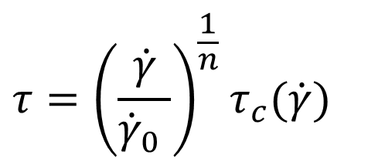
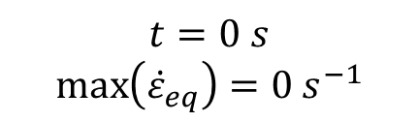
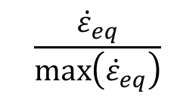
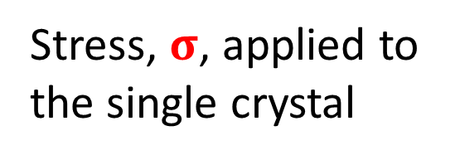
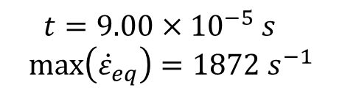
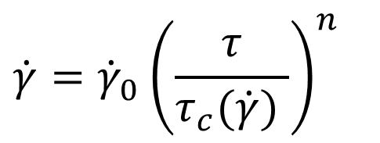
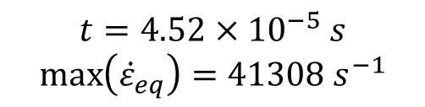
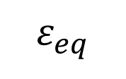
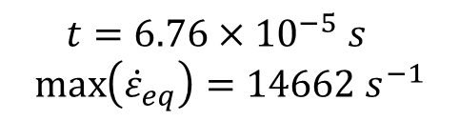
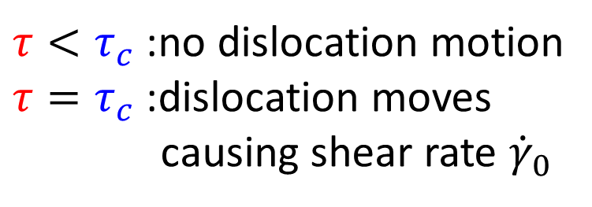

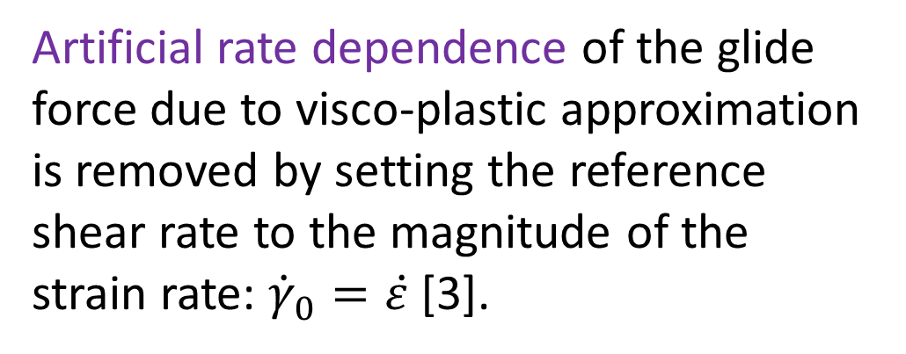
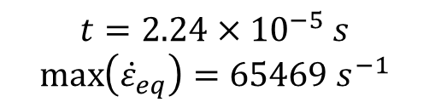
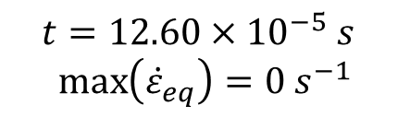
Visco-plastic self-consistent modeling of high strain rate and
impact deformation of tantalum
Miroslav Zecevic and Marko Knezevic
Department of Mechanical Engineering
University of New Hampshire
Introduction
Polycrystalline response
Comparison of the predicted post-test cylinder geometry with the measurements.
Mechanical behavior of tantalum is rate and temperature dependent. Commonly used crystal plasticity models based on the visco-plastic constitutive equation are not capable of predicting the complex rate dependence of stress characteristic for tantalum. We propose an improved visco-plastic model which accurately predicts the rate dependence of the mechanical response.
The proposed model is calibrated to simulate monotonic mechanical behavior of tantalum and subsequently applied to simulate the Taylor impact test.
The mechanical response of the polycrystal is obtained by self-consistent homogenization (VPSC model).
Self-consistent approximation for each single crystalline grain.
$$ε_{eq}$$
[1]
Grain
Polycrystalline material under applied load.
Matrix
The measured and predicted major and minor profiles.
Taylor impact test consists of propelling a cylindrical specimen into a rigid target and it is used for determination of dynamic yield stress and verification of constitutive models.
Results
Calibration
Predicted textures.
Model
The measured mechanical response during uniaxial compression at different strain rates and temperatures is used for calibration of the model parameters.
Single crystalline response
Relationship between stress and strain rate at the single crystal level is approximated using the visco-plastic equation.
Stress, $σ$, applied to the single crystal
Plastic deformation occurring by dislocation glide [2].
Taylor impact test
1/4 of tantalum cylinder.
Rigid target.
Measured textures.
8.0
5.7
4.0
2.8
2.0
1.4
1.0
0.7
Finite element model of the Taylor impact test with the visco-plastic self-consistent material model at each point of the cylinder.
Comparison of the predicted and measured crystal orientations within the polycrystal (texture) at different locations along the length of the deformed cylinder shows good agreement.
175 m/s
Forces acting on the dislocation:
$$τ_{c}=f(\dot{ε})$$
Evolution of equivalent plastic strain rate in the cylinder during the impact.
$$τ=m∙σ$$
Conclusions
Visco-plastic approximation for shear rate:
The applied glide force.
Rate dependent material resistance.
$$t=0 s$$
$$\max\left({\dot{ε}}_{eq}\right)=0 s^{−1}$$
y
z
$$t=4.52×{10}^{−5} s$$
$$\max\left({\dot{ε}}_{eq}\right)=41308 s^{−1}$$
$$t=9.00×{10}^{−5} s$$
$$\max\left({\dot{ε}}_{eq}\right)=1872 s^{−1}$$
$$\dot{γ}={\dot{γ}}_{0}{\left(\frac{τ}{τ_{c}(\dot{γ}) }\right)}^{n}$$
$τ<τ_{c}$ :no dislocation motion
$τ=τ_{c}$ :dislocation moves
causing shear rate ${\dot{γ}}_{0}$
A physics based polycrystal plasticity model capable of accurately simulating material rate sensitivity was developed. Single crystalline mechanical response was simulated using the modified visco-plastic equation and implicit evolution of slip resistance with shear strain. Homogenization of the polycrystal was preformed using the self-consistent homogenization scheme (VPSC). The monotonic stress-strain curves of tantalum at variety of different strain rates and temperatures were successfully fitted. In addition, the Taylor impact test of tantalum cylinder was simulated and the predictions were compared with the experimental measurements. Good agreement of the predicted post-test cylinder geometry and texture with the measurements was observed.
$$t=2.24×{10}^{−5} s$$
$$\max\left({\dot{ε}}_{eq}\right)=65469 s^{−1}$$
$$t=6.76×{10}^{−5} s$$
$$\max\left({\dot{ε}}_{eq}\right)=14662 s^{−1}$$
$$t=12.60×{10}^{−5} s$$
$$\max\left({\dot{ε}}_{eq}\right)=0 s^{−1}$$
The rate dependence of the applied glide force.
Artificial rate dependence of the glide force due to visco-plastic approximation is removed by setting the reference shear rate to the magnitude of the strain rate: ${\dot{γ}}_{0}=\dot{ε}$ [3].
$$τ={\left(\frac{\dot{γ}}{{\dot{γ}}_{0} }\right)}^{\frac{1}{n}}τ_{c}(\dot{γ})$$
$$\frac{{\dot{ε}}_{eq}}{\max\left({\dot{ε}}_{eq}\right)}$$
0.00 0.08 0.17 0.25 0.33 0.42 0.5 0.58 0.67 0.75 0.83 0.92 1.0
Literature cited
Acknowledgments
Contact
[1] Sarva, S., Mulliken, A. D., & Boyce, M. C. (2007). Mechanics of Taylor impact testing of polycarbonate. International journal of solids and structures, 44(7-8), 2381-2400.
[2] Hull, D., & Bacon, D. J. (2001). Introduction to dislocations. Butterworth-Heinemann.
[3] Zecevic, M., Knezevic M. (2018). A new visco-plastic self-consistent formulation implicit in dislocation-based hardening within implicit finite elements: Application to high strain rate and impact deformation of tantalum, Computer methods in applied mechanics and engineering – under review
The authors would like to thank Dr. John F. Bingert for supplying the Taylor impact testing and characterization data sets.
Miroslav Zecevic (mz3@wildcats.unh.edu)
Marko Knezevic (marko.knezevic@unh.edu)

