Slide 1

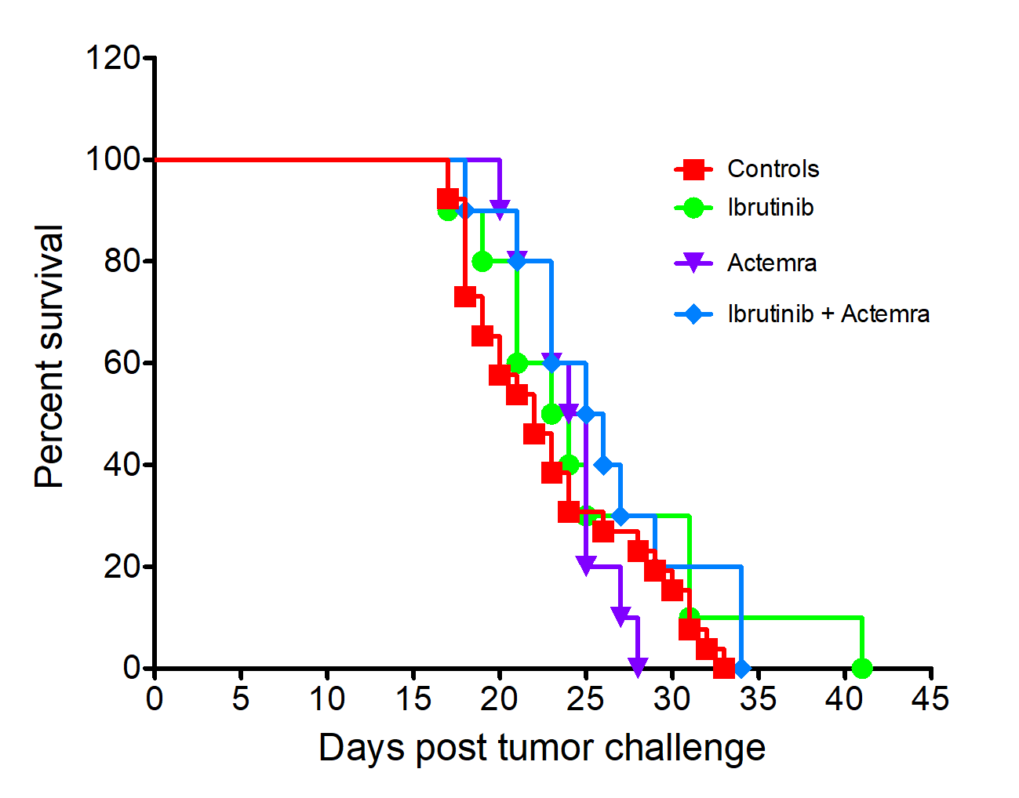
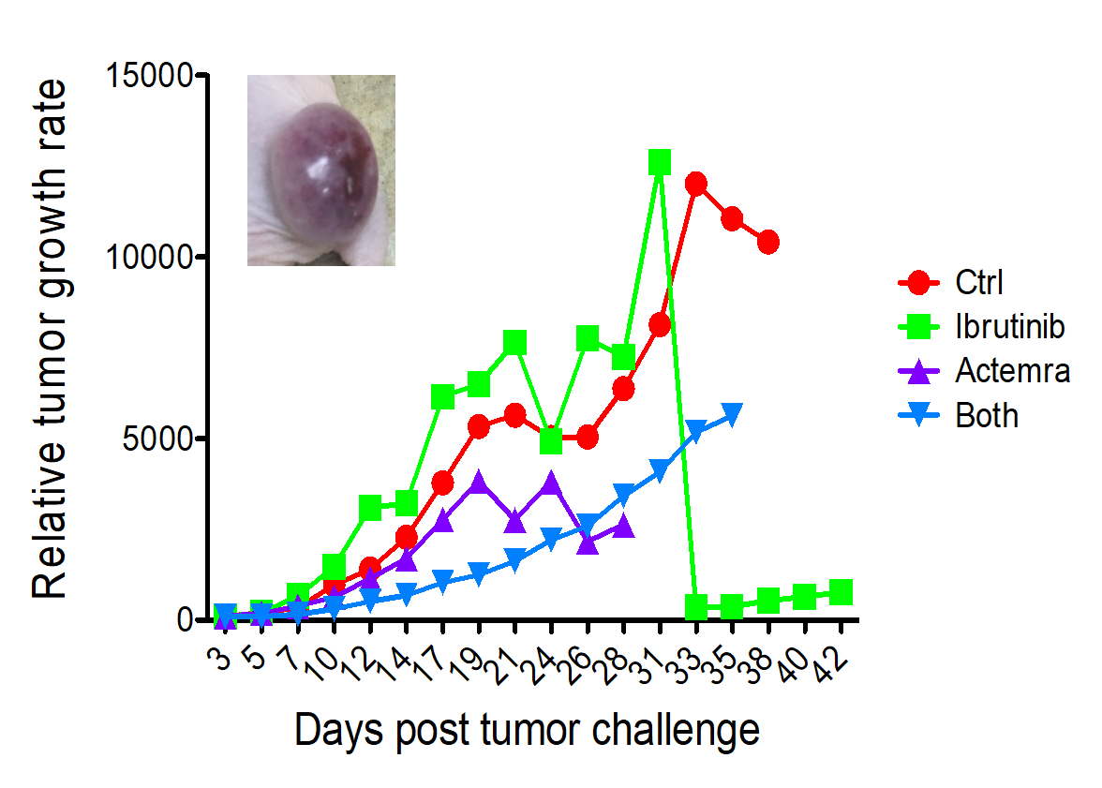
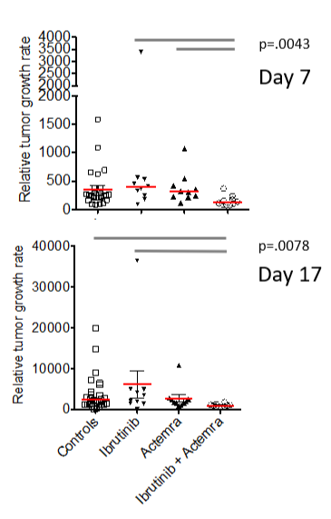
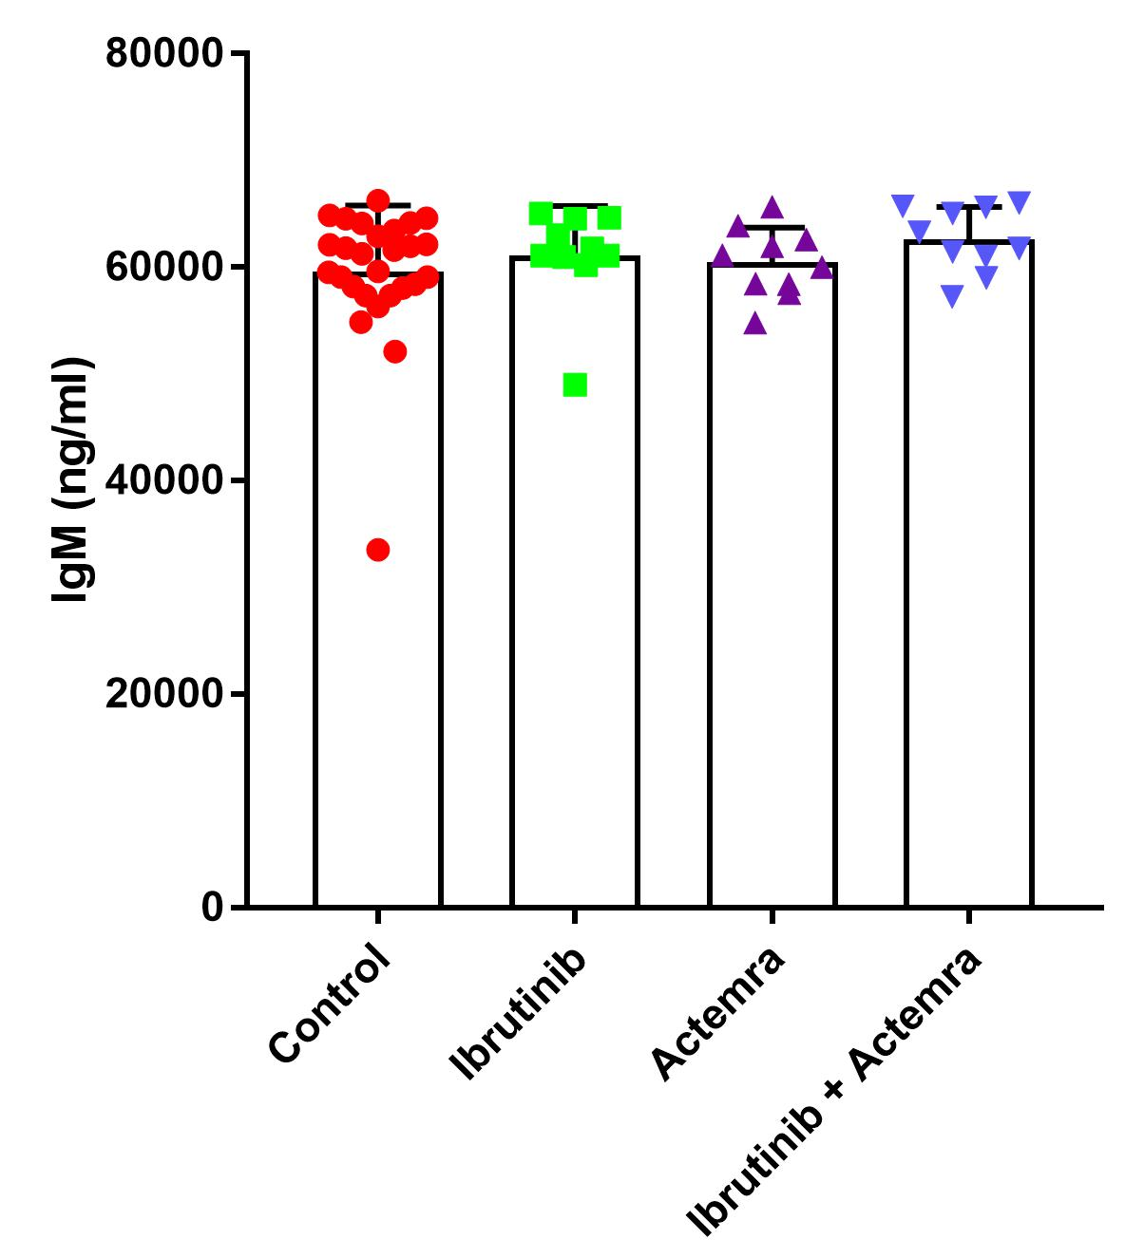
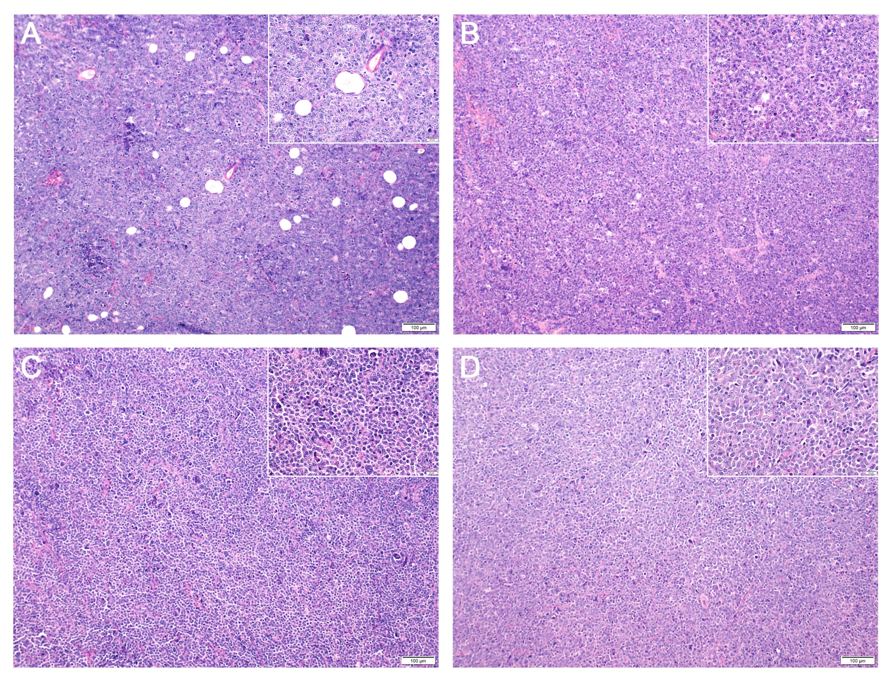
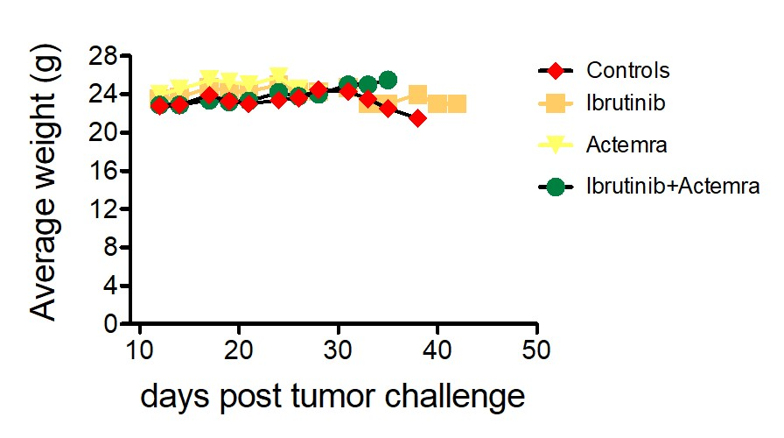
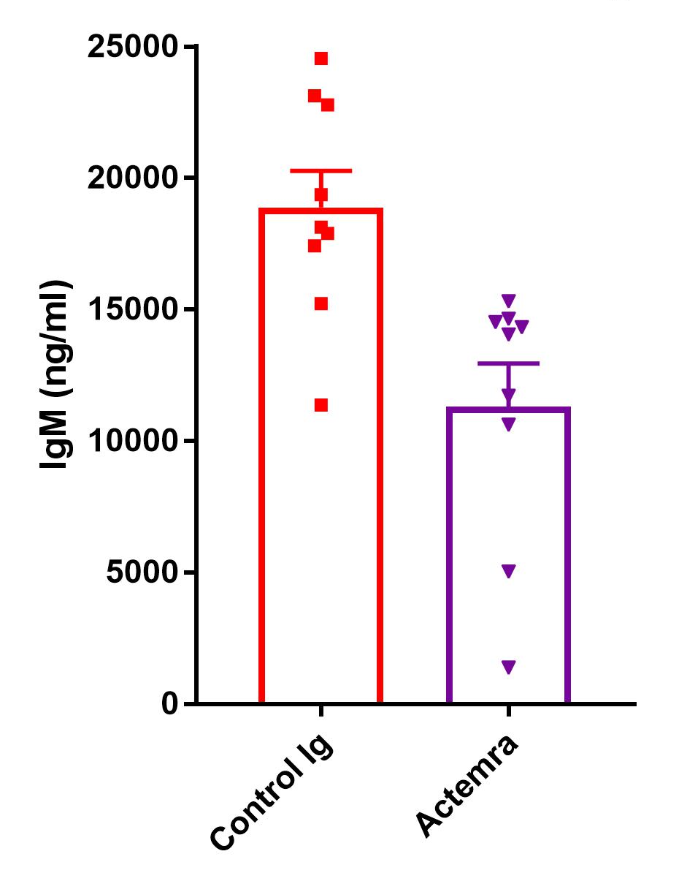
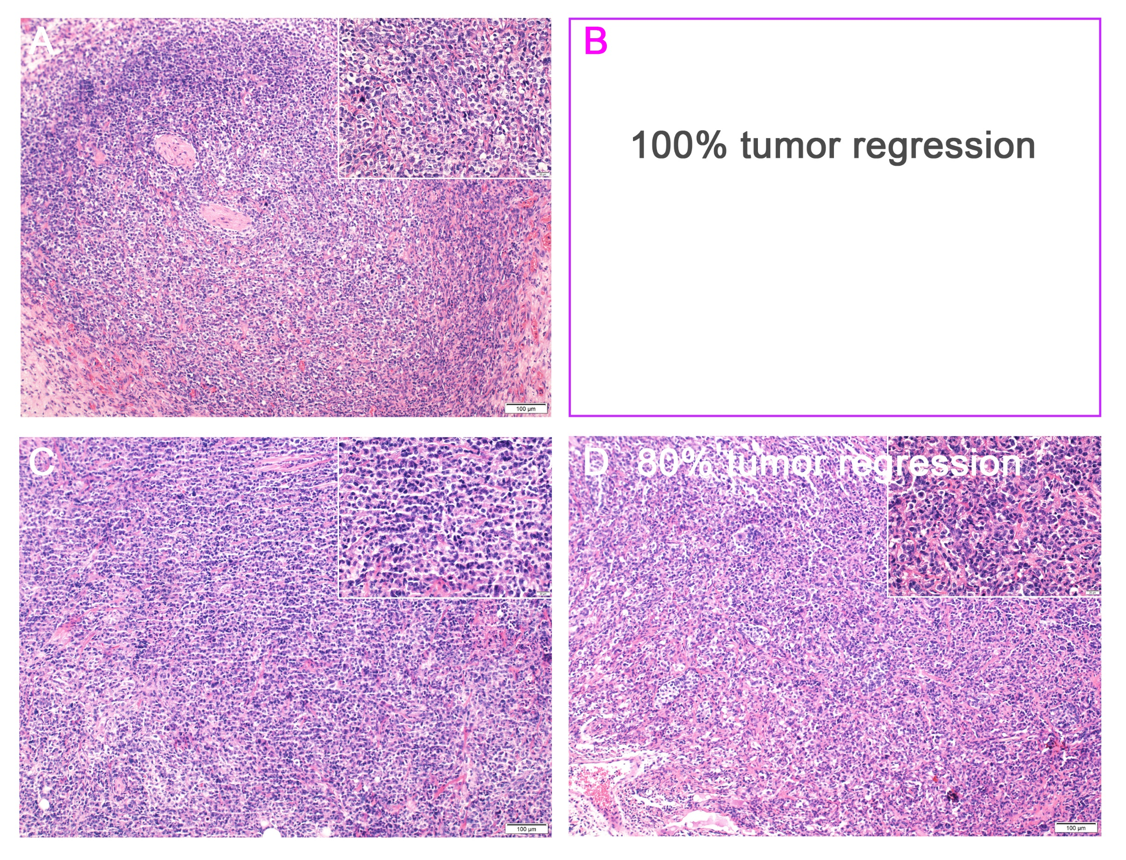
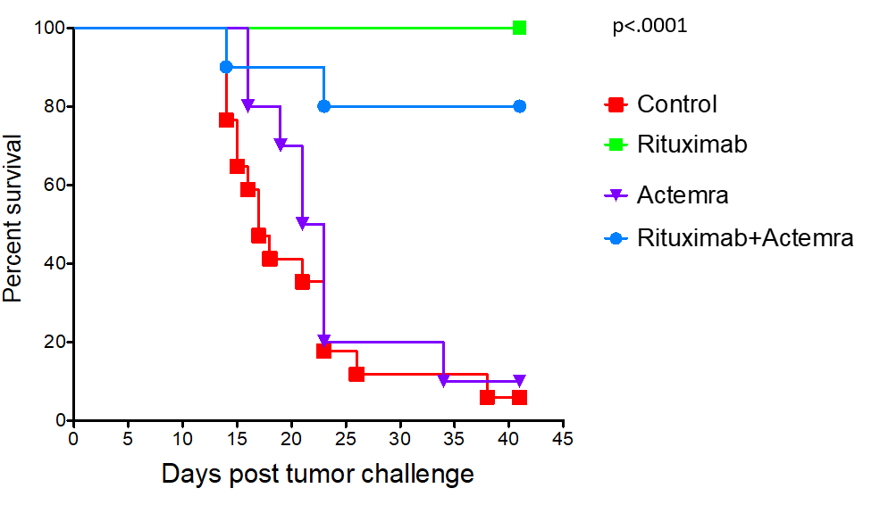
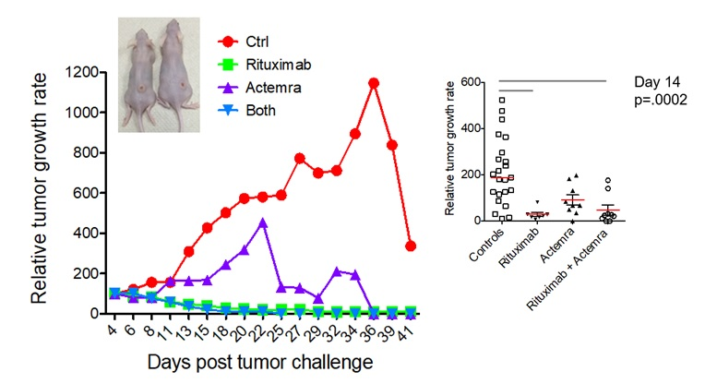
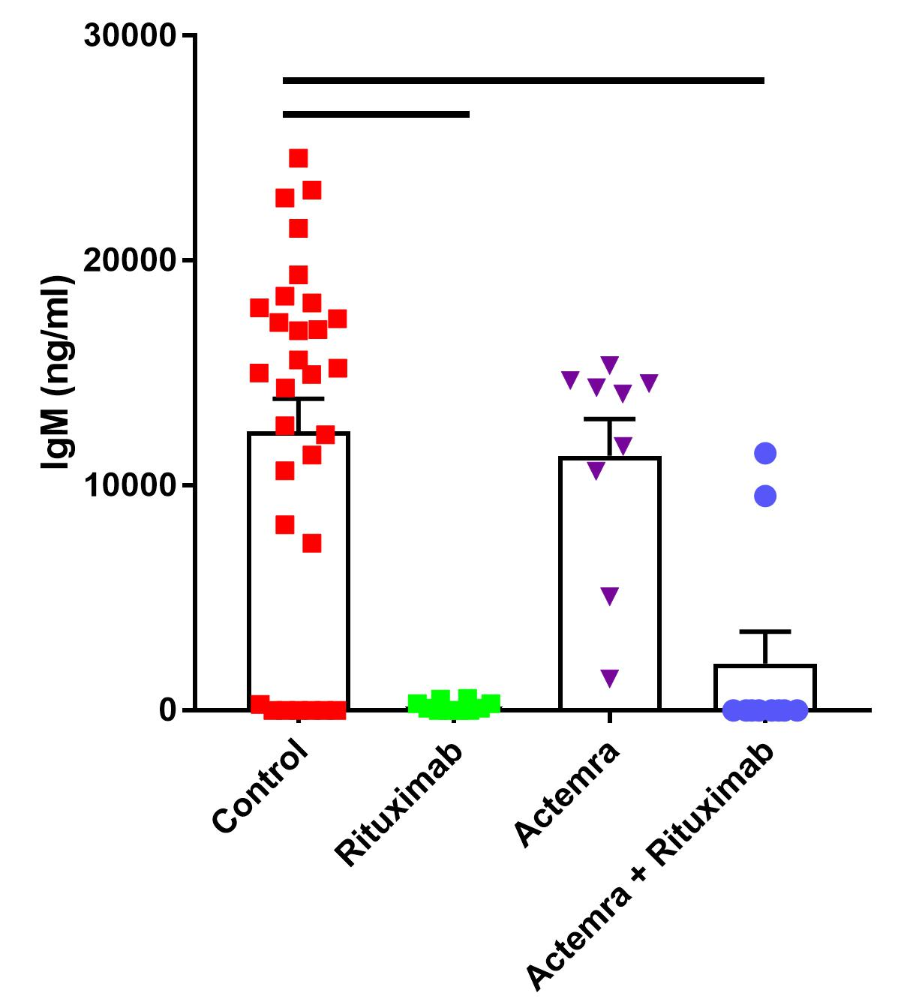
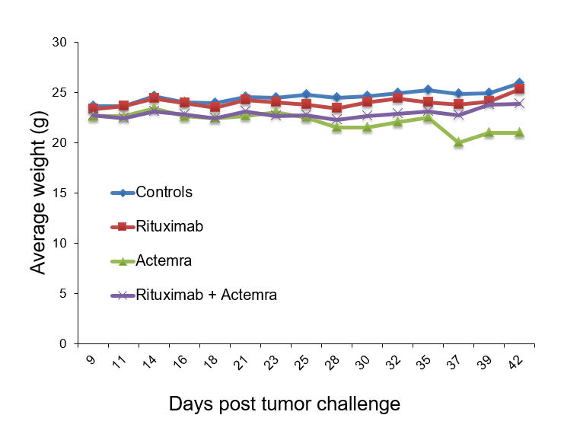



The tumor microenvironment protects against Ibrutinib but not Rituximab-mediated control of Waldenström macroglobulinemia (WM) in vivo
Weiguo Han, Brandon L. Sklavanitis, David A. Jackson, Stephan J. Matissek, Kaia Gervolin and Sherine F. Elsawa
Department of Molecular, Cellular and Biomedical Sciences, University of New Hampshire, Durham, NH 03824
ABSTRACT
RESULTS
The tumor microenvironment (TME) plays an important role in the development and progression of cancer. It has also been shown to play a protective role in resistance to therapy. Therefore, understanding the role of the TME is a vital component of our understanding of malignant cell biology. In Waldenström macroglobulinemia (WM), a B cell malignancy characterized by the overproduction of a monoclonal IgM protein, several studies have shown that the TME plays an important role in malignant disease. Therefore, the goal of this study was to investigate the efficacy of combined targeting of the TME with either Ibrutinib or Rituximab therapy in WM in vivo. SCID mice were injected with RPCI-WM1 + HS-5 stromal cells (5:1 ratio) and upon tumor development, mice were treatment with Ibrutinib (αBTK), Actemra (αIL-6), or a combination of Ibrutinib+Actemra or vehicle controls. An additional group of mice were injected with BCWM.1 + HS-5 cells (5:1 ratio) subcutaneously followed by treatment with Rituxmab (αCD20), Actemra (αIL-6) or both Rituximab+Actemra or controls. There was no improvement in survival of mice treated with Ibrutinib or Actemra as single therapy and combined treatment did not improve survival compared to controls. We also found a reduction in tumor growth rate in mice treated with Ibrutinib + Actemra compared with mice treated with Ibrutinib alone. There was no difference in human IgM secretion among different groups when examining serum samples by ELISA. In the cohort of mice treated with Rituximab, we found that the TME did not provide a protective effect on Rituximab therapy as Rituximab significantly enhanced the survival of mice (p<0.0001). Consequently, combined treatment with Rituximab and Actemra did not improve survival compared with Rituximab alone. We also found that mice treated with Rituximab alone had a significant reduction in tumor growth rate and combined therapy did not reduce tumor growth rate beyond that of Rituximab alone. Furthermore, we found a significant reduction in human IgM secretion in mice serum in mice treated with Rituximab alone (p=0.005) or combined therapy (p=0.0007) compared with control mice. However, there was no difference between Actemra alone and combined therapy, although, Actemra alone did reduce IgM secretion (p=0.0099). There was no significant change in mice weight over the course of the treatment suggesting that none of these therapies had toxic effects. Taken together, our data suggests that the TME provided a protective effect against Ibrutinib, but not Rituximab therapy and inhibition of IL-6, a cytokine known to modulate the TME in WM did not enhance either therapy, although targeting IL-6 alone may be beneficial by reducing IgM secretion..
Figure 1. The TME protects against Ibrutinib-mediated survival.
Groups of mice (n=10/gp) were treated with Ibrutinib, Actemra, Ibrutinib + Actemra or vehicle controls as indicated in methods. Mice survival was monitored 3x/week and recorded.
Figure 2. Ibrutinib + Actemra enhanced the control of tumor growth.
Relative tumor growth rate compared to original (1st recorded) tumor volume in groups of mice treated with Rituximab, Actemra, Rituximab + Actemra or vehicle controls. A reduction in tumor growth rate was observed in mice treated with Ibrutinib + Actemra compared with mice treated with Ibrutinib alone. Graphs on the right show day 7 and 17 tumor growth rates.
Figure 3. Ibtutinib/Actemra did not affect human IgM secretion.
Human IgM levels in mice sera were examined by human IgM ELISA kit.
Figure 4. Ibtutinib/Actemra not toxic to mice.
Mice weights were monitored 3x/week and recoded to determine potential treatment toxicity.
Figure 5. H & E staining for tumors harvested from mice receiving ibrutinib therapy.
Tumor samples were harvested and immediately fixed in 4% formaldehyde, followed by dehydration, parafilm embedding, histologic sectioning and staining with H & E. A: control. B: Ibrutinib treatment. C: Actemra treatment. D: Combination treatment.
BACKGROUND
Waldenström macroglobulinemia (WM)
The TME promotes malignant B cells – resistance to therapy
CCL5 regulates IL-6 secretion (TME) leading to increased IgM secretion by WM cells
Ibrutinib (BTK inhibitor) FDA approved for WM
Rituximab (αCD20 monoclonal Ab) R-CHOP in WM
Goal of this research: to block IL-6 using the monoclonal antibody Actemra in combination with either Rituximab or Ibrutinib.
Figure 6. The TME does not affect Rituximab-mediated control of WM.
Groups of mice (n=10/gp) were treated with Rituximab, Actemra, Rituximab + Actemra or vehicle controls as indicated in methods. Mice survival was monitored 3x/week and recorded.
Figure 7. Rituximab significantly reduced tumor growth.
Relative tumor growth rate compared to original (1st recorded) tumor volume in groups of mice treated with Rituximab, Actemra, Rituximab + Actemra or vehicle controls. Graphs on the right show day 14 tumor growth rates.
Figure 8. Rituximab/Actemra affect human IgM secretion.
Human IgM levels in mice sera were examined by human IgM ELISA kit. A significant reduction in human IgM secretion in mice serum in mice treated with Rituximab alone (p=0.005) or combined therapy (p=0.0007) compared with control mice.
Actemra treatment significantly reduced human IgM secretion (p=0.0099).
Figure 9. Rituximab/Actemra not toxic to mice.
Mice weights were monitored 3x/week and recoded to determine potential treatment toxicity.
Figure 10. H & E staining for tumors harvested from mice receiving rituximab therapy.
Tumor samples were harvested and immediately fixed in 4% formaldehyde, followed by dehydration, parafilm embedding, histologic sectioning and staining with H & E. A: control. B: Ritumimab treatment. C: Actemra treatment. D: Combination treatment.
METHODS
CONCLUSIONS
ACKNOWLEDGMENT
TME protected against Ibrutinib-mediated therapy but not Rituximab-mediated therapy;
Targeting the TME provides no survival benefit;
Combined targeting of the TME and BTK reduces tumor growth rate in Ibrutinib group.
Actemra may provide therapeutic benefit by reducing IgM secretion.
This research was supported by NIH grant CA175872, a grant from the International Waldenstrom Macroglobulinemia foundation.
We would like to thank my previous institute Northern Illinois University Department of Biological Sciences and my current institute University of New Hampshire Department of Molecular, Cellular and Biomedical Sciences for GTA support.

