Slide 1
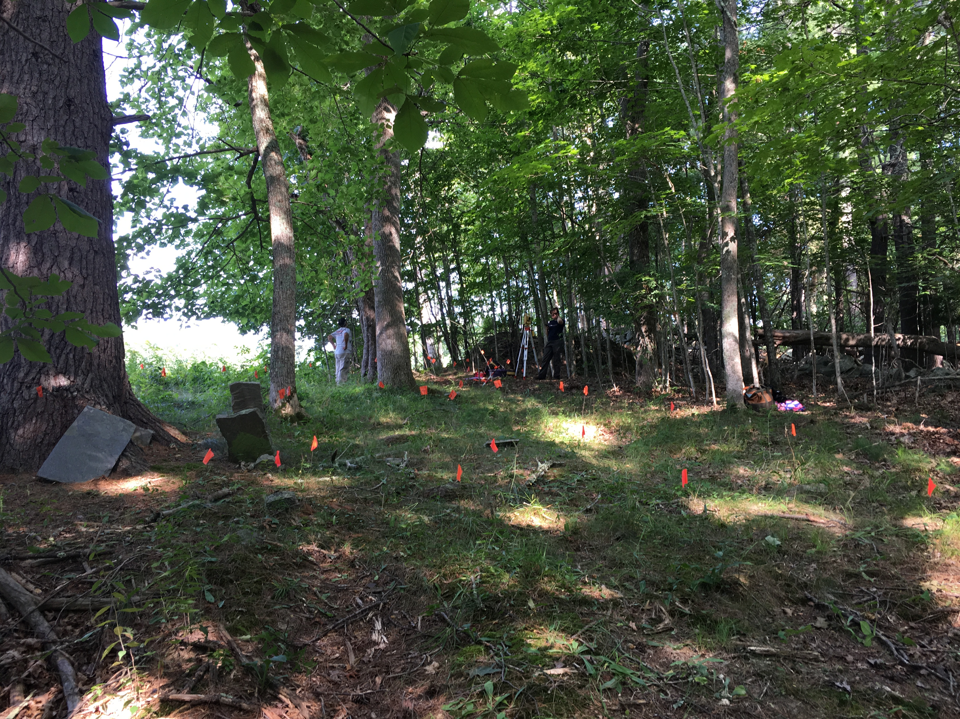

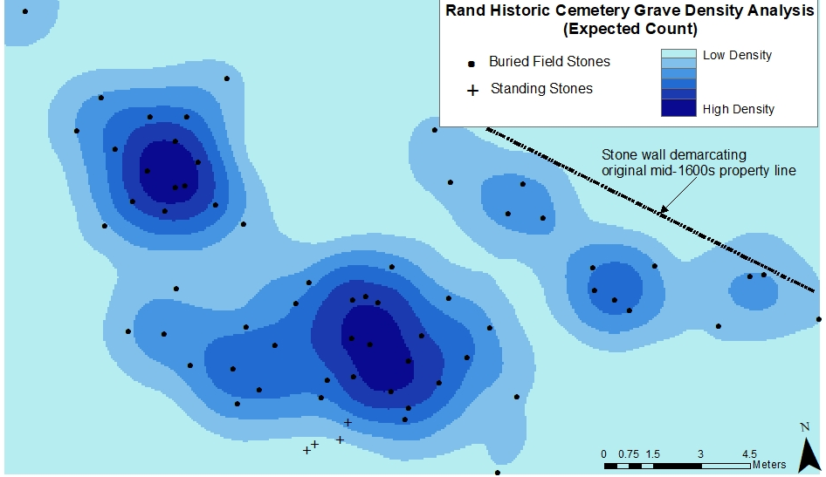
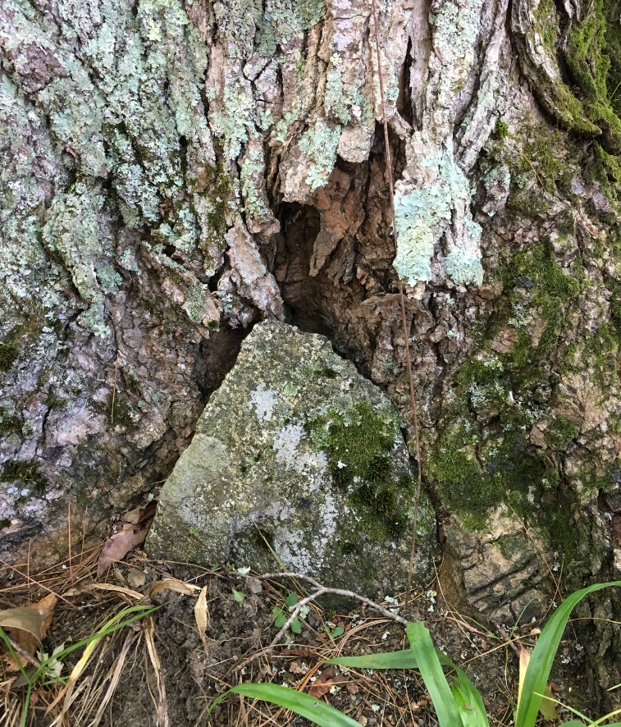
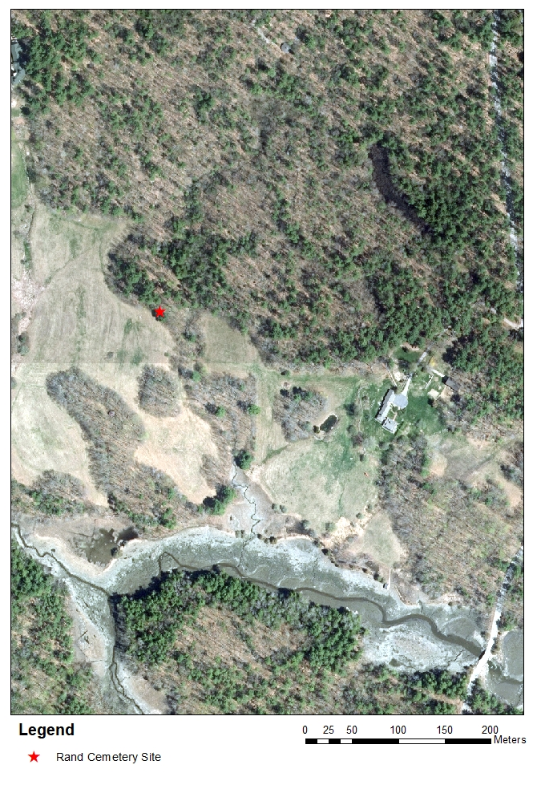
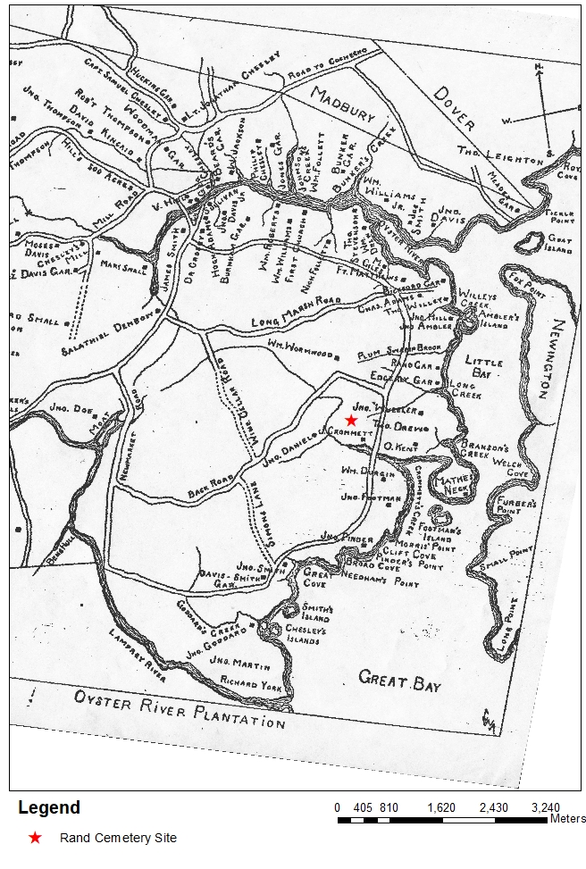
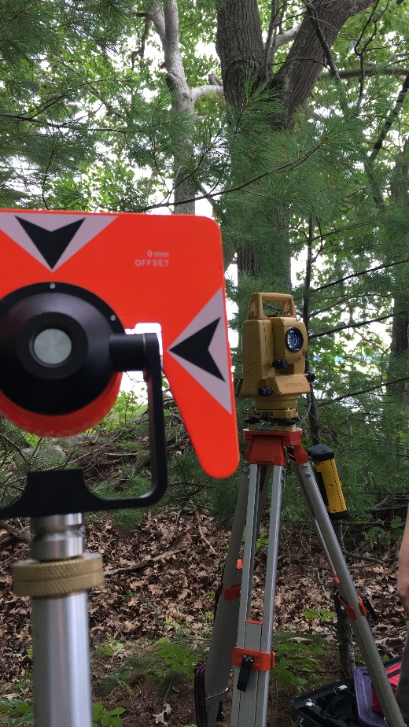
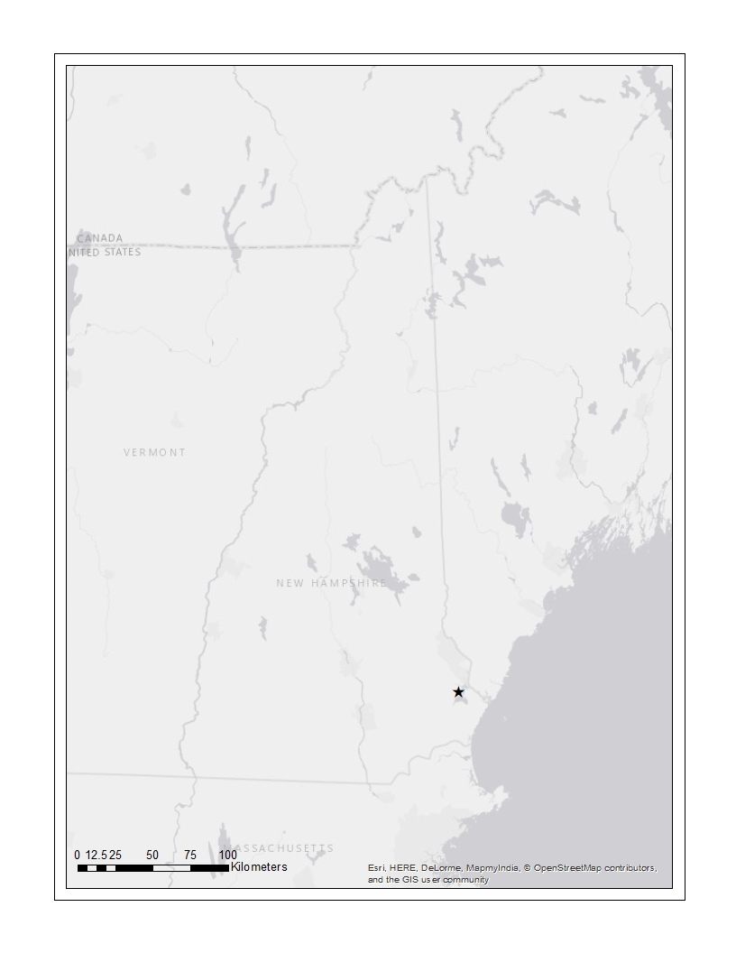
Graves in the Forest: Mapping Lost Colonial Cemeteries in the Oyster River Watershed
Emily Mierswa, Crystina Friese, and Dr. Meghan Howey
University of New Hampshire Department of Anthropology
Fieldstone Cemeteries in the Mortuary Landscape of Early Colonial New Hampshire
Since its popularization in the 1970s, mortuary archaeology has been used to advance a wide array of burial analyses (Binford 1971; Goldstein 1981; O’Shea 1984; Peebles and Kus 1977; Saxe 1970). Taking an analytic, anthropological and often spatial approach to burials has led to deeper understandings of past societal dynamics and organization (Cannon 2008; Komar 2008; Yao 2005). These methods have not, however, been widely transferred to research on historic burial sites. This is particularly striking in Historic New England where gravestones are an extremely well-know and common feature but yet they are rarely conceived as even being archaeological sties let alone discussed as being features of a socially-embedded mortuary landscape. In his famous study of New England gravestones, Deetz examined the the facial aesthetic attributes of carved headstones to create a chronology (Deetz 1977). While seminal work for typology, this work was not spatially-oriented.
In our ongoing archaeological survey program aimed at documenting the earliest colonial occupation in the Oyster River watershed in the Great Bay Estuary, New Hampshire, we have incorporated finding the earliest cemeteries of the colonial period into our survey approach and project goals. The Oyster River watershed in New Hampshire was home to some of the earliest English colonial occupation outside of Boston with settlements starting in the early 1630s. During this century, this area was a true frontier, a place where venture merchants left the pull of the Puritan capital to strike it rich out on their own. Known as the Oyster River Plantation, this frontier zone became a thriving economic center furnishing numerous products to the West Indies trade and seeing successful, large farms. The estimated English population of this community during the 1600s was around three hundred (Brown et al. 2014). Far, both physically and ideologically, from Boston, this frontier settlement did not have access to grave stone carvers until well into the late 1700s. The first cemeteries in this region used only ordinary fieldstones to mark graves. These stones were oriented east and early colonial families typically placed their dead along their stone-walled property lines.
Fieldstone burial markers are small and are hard to find today as they have sunk into the ground and become covered by soil, plants,
embedded in trees, etc. over centuries. Moreover, they look like every other stone on the ground. Put simply, fieldstone burials are not
easy to recognize and historic archaeological research has overlooked fieldstone burial sites within the early colonial landscape.
In this poster, we present our novel approach to identifying and analyzing the presence, extent and distribution of early fieldstone cemeteries using the case study of the “Rand” cemetery. The cemetery was only recorded, as is common practice, because it has standing engraved headstones and is named after the only legible headstone at the site, Nancy Rand née Edgerly, death in 1860 (Durham History 1913). The Rand cemetery is currently located on property owned by the University of New Hampshire at the edge of a cleared meadow and within the boundary of a stone wall running east-west. The site sits on a slopping hill leading towards a small creek which feeds into Crommet’s Creek which flows into Great Bay Estuary.
Intensive Field Survey Approach for Fieldstone Burials
There were, again, 4 recorded graves at the “Rand” cemetery based on the 4 standing stones when we came to the site. No one had ever confirmed the number of graves here. Based on our understanding of fieldstone burials and knowing this cemetery location was in an early 1600s colonial property, we hypothesized there were more burials. We began with a walk over visual survey from the meadow to the stone wall our previous deed research indicated was an original property line. Through this quick assessment we found a few fieldstones. After this, we set up a systematic grid across the site using a total station. We laid metric tapes East-West along the stone wall and used the standing stones as the other edge of the site. These tapes were 25 meters long. Running a tape between these two lines, we used chaining pins and poked the ground every 50 cm. When we hit a hard spot, we then poked around more to determine if the item had the shape and also sound of a field stone (metal chaining pins on stone make a distinct sound). When at least 2 people had done this evaluation and agreed it was a fieldstone, we marked it with a pin flag. We then moved the tape up 50 centimeters and did this again, thereby covering the area in a 50 x 50 centimeter survey grid.
We identified 123 probable fieldstone grave markers through this process. We mapped in all of these identified features, assigning a rating of
definite/probable/tentative to each based on our in-field assessment. Before survey, this cemetery was considered to have 4 burials. Our work
demonstrates standing engraved grave stones area a very poor indicator of historic, especially early historic, cemetery size. It also carries implications for
thinking about how many early colonial cemeteries have gone unrecorded all together if they did not have later headstones. Even into the 1700s and 1800s,
when engraved stones were available in this area, lower class people, slaves, and indentured Native American servants (which were present in the Oyster
River Plantation) would not have received standing stones and so their cemeteries have also likely gone overlooked.
Spatial Analysis of Fieldstone Burial Survey Data
We used a trimble GPS to record our datums and then downloaded our total station data and imported it into ArcGIS 10.5. We created a series of shapefiles with the differentially ranked certainty of the collected points being actual historic fieldstone grave markers. Using our strictest shapefile of fieldstones (i.e. confirmed stones and the most probable), we ran a kernel density analysis (based on Expected Count; in Spatial Analyst). Three groupings appeared in this analysis (above). The first is the series of fieldstone grave markers along the stone wall. Given this is the original property line, it appears when the site was first settled they placed their dead not in any specific order next to this wall. As the settler family grew, they began placing graves in organized rows spreading out from the wall (there are visible sunken graves that confirm the linear nature of these stones). There are clearly two groups of these rowed burials we feel mark family groupings. While this is called the “Rand” cemetery, our historic research shows an early intermarriage of daughters between the Rands and Edgerlys, likely for economic reasons, who then subdivided the property. We interpret these two groupings as the descendants from the brother-in-laws from that marriage (who each built their own garrisons nearby). Interestingly, the standing stones fall outside the high density area of graves, suggesting these later features were the side note, spatially and historically, in this cemetery’s story but only looking at standing stones inflated their importance. Our work shows that when these overlooked features are treated as archaeologically significant, they have much to teach us about the social, economic, and ideological processes of colonial New England.
Rand Cemetery
A 2015 Aerial Photo with the location of cemetery in the woods on the bound of the meadow and on the feeder creek to Crommet’s Creek.
A 1913 map of the 1600s Oyster River Plantation settlement, Georectified and with the cemetery location indicated
(Durham History 1913).
* Research funded by the James H. and Claire Short Hayes Professor in the Humanities

