Slide 1

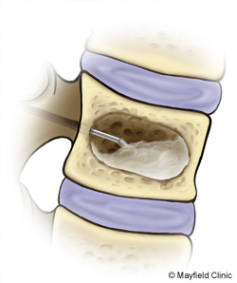
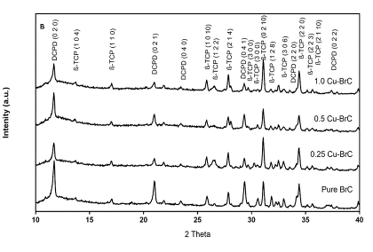
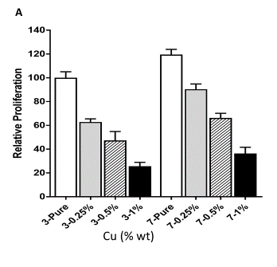


Effects of Copper on Physical, Mechanical, and Biological Properties of Brushite Cement
Haley Cummings¹, Weiguo Han², Kareem Elkwae¹, Sahar Vahabzadeh¹, Sherine F Elsawa²
¹Department of Mechanical Engineering, Northern Illinois University, Dekalb, IL 60115
²Department of Molecular, Cellular and Biomedical Sciences, University of New Hampshire, Durham, NH 03824
Contact: svahabzadeh@niu.edu
Abstract
Calcium phosphate cements (CPCs)
Background
Role of Cu
Among different calcium phosphate ceramics (CPCs), brushite cement (BrC) has received significant attention due to its bioactivity, and injectability. Reports have shown the efficiency of dopant incorporation on physical and biological properties of CPCs. Dopants such as silicon (Si) and zinc (Zn) enhance the in vitro and in vivo osteogenic properties of CPCs. We have shown that Si enhances bone formation in a dose dependent manner. In addition, incorporation of Si and Zn in a binary system stimulates in vivo bone formation[1,2]. The purpose of the current study was to investigate the effects of copper (Cu) on physical, mechanical, and biological properties of BrC. Cu is known for its angiogenic effect [3]. Results showed that Cu addition increased the dicalcium phosphate dihydrate (DCPD) amount. Initial and final setting time increased with presence of Cu in a dose dependent manner. Though osteoblast cell proliferation decreased with increase in Cu concentration, the osteogenic and angiogenic markers were upregulated. In addition, the in vitro inflammatory responses were downregulated.
Possess unique characteristics of bioactivity, bioresorbability, self-setting properties, moldability and low setting temperature.
Can be applied to fill small bone defects with complex geometry due to their injectability and mouldability to any shape at defect site.
Are classified in two groups of a) brushitic cement which contains brushite (BrC,, DCPD) as major phase and b) apatitic cement, containing hydroxyapatite (HA) or calcium deficient HA (CDHA).
Plays a role in the metabolism of iron and formation of blood vessels
Promotes angiogenesis and the proliferation of osteoblasts [4]
Objective
To evaluate the effect of Cu addition and its concentration on BrC phase, mechanical properties, and its interaction with osteoblast cells.
BrC vs. CDHA
Cement injection
Hypothesis
Higher Log K_{sp} higher dissolution rate
Suitable candidate as bone substitute to dissolve during few months for complete bone healing.
Incorporation of Cu will affect the phase composition, mechanical properties, and in vitro biological properties of BrC.
Experimental Procedure
Results
Cement Preparation and Characterization
Mixing β-TCP (beta-tricalcium phosphate) and monocalcium phosphate monohydrate (MCPM) powder at specific ratio,
Relative CuO addition to β-TCP to make 0.25, 0.5, and 1.0 wt% Cu-doped brushite cement,
Forming the paste using polyethylene glycol solution,
Phase analysis using X-ray diffraction method (XRD),
Compressive strength measurement,
Setting time measurement using Gillmore needle,
0, make 0.25, 0.5, and 1.0 wt% Cu-doped brushite cement were denoted as BrC, 0.25 Cu-BrC, 0.5 Cu-BrC, and 1.0 Cu-BrC, respectively.
Cements’ Phase Analysis, Setting Time and Compressive Strength
Initial and Final Setting Times of Cements.
Composition | Initial setting time (min) | Final setting time (min) | Compressive Strength (MPa)
BrC | 3.7±0.23 | 8.17±0.23 | 2.9
0.5 Si- BrC | 6.42±0.59 | 13.5±0.61 | 6.3
0.8 Si- BrC | 7.67±0.23 | 18.67±1.43 | 3.3
1.1 Si- BrC | 14.67±2.05 | 51.17±1.32 | 0.5
Cu addition increased initial and final setting time of BrC in a does dependent manner.
Decrease in compressive strength at higher dopant amounts
XRD phase analysis of cements.
Increase in compressive strength with low dopant amount
Maximum compressive strength obtained with Cu dopant amount between of 0.5 wt.%.
β-TCP and DCPD were the two present phases present in all cements.
Addition of Cu decreased the DCPD amount in final product.
Osteoblast Cell Culture, RNA Extraction and quantitative RT-PCR
Human preosteoblast cell line hFOB 1.19, seeded at density
of 50 × 10³ and 2 × 10⁶ cells/sample for XTT and RT-PCR assays, respectively.
Optical cell density was determined by XTT assay,
Cells were lysed using 1 ml TRIzol reagent
Reverse transcription reactions were performed using Moloney murine leukemia virus (M-MLV) reverse transcriptase.
Quantitative real-time PCR (qPCR) was conducted using the ViiA7 real-time PCR instrument.
Osteoblast Cell Proliferation and Differentiation
References
[1] Vahabzadeh S and Bose S. Annal Biomed Eng. 2017;45: 819-828.
[2]Vahabzadeh S, Bandyopadhyay A, Bose S, Mandal R and Nandi SR. Integr Biol. 2015; 7:1561-1573
[3] Gbureck U, Hölzel T, Doillon CJ, Müller FA, Barralet JE. Adv Mater; 2007:19: 795-800.
[4] 4. J. Barralet, U. Gbureck, P. Habibovic, E. Vorndran, C. Gerard, and C. J. Doillon, Tissue Eng. Part A 15, 1601 (2009).
[5] 5. M. Schamel, A. Bernhardt, M. Quade, C. Würkner, U. Gbureck, C. Moseke, M. Gelinsky, and A. Lode, Mater. Sci. Eng. C 73, 99 (2017).
Summary
Acknowledgement
Addition of Cu changed the phase composition of BrC in a dose-dependent manner.
Compressive strength of BrC increases with addition of 0.25% Cu followed by a decrease the presence of higher Cu concentration.
There is a dose-dependent decrease in cell proliferation in the presence of increasing Cu concentration.

