Slide 1


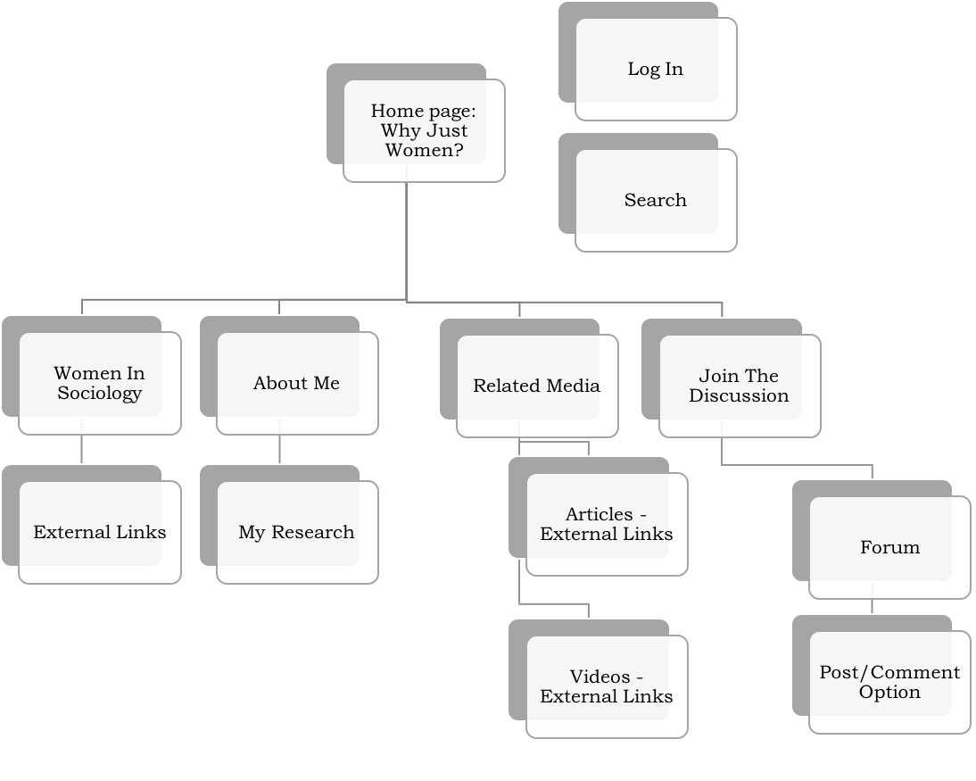
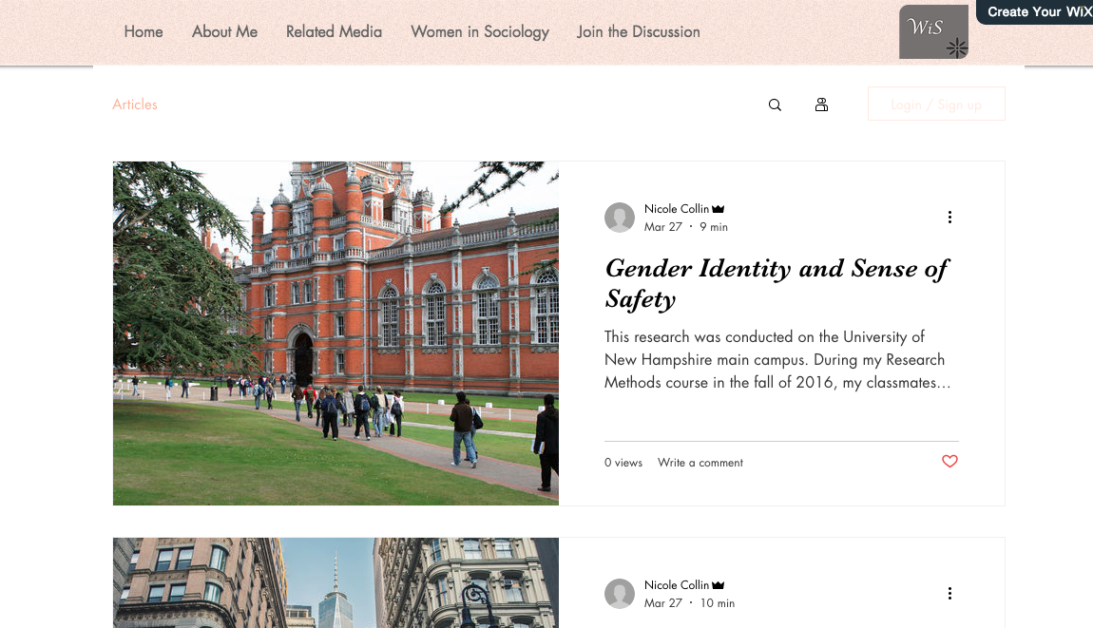
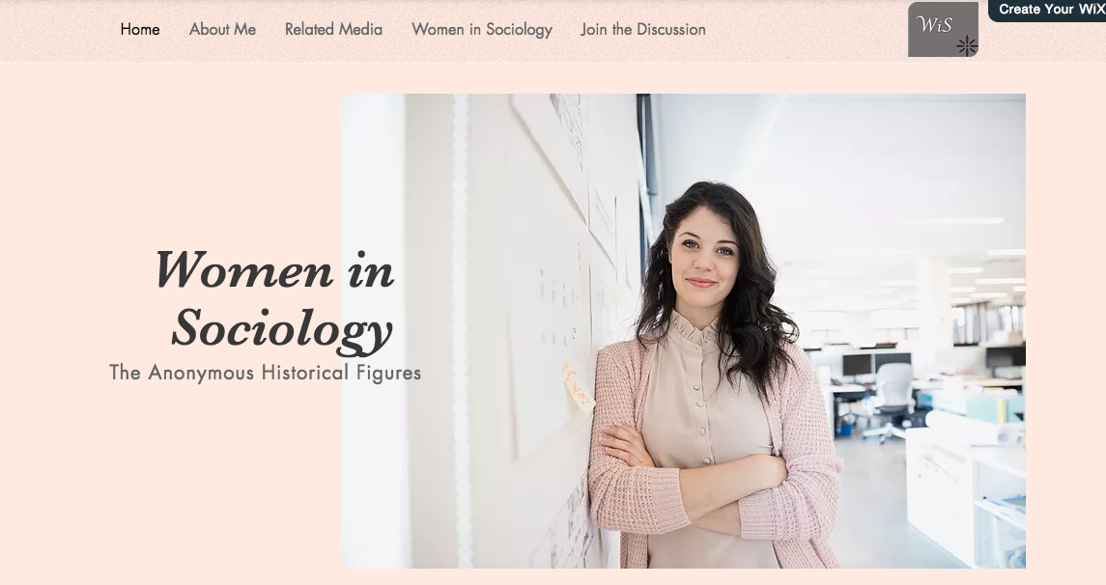
Women in Sociology: A Virtual Community
Nicole Collin
Professional and Technical Writing – Prof. Molly Campbell – University of New Hampshire
OVERVIEW
DESIGN
RESULTS/CONCLUSION
The purpose of this assignment is to choose a topic of interest and professionalize it online. With a combination of preliminary research and audience analysis, one can design a website unlike any other.
This project is dedicated to creating an academic blog website catered to people who are interested in sociological topics, and want an outlet to share their ideas. This website will be a place for people to explore, research, discuss, and more.
It became apparent through this research that there is a lacking of an active community in the online world of sociology. Although the websites that were observed had key concepts, there was a need for a domain that had an academic quality as well as a social one. The aspect that makes Women in Sociology unique is the strong active community that the forum will bring.
Women in Sociology will be a online portal where an audience can go to read research, explore relevant news online, and discuss important sociological topics amongst each other.
RESEARCH METHODS
Research Methods
Search for a Topic
  Conducted research on several topics of interest, and decided on an area of focus.
  Researched that topic deeper to see what was available in the online world.
Rhetorical Analysis on Audience
  Assessed what type of audience would be interested in the topic, what their needs and interests may be, and their familiarity with the topic.
20 Website Observation
  Observed 20 websites regarding a broad topic (Sociology, Women, Media, Education).
  Analyzed each website’s design and how effective they were.
  Evaluated the types of audiences each website had, as well as the needs of the audience.
Copyright Ethics
  Discussed the responsibilities that come with designing a website and using media that is found online.
URL AND PUBLISH DATE
Website URL:
https://nicolemcollin.wixsite.com/womeninsociology
Anticipated Publish Date:
May 4, 2018
CONTACT
Nicole Collin
Department of Sociology
nmc2001@wildcats.unh.edu
www.linkedin.com/in/nicolemcollin

