Slide 1

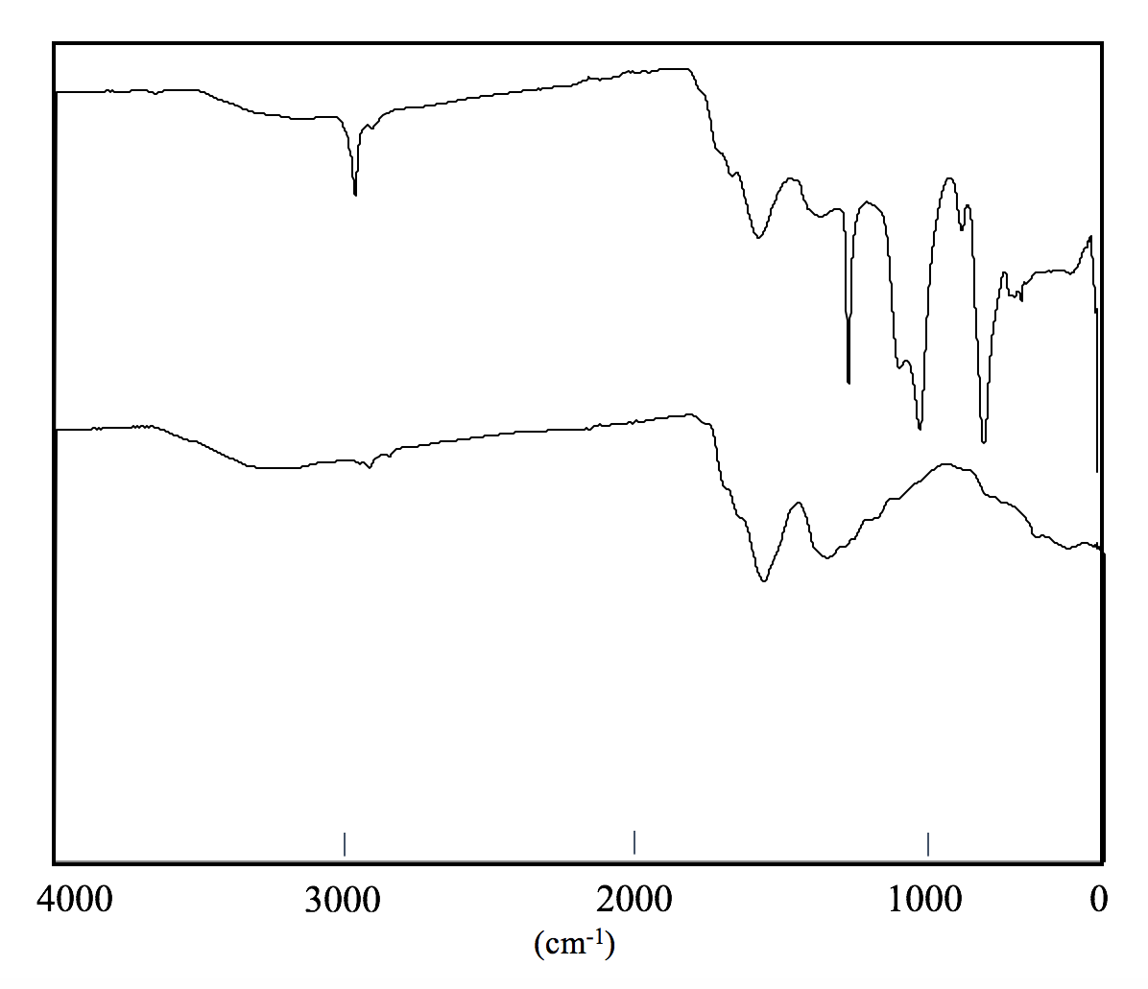
Towards the Synthesis of a Co(II) Diketo-Pyrphyrin Catalyst for Hydrogen Production
from Water
Katherine Dombroski, Dejun Dong, Hannah Coco
Dr. Christine Caputo, Faculty Advisor
Department of Chemistry
Introduction
Experimental Design
Results and Discussion
Hydrogen production from water through hybrid photocatalytic systems requires several components. This research focuses on the synthesis of two separate components: a photocatalyst and a photosensitizer.
The primary step in the synthetic route to Co(II) diketo-pyrphyrin 2-TFA is to synthesize 6,6’-dibromo-2,2’-bipyridine from 2,6-dibromopyridine (Scheme 3). 2,6-dibromopyridine is initially converted into 6-bromopyridyl-2-lithium with n-BuLi, followed by oxidative coupling with POCl₃ to yield the target molecule 6,6’-dibromo-2,2’-bipyridine. The product was purified by column chromatography.
A
B
C
B
A
C
A
Co(II) diketo-pyrphyrin 2-TFA has been proven to act as an efficient photocatalyst for production of hydrogen from water in a hybrid photocatalytic system.¹ (Scheme 1) shows the proposed synthetic route to Co(II) diketo-pyrphyrin 2-TFA.
HDO
Figure 1. ¹H NMR of 6,6’-dibromo-2,2’-bipyridine
Scheme 3. Synthesis of 6,6’-dibromo-2,2’-bipyridine from 2,6’-dibromopyridine
Figure 1 confirms that 6,6’-dibromo-2,2’-bipyridine was formed, as well as some impurity. A possible impurity is (Figure 2) 6,6”-dibromo-2,2’:6’2’’-terpyridine.
The carbon dots used in this experiment were previously made from aspartic acid. Thionyl chloride mixed with CD-COOH was heated to reflux to yield acyl chloride-capped carbon dots (Scheme 4).
Scheme 1. Proposed synthesis of Co(II) diketo-pyrphyrin from 6,6’-dibromo-2,2’-bipyridine¹
Figure 2. 6,6”-Dibromo-2,2’:6’2’’-terpyridine
One property of carbon dots (CDs) is that they absorb light. The electrons absorbed by the CDs can be harvested, allowing them to act as efficient photosensitizers. Another property of CDs is that they have a surface that makes them easy to functionalize. Scheme 2 illustrates the proposed synthetic route to polyethyleneimine (PEI) capped carbon dots from carbon dots that were previously made from aspartic acid. PEI CDs are specifically of interest due to their excellent ability for electron transfer.
The formation of carboxylic acid capped CDs was successful and is illustrated (Figure 2) by the formation of peaks in the 1000-800 cm⁻¹ range, indicating formation of a halogen. The broadness of the peak at 3187.95 cm^{–1}, indicative of a carboxylic acid –OH stretch, lessens in the CD-COCl spectrum.
CD-COCl
Scheme 4. Acyl chloride functionalization of CDs from previously made carboxylic acid CDs
2962.34
Conclusion
CD-COOH
3187.95
2913.56
Both the formation of 6,6’-dibromo-2,2’-biypridine and acyl chloride-capped CDs were successful. Although impure, the formation of 6.6’-dibromo-2,2’-bipyridine was synthesized with an 8% yield. Column chromatography was unsuccessful in separating 6,6’-dibromo-2,2’-bipyridine from the suspected byproduct, 6,6”-dibromo-2,2’:6’2’’-terpyridine, due to their similar structures.
Scheme 2. Synthetic route to PEI capped carbon dots
(cm^{–1})
Co(II) diketo-pyrphyrin 2-TFA and CD-PEI are both cost-effective, stable and water-soluble, which makes them highly desirable components for hybrid photocatalytic systems. ^{1,2}
Figure 2. Infrared spectroscopy spectrum of CD-COOH and CD-COCl.
Future Work
References:
Acknowledgements
The next step towards synthesizing 6,6’-dibromo-2,2’-bipyridine is to determine an efficient way to purify the target molecule and increase yield.
The next step towards synthesizing a suitable photosensitizer is to synthesize CD-PEI from CD-COCl.
Joliat-Wick, E.; Weder, N.; Klose, D.; Bachmann, C.; Springler, B.; Probst, B.; Alberto, R. Inorg. Chem. 2018 57, 1651-1655.
Hutton, G.A.; Reuillard, B.; Martindale, B.CM.; Caputo, C.A.; Lockwood, C.W.J.; Butt, J.N.; Reisner, E. J. Am. Chem. Soc. 2016 138, 16722-16730.
  I would like to thank Dr. Christine Caputo, Dejun Dong, Hannah Coco, the UNH Chemistry Department, and the UNH Hamel Center for Undergraduate Research

