Slide 1

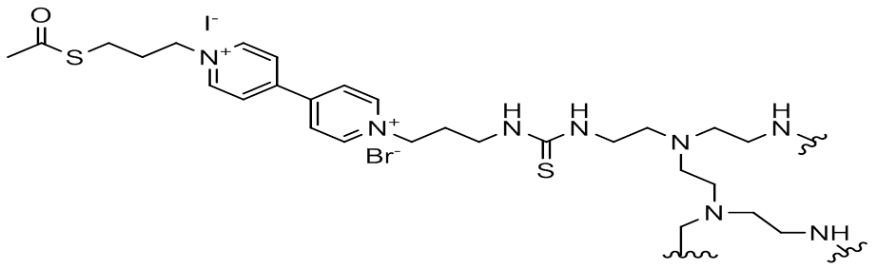
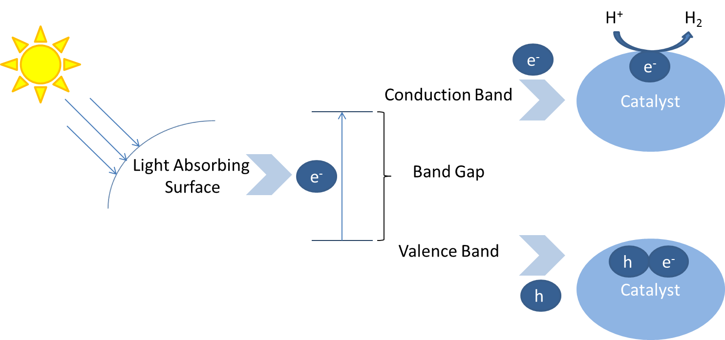
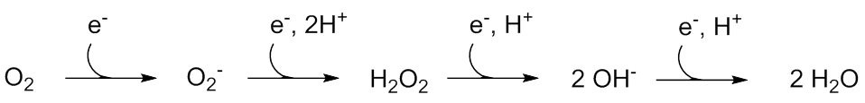
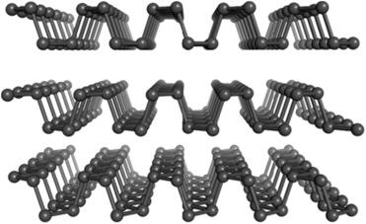
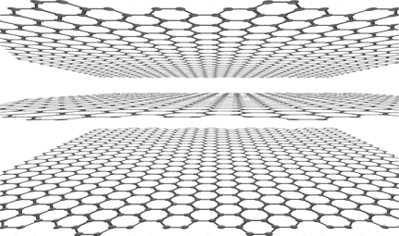
Synthesis of a Redox-Active Hydrogel for the Protection of Black Phosphorous
Erin E. Braker, Charles A. Ayotte, Christine A. Caputo
University of New Hampshire, Department of Chemistry
_{eb2018@wildcats.unh.edu}
Problem:
Over 20 million cubic feet of natural gas was processed in 2017 in the U.S.¹ At this rate, these resources are hypothesized to be depleted in the next 60-160 years.² These statistics show that there’s a desperate need for change. One glaringly obvious solution is to use the sun. The sun is a promising source of energy as in 2013 the earth used 5.67 × 10²⁰ J and the sun has been measured to provide 4.3x10²⁰ J in a single day.² Harnessing the sun’s energy could lead to a brighter future.
Redox-Active Hydrogel:
Figure 4 Structure of the redox-active hydrogel
BP degrades with exposure to H₂O, light, and O₂. Studies have suggested that if O₂ isn’t present this degradation cannot occur.⁷ The introduction of a previously synthesized, redox-active hydrogel (Figure 4) could make this material functional. This hydrogel was designed to protect hydrogenase from O₂. The study showed the hydrogenase had increased stability when incorporated in the gel’s matrix.⁸
Figure 5 Redox chemistry of O₂ and the viologen moiety
This hydrogel is hypothesized to reduce molecular oxygen to H₂O₂ and ultimately to H₂O through the viologen moiety (Figure 5). It is hypothesized that this gel would allow BP to be stable under ambient conditions where it could be used in PC.
Nuclear Magnetic Resonance Spectroscopy:
Figure 6 ¹H-NMR, CDCL₃, 400 MHz of (1)
Figure 7 ¹H-NMR, CDCL₃, 400 MHz of (2)
Figure 8 ¹H-NMR, CDCL₃, 400 MHz of (3)
Pieces of the Puzzle:
Proton Reduction & Hybrid Photocatalysis
Figure 1 Hybrid photocatalytic system scheme
Solar driven production of hydrogen is an option for renewable energy. Photocatalysis (PC) is one method for redox, where two most studied kinds of PC are molecular catalysts (MCs) and semiconductors (SCs).³ Scientists have not been able to maximize SCs or MCs efficiency due to their imperfections. Hybrid PC systems combine the benefits of both of these methods.⁴
Black Phosphorous (BP)
Figure 2, 3 Black Phosphorous (left) and graphene (right)^{4,5}
BP is a material similar to graphene, but it is puckered sheets of phosphorous atoms as opposed to planar sheets of carbon. BP has shown promise in PC processes as a light absorber due to its tunable band gap (0.3-2.0 eV).⁶ This gap sits in between those of other SCs in a “sweet spot”. However, BP degrades in ambient conditions.
Synthetic Routes:
Synthesis of Cross-linker (1)
Scheme 1 The synthesis of 1-iodo-3-thioacetylpropane
Synthesis of the Site of Polymer Attachment (2)
Scheme 2 The synthesis of 1-bromo-3-isothiocyanopropyl
Attachment of Cross-Linker and Site of Polymer Attachment to Viologen Moiety (4)
Scheme 3 The synthesis of 1-(3-acetylthiopropyl)-1’-(3-isothiocyanopropyl)-4,4’-bipyridine iodide bromide
Polymerization of the Hydrogel (5)
Scheme 4 Addition of polyethyleneimine to (4)
Conclusion:
Synthetic strategies of forming the cross-linker and the site of polymer attachment were successful. The attachment of the cross-linker to the viologen moiety was also successful.
Future work with this hydrogel would include swelling it with BP and testing its ability to do electron transfer by irradiating the mixture with solar light. If the mixture does allow electron transfer, this could lead to BP being a contender in the scheme of solar energy.
References:
[1] Natural Gas Data. U.S. Energy Information Administration: Independent Statistics and Analysis. 2018, https://www.eia.gov/ (accessed: Apr 12, 2018)
[2] Lewis, N.S.; Nocera, D.G. Proc. Natl. Acad. Sci. USA. 2006, 103. 15729-15735.
[3] Cook, T.R.; Dogutan, D.K.; Reece, S.Y.; Surendranath, Y.; Teets, T.S.; Nocera, D.G.Chem. Rev. 2010, 110, 6474-6502.
[4] Hu, J.; Guo, Z.; McWilliams, P.E.; Darges, J.E.; Druffel, D.L.; Moran, A.M.; Warren, S.C. Nano. Lett. 2016,16, 74-79.
[5] Graphene Oxide. Reade International Corp. 2018, https://www.reade.com/products/ (accessed: Apr 12, 2018)
[6] Ling, X.; Wang, H.; Huang, S; Xia, F.; Dresselhaus, M. Proc. Natl. Acad. Sci. 2015, 112, 4523-4530.
[7] Bagheri, S.; Mansouri, N.; Aghaie, E. Int. J. Hydrog. Energy. 2016, 41, 4085-4095.
[8] Plumere, N.; Rudiger, O.; Oughli, A.A.; Williams, R.; Vivekananthan, J.; Poller, S.; Schuhmann, W.; Lubitz, W. Nat. Chem. 2014, 6, 822–827.
Acknowledgements:
Dr. Caputo & the Caputo Group
United States Department of Energy
University of New Hampshire’s Department of Chemistry
Undergraduate Research Conference – ISE Symposium

