Slide 1



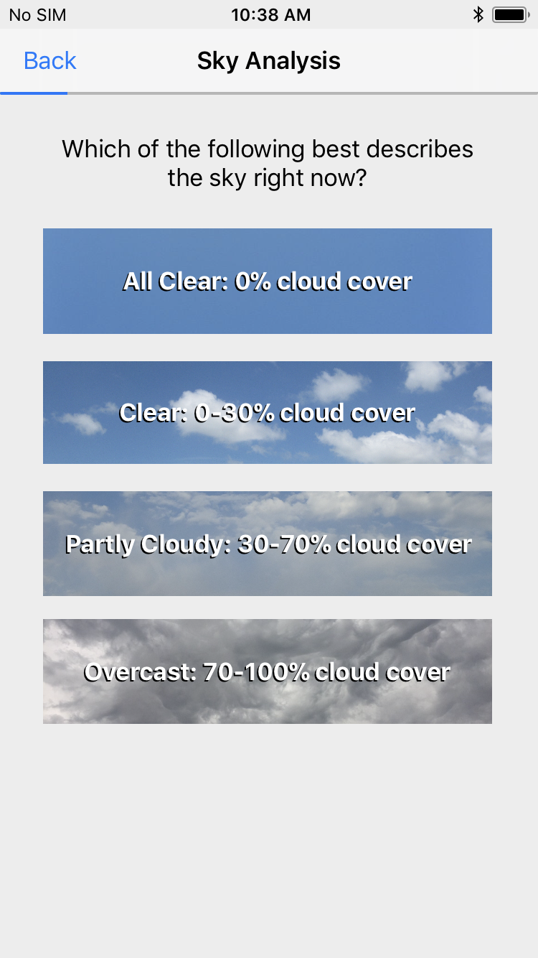
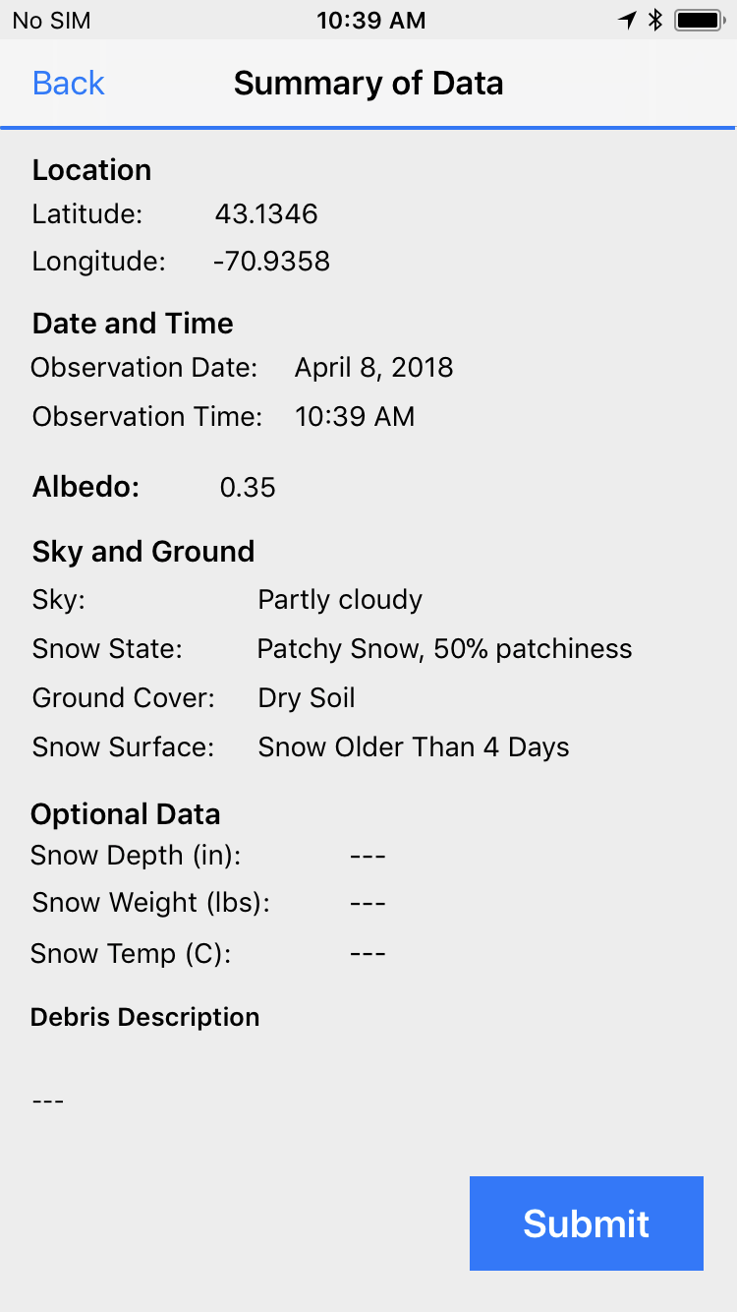
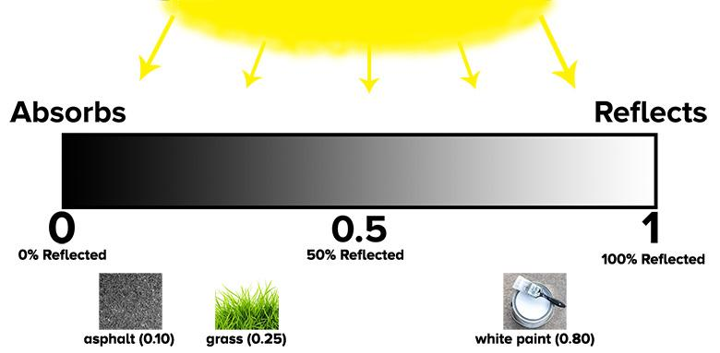
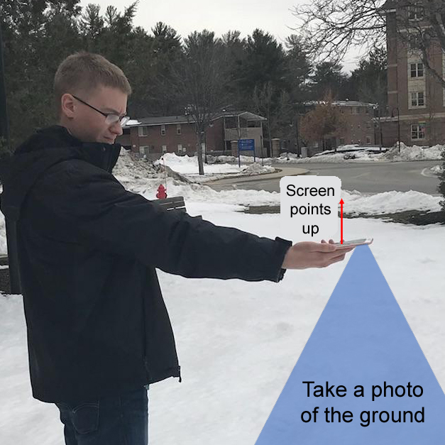
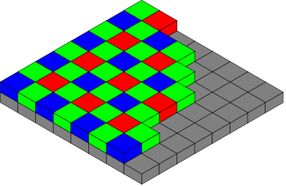
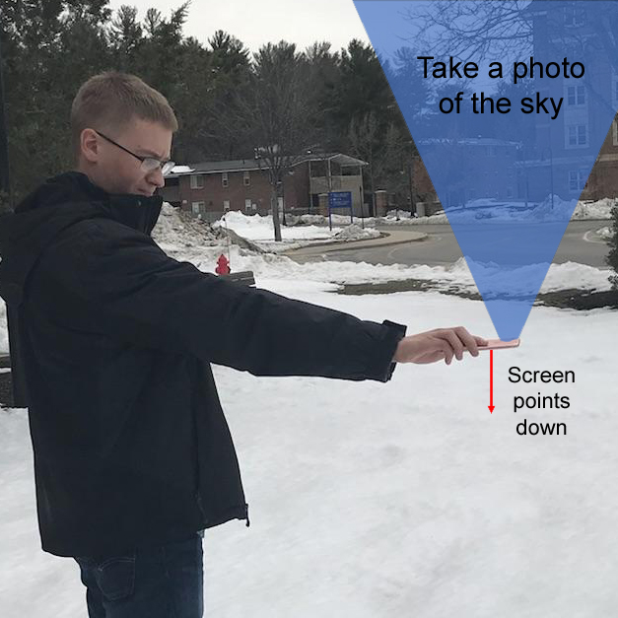




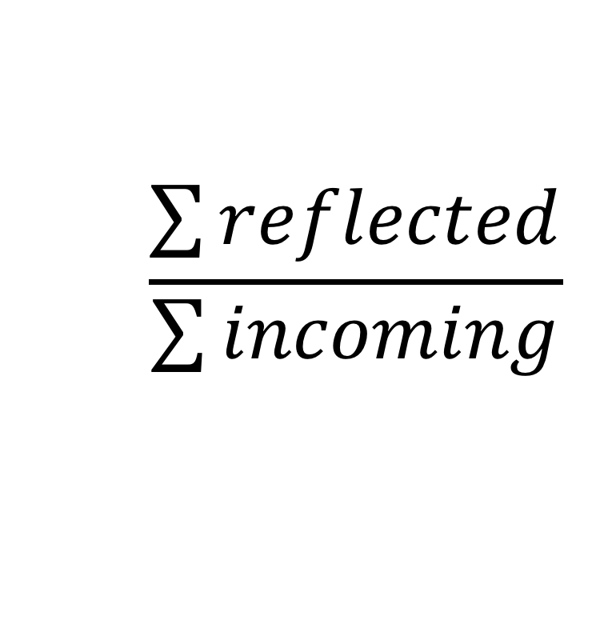
Measuring Albedo (Reflectivity) with Smartphones:
A Citizen Science App
Authors: Evelyn Thompson, Camden Tatsapaugh, Noah Aronson
Department of Computer Science
Sponsor: Prof. Elizabeth Burakowski
Institute for the Study of Earth, Oceans, and Space
Problem Statement
The Community Collaborative Rain, Hail and Snow Albedo (CoCoRaHS-Albedo) Network currently collects albedo data, but participation is limited by high cost of equipment.
Our Solution
Create an app that:
  collects data
  calculates albedo
  effectively displays the gathered information to the user
Pixel data from RAW images is used to calculate albedo
We developed a proof-of-concept that models the albedo calculation using JPEG images
Albedo is a measure of reflectivity and is a ratio of reflected and incoming solar radiation
Future Plans
Transition from a JPEG proof-of-concept to actual RAW image capture
Establish a connection to the CoCoRaHS-Albedo database so data is pushed to the website automatically
Integrate authentication between the CoCoRaHS-Albedo website and the app
Reflected
∑P_{ReflectedR,} / ∑P_{incomingR} = Albedo_{R}
∑P_{ReflectedG,} / ∑P_{incomingG} = Albedo_{G}
∑P_{ReflectedB,} / ∑P_{incomingB} = Albedo_{B}
$$\frac{\sum{reflected}}{\sum{incoming}}$$
Albedo_{rgb} = m_{R}Albedo_{R} +
m_{G}Albedo_{G} +
m_{B}Albedo_{B}
Incoming
Trello
Swift
Xcode
iPhone 7

