Slide 1

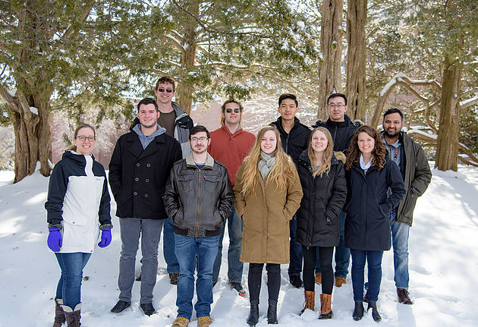
Chiral Properties of Carbon Dots Synthesized from Aspartic Acid
Hannah Coco, Christine Caputo
Department of Chemistry, University of New Hampshire, Durham, NH 03824
Place your Project Logo Here
Place your Project Logo Here
Introduction
Results and Discussion
Conclusion
Carbon dots (CDs) are nanoparticles with a range of applications in bio-imaging, biochemical sensing, drug delivery and as photosensitizers for photocatalysis. CDs are easy to synthesize from cost-effective and readily-available starting materials. They have been found to be non-toxic, making them attractive nanomaterials for biological applications. Chiral CDs are of particular interest due to their potential applications in chiral sensing, chiral purification materials, and potentially as chiral catalysts. Chiroptical activity has previously been induced in quantum dots with chiral capping ligands containing thiol groups.¹ Chirality has also been induced from achiral CdSe quantum dots and a chiral ligand.² For this reason, aspartic acid was chosen for synthesis of CDs due to the availability of both L- and D- enantiomers. The work toward formation of chiral CDs from aspartic acid will be presented.
Synthesis of carbon dots from the chiral enantiomers or aspartic acid yields an achiral CD. There is no difference in chirality between the CDs synthesized from L- and D- enantiomers and the DL- mixture.
The synthesis of surface functionalized carbon dots with amino acids is still underway. Based on initial IR images there are changes in the surface of the CD from the achiral CD to the acyl-chloride capped CDs. IR spectra of aspartic acid surface functionalized carbon dots indicate some changes in the surface of the CD. However, the lack of an amide carbonyl stretch (1680-1630 cm⁻¹) indicates that aspartic acid may not be bonded to the surface of the carbon dot.
CD/mdeg
Future Work
Experimental Work
Further characterization of the amino acid surface functionalized carbon dots is necessary to determine if acyl chloride capped carbon dots have fully reacted with L-aspartic acid. CD-Spectroscopy will be used to determine the chirality of the resulting carbon dots.
Figure 1: Circular dichroism spectroscopy of L-, D-, and DL- carbon dots.
Acknowledgements
Special thanks to the Caputo Group, including Dr. Caputo, Zane Relethford, Charlie Ayotte, and Ian Smith for their support throughout this project. I would also like to thank Dr. Varga and Ben Haynie for their expertise in CD Spectroscopy.
References
Scheme 1: Synthesis of carbon dots from L- and D- enantiomers and the racemic mixture
(1) Haynie, B. Chiral Biomolecule-Induced Chiroptical Activity in Quantum Dots. Masters Thesis, University of New Hampshire, Durham, NH, 2017.
(2) Choi, J. K.; Haynie, B. E.; Tohgha, U.; Pap, L.; Elliott, K. W.; Leonard, B. M.; Dzyuba, S. V.; Varga, K.; Kubelka, J.; Balaz, M. ACS Nano 2016, 10, 3809–3815.
(3) Martindale, B. C. M.; Hutton, G. A. M.; Caputo, C. A.; Prantl, S.; Godin, R.; Durrant, J. R.; Reisner, E. Angew. Chem. Int. Ed., 2017, 56, 6459–6463.
(4) Hutton, G. A. M.; Reuillard, B.; Martindale, B. C. M.; Caputo, C. A.; Lockwood, C. W. J.; Butt, J. N.; Reisner, E. J. Am. Chem. Soc., 2016, 138, 16722–16730.
Wavelength / cm⁻¹
Scheme 2: Synthesis of surface functionalized carbon dots with L- Asp.
Figure 2: IR spectra of L-Asp, CD-COOH, CD-COCl, and CD-Asp.

