Slide 1
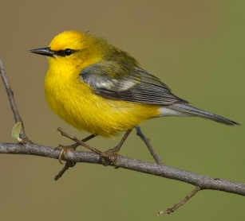
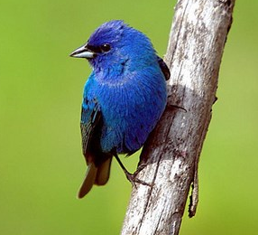
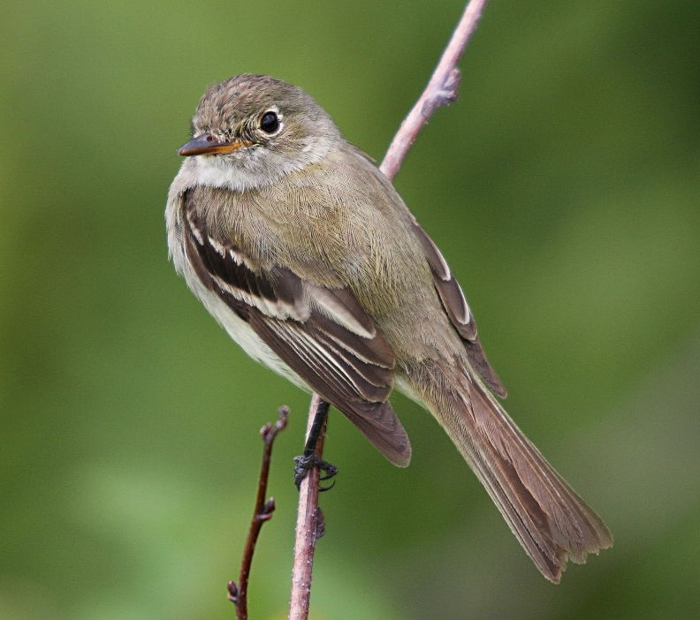
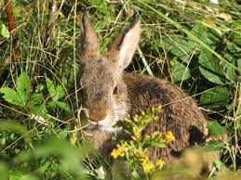

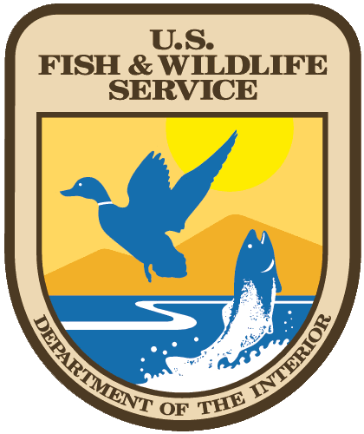
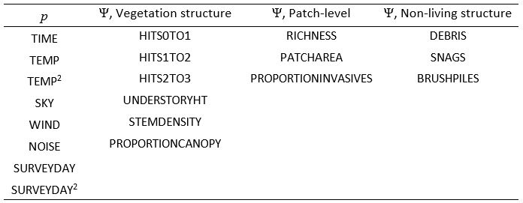
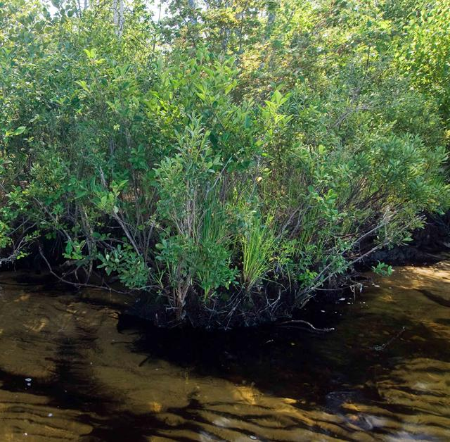
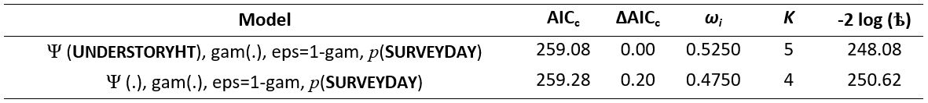
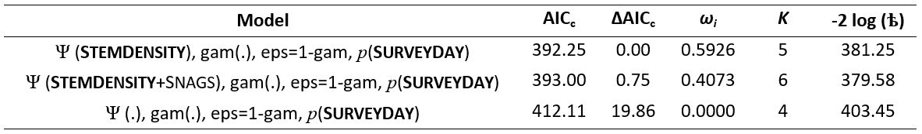
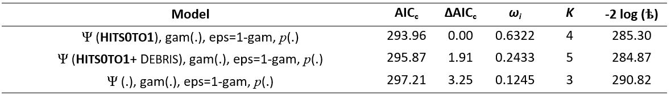
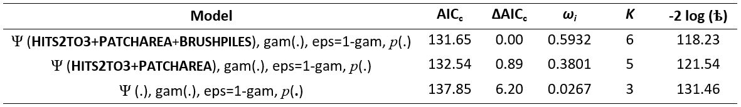
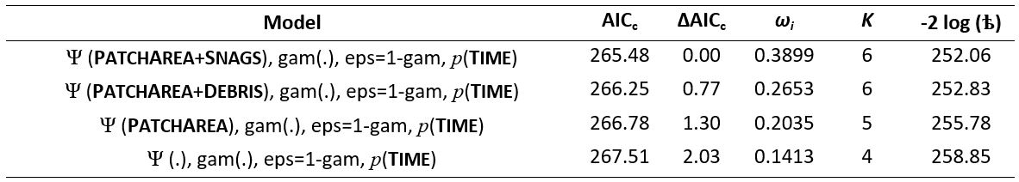
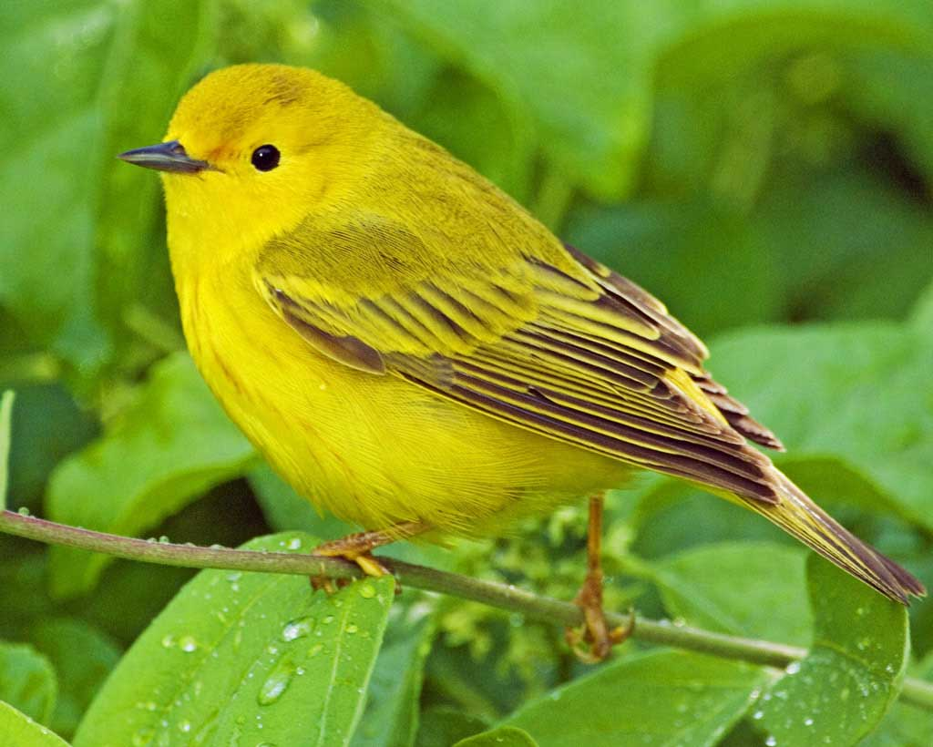
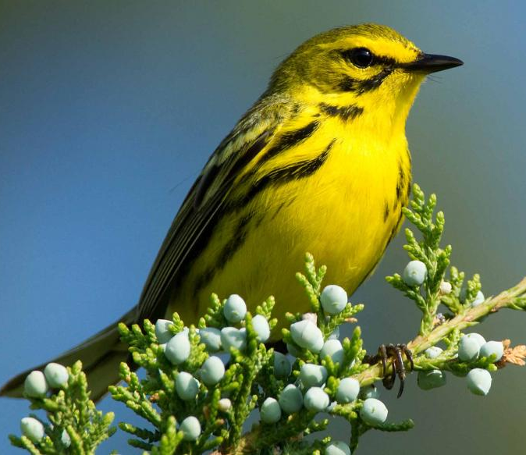
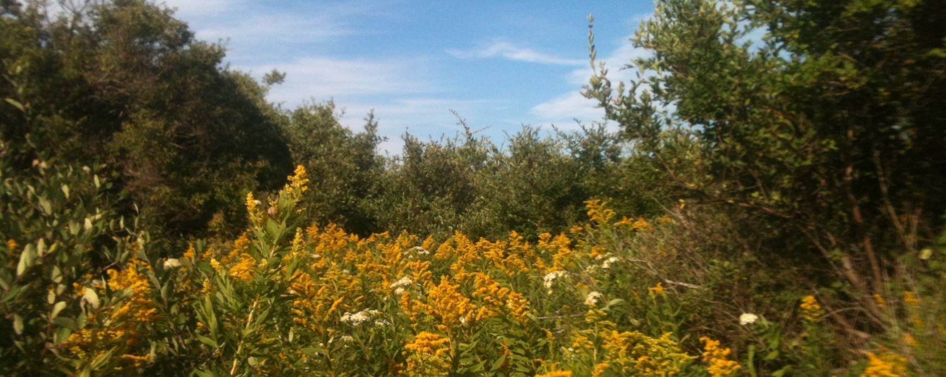
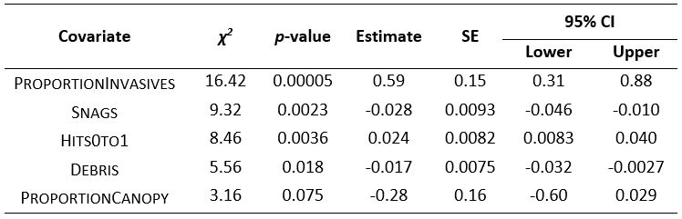
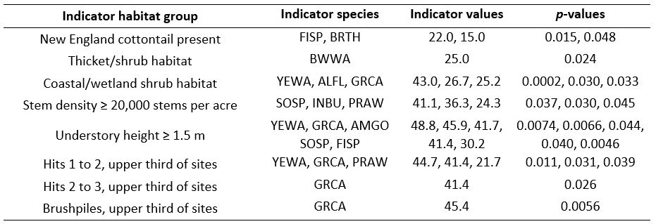
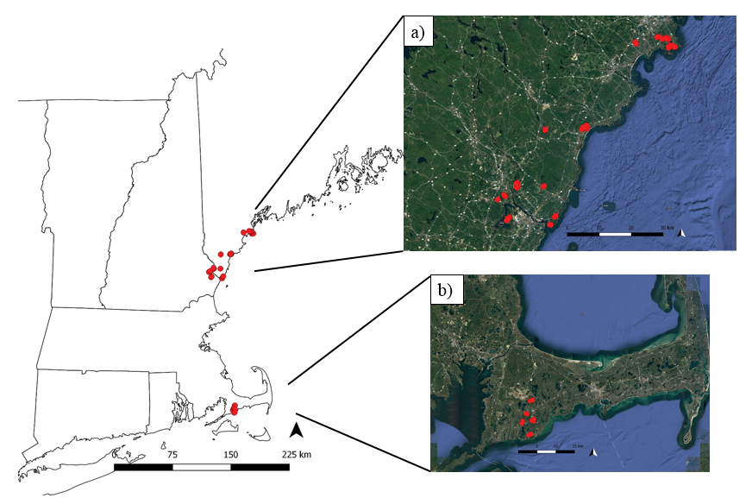
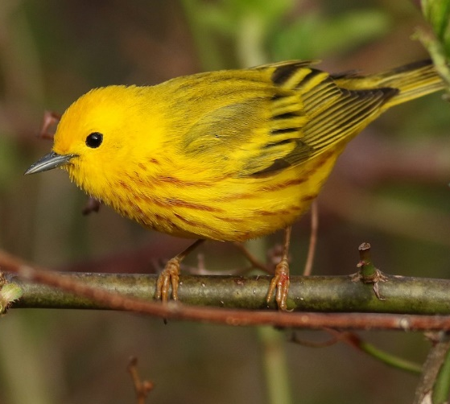
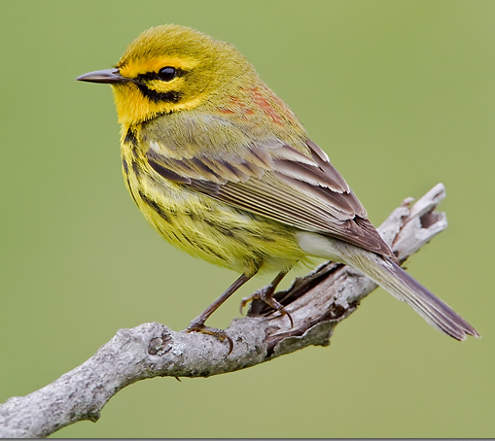
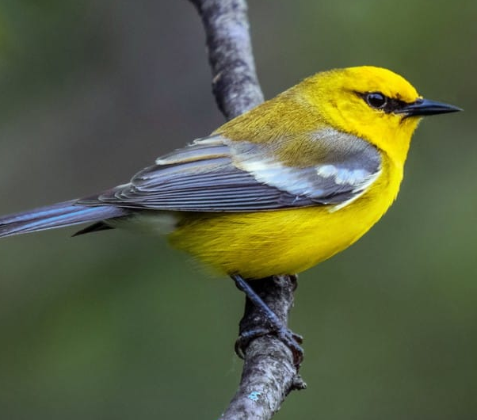
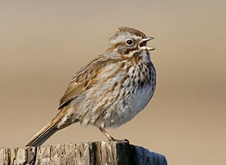
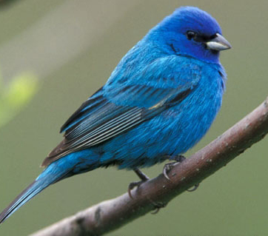
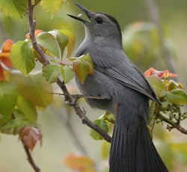
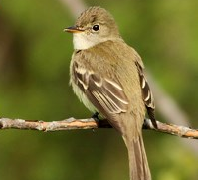
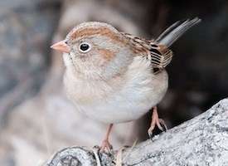
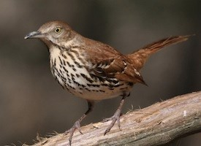
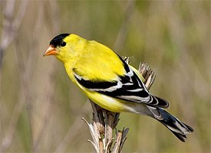
Conserving New England cottontail rabbits:
What other species benefit?
Melissa L. Bauer¹, Kathleen M. O’Brien², Adrienne I. Kovach¹
¹Department of Natural Resources and the Environment, University of New Hampshire; ²U.S. Fish and Wildlife Service
BACKGROUND
Habitat covariates at cottontail sites influence shrubland bird occupancy
Species that rely on shrubland habitat are declining throughout the Northeast due to habitat loss and fragmentation from development, succession, and restriction of natural disturbances. Species of particular conservation concern include shrubland birds and the New England cottontail. Each species’ specific habitat associations influence how they will fit into landscape-level management in the Northeast. The U.S. Fish and Wildlife Service facilitates efficient conservation design for multiple species through representative species designations. The goal of this study was to assess the value of habitat management for the New England cottontail as representative of conservation design for shrubland bird specialists. This research identifies shrubland bird species that will benefit from restoration that improves and increases habitat for New England cottontails.
RESULTS
Tables 1-5 Supported occupancy models (≤ 2 AIC_{c}), from multi-stage modeling with vegetation structure + patch-level + non-living structure habitat covariate groups.
Table 1 Chestnut-sided Warbler.
Table 6 Covariates, by group, tested in a 3-stage occupancy modeling process.
Riparian shrub.
Table 2 Yellow Warbler.
Table 4 Black-and-white Warbler.
Table 3 Prairie Warbler.
Table 5 Eastern Towhee.
OBJECTIVES
Determine habitat and patch-level influences on shrubland bird occupancy at sites occupied by or managed for New England cottontails.
Identify shrubland bird specialists that are indicative of the specific habitats required by New England cottontails.
We found significant relationships between occupancy of shrubland specialist birds and vegetation structure, patch-level habitat attributes, and non-living structure habitat attributes.
Yellow Warblers and Prairie Warblers showed higher occupancy at sites suitable for New England cottontail.
Yellow Warblers occupied sites with high stem densities and Prairie Warblers occupied sites with dense vegetation between 2 and 3 m.
Fig. 1 Coastal shrub habitat at Crescent Beach State Park in Maine.
Specialist birds are indicative of habitats required by New England cottontails
Table 8 GLM Poisson regression models assessing relationships between measured covariates and shrubland bird specialist richness.
RESULTS
METHODS
Table 7 Results of indicator species analyses identifying shrubland specialist birds detected with high frequency and exclusivity in habitat suitable for New England cottontails (p<0.05).
FIELD: Point counts were conducted 3 times per season and vegetation data were collected at 44 points in 2015 and 66 points in 2016 in Maine, New Hampshire, and on Cape Cod.
ANALYSIS: Occupancy models were developed in PRESENCE to identify habitat covariates influencing occupancy of shrubland specialist birds with sufficient data, including: Chestnut-sided Warblers, Yellow Warblers, Black-and-white Warblers, Prairie Warblers, and Eastern Towhees. Indicator species analyses identified bird species detected with high frequency and exclusivity in habitat suitable for New England cottontails, and shrubland bird species richness was compared across sites.
Indicator species analyses identified 10 species (p<0.05) that occurred with high frequency and exclusivity in habitat suitable for New England cottontails.
Shrubland bird specialist richness was positively associated with proportion of woody invasives (χ²=16.42, GLM, p<0.001) and vegetation hits from 0 to 1 m (χ²=8.46, GLM, p<0.01).
Fig. 2 Point count locations in a) southern Maine and seacoast New Hampshire, and b) Massachusetts on Cape Cod.
CONCLUSION AND MANAGEMENT IMPLICATIONS
Our findings support the notion that the New England cottontail serves an indicator species role for shrubland habitat management. Ten species of shrubland specialist birds are associated with sites that have been occupied by New England cottontails within the past 5 years, or sites with habitat that could support, and is being managed for New England cottontails. Of these 10 specialist birds, 8 are listed as Species of Greatest Conservation Need. Creating shrub habitat for cottontails with ≥ 20,000 stems per acre and an understory height of ≥ 1.5 m for cottontails will benefit specialist birds including Yellow Warblers, Prairie Warblers, Blue-winged Warblers, Song Sparrows, Indigo Buntings, and Gray Catbirds. Designating the New England cottontail a representative species is an efficient conservation strategy for the management of multiple shrubland habitat specialists.
Yellow Warbler
Prairie Warbler
Blue-winged Warbler
Song Sparrow
Indigo Bunting
Gray Catbird
Alder Flycatcher
Field Sparrow
Brown Thrasher
American Goldfinch
Acknowledgments
Funding: U.S. Fish and Wildlife Service, NH Agricultural Experiment Station
Partners: Eileen McGourty, Nancy Pau 2015 Point Counts: Logan Maxwell Image Credits: K. Boland, G. Bartley, L. Elliot

