Slide 1

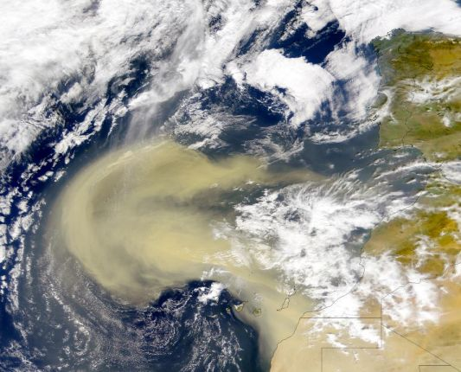
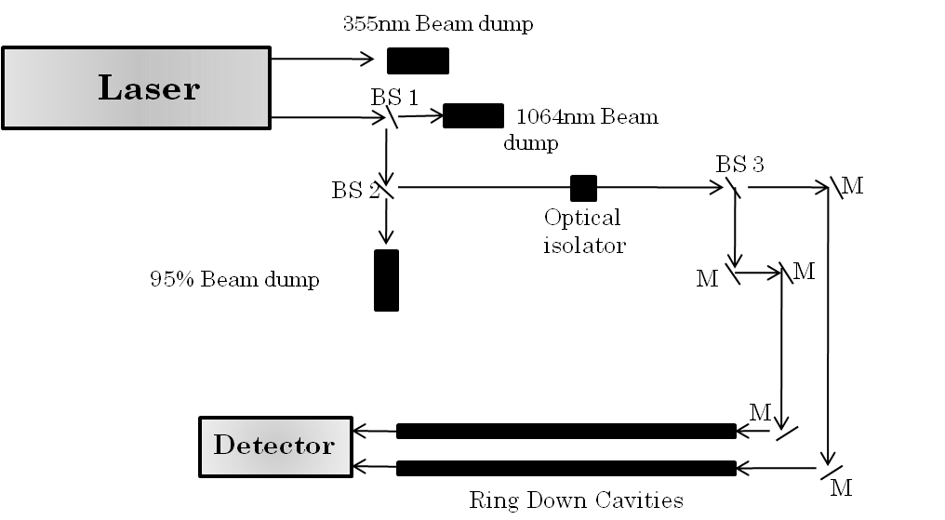
Deliquescence Behavior of Internally Mixed Clay and Salt
Aerosols by Optical Extinction Measurements
Alexis R. Attwood and Margaret E. Greenslade
University of New Hampshire, Chemistry Department, Durham, NH 03824
Introduction
Results
Discussion
Atmospheric particles are produced from a wide variety of both anthropogenic and natural sources.
An estimated 45% of the total global aerosol load is mineral dust.¹
Mineral dust can scatter incoming short-wave radiation or absorb outgoing infrared terrestrial radiation.²
Mineral dust is often associated with
Ammonium Sulfate
The abrupt increase in extinction for pure salts is due to an increase in size as the particle transitions from solid to liquid, signifying the deliquescence relative humidity (DRH).
Our results are consistent with other studies, which report the DRH of AS at 78-81% RH and the DRH of NaCl at 70-75% RH.⁹
For mixtures with low wt% salt, particles do not have a DRH but continually take up water similar to pure montmorillonite. However, the fRH_{ext} indicates that more water is absorbed onto the surface at high RH in comparison to montmorillonite alone.
For mixtures with high wt% salt, particles show little enhancement in extinction until an abrupt increase signifying the DRH. However, the DRH for these internal mixtures occurs at a lower RH than the pure salt.
DRH lowering is a well known phenomena that has been observed for both AS and NaCl when mixed with another electrolyte or a weakly dissociating organic compound,⁹ but this is the first time to our knowledge that it has been observed in mixtures with insoluble species.
The extent to which the DRH decreases is independent of the relative proportions of the salt and montmorillonite in the sample.
Montmorillonite has the ability to reduce the Coulomb attractive forces between the cation and anion in the salt while causing disorder of the lattice structure of the salt, slightly increasing the Gibbs free energy of the system.¹⁰
The increase in energy causes the particles to incorporate water at a lower RH than the DRH of the pure substance so the overall Gibbs free energy of the system can decrease.
Optical property predictions based on volume weighted mixing rules (theory, at left) are a good first approximation of these mixtures at high and low RH, but fail to capture the changes to the DRH.
The difference in accuracy of the theoretical predictions between the two salts seen in the small figures to the left, could be due to the differences in the volume weighted fractions at each mass fraction which are larger for AS.
soluble species like ammonium sulfate (AS) and sodium chloride (NaCl) and up to 85% of transported dust is internally mixed with other material.³
size, complex refractive index and shape and these three characteristics determine the extent of extinction, or the sum of absorption and scattering, of light by the particle.
Some measurements reported in the current literature suggest little change in the hygroscopic behavior or optical properties of internal mixtures of mineral dust and soluble material.⁵⁻⁸
We directly measured the optical response of AS and NaCl internally mixed with montmorillonite using cavity ring down spectroscopy (CRD).
The sensitivity of the relative humidity dependence of extinction based on the fraction of salt added is examined to better understand how the optical properties and hygroscopicity of mineral dust change as a function of its mixing state.
Further, our investigation gives insight into whether using the optical properties of pure components in conjunction with simple volume weighted mixing rules is sufficient to approximate the optical changes in internally mixed aerosol composed of both soluble and largely insoluble species.
http://earthobservatory.nasa.gov
Pure Montmorillonite
Our group has recently shown
that the optical properties of montmorillonite, a clay
component of mineral dust, changed at high relative humidities due to significant water uptake.⁴
Water uptake affects particle
Sodium Chloride
 | wt% salt | vol% salt
Ammonium Sulfate 1.769 g/cm³ | 0.1 1.0 3.0 15 40 | 1.3 12 28 66 84
Sodium Chloride 2.165 g/cm³ | 0.1 1.0 3.0 15 | 1.1 9.8 25 62
Measurement Technique
Aerosols were atomized using 10 wt% suspension of montmorillonite, and a 1 wt% solution of either AS or NaCl for single component measurements.
For mixed aerosol measurements, a suspension of 10 wt% montmorillonite with either AS or NaCl at 0.1-40 wt% was used.
CRD spectroscopy is employed to
measure the extinction of light by
particles.
Laser source is a solid state 20 Hz pulsed
Nd:YAG laser.
CRD uses the frequency doubled output wavelength at 532 nm.
This wavelength is close to the maximum of the solar spectrum and a good choice for studying aerosol optical properties.
CRD in conjunction with particle concentration measurements are used to determine the extinction cross section (σ_{ext}) of 250 nm aerosols as a function of relative humidity, fRH_{ext}(RH, Dry), where fRH_{ext} is:
Atmospheric Implications
Contrary to previous studies, we have shown that insoluble mineral dust does affect the hygroscopic properties of salt particles.
If the DRH lowering is not accounted for when assessing the optical properties of the mixed particles, the predicted extinction has the potential to be underestimated.
The lowered DRH will not only affect physical but chemical properties as some heterogeneous reaction rates on particle surfaces are influenced by particle phase and water content.
References
1. Caquineau, S., et al. (2002), Mineralogy of saharan dust transported over northwestern tropical Atlantic Ocean in relation to source regions, J. Geophys. Res., 107(D15), D154251.
2. Hudson, P. K., et al. (2008), Coupled infrared extinction and size distribution measurements for several clay components of mineral dust aerosol, J. Geophys. Res., 113, D01201.
3. Zhang, D., et al. (2003), Mixture state and size of asian dust particles collected at southwestern Japan in spring 2000, J. Geophys. Res., 108(D24), 4760.
4. Attwood, A. R., and M. E. Greenslade (2011), Optical Properties and Associated Hygroscopicity of Clay Aerosols, Aerosol Sci. Technol., 45(11), 1350-1359.
5. Martin, S. T., et al. (2004), Effects of the physical state of tropospheric ammonium-sulfate-nitrate particles on global aerosol direct radiative forcing, Atmos. Chem. Phys., 4(1), 183-214.
6. Carrico, C. M., et al. (2003), Mixtures of pollution, dust, sea salt, and volcanic aerosol during ACE-Asia: radiative properties as a function of relative humidity, J. Geophys. Res., 108(D23), 8650.
7. Semeniuk, T. A., et al. (2007), Water uptake characteristics of individual atmospheric particles having coatings, Atmos. Environ., 41(29), 6225-6235.
8. Bauer, S. E., et al. (2007), Do sulfate and nitrate coatings on mineral dust have important effects on radiative properties and climate modeling?, J. Geophys. Res., 112(D6), D06307.
9. Tang, I. N. (1976), Phase transformation and growth of aerosol particles composed of mixed salts, J. Aerosol Sci., 7(5), 361-371.
10. Miñambres, L., et al. (2010), Hygroscopic Properties of Internally Mixed Particles of Ammonium Sulfate and Succinic Acid Studied by Infrared Spectroscopy, J. Phys. Chem. A, 114(20), 6124-6130.
Acknowledgments
Dr. Greenslade and the Greenslade Group
Funding provided by the UNH Graduate School, UNH College of Engineering and Physical Sciences (CEPS) and the Dean’s Office for start-up
Travel paid in part by UNH Graduate School and UNH Chemistry Department

