Slide 1

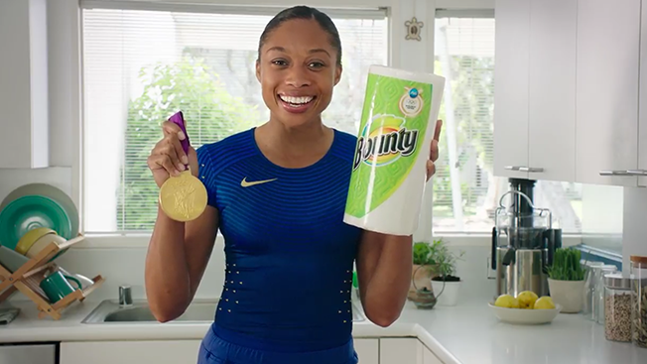
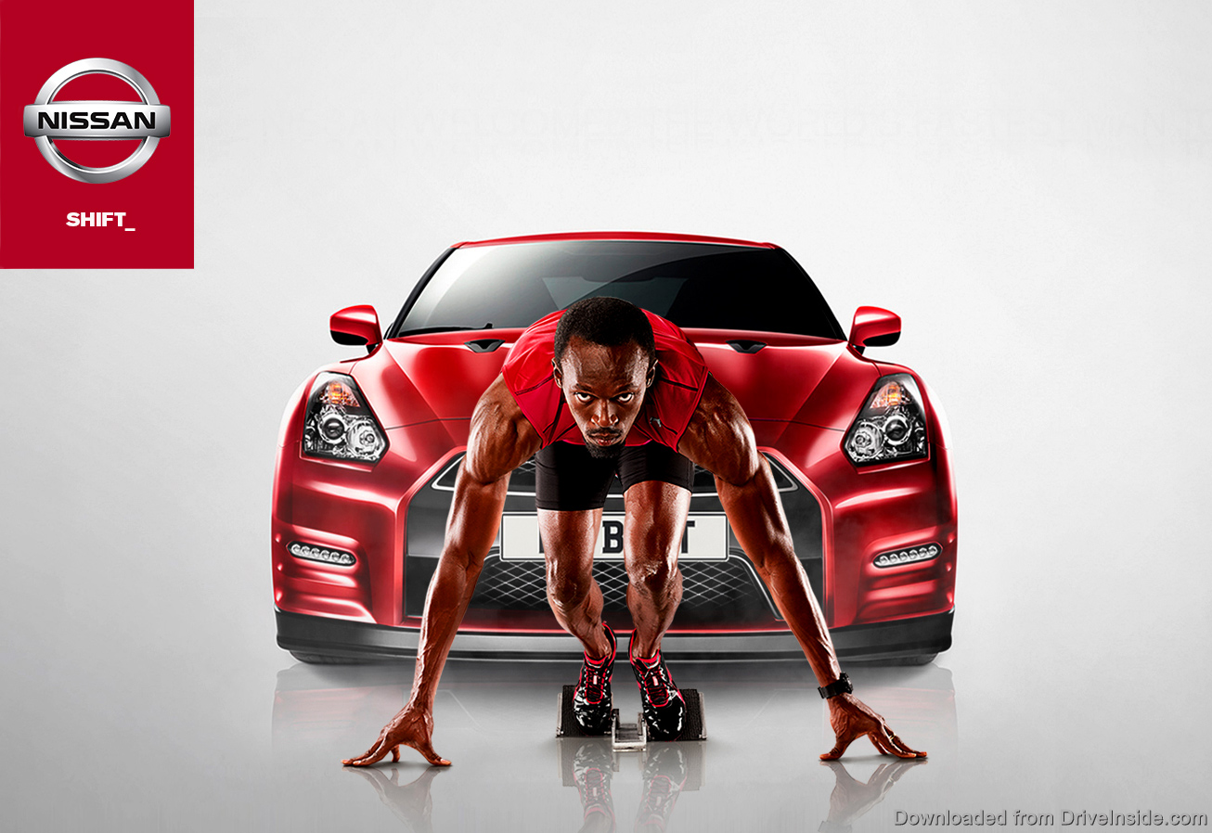
SPORTS CELEBRITY INFLUENCE ON THE
BEHAVIORAL INTENTIONS OF GENERATION Z
Kayla Farren
Department of Marketing, University of New Hampshire
Faculty Advisor Dr. Nelson Barber
Introduction
Methods
There is a lack of published research that investigates the influence professional athletes have on a target market, specifically generation Z.
This study explores whether or not sports celebrity role models influence generation Z’s behavior or intentions.
Serious analysis of generations began in the nineteenth century. Generation Z, Baby Boomers, and Generation Y have been studied heavily. The youngest generation right now known as Generation Z, has been relatively unstudied especially during their teenage years.
The widespread use of the Internet from a young age is a critical aspect of this generation.
After receiving IRB approval, a Qualtrics survey was sent to students of UNH, Milford High School in Massachusetts and Lakes Region Community College. Data will also be collected from UNH freshmen.
The goal is to collect at least 100 usable responses. The survey is currently being distributed and has collected about 30 responses at this time. Using SPSS the data will be analyzed via descriptive statistics, analysis for variance, and possibly regression analysis.
Survey
20 Question survey consisting multiple choice, ranking, likert scale, rating scale, dichotomous, and some demographic questions.
Survey question example-
How likely are you to buy this product?
Research Questions
Do sports celebrity spokespersons and or endorsers act as vicarious role models to members of Generation Z?
Do sports celebrity spokespersons and or endorsers influence Generation Z’s behavioral intentions?
What is the influence of sports celebrity spokespersons or endorsers on female members of Generation Z?
Expected Outcome
I expect to find drastic change in this topic area when comparing generation Y to Z. I believe that sports celebrities represented positively on social media will have a greater influence on teenagers today. Celebrities that are speaking on television or radio will not influence generation Z as much.
References
      References available upon request

