Slide 1
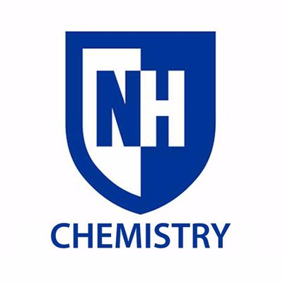

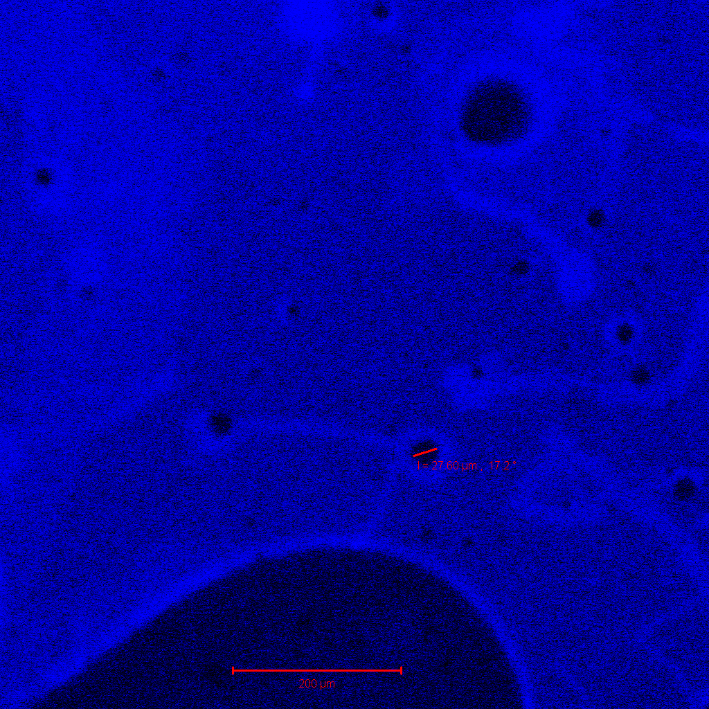
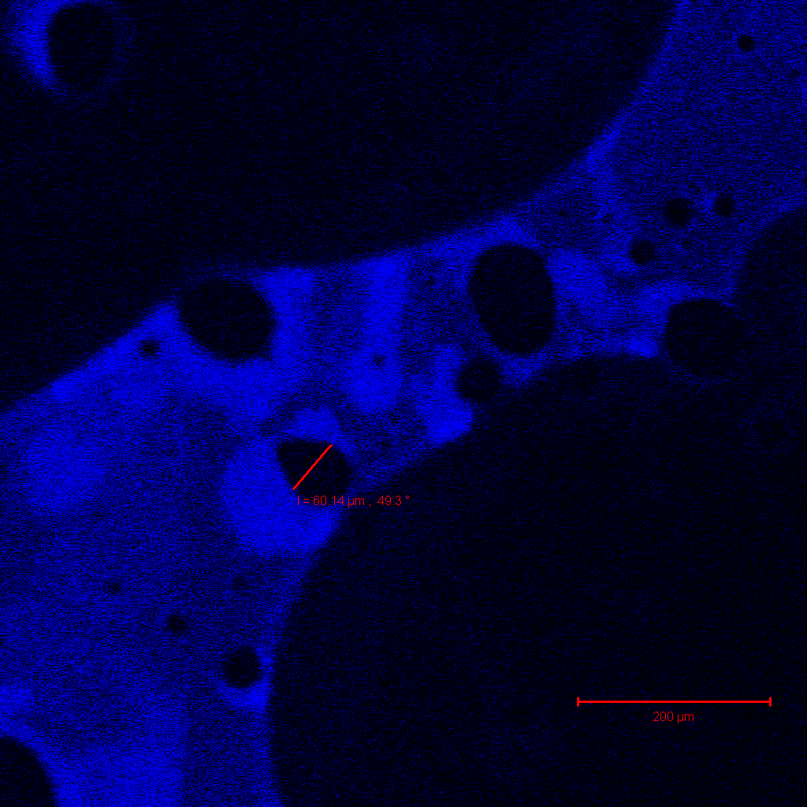
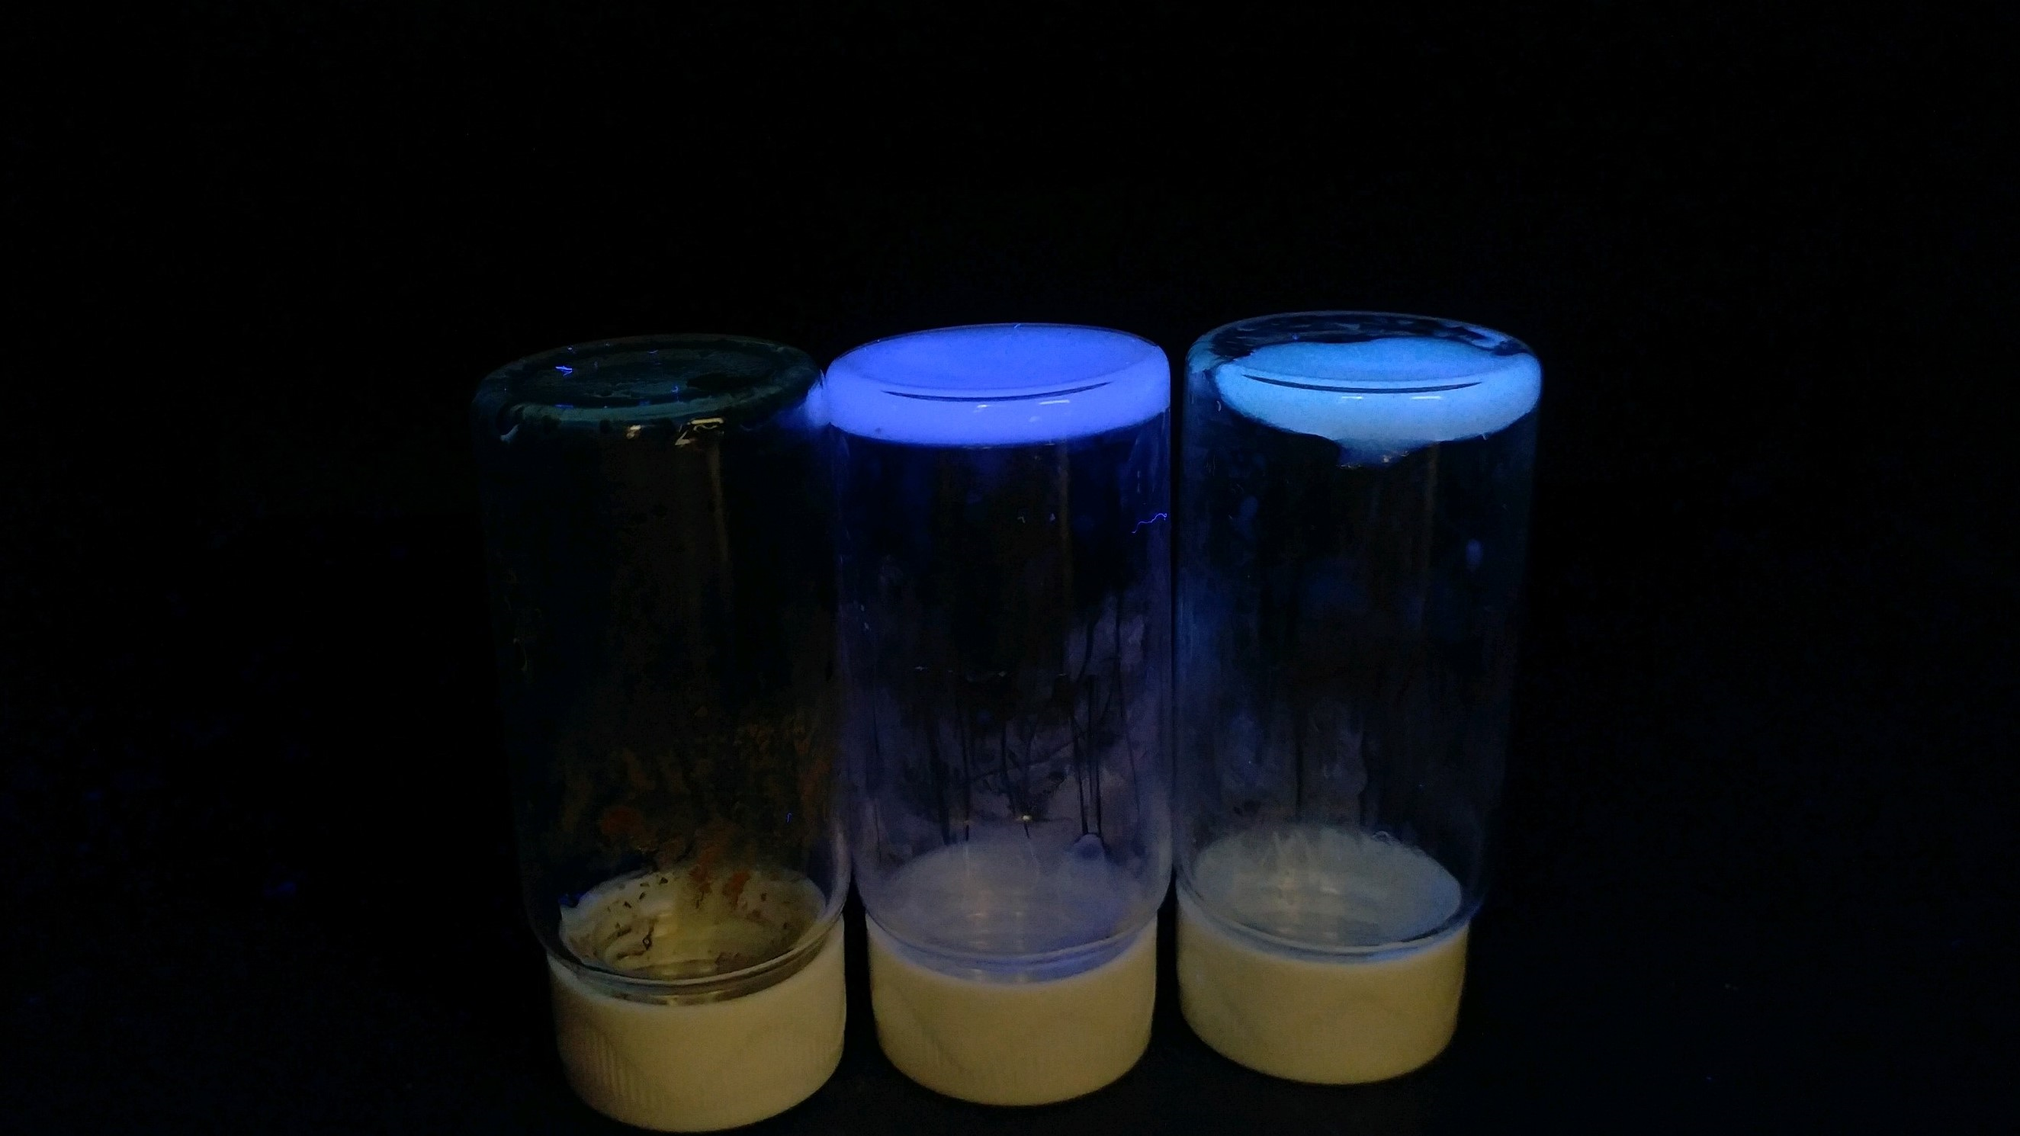
Development of New Fluorescent Materials: Putting Carbon Dots to Work
Ian Smith, Miriam Velasquez Hernandez, Anthony Lemieux, Christine Caputo
imw8@wildcats.unh.edu, Department of Chemistry, University of New Hampshire, Durham, NH
4/18/2018
Since the accidental discovery in 2004 by Xu and coworkers carbon dots (CD) have been a hot topic in the chemistry community. Due to CDs straightforward synthesis and relative low toxicity, they have replaced many conventional semiconductor nanoparticles in multiple scientific fields such as medicine, biology, and chemistry.^{3,5} This has led them into many labs focused on green energy research, and advanced material research. This project’s goal is to synthesize CD and embed them within polysilioxane (PS) creating a hybrid material with viscoelastic and fluorescent properties useable as a photosensitizer in catalytic redox chemistry. Surface functionalization of CDs consist of carboxylic acids and alcohol groups, which allow for bonding interactions with PDMS. A hybrid material has multiple applications in photosensitive redox chemistry. Viscoelastic properties of this hybrid compound allow for additional flexibility in possible working conditions, and spreading on surfaces. Progress towards this novel compound is presented here.
The synthesis of carbon quantum dots is performed by thermolysis of citric acid. The citric acid is placed into a furnace/oven and left for up to 40 hrs at 180°C. This allows for the creation of acidic CDs at pH 3-4.⁴
(1) (2)
Scheme 1. Synthesis of CDs (2) from Citric Acid (1)
The synthesis and characterization of the CD has been carried out by Anthony Lemieux in a previous experiment.
PDMS (3) used in a similar method with boric acid (B(OH)₃) (4) can create a silicon polymer, which will be used as a control. B(OH)₃ acts as a cross-linker to strands of PDMS in a reaction setting of 5% w/w of to 750mg respectively, then manually stirred while heating at ~180°C for 1hr. Dehydrogenation occurs between the reactants to allow the cross-linking to occur.²
(3) (4)
Scheme 2. Synthesis of PS polymers controls.
Figure 1. Fluorescence of CD-PS Hybrid material under UV light irradiation.
Synthesis of the CD-PS hybrid material adds CD into Scheme 2. Combining CD with PDMS at a 1:30 ratio, with the 5% w/w of B(OH)₃, the reaction vial runs at ~160°C for 1hr. Samples show ~75-70% yield of sample material yield by weight. Under a UV handheld 325nm, the hybrid polymers show fluorescence of a similar wavelength to the CD solutions. The intensity is lowered though due light blocking from the polymer chains, which was expected.
A)
(2) (3) (5)
B)
(3) (4) (2)
(6)
Scheme 2A) Method for synthesizing covalent CD-PS hybrid material, without the need for B(OH)₃.
Scheme 2B) Method for synthesizing covalent CD-PS hybrid material, with B(OH)₃. (6) is a possibility of different structures, not resonance structures.
Figure 2-3. Fluorescent Microscopy Images of CD-PS hybrid polymer.
Analysis of the CD-PS hybrid material is done through IR, rheology, fluorimetry, and fluorescence microscopy.¹ Solubility tests were also conducted to determine the covalence or non-covalence of the CD in the polymer. Fluorescence microscopy under 405nm light shows higher intensity of fluorescence by the compound. (Figures 2-3) Spectroscopy results show CD with an absorbance of 0.1 at ~400nm, which would mean that any fluorescence from CD would be limited.
The next step in characterization of the hybrid polymer would be infrared identification of the surface functionalization of the CD and the suggested covalent bonding of the PS in the polymer. The final step would be to use the CD-PS hybrid material as a photosensitizer for redox catalysis in hybrid photochemical systems.
A large thanks to Prof. Christine Caputo, Miriam Velasquez Hernandez, Anthony Lemieux, and the rest of my research group. I would also like to thank the UNH chemistry Department.
Barman, M. K.; Jana, B.; Bhattacharyya, S.; Patra, A. J. Phys. Chem. C. 2014, 118, 20034–20041.
Boland, C. S.; Khan, U.; Ryan, G.; Barwich, S.; Charifou, R.; Harvey, A.; Backes, C.; Li, Z.; Ferreira, M. S.; Mobius, M. E.; Young, R. J.; Coleman, J. N. Science 2016, 354, 1257–1260.
Ma, Y.; Li, Y.; Ma, S.; Zhong, X. J. Mater. Chem. B 2014, 2, 5043.
Martindale, B. C. M.; Hutton, G. A. M.; Caputo, C. A.; Reisner, E. J. Am. Chem. Soc. 2015, 137, 6018–6025.
Xu, X.; Ray, R.; Gu, Y.; Ploehn, H. J.; Gearheart, L.; Raker, K.; Scrivens, W. A. J. Am. Chem. Soc. 2004, 126, 12736–12737
Introduction:
Results and Discussion:
Experimental Work:
Future Work:
Acknowledgements:
References:
Conclusions:

