Slide 1

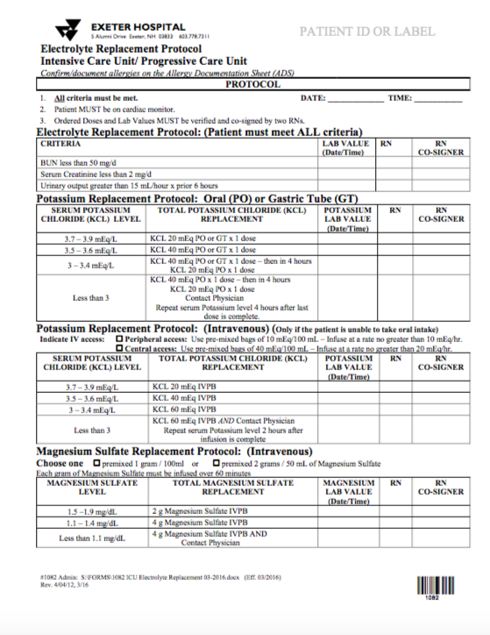
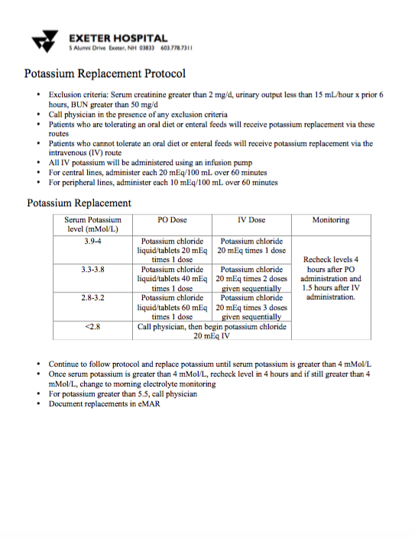
Potassium Replacement Protocol Revised
Christina McDonald, Senior Nursing Student, UNH Department of Nursing
Purpose
Generalized Weakness
Fatigue
Constipation
Impaired Respiratory Function
Increased Arrhythmias
Muscle Necrosis
Respiratory Failure
Increased Risk of Sudden Cardiac Death
Hypokalemia
Clinical Implications
To compare the efficacy of utilizing a nurse-driven potassium replacement protocol as opposed to a physician-driven protocol
To implement a nurse-driven potassium replacement protocol at Exeter Hospital
Nurse-driven electrolyte replacement protocols improve patient outcomes
Nurse and physician satisfaction improves with quality patient outcomes and increased nurse autonomy
May be a need for dose adjustment
  Noted need to increase the doses of electrolyte replacement to reduce the incidences of post replacement hypokalemic episodes (Hijazi & Al-Ansari, 2005; Todd et. al, 2009)
Background
Protocols improve outcomes: reduced mortality and efficient use of resources (Kanji & Jung, 2009)
Documented benefits of protocol driven care: transfusion of blood products, mechanical ventilation weaning, sepsis resuscitation (Todd, Sucher, Moore J., Turner, Hall, & Moore A., 2009)
Effective electrolyte replacement is difficult: variability in dosing, monitoring, and timing by different physicians (Todd et. al, 2009)
Sufficient potassium levels are associated with blood pressure (BP) reduction and reduced risk of stroke (independent of BP) (Macdonald & Struthers, 2004)
Current protocol at Exeter Hospital: physician-driven with no intervals to recheck labs and continue replacement
Current Evidence
Improvements with a Nurse-Driven Electrolyte Protocol
Improved electrolyte replacement
  Todd et. al (2009) found that electrolyte replacement improved from 70% to 79% and the effectiveness of replacement improved from 50% to 65%
  Decrease in number of needed electrolyte replacements missed (Hijazi & Al-Ansari, 2005)
Decreased time of needed potassium replacements
  Mean time interval of identification of low potassium values significantly reduced (Hijazi & Al-Ansari, 2005)
Improved nurse autonomy and satisfaction (Kanji & Jung, 2009)
  Nurses were more satisfied with the nurse-driven protocol and had to consult the physician less in regards to potassium management (Hoekstra, Vogelzang, Drost, Janse, Loef, van der Horst, Zijlstra, & Nijsten, 2010)
Improved physician satisfaction with the timeliness of replacement (Kanji & Jung, 2009)
  Less contact with nurses throughout the replacement process
Practice Recommendations
Switching from a physician-driven potassium replacement protocol to a nurse-driven protocol would improve potassium management and patient outcomes
Rechecking potassium levels at set intervals can improve the management of potassium levels and replacement efforts
While this mainly reviews the potassium replacement protocol, studies reviewed other electrolytes for which a similar protocol would be beneficial
Current Protocol
Proposed Revision

