Slide 1

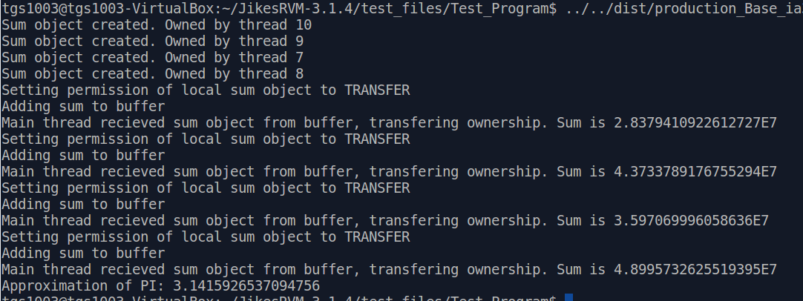
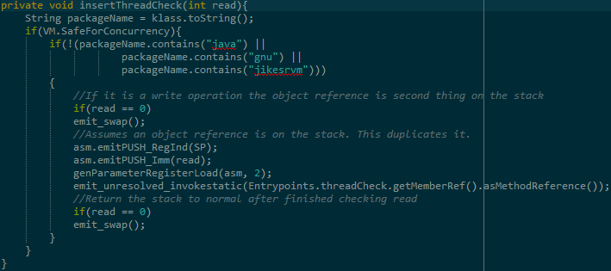
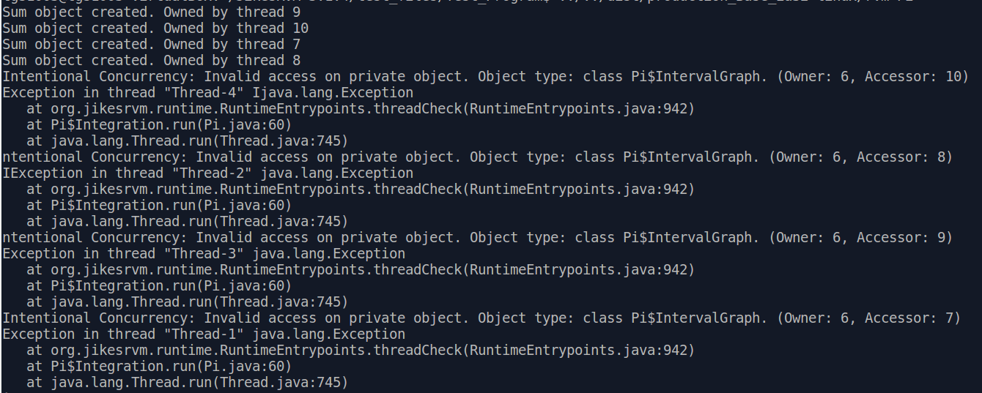
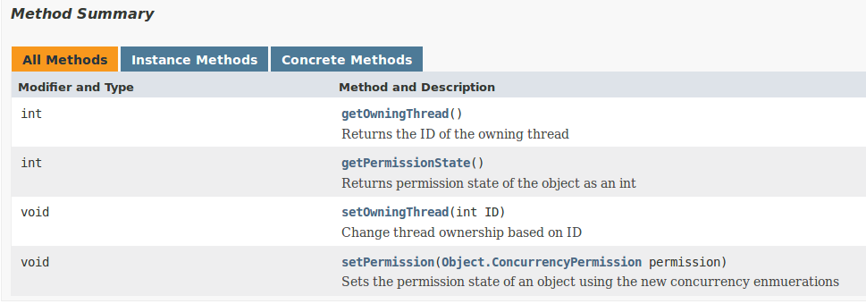
Implementing a System for Intentional Concurrency in Jikes RVM
Sponsor: Dr. Philip Hatcher
Student Authors: Thomas Sorrell, Adam Seavey
Background
Implementation
results
When trying to improve program execution speed, one potential optimization is to make the program concurrent, splitting operations into multiple pieces that can be run simultaneously. However, this can cause numerous issues, as when data is shared among different simultaneous tasks the programmer must be careful how the data is shared. This is because the different tasks do not update shared data in a deterministic manner. This can often lead to scenarios where two tasks attempt to edit data at the same time, or one task reads the data before the other task has finished editing it, etc. Preventing these sorts of issues makes concurrent programming difficult.
Our implementation of intentional concurrency focused on Java and the Jikes Research Virtual Machine. Implementing our system inside the virtual machine itself means that all code participates in the system without requiring any special libraries. Our implementation had three main parts:
Storing Concurrency Information in the Object Header
---------------------------------------------------------------
|GCHeader| MiscHeader | JavaHeader | fld0 | fld1 | … |fldN – 1|
---------------------------------------------------------------
We were able to add our own fields to the object header (in MiscHeader) to track which thread owned an object, and what permission state an object had
Inserting Permission Checks Before Data Accesses
We inserted our own machine code when data is accessed to check the fields in the object header. This code effectively added our check before any data is accessed in any object
A User Interface
We found an existing interface between Jikes RVM and Object.java. We were able to use this interface to add methods that allowed the user to access the object header from their own code in order to manage permissions themselves.
Our main goal for our project was to demonstrate the feasibility of implementing our system in Jikes RVM. To test our implementation, we created a simple program to estimate Pi using multiple threads.
Multiple threads read from a frozen object
Threads create a private object to store the results
Each thread then transfers the object to the main thread, and stores it in a global buffer
The main thread performs the final calculations using the objects created by the threads
Fig. 2. Spacial Layout of Object
Intentional Concurrency
Our project aims to help prevent concurrency issues by adding the concept of intent to concurrent programming. The concept of intent forces the programmer to think explicitly about which data should be shared among tasks, and which should not. This is accomplished by adding a set of permission states for data within the program. The hope is that if the programmer is forced to think about how their data is accessed, and the system enforces restrictions on data accesses, they will take steps to ensure that data is accessed appropriately.
Fig. 5. Testing using parallel Pi approximation
Permission | Read Access |  | Write Access |  | Change Permission
Task | Owner | Other | Owner | Other | Owner | Other
Private | ✔ | ✘ | ✔ | ✘ | ✔ | ✘
Frozen | ✔ | ✔ | ✘ | ✘ | ✘ | ✘
Permanently Thread Safe | ✔ | ✔ | ✔ | ✔ | ✘ | ✘
Thread Safe | ✔ | ✔ | ✔ | ✔ | ✔ | ✔
Fig. 3. Check Insertion
Fig. 6. Incorrect accesses generate errors
FUTURE WORK
Future work would be focused on completing the implementation of the remaining permissions Loan and SameAsLeader. In addition, a new concurrency library is needed, similar to the existing java.util.concurrent library. This library would be focused on adding internal support for intentional concurrency, so that the user can take advantage of useful concurrency objects, such as semaphores and latches, without having to explicitly worry about the permission state of these objects.
Fig. 1. Visual Representation of Access Rights
Fig. 4 New methods in Object.java

