Slide 1







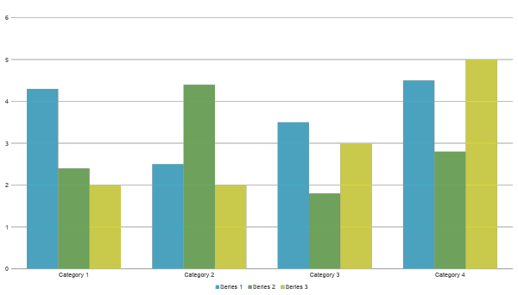

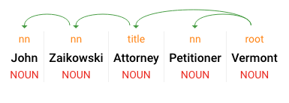
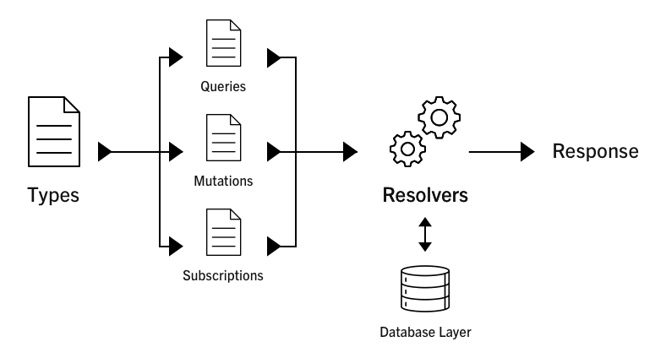
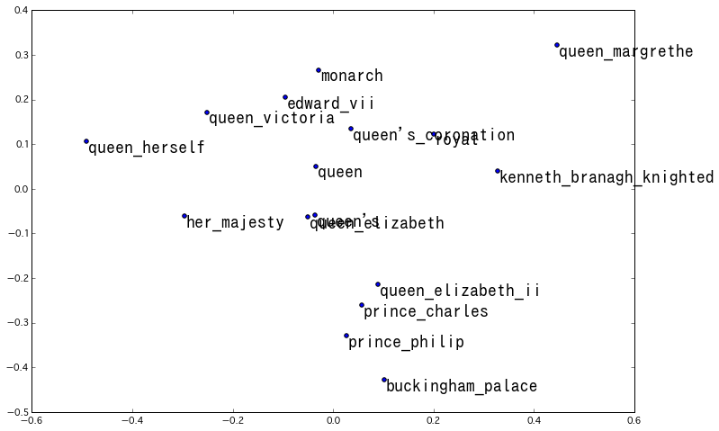
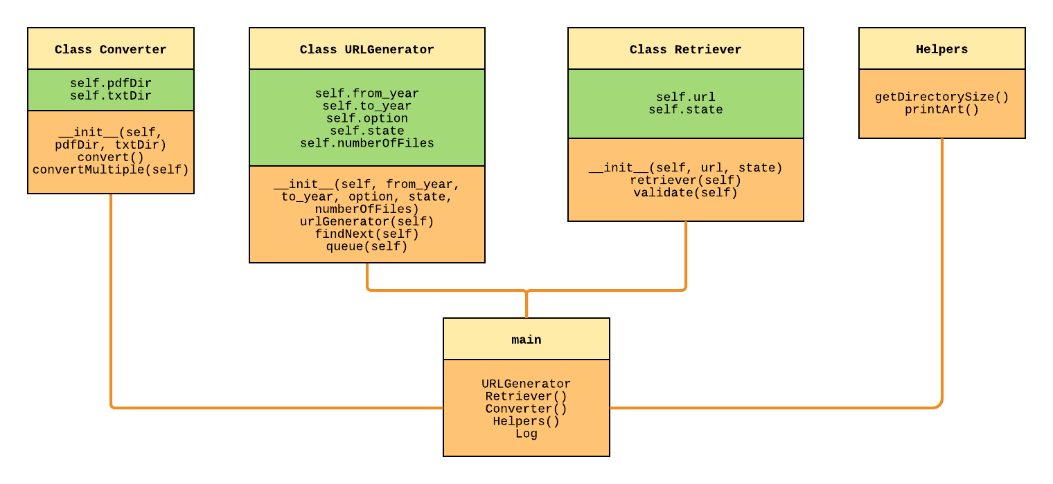
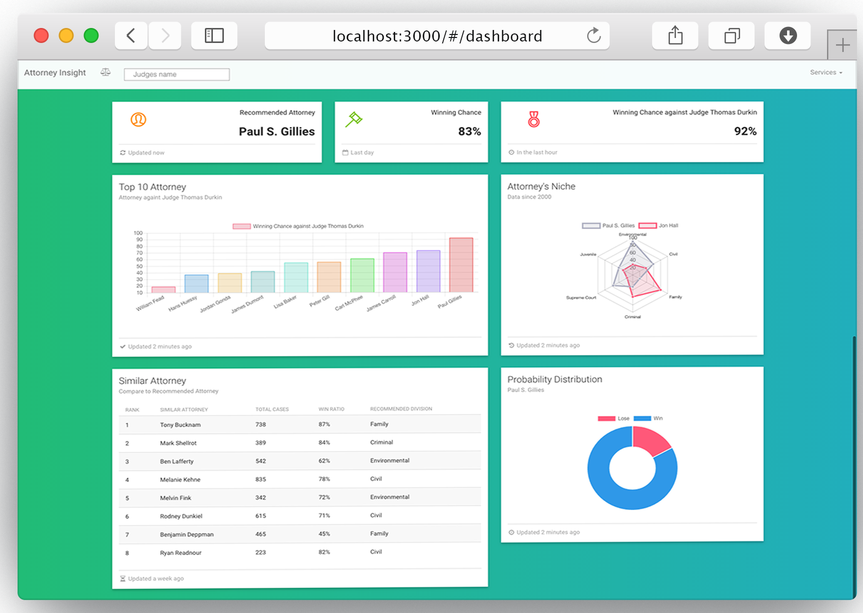
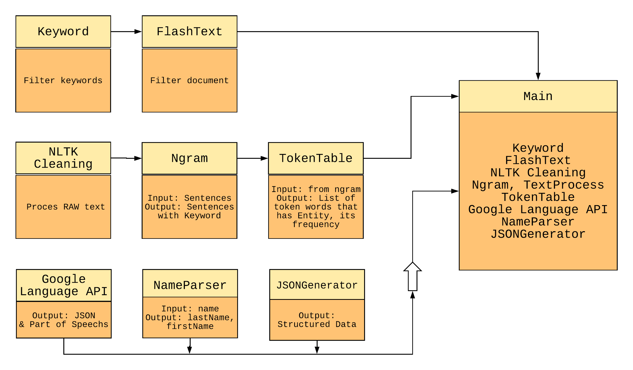
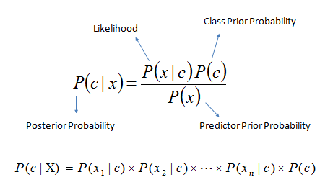















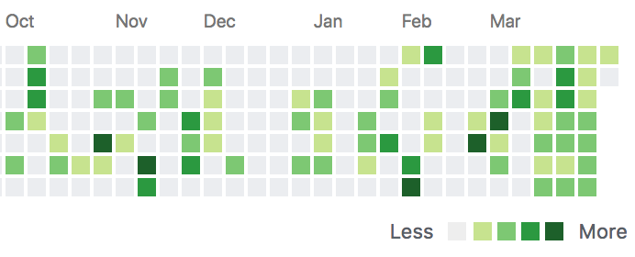
Court Documents Mining Pipeline
Liberty Mutual Insurance
Step 1
Step 2
Step 3
Step 4
Describe this step in your experiment
Describe this step in your experiment
Describe this step in your experiment
Describe this step in your experiment
Authors - Huy Le and Heli Amin | Advisors - Jane Hillyard and Professor Matthew Magnusson
Overview
Data Processing
Backend and GraphQL API
Problem
Saving time
Saving budget
Finding solution and answer to these questions
  “Are there a set of characteristics common to positive outcomes?”
  “Can you see any sort of trending for certain judges, certain attorneys or combinations therein?
  “Can you develop a win/loss ratio for each attorney?”
  “Can you segment cases into different case types?”
This project is proposed and sponsored by the Liberty Mutual Information Technology Enterprise Technology Services (ETS). ETS is responsible for creating, designing, and supporting enterprise solutions for all of the Liberty Mutual. As part of that responsibility, ETS seeks to create a dataset for their Legal team to better understand key components in judicial outcomes. This project creates a software that aids Liberty Mutual’s Legal team in identifying the best attorney. The system mines data from publicly available websites, creating a source for further research and development to aid in this decision.
GENSIM Word2Vec
Entities Recognition
query {
viewer {
attorneys {
edges {
node {
firstName
lastName
avgWinRatio
totalWinCases
}
}
}
}
}
{
"data": {
"viewer": {
"attorneys": {
"edges": [
{
"node": {
"firstName": "John",
"lastName": "Zaikowski",
"avgWinRatio": 0.83,
"totalWinCases": 49
}
},
{
"node": {
"firstName": "Tony",
"lastName": "Bucknam",
"avgWinRatio": 0.75,
"totalWinCases": 38
}
},
{
"node": {
"firstName": "Mark",
"lastName": "Shellrot",
"avgWinRatio": 0.84,
"totalWinCases": 25
}
}
]
}
}
}
}
Goal: Explore our dataset with the Machine Learning Model
decision
offense
eviction
convince
argument
inquiry
defendant
guilty
petitioner
civil
esq
defendants
court
attorney
state
{
"name": "John Zaikowski",
"type": "PERSON",
"metadata": {
},
"salience": 0.12607326,
"mentions": [
{
"text": {
"content": "Attorney",
"beginOffset": 46
},
"type": "COMMON"
}
lawyer
law
attorneys
explained
trial
lawyers
alleged
appeal
judge
provided
blacked
affirmed
entered
plea
believed
claimed
occurred
described
stated
accepted
Data Retrieval
Result: Understanding the semantic meaning, output a plotted map of words with similar meaning
Backend MongoDB Mlab and GraphQL diagram
QUERY AND RETURN
Materials (detailed list) | Quantity (be specific)
Item | Amount
Item | Amount
Item | Amount
Item | Amount
Item | Amount
Item | Amount
Item | Amount
N-GRAM MODEL
How it works
MongoDB mlab stores structured data
GraphQL API queries and fetches data to client App
Types: Represents data model
Queries: Used to run against the schema
Mutations: Connect to the server to perform DB functions like INSERTS, UPDATES
Resolvers: Performing responses to a query or mutations
Schema: Connecting all the moving parts together
Result:
Handling multiple round trip calls
Handling over-fetching of data
One single query to render the entire web app
Implemented with React, Relay and Redux
Objectives (In-Scope)
Tools
Goal: Prepare for Name Entity Recognition by locating the position of the keyword “attorney”
Sample Entities Recognition return
Python 3.6
INPUT
“ … John Zaikowski Attorney Petitioner Vermont ... “
Tools
BeautifulSoup
TOKENIZE
[ “John”, “Zaikowski”, “Attorney”, “Petitioner” “Vermont” ]
  Automated collect published data of Court cases and attorney by web scraping
  Classifying unstructured data and turn collected data into structured data Natural Language Processing and Data Munging techniques
  Predicting outcomes from the structured data using Data Mining algorithm
N-GRAM
“Attorney”
“Petitioner”
“Vermont”
Attorney,
Petitioner,
Vermont
Google Language API
Urllib.request
N = 1
Right
“John”
“Zaikowski”
“Attorney”
N-gram
SSL Module
N = 1
Left
John,
Zaikowski,
Attorney
“John Zaikowski”
NOUN
PROPER
“Attorney”
NOUN
COMMON
Gensim
Web Application
Fully unstructured data sourced from Court Case PDFs are collected automatically from publicly available sources such as Vermont Judiciary website.
Result: Able to achieve better Name Entities Recognition outcome using Part of Speech
Matplotlib
Data Mining
Web Application is created using ReactJS, NodeJS, ExpressJS, and ChartJS. The app is a data visualization dashboard that displays different charts and tables showing relationships among different attorneys and judges. Users can search and perform comparisons.
Data Munging
Tools
BAYES THEOREM
Edges
Attorney
Bar Graph | Top 10 attorney before selected judge.
Radar Chart | Two top attorney’s niche among different divisions.
Pie Chart | Probability distribution of recommended attorney.
Table | Compare similar attorney to recommended attorney.
PDF
PDF
NLTK.tokenize
Viewer
Edges
Attorney
NLTK.corpus
Edges
Attorney
.TXT
PDFminer
Compute John Zaikowski win chance with Judge Thomas Durkin
P(win | john zaikowski & thomas durkin)
= P(john zaikowski | win) P(thomas durkin | win) P(win)
= 3/19 * 4/19 * 12/19 = 0.1578 * 0.2105 * 0.6315 = 0.02097
To normalize Joe Zaikowski’s probability:
P(lose | john zaikowski & thomas durkin)
= P(john zaikowski | lose) P(thomas durkin | lose) P(lose)
= 2/19 * 2/19 * 7/19 = 0.1052 * 0.1052 * 0.3684 = 0.00407
Normalized rating for wins: 0.02097/(0.02097 + 0.00407) = 0.83
Data mining outcome is stored in JSON for each attorney
Flashtext.keyword
As the result, we generated win ratio for each attorney, predicted the probability to win against a particular Judge. The structured data is exported to JSON files.
Independent variable
Regex
Fully unstructured data is processed to generate better unstructured data for the next step of data mining.
Future Work
  The one variable you purposely change and test
Technology
Scale the data size
  Mining data from more states
  Develop a method to fetch and update existing data
Improve Data Processing Pipeline
  Apply Deep Learning in Entities Recognition and Extraction
Deliverable and Maintenance
  Final product on GitHub
Python | Scikit learn | Docker | MongoDB | AWS S3, Lambda | Google Cloud Language API
JavaScript | ReactJS | GraphQL and Relay | NodeJS | Webpack and Babel | HTML5 and SASS
50+ Commits
Notes:
Overview
Set up the environment
Why
Time
Resources
proof of record
Solution
Data Retrieval
first step of process flow
retrieval publicly available data using python, ...
object orientation in python
successfully collected 10,000 data files
Huy Intro by Heli
Data Munging
Goal: Unstructured data to better data
PDF to text
Using NTLK and corpus
Filter out the documents those don’t have the wanted data
remove meaningless stopwords
remove non-alphabet char
Results => Processed text, ready for data process
Data Processing
Goal (1): Explore our data with Machine Learning Model
How (1):
Word2Vec: understanding the semantic meaning, to spot out the words with similar meaning by represent it in vector or number
Gensim model: Input as sequence of sentences , output a map plotting group of same meaning words
Goal (2): Extract important data like Attorney Name, Case Decision
How (2):
NGram: Break large sentences into a list of words, and repeat it for 5 times OR 5 gram. Outcome is for more accurate in detecting Attorney Name .
Google Language API to confirm us the correct entity is the attorney using their pre-trained Entity Recognition system
Outcome: We got win/loss decision of the case, judge and attorney name that associated
Data Mining

