Slide 1

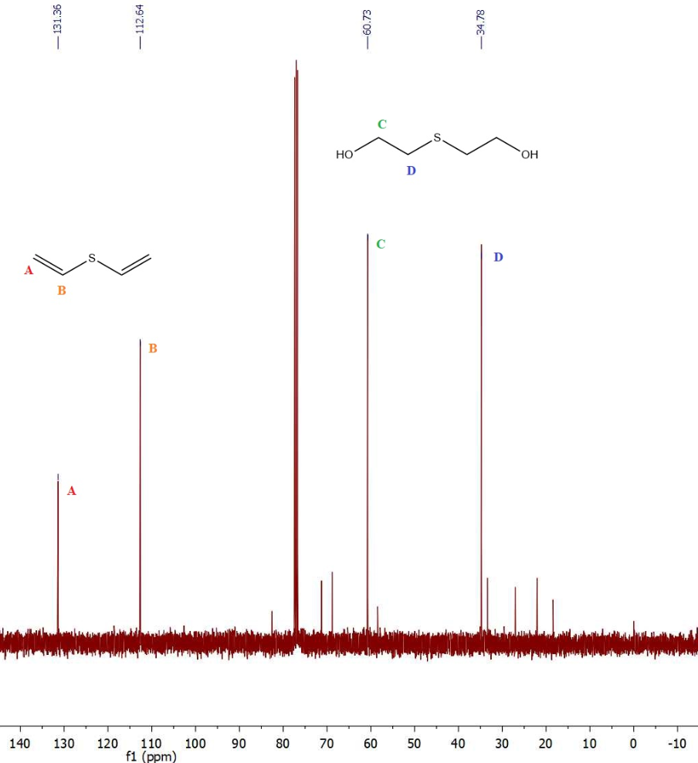
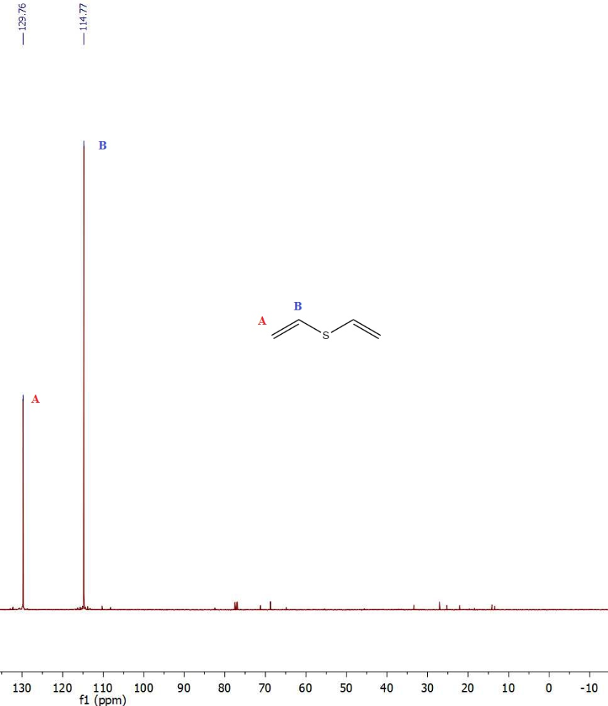
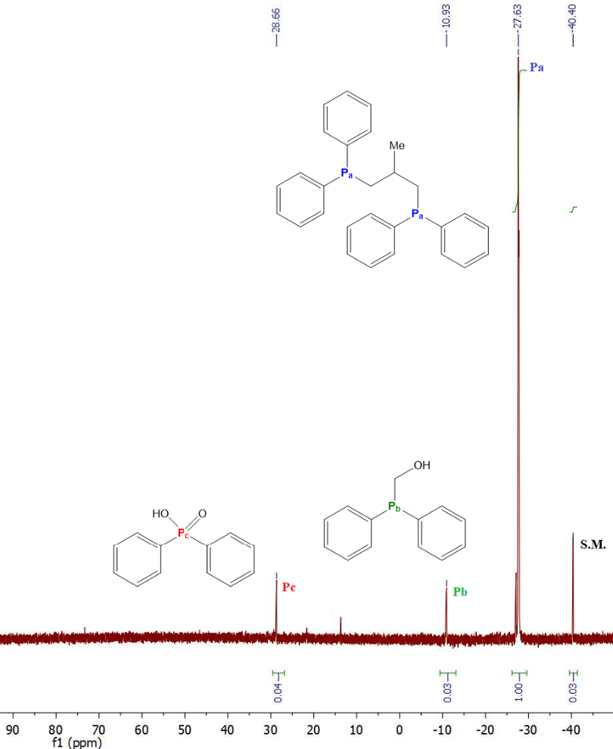
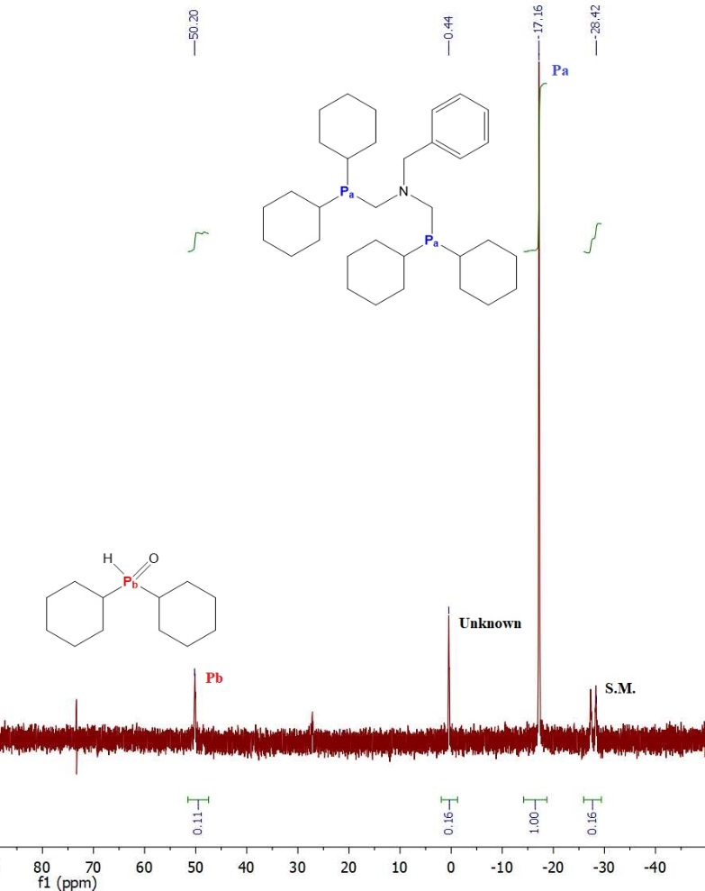
SYNTHESIS and FUNCTIONALIZATION of NOVEL MULTIDENTATE LIGANDS for CATALYSIS with CO₂ and ETHYLENE
SYNTHESIS and FUNCTIONALIZATION of NOVEL MULTIDENTATE LIGANDS for CATALYSIS with CO₂ and Ethylene
Matthew Reuter, Luke Fulton, Dr. Roy Planalp*
mbr2003@wildcats.unh.edu; Department of Chemistry, University of New Hampshire
INTRODUCTION
SPARTAN COMPUTATIONS OF PINCER LIGANDS
CONCLUSION
Nickel catalyzed carboxylation reactions are a promising pathway to afford acrylic acid from CO₂ and ethylene. However, the idealized “one-pot” does not work since the nickelalactone does not undergo a β-hydride elimination.¹
Initially we conducted Spartan computations on Group 16 based pincers, specifically oxygen and sulfur. We wanted to observe a pincer atom-nickel distance of 2.5 to 3.0 Å, which is indicative of an intramolecular interaction.
The pathways to produce PNP and P^{cy}N^{bz}P^{cy} were successful, with ³¹P NMR that corresponds favorably to literature sources. Initially, the elimination of DVS failed to produce either high-yielding or pure product, with subsequent experimental variations also failing. However, the isolation of DVS was ultimately successful with a NaOH/KOH mixture (1:3), with ¹H and ¹³C NMR comparing well to literature sources.
ONE-POT
ISOLATING DIVINYL SULFIDE AND PSP SYNTHESIS
FUTURE WORK
The ultimate end goal of this research is to release acrylates from a nickelalactone complex chelated to a pincer ligand. Acrylates are easily acidified to acrylic acid and are easily characterized via ¹H and ¹³C NMR. The short-term goal of this project is to chelate PNP, P^{cy}N^{bz}P^{cy}, and PSP to the nickelalactone for publication.
Figure 4. ¹³C NMR of DVS, showing a mixture of product, by-product, and starting material.
Figure 5. ¹³C NMR of DVS, showing significant isolation of product and minimization of starting material and by-product.
Figure 3. Synthetic Pathway to afford DVS and PSP.²
NITROGEN PINCER LIGANDS
NICKELALACTONE
Figure 10. Nickelalactone chelated to PNP, P^{cy}N^{bz}P^{cy}, and PSP, respectively.
Figure 1. The idealized one-pot of CO₂ and ethylene to afford acrylic acid. The introduction of CO₂ leads to the formation of the nickelalactone (Blue) in an oxidative coupling (A). The nickelalactone is supposedly to undergo a β-hydride elimination (B), followed by a reductive elimination (C), and finally a ligand exchange (D) that ultimately liberates acrylic acid (Red).
The ultimate goal of these syntheses is to produce a pincer ligand that has the potential to interact with nickel during this catalysis. However we wish produce the nickelalactone via other synthetic means to confirm that these ligands actually chelate to nickel.
Other goals within our spectrum are to substitute these three ligands with electron-donating or electron-withdrawing groups that may further promote push-pull catalysis between the pincer ligand and nickel.
REALITY
ACKNOWLEDGEMENT
I would like to thank Dr. Planalp for his insight and direction in this project. I would like to thank Annie and Scott Reuter as well as my fiancé Madison Murphy for their endless support throughout the years. I would like to acknowledge Luke Fulton for his guidance and knowledge on this project, as well as Brady Barron, Aaron Chung, and Evangelos Rossis. Finally, I would like to thank Dr. Berda and Dr. Greenslade for their professional counsel through the years.
Figure 6. Synthetic pathway and ³¹P NMR characterization of PNP.³
Figure 8. Synthesis to produce the nickelalactone chelated to TMEDA.
Figure 2. One-pot synthesis showing the use of a base (violet).
REFERENCES
GOAL
Huguet, N.; Jevtovikj, I.; Gordillo, A.; Lejkowski, M. L.; Lindner, R.; Bru, M.; Khalimon, A. Y.; Rominger, F.; Schunk, S. A.; Hofmann, P.; Limbach, M. Nickel-Catalyzed Direct Carboxylation of Olefins with CO2: One-Pot Synthesis of α,β-Unsaturated Carboxylic Acid Salts. Chem. Eur. J. 2014, 20, 16858 – 16862.
Persson, R.; Stchedroff, M. J.; Gobetto, R.; Carrano, C.J.; Richmond, M. G.; Monari, M.; Nordlander, E. Synthesis, Characterization, and Dynamic Behavior of Triosmium Clusters Containing the Tridentate Ligand {Ph₂PCH₂CH₂}₂S (PSP). Eur. J. Inorg. Chem. 2013, 2447 – 2459 .
Ezzaher, S.; Capon, J. F.; Gloaguen, F.; Petillon, F. Y.; Schollhammer, P.; Talarmin, J. Influence of a Pendant Amine in the Second Coordination Sphere on Proton Transfer at a Dissymmetrically Disubstituted Diiron System Related to the [2Fe]_{H} Subsite of [FeFe]H₂ase. Inorg. Chem., 2009, 48, 2 – 4.
Weiss, C. J.; Groves, A. N.; Mock, M. T.; Dougherty, W. G.; Kassel, W. S.; Helm, M. L.; DuBois, D. L.; Bullock, R. M. Synthesis and reactivity of molybdenum and tungsten bis(dinitrogen) complexes supported by diphosphine chelates containing pendant amines. Dalton Trans., 2012, 41, 4517 – 4529.
We chose to pursue pincer ligands, which retain central pincer atoms that have the potential to interact with the nickelalactone center and promote “push-pull” catalysis.
Figure 7. Synthetic pathway and ³¹P NMR characterization of P^{cy}N^{bz}P^{cy}.⁴
Figure 9. Synthetic routes to produce the nickelalactone chelated to the desired nitrogen-based ligands.

