Slide 1
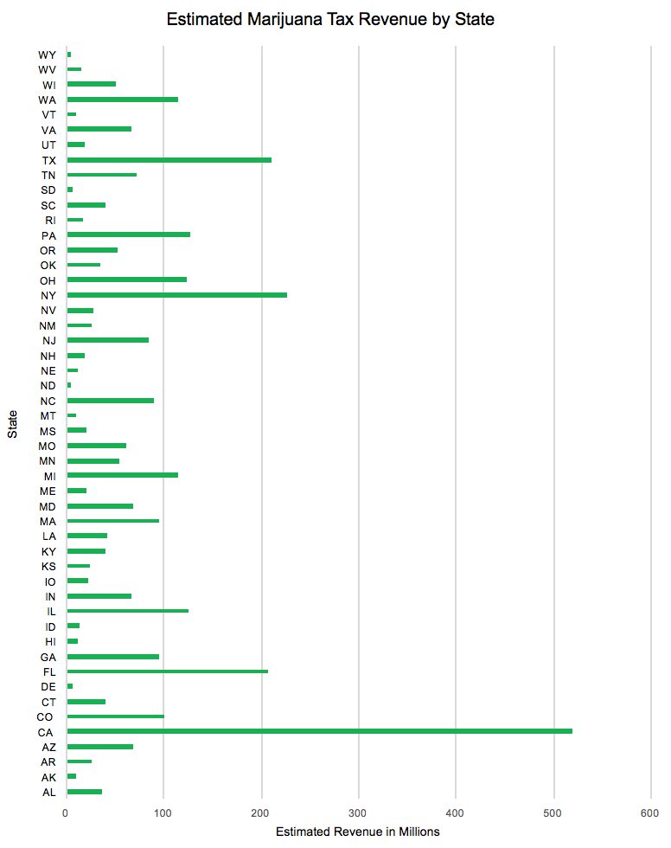
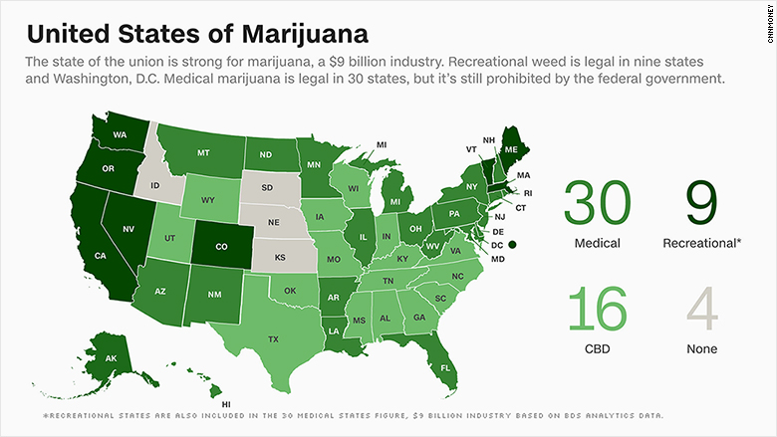
Impact of a Total Legalization of Marijuana on
State Tax Revenue in the United States
William T. Santora, B.S. Economics
Professor: Aziz Saglam
Research Question
Methodology
Results
What is the amount of state tax revenue that could be generated if every state in the U.S. was to legalize recreational marijuana?
State’s Market Size:
State/Local Average Sales Tax:
$3.3 billion in marijuana tax revenue was estimated to have been generated.
California generated the most revenue with estimated $518.7 million.
Wyoming was estimated to generate the least amount of marijuana tax revenue with $4.31 million.
The average annual state tax is $67.5 million.
% of marijuana users 18+ * state population 18+
total marijuana users 18+ in the U.S
Average of all local sales tax rates by zip code in addition to the state’s sales tax rate
Motivation:
The legal marijuana industry in the United States was estimated to be around $9 billion in 2017.
Total of $1.4 billion in state tax revenue in 2017.
Canada is expected to fully legalize recreational marijuana in July of 2018.
* $14 billion
State’s Marijuana Tax Rate:
State/Local average sales tax
+ est. 17% marijuana excise tax
State’s Marijuana Tax Revenue:
State’s Marijuana Tax Rate * State’s Market Size
Literature Review
Methodology is based on Jeff Morin’s Harvard study which conservatively
estimates the total U.S. marijuana market (legal & illegal) at $14 billion.
Issues with Taxing Marijuana at the State Level (2015), Richard Phillips
Taxing legal recreational marijuana too high creates incentives for people to use the black market.
Value based tax vs. per-unit excise tax.
Earmarking marijuana tax funds towards specific purposes such as education. (Colorado devotes the first $40 million in tax revenue towards school construction.)
Potential Tax Revenue from a Regulated Marijuana Market (1994), Michael Caputo & Brian Ostrom
A “phasing-in” approach, similar to federal regulators back when alcohol prohibition ended in the 1930s.
The question, "How much tax revenue will be generated?", is difficult to answer because no states have legalized and taxed recreational marijuana for a large amount of time.
The illegality of marijuana also adds to the difficulty because it makes it harder to collect data on current consumption of marijuana.
Marijuana Legalization and Taxes: Federal Revenue Impact (2016), Gavin Ekins & Joseph Henchman
Projects that, “A mature marijuana industry could generate up to $28 billion in tax revenues for federal, state, and local governments, including $7 billion in federal revenue: $5.5 billion from business taxes and $1.5 billion from income and payroll taxes.”.
Estimates that the total marijuana market in the U.S. is $45 billion (legal and illegal).
States with tax rates similar to Washington and Colorado could an increase of $13 billion in tax revenue per year, with an additional $5 billion from normal sales taxes.
Conclusion
Revenue from the legalization & taxation of marijuana is a large pool of money that is currently nonexistent in most states.
This potential income stream can be put towards a number of causes states such as:
  Education
  Infrastructure
  The war on hard drug usage
Policymakers must be aware that a tax rate which is too high will not be effective because it will incentive people to utilize the black market.
IBISWorld predicts that the legal marijuana industry will grow to over $21.8 billion by 2023.
Data
Substance Abuse and Mental Health Services Administration
Statistics by state for people older than 18 that have consumed marijuana in the past year.
The United States Census
State’s population data of 18+ year olds.
The Tax Foundation
State & local sales tax rates.
The 17% marijuana excise tax rate that was added in was a conservative estimate of
what states would likely add in addition to sales tax (i.e gas & cigarette tax).

