Slide 1


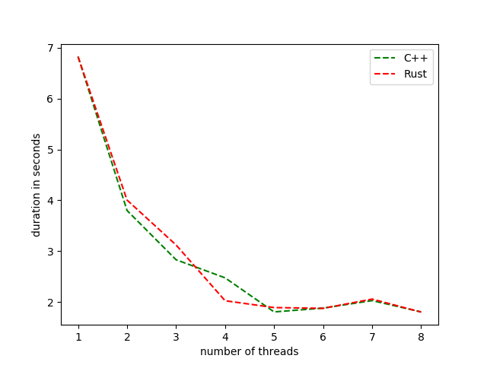
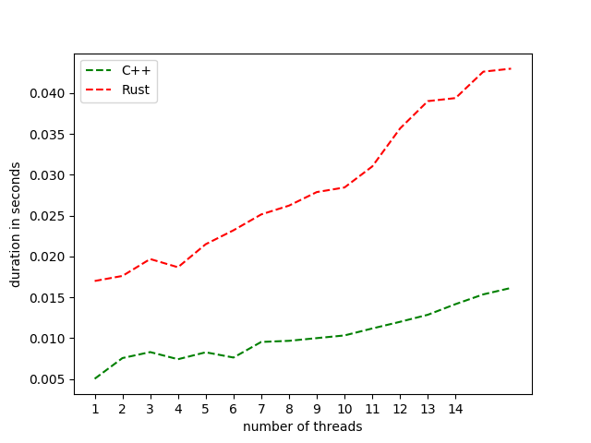
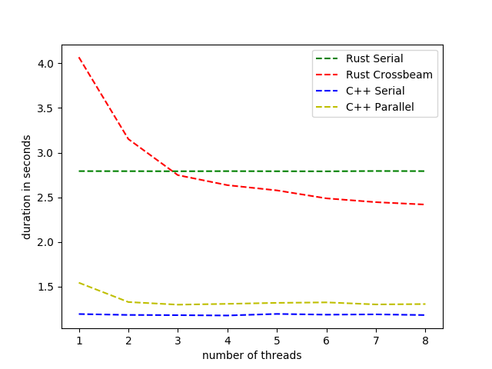
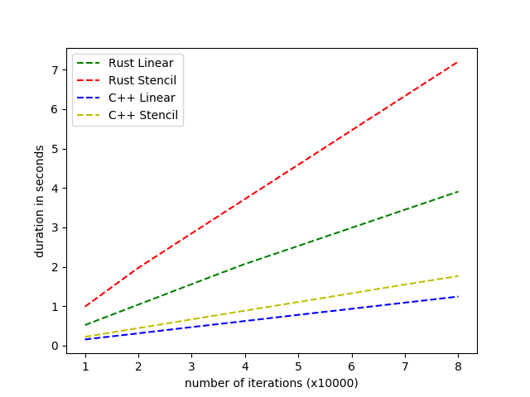
Evaluating Rust
Ethan Larkham & Todd Gaunt
Department of Computer Science, University of New Hampshire, Durham, NH 03824
Abstract
Objectives
Results
The purpose of this project was to compare Rust with C++. Rust was tested to see if it held up to its claims of being nearly as performant as C++, and if the language made writing safe programs easy. These tests and analysis were carried out using three small programs written at least twice in each Rust and C++. Each implementation attempted to use as similar an algorithm as possible to solve the problem at hand, and were used to benchmark performance.
Compare the performance of rustc and clang++ to see if rustc can generate programs as performant as clang++
Highlight the different capabilities of the languages objectively.
Analyze the data structures used by each compiler and compare the optimizations made when the performance difference between programs written in each language is not obvious.
Describe the experience of writing in each language. Does Rust make it easier to write safe code? Is C++ difficult to troubleshoot or develop with in comparison?
Rust tended to perform worse due to various limitations in the language
Found inability to create a mutable global 2D array in Rust necessitating the use of vectors, causing Jacobi’s poor performance
Pi digits performed comparably well in each language.
Wordfind had a near constant overhead, Rust performance was improved when words were shared in batches
For Jacobi, Rust parallel eventually was able to beat the Rust serial Jacobi, while C++ parallel performed worse than C++ serial
Vectors could not compete with arrays
Methodology
Graphs
Conclusions
Write three programs, “Pi-digits”, “Jacobi”, and “Wordfind” in each language with similar algorithms
Alternate which language each member writes in to allow each to gain experience with Rust
Objectively analyze program performance during runtime on a machine with no extraneous processes running
Subjectively remark and report on the ease-of-use of each language
Graph the performance of each program over an average of runs to reduce performance intermittent performance anomalies.
Pi Comparison (8 runs)
Wordfind Comparison (16 runs)
It appears from our results that Rust's "fearless concurrency" is at the cost of performance. At first glance Rust appeared to be an attractive more secure C++ alternative with better built in concurrency handling. Rust's "fearless concurrency" was attributed to its compiler's ability to detect threading errors without forcing the developer to test during runtime.
Rust's compiler features, while guaranteeing safety in a program, reject many correct programs which requires the developer to write around the language for certain algorithms. In order for the compiler to guarantee its safety, strict rules must be followed by the developer throughout the program. Programming in Rust can be a fight against the compiler when writing even trivial concurrent programs. This is also all at the cost of performance since, even without runtime checks, the safety guarantees often have overhead. In most programs benchmarked Rust performed noticeably worse. For a fast system language, Rust may not be a suitable replacement for C++.
T
Benchmarks
Jacobi Comparison (8 runs)
Serial 2D Vector and Array Comparison (8 runs)
“Pi-digits” is a concurrent implementation of using Riemann sums to compute the value of pi.
“Jacobi” runs the Jacobi temperature distribution algorithm concurrently by subdividing the array where the computation is being performed horizontally between threads. Implemented four times, in two different ways.
“Wordfind” utilizes a concurrent hashtable to find the largest word over 6 ASCII characters long in a given set of text files, usually books.
The serial 2D vector benchmarks were written to discover a potential reason for Jacobi’s poor performance in Rust.
Acknowledgements
Professor Philip J. Hatcher
Professor Collette Matthias Powers

Slide 2

This poster template provided courtesy of
UNH ESRC Poster Printing Services
Trust us to make your poster look GREAT!
Website: http://posters.unh.edu
Poster Guide: http://goo.gl/1E7TJY
DELETE THIS SLIDE BEFORE PRINTING

