Slide 1


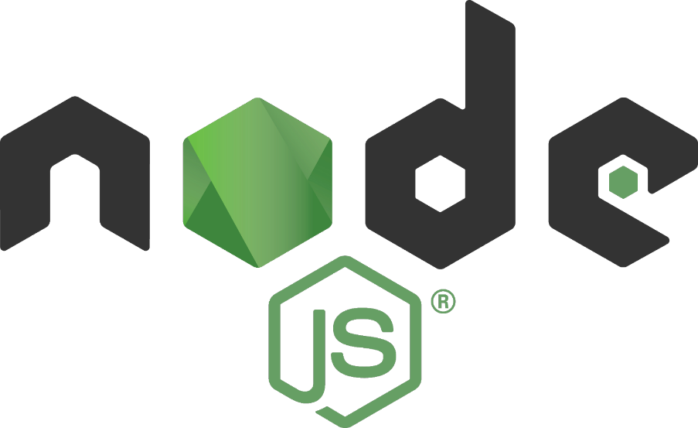

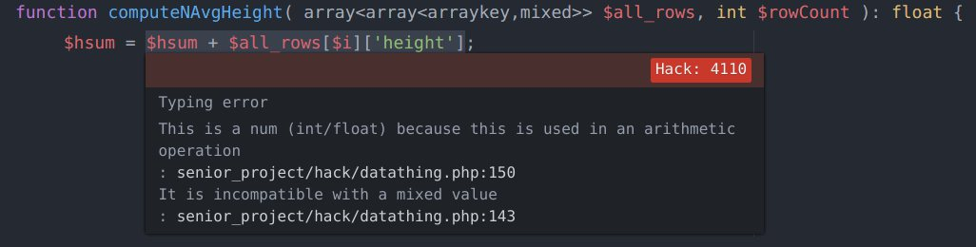

Evaluating Hack
Nikki Sloan and Cameron Smith
Advisor: Phil Hatcher
Hack reconciles the fast development cycle of a dynamically typed language with the discipline provided by static typing
Background
Hack is a language developed by Facebook as an extension to PHP. The primary change introduced is the idea of gradual typing. Gradual typing lets the user to specify types where they choose, then the Hack type checker uses those declarations to infer undeclared types.
Project Goals
Investigate Facebook’s claim that Hack successfully combines the benefits of both static and dynamic typing
Compare both the performance and ease of use of Hack to similar languages such as PHP and Node.js
Methods
Several programs were used to test the performance and ease of each language:
Database access
    String and integer computation
Array initialization and access time
BST allocation and deallocation
Initial Program
Retrieve all the rows from the database filled with Pokémon data and store into a local data structure.
Iterate through all the rows and compute the average height of the Pokémon.
Iterate through all the names, and compute how many times a letter appears.
Qualitative Analysis
Nuclide IDE
  Type hints not helpful and lead to complex type declarations
  Hard to install, poor Windows support
Addition of type declarations does improve code readability
Addition of Vectors improves usability
Conclusions
Gradual typing improves readability and ease of use, however no increase in performance was observed
PHP documentation not written with types in mind
Node outperforms both Hack and PHP

