Slide 1




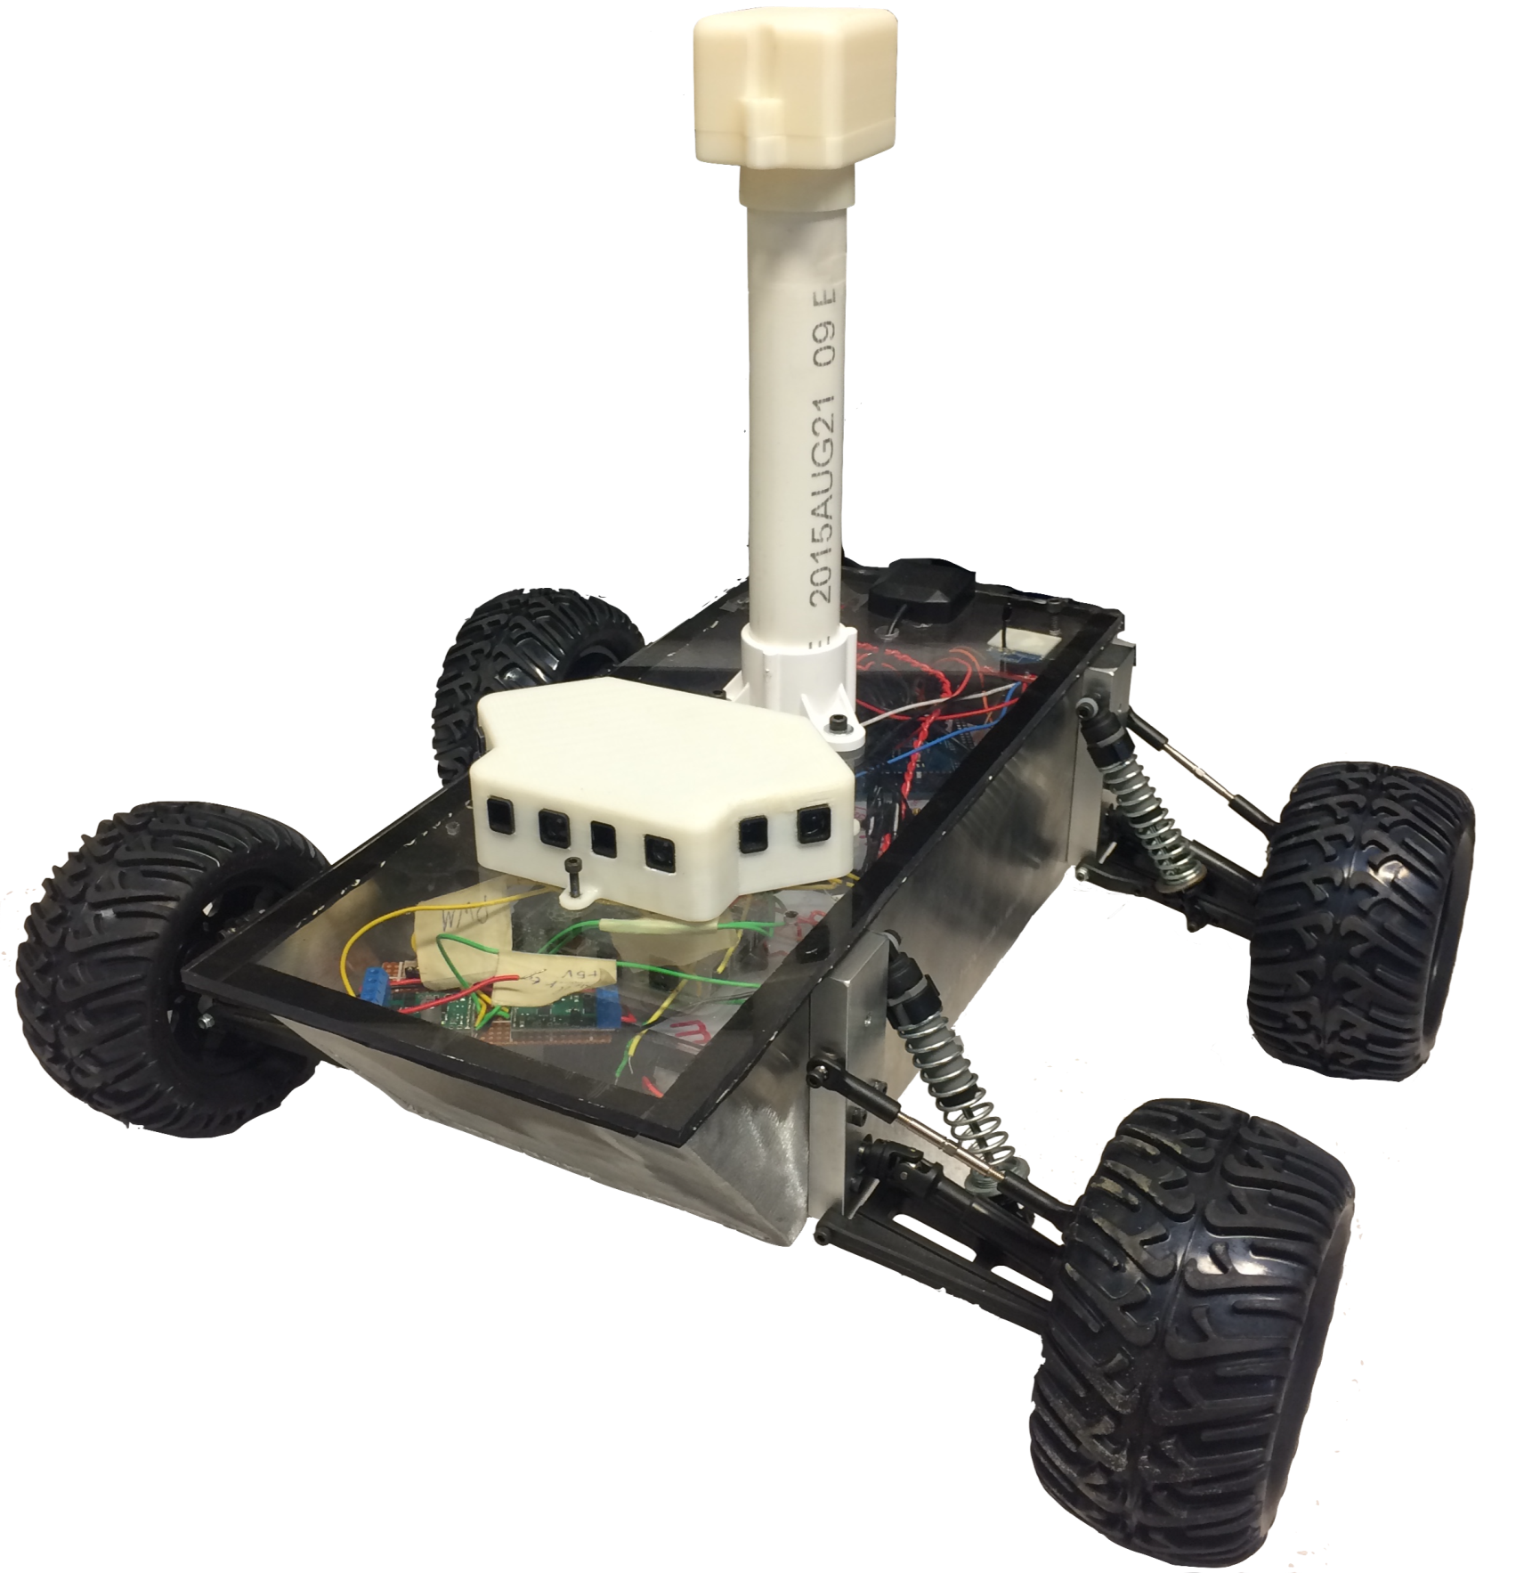
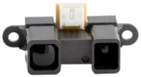
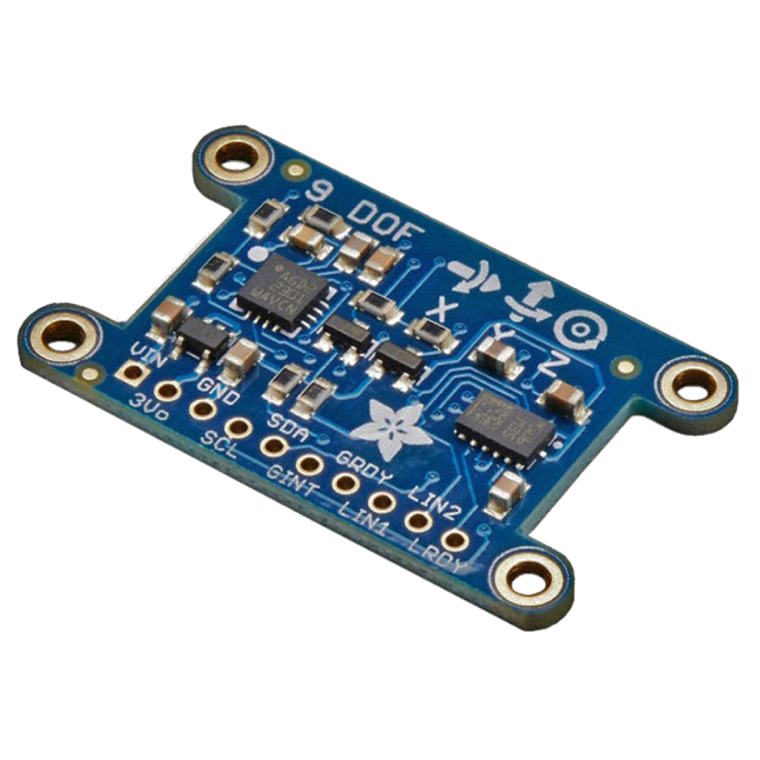
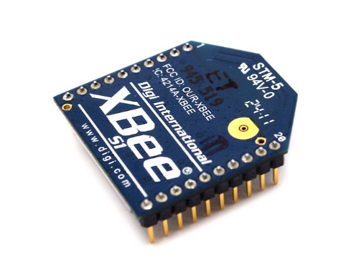
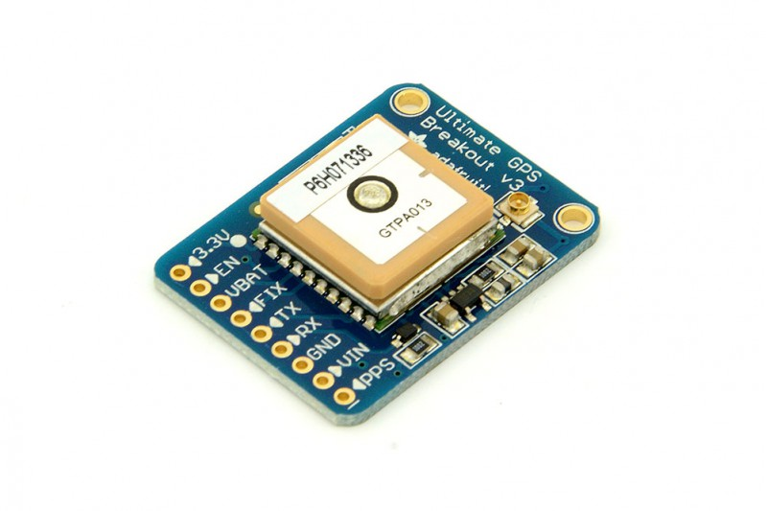
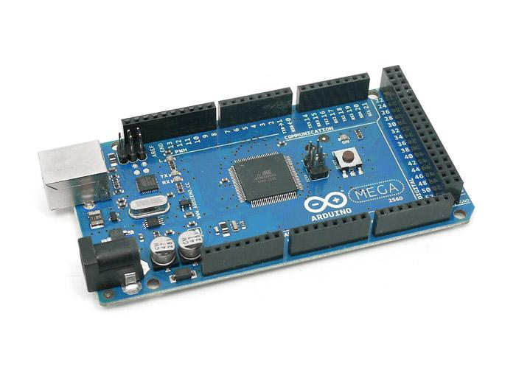
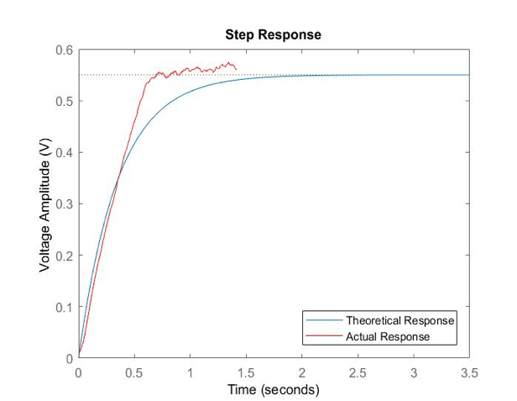
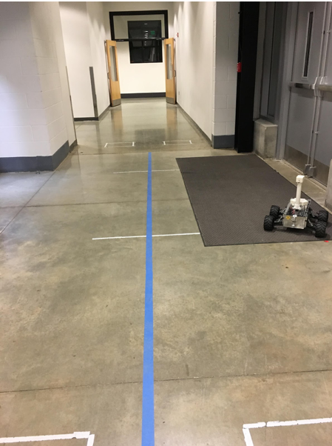
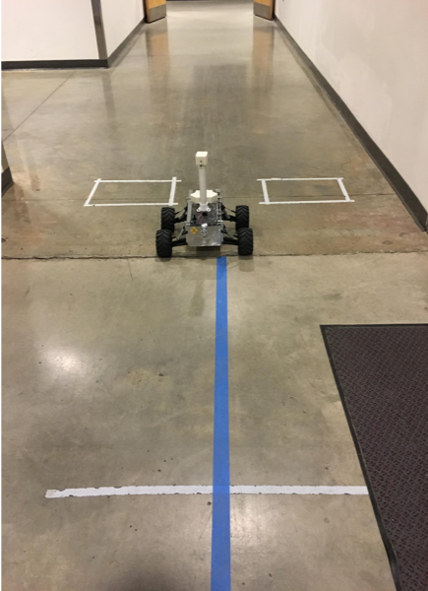
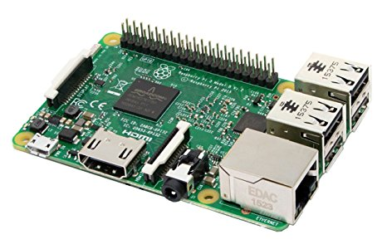
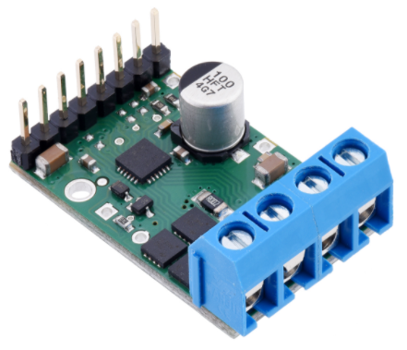
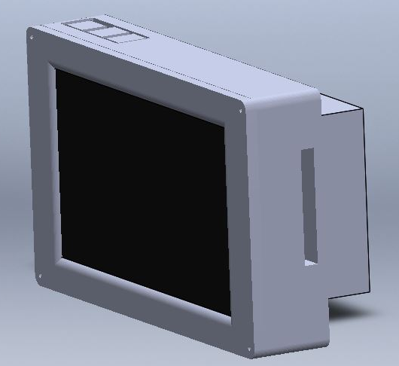
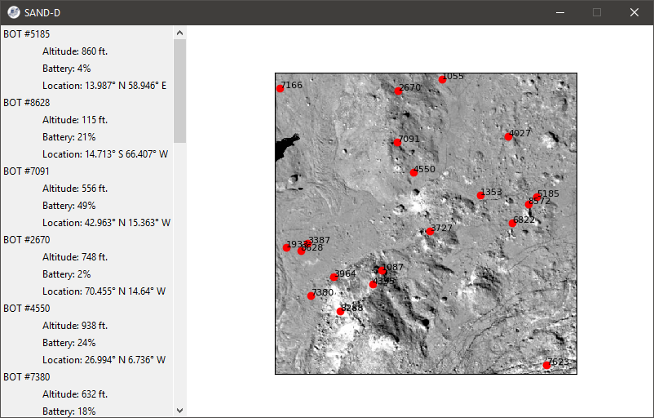
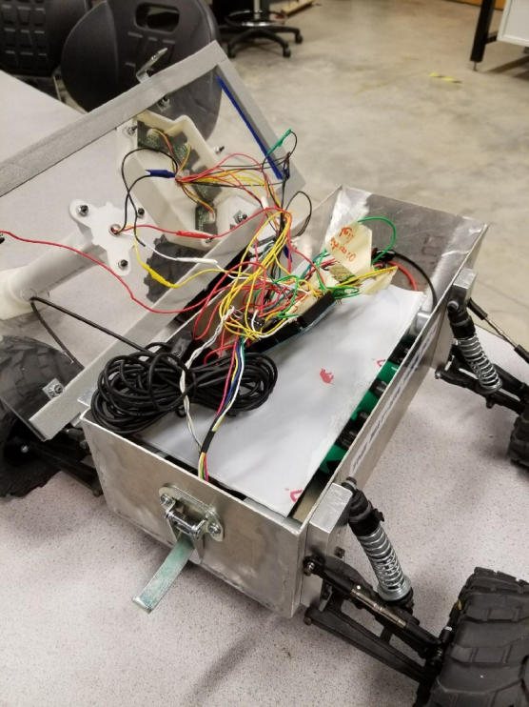
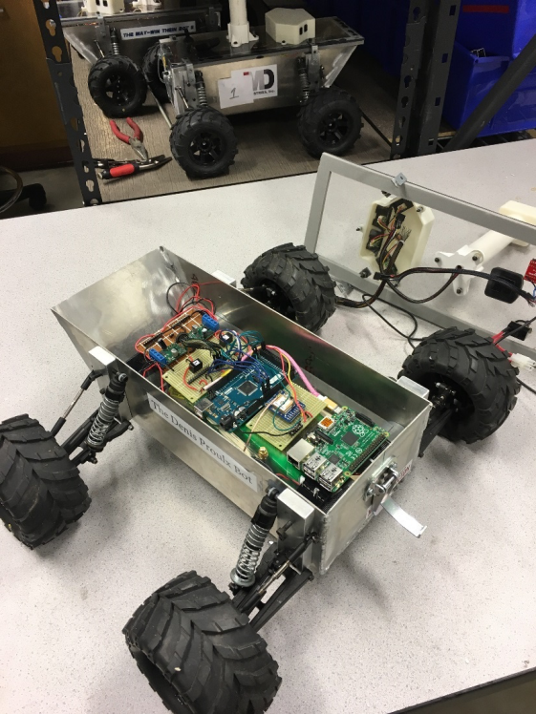
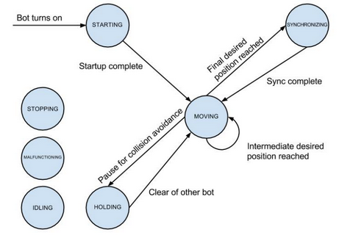
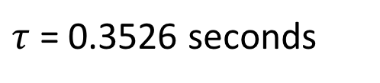
Advisors: Professor May-Win Thein,
John McCormack
Team Members : Jordan Bates, Jacob Branchaud, Andrew Dickson, James Holden, Ryan Nagelschmidt, Timothy Morales, Mohit Sagar, Shelby Strickland
Sensors and Electronics
Rover Specifications
IR Distance Sensors
Detects obstacles, provides 110 º field of view
Aluminum welded chassis
Water resistant
17” H x 18.5” W x 15” L
Dynamic suspension
Top speed: 2.5 mph
Total weight: 11.4 lbs
Inertial Measurement Unit (IMU)
Combination accelerometer, magnetometer, and gyroscope
Accurately determines roll, pitch and yaw of robot with 9 degrees of freedom
Particle Swarm Optimization Algorithm (PSO)
PSO utilizes mathematical principles to determine the most efficient movements to accomplish a common goal amongst the swarm. Derived from the behavior of nature’s swarms (birds, bees etc.), the algorithm operates without a centralized leader. Each robot communicates with one another and makes decisions based on shared information
XBee Wireless Transceiver
2.4 GHz transmitter/receiver used to wirelessly communicate data throughout the swarm
Global Positioning System (GPS)
Communicates with up to 22 satellites to determine the robot’s location in the coordinate system
Velocity Control
Arduino Mega Microcontroller
Analog and digital input/output pins read sensor data and perform various tasks
Sends sensor data to Raspberry Pi via serial communication for processing
$τ$ = 0.3526 seconds
Raspberry Pi Microprocessor
Main microcontroller for the Swarm
Uses sensor data and the PSO algorithm to select search points and plan path to destination
Mission: We aim to design, manufacture, and test a swarm of autonomous rovers to search an area for the highest and lowest elevation. The swarm serves as a test platform for the Particle Swarm Optimization Algorithm
Theoretical response vs actual response of PID controller implementation
Trajectory without PID controller implemented (left) vs trajectory with PID controller implemented (right)
Pololu 18v17 Pi Motor Controller
Uses pulse width modulation from Arduino to power motors
Each controller powers one side of the robot
Software and Controls
SAND-D
Internal Organization
Arduino code for optimization, organization, sensor processing, GPS waypoint navigation, and communication with Pi
Python code for Raspberry Pi to handle high level control, planning, and cross-swarm communication
Behavior modes for demonstration and testing purposes
Threading of Arduino with C Protothreads and interrupts
Basic bot to bot communication via Xbee
Arduino Mega (C/C++)
Raspberry Pi (Python)
GPS Waypoint Navigation
Arduino Interface
PSO Goal Calculation
Front View
Proposed UI
Swarm Autonomous Navigation and Diagnostic Display (SAND-D) is a handheld device that is used to consolidate and monitor information about the Swarm. It can display data the bots have collected, bot battery life, and the real time position of each bot
Obstacle Avoidance
Swarm Network
Before After
XBee Interface
Before, it was difficult to troubleshoot due to the disorganization of internal components
Wires would frequently come undone, and components were not modular
Added a power board so all components are powered through one main board
Internal components are modular and easily removed and troubleshot
Basic state machine diagram representing bot behavior at the highest level
Overview of connected software mechanisms

