Slide 1
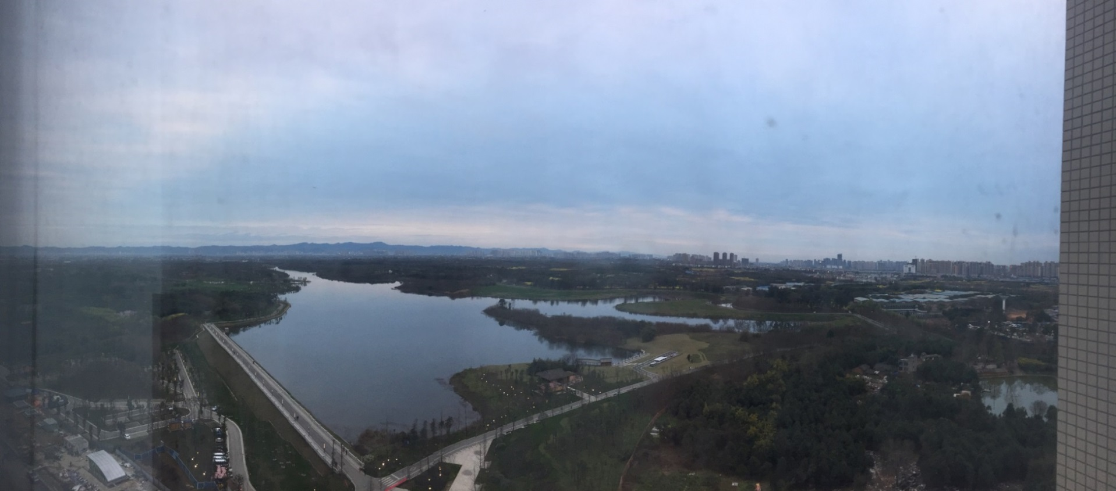
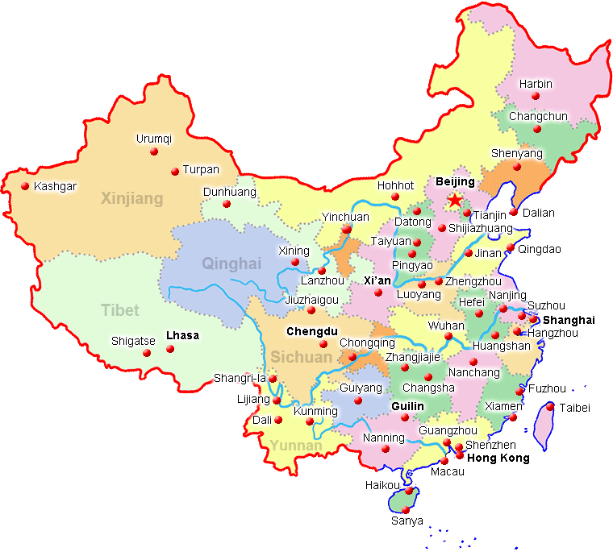
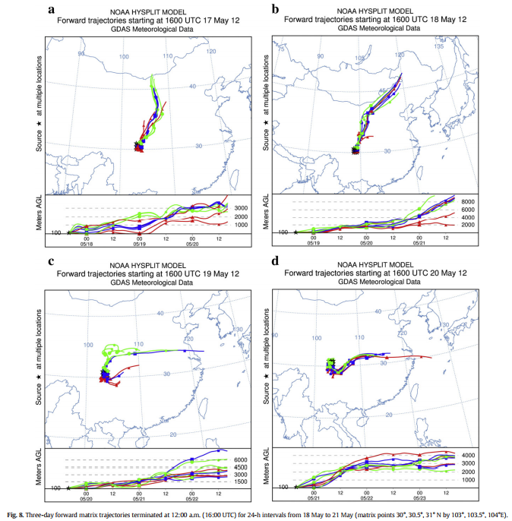

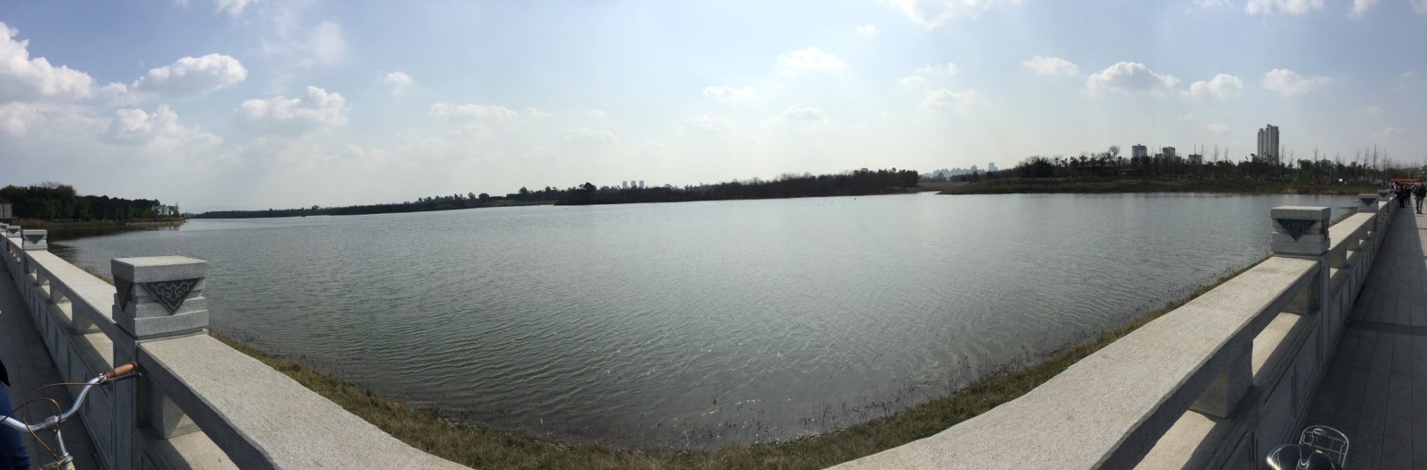

Air Pollution in Chengdu, China
Christine M. Aiello
Department of Geography
Introduction
Air pollution is often a result of burning fossil fuels which release gases, chemicals, and particulate matter (PM) into the atmosphere. If an area has high air pollution levels, these can spread to surrounding cities and create a nationwide problem. I conducted the research for the case study below during a semester abroad in Chengdu, China and in a Geography course in Political Ecology.
Case Study: Chengdu
On May 18-21, 2012, Chengdu experienced the heaviest and longest-lasting pollution event ever recorded. It was caused by stagnant dispersion conditions and enhanced PM_{2.5} emissions from biomass burning, including the harvest and consumption of agricultural residues for energy. At night, northwest winds brought more pollutants to urban regions from northern suburbs of Chengdu, where fire spots were observed. The Cheng-Yu region (Sichuan Basin), which covers 260,000 km² with low altitudes of about 500 m and surrounded by mountains and plateaus higher than 4 km, experienced low visibility and high PM levels. Burning was higher at night than in daytime because of less supervision and regulation, and farmers tend to straw during the day. The wind changed drastically over the three days of burning and pollution was carried
To Inner Mongolia (May 19)
East to Hubei, Henan, and Yangtze River Delta (May 20)
Southeast/East (May 21)
Air pollution can also contribute to water pollution. Several major cities in the Sichuan Basin, including Chengdu, are along the Minjiang and Yangtze Rivers. These rely on groundwater from shallow wells and springs. Poor air quality links cyclically to water pollution. Air pollution deposits sulfate on the ground, which pollutes water, and water purification generates more air pollution. This vicious cycle is a particular problem in upstream areas of the Minjian River.
Literature Review
Health impacts of air pollutants
Shanghai - Statistical analysis of PM₁₀, SO₂, NO₂, O₃ and health effects in 2001-2004:
Seasons: higher deaths, pollutant levels, and drier conditions in colder seasons (except O₃higher in warmer seasons)
Age: people ages 5-44 and 45-65 had no significant health effects from air pollution; people ages 65+ had significant levels of all four pollutants, ~2-5x higher than other age groups
Education: less educated people had higher death rate; NO₂ was significant for mortality
Hong Kong – Statistical analysis of NO₂, PM₁₀, O₃, and SO₂ and health effects in 1995-1998
46% of deaths caused by respiratory and circulatory disease
Ischaemic heart diseases significantly associated with all four pollutants
NO₂ and SO₂ significant in cardiovascular disease
O₃ and SO₂ significant in respiratory mortalities
NO₂ associated with Ischaemic heart disease
Relative risks of cardiovascular mortalities not significant among the four pollutants
Public Policy
Existing laws, regulations, and standards to reduce pollution:
National pollution monitoring established
National Ambient Air Quality Standards of 1996 for 10 pollutants
Standards on coal combustion and safety
SO₂ reduction in Sichuan
Vehicle emission standards, no leaded gas
128 environmental nongovernmental organizations in China as of 2004, 7 in the Jiangsu-Sichuan-Zhejiang area
Conclusion
After the burning of biomass in May 2012, there was a negative long-term effect on the city and the surrounding area. Results from the Shanghai and Hong Kong studies can be found in Chengdu with some variances because the climates are different. Water pollution will be on the rise since air pollution is one of the leading causes of water contamination. It is important to be concerned about the air pollution in China because if it gets worse, the pollution could spread to surrounding countries creating more problems. It will be interesting to see whether or not Chengdu will succeed in cleaning up their air pollution.
Resources
Chen, Y. and X. Shao-Dong. 2014. “Characteristics and Formation Mechanism of a Heavy Air Pollution Episode Caused by Biomass Burning in Chengdu, Southwest China.” Science of the Total Environment, 473-474, 507-517.
He, K. et al. 2002. “Urban Air Pollution in China: Current Status, Characteristics, and Progress.” Annual Review of Energy and the Environment, 27(1), 397-431.
Kan, H. et al. 2008. “Season, Sex, Age, and Education as Modifiers of the Effects of Outdoor Air Pollution on Daily Mortality in Shanghai, China.” Environmental Health Perspectives, 116(9), 1183–1188.
Li, X. et al. 2006. “Degradation of Groundwater Quality Due to Anthropogenic Sulfur and Nitrogen Contamination in the Sichuan Basin, China.” Geochemical Journal, 40(4), 309-332.

