Slide 1

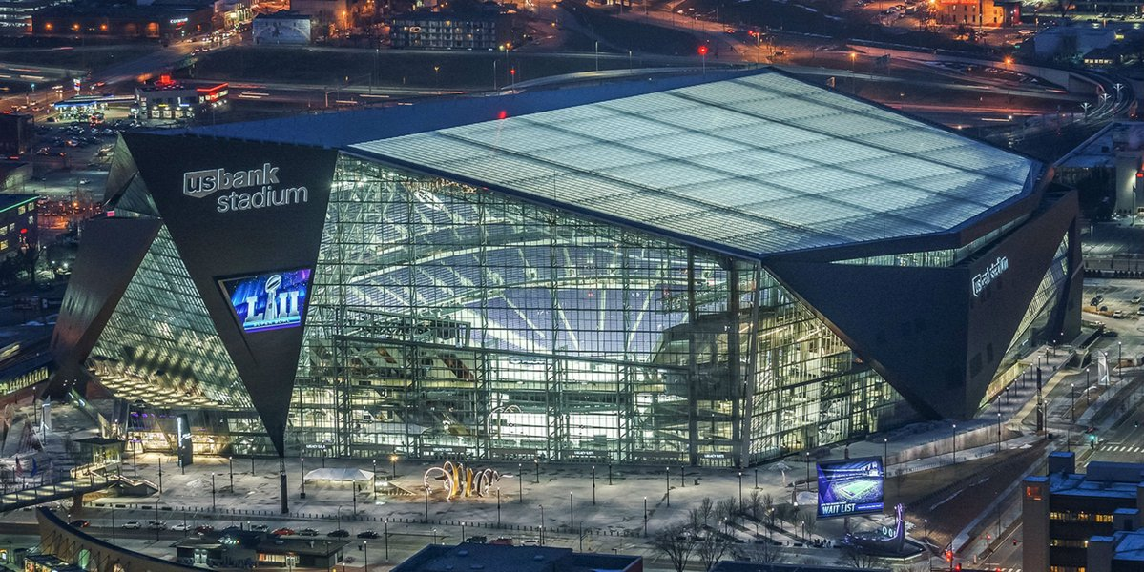
The Impact of Sports Stadiums On Local Economy
Ryan M. Buckley, B.S. Economics, Capstone
Professor: Aziz Saglam
Motivation and Question
Data and Methodology
Results
In recent years we have witnessed the construction of massive new sport stadiums, most of which have been publically financed.
Do cities truly benefit from these large investments?
What impact does building new professional sports stadiums have on personal income in metropolitan areas?
Do new stadiums have a positive or negative impact on local economy?
Multiple Linear Regression for cities with recent renovation or construction of sport stadiums
13 cities with new or renovated baseball or football stadiums
Metropolitan Statistical Area data – U.S. Bureau of Economic Analysis
  GDP per capita
  Population
Data from 2001 to 2016
Literature Review
“The Impact of Stadiums and Professional Sports on Metropolitan Area Development” 1990
Author: Robert A. Baade and Richard F. Dye - Lake Forest College
First to study the effects of MSA personal income and sport stadiums
Regressed data on 9 cities that had a baseball or football stadium built between 1965 and 1983
New professional baseball and football stadium development leads to possible negative impact on local economy
“Sports Facilities and Metropolitan Economic Development:
The Impact of Professional Sports Facilities on Sales Tax Revenue in Metropolitan Statistical Areas” 1997
Author: Michael A. Greenberg- Texas State University
Studied the effects of sales revenue in cities and new professional sport stadiums
Included cities with NBA arenas in addition to NFL and MLB stadiums
Found only one city where the addition of a sport stadium had a positive impact on sales revenue
Overall results showed new professional sports facilities had no significant impact on local area sales tax revenue
“The Economic Impact of Sports Stadiums: Recasting The Analysis In Context” 2001
Author: Charles Santo - Portland State University
Regressed similar model from Baade and Dye, with new MSA data
Looked at data from 19 cities that built baseball and football teams between 1984 and 2001, the years directly following the ones used by Baade and Dye
Found that cities with stadiums located in downtown or central city locations had an overall positive impact on personal income whereas cities with stadiums located in suburban areas, outside the city, had an overall negative impact on personal income
Overall evidence showed no significant impact of sports stadiums on metropolitan economy, contradicting Baade and Dye
Interpretation of Results
The construction or renovation of a football or baseball stadium will lead to a 0.11% decrease in GDP per capita
A 1% increase in population will lead to a 0.053% increase in GDP per capita
The effect of population on GDP per capita is statistically significant
The effect of construction or renovation of a football or baseball stadium is statistically significant
Model
Conclusions and Policy Implications
ln(Y_{i}) = β₀ + β₁(ln(POP)) + β₂(STAD) + β₃(REC) + β₄(TREND) + ε
Y_{i} : i^{th} MSA’s Per capita real GDP
POP : the MSA’s population
STAD : 0 before the MSA renovates or builds a baseball or football stadium; 1 after a stadium is renovated or built
REC : A recessionary variable. 1 for years 2008 and 2009 and 0 for all other years
TREND : a variable assigned a value of 1 for 2001 and increasing to 16 for 2016
ε : error term
My results show that renovation or construction of professional sports stadiums have a statistically significant negative impact on GDP per capita in metropolitan areas
It may not be beneficial to a city’s economy to publically finance construction of sports stadiums
The addition of low-wage jobs may be a possible explanation for the decrease in GDP per capita
Additional years of data will have to be looked at to determine the long-run effects of sports stadiums on metropolitan economies

