Slide 1


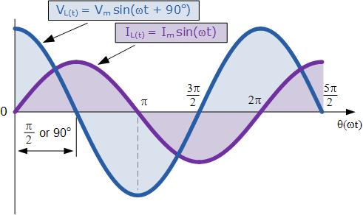
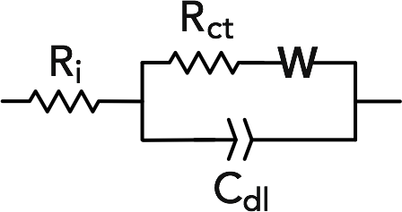
Detection of Beta Carotene and Lutein
Using Electrochemical Impedance Spectroscopy
Sabrina Marnoto and Jeffrey M. Halpern
Department of Chemical Engineering, University of New Hampshire
Introduction
Beta Carotene and Lutein
Carotenoids in the
Presence of each other
Cyclodextrin Modified
Antioxidants are found in vegetables and fruits
Antioxidants are beneficial to humans
Antioxidants correlate to various diseases
Carotenoids are hydrophobic antioxidants
Beta Carotene
Beta Carotene in Presence of 100nM Lutein
Beta Carotene
Carotenoids
Lutein
B-Carotene
Methods
Electrochemical Impedance Spectroscopy
Lutein
Lutein in Presence of 100nM Beta Carotene
Lutein
Opposition to the flow of electrons with alternating current
Fe^{3-/4-}(CN)₆ reaction is used to create electron transfer
20 mM Fe^{3-/4-}(CN)₆ in PBS with tween at pH 7.4
R_{CT} is found by fitting impedance data to Randles Circuit
http://www.electronics-tutorials.ws/accircuits/ac-inductance.html
http://pubs.rsc.org/en/content/articlehtml/2016/cc/c6cc01106c
Attachment of Beta Cyclodextrin
Hypothesis: Increases sensitivity of hydrophobic analytes
Cyclodextrin forms inclusion complexes
Conclusion
Future Work
Acknowledgements
Hernandez et al. 2014, Covalent modification of carbon surfaces with cyclodextrins by mediated oxidation of beta-cyclodextrin monoanions
Beta carotene and Lutein successfully detected using EIS
Carotenoids in presence of each other showed greater error
No significant difference between bare and unmodified electrode
Publish current data
Obtain triplicate data for modified experiments
Test carotenoids in the presence of each other using a modified electrode
Hamel Center for Undergraduate Research
College of Engineering and Physical Sciences
NSF CBET EAGER 163896
CIBBR NIH P20 GM113131
SEEDS Laboratory
Cycle
1
1
2
1
2
3
1.
2.
3.

