Slide 1
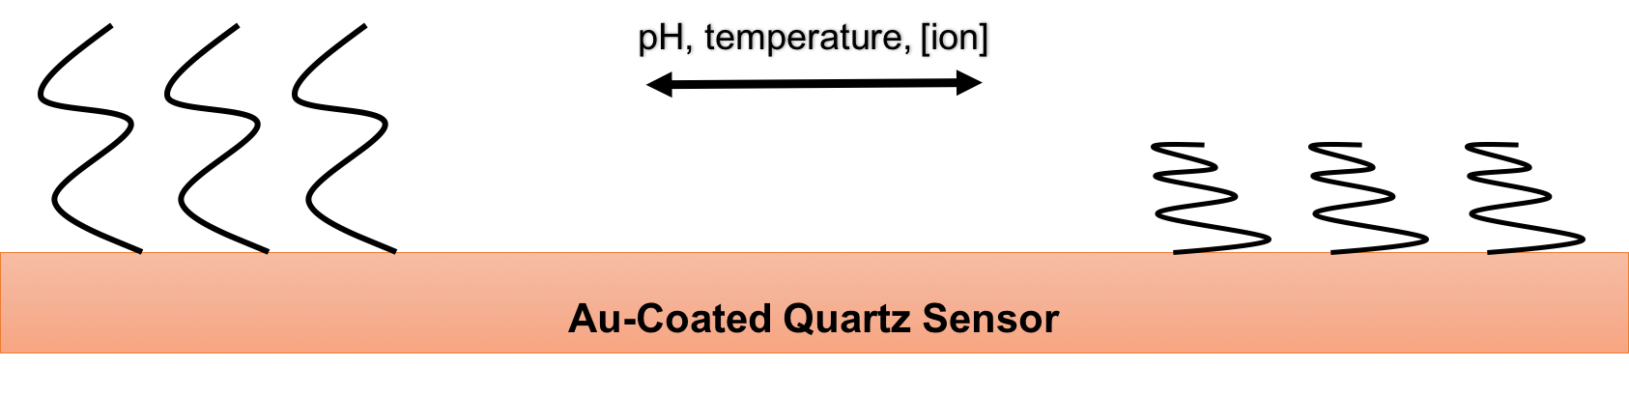
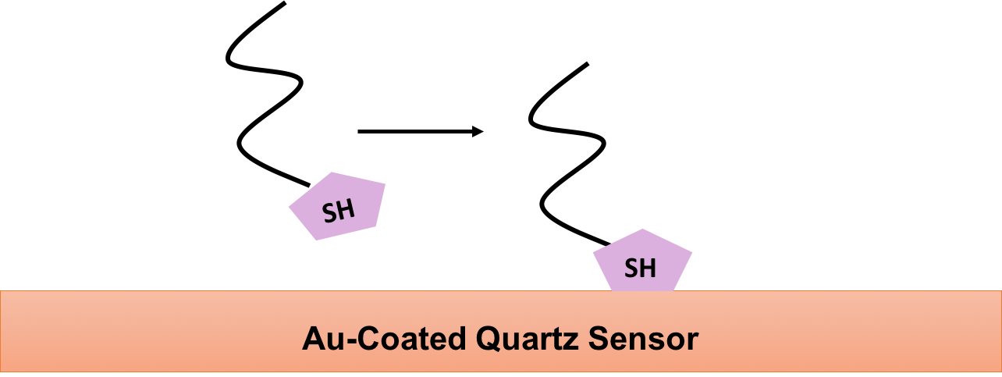
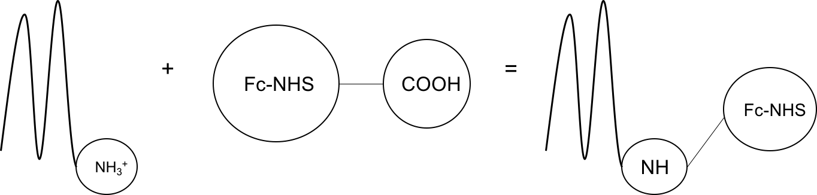
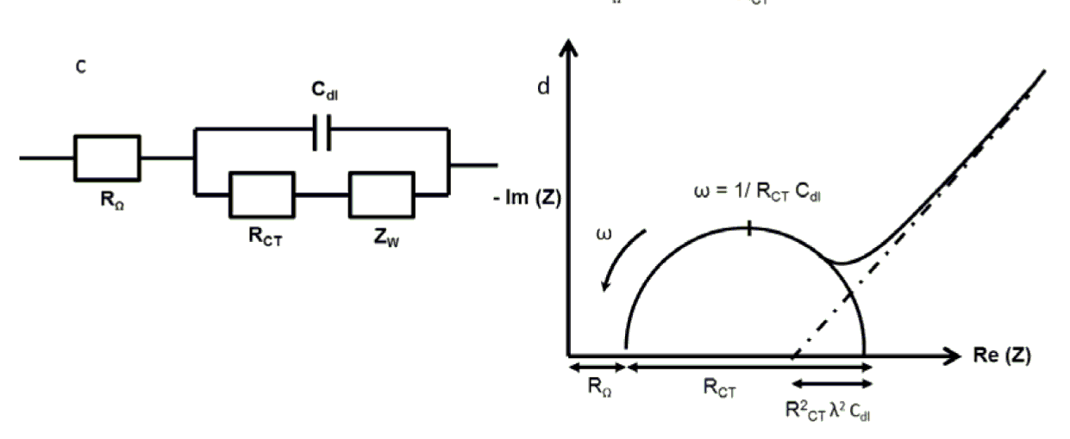
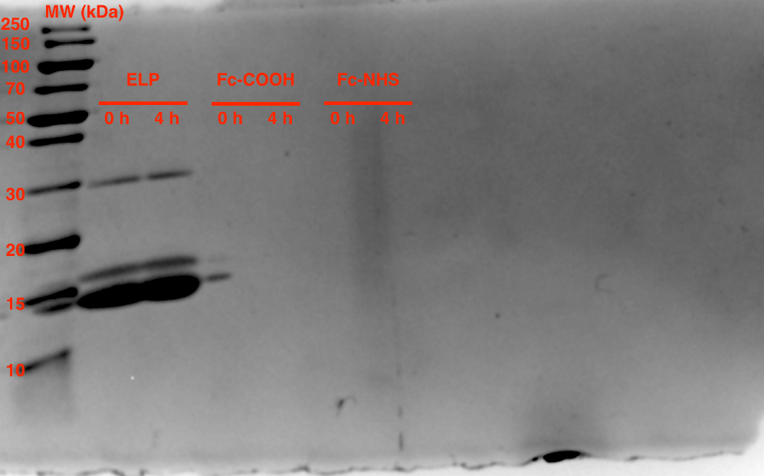
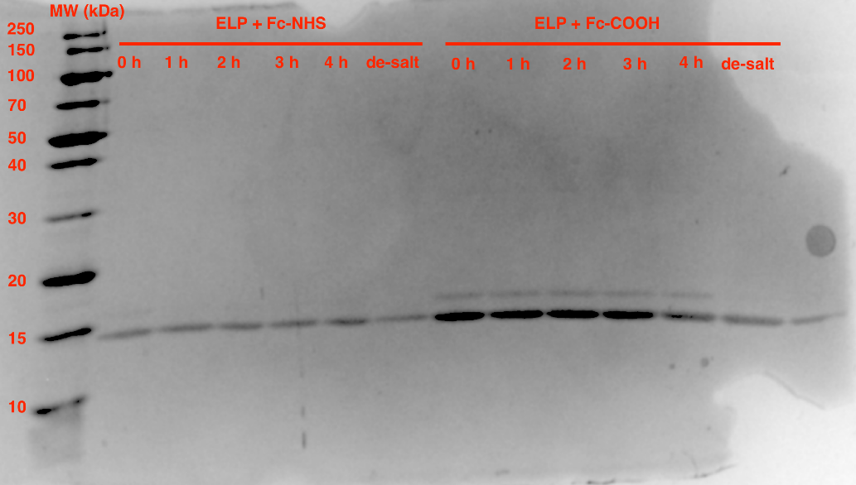
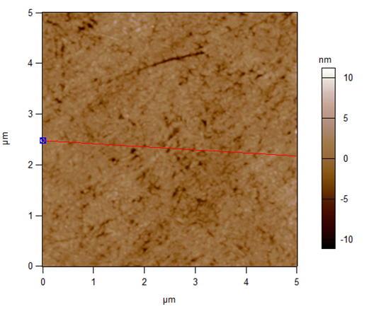
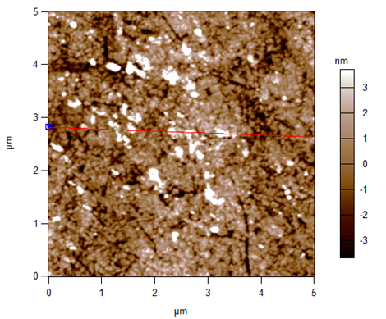
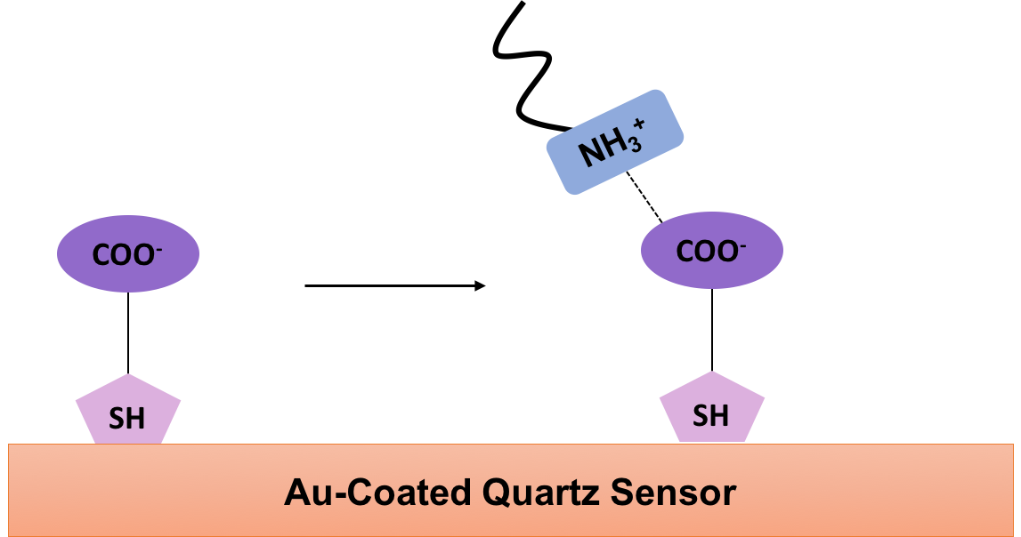
Troubleshooting the Electrochemical analysis of elastin-like polymers
Alexis F. Mack,ª Marissa Morales,^{b} Eva Rose M. Balog,^{c} and Jeffrey M. Halpern^{b} ªDepartment of Molecular, Cellular, and Biological Sciences, University of New Hampshire
^{b}Department of Chemical Engineering, University of New Hampshire
^{c}Department of Chemistry and Physics, University of New England
Introduction
Elastin-Like Polymers (ELP) are stimuli-responsive smart polymers
  Consist of a 25 amino acid penta-peptide repeat, VPGIG
  Not electrochemically active
  Two constructs
        K-ELP contains 3 lysine residues
        C-ELP contains a cysteine residue prior to repeats
  Undergo a characteristic transition based on the external environment
    pH, temperature, and ion concentration responsive
    Transition has yet to be monitored electrochemically
      Requires production of an electrochemically active polymer
      Or
      Use Electrochemical Impedance Spectroscopy (EIS)
        Eliminates need for producing an electrochemically active ELP
Bio-Conjugation Method
Thiol Attachment Method
EIS Method
  Ferrocene is a widely used electrochemical tag
    However, highly insoluble in H₂O
  Ferrocene-NHS ester- expected to covalently bond with the NH₃⁺ on K-ELP
    Ferrocene-NHS ester 10x excess to bind all NH₃⁺
    Excess ferrocene-NHS ester removed via desalting
  Expected Mechanism:
  Thiol Attachment Method leads to Covalent linkage between cysteine residue of C-ELP and Au surface
  TCEP- reducing agent used to prevent disulfide bridge formation
    Performed at 4°C to ensure C-ELP is in its elongated, monomeric form
Ferri/ferrocyanide solution (Fe²⁺/Fe³⁺) allows for electron transfer
  Electron transfer measured via EIS
Used C-ELP modified Au-coated quartz as sensor
  Ran a heat profile (4°C - 40°C) and cooling profile (40°C - 4°C)
C-ELP collapse in response to heating expected
  Collapsed ELP will impede electron transfer at the sensor surface
Analyzed using a Randles Circuit and Nyquist Plot
Bio-Conjugation Results
Thiol Attachment Results
https://www.omicsonline.org/JMBTimages/JMBT-S6-004-g002.html
EIS Results
Fig. 1. Gel electrophoresis results of the control bio-conjugation groups
Fig. 2. Gel electrophoresis results of the experimental bio-conjugation groups
Fig. 3. AFM analysis of a bare Au-coated quartz crystal
Fig. 4. AFM analysis of a C-ELP modified Au-coated quartz crystal
Fig. 5. Heating profile on a bare Au-coated quartz crystal
Fig. 6. Heating Profile on a C-ELP modified Au-coated quartz crystal
Bio-Conjugation Discussion
Thiol Attachment Discussion
EIS Discussion
Inability to solubilize conjugated ferrocene-NHS ester-K-ELP
  Inability to desalt conjugation because protein remained in desalting column
Inconclusive results on extent of conjugation due to solubility issues
  Addressed this by modifying a sensor for other electrochemical analyses
Sparse monolayer coverage of C-ELP
May be due to experiment duration
  Insufficient –SH contact with Au
Bare Au-coated quartz crystal R_{CT} change = ~250 Ω between 25°C - 50°C
C-ELP modified quartz crystal R_{CT} = ~550 Ω between 25°C - 50°C
Unsure of R_{CT} change implications
  Lack of uniform C-ELP coverage
  Temperature increase may be influencing the R_{CT}
Future Work
Acknowledgements
.
Bio-conjugation
Revisit potential electrochemical tags
  Must be soluble in H₂O
Amide Chemistry
Requires 11-mercaptoundecanoic acid to activate surface with carboxyl groups
Amide linkage between lysine residue on K-ELP and the carboxyl groups
SEEDS Laboratory
NSF CBET 1638896
UNH Student Chapter ASBMB
UNH Hamel Center for Undergraduate Research

