Slide 1

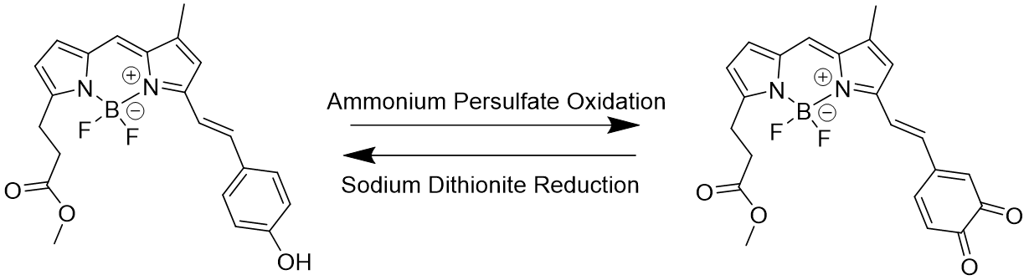
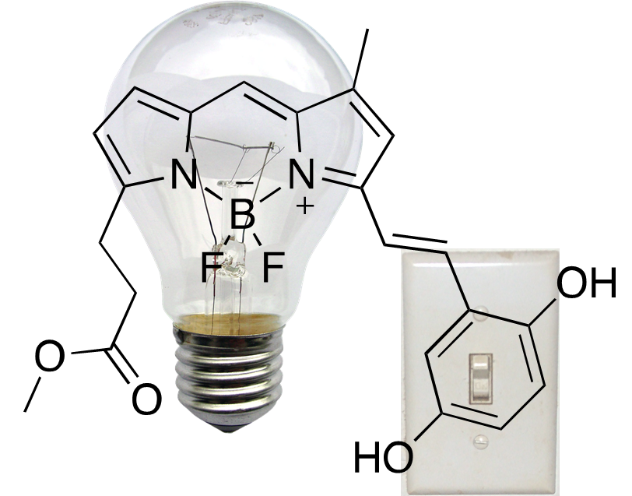
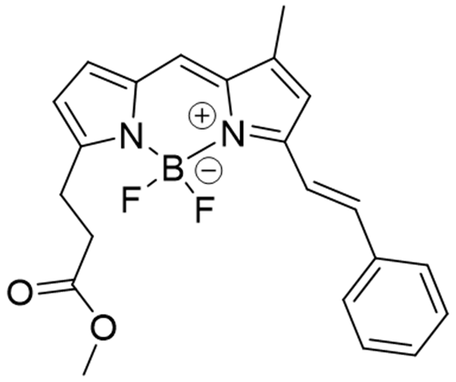
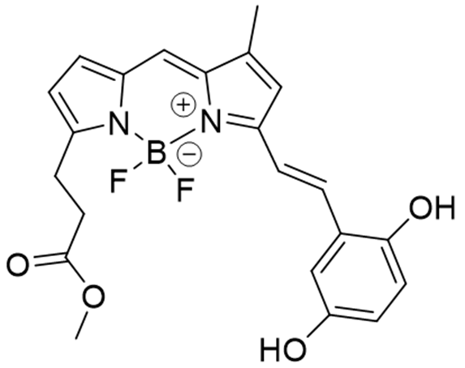
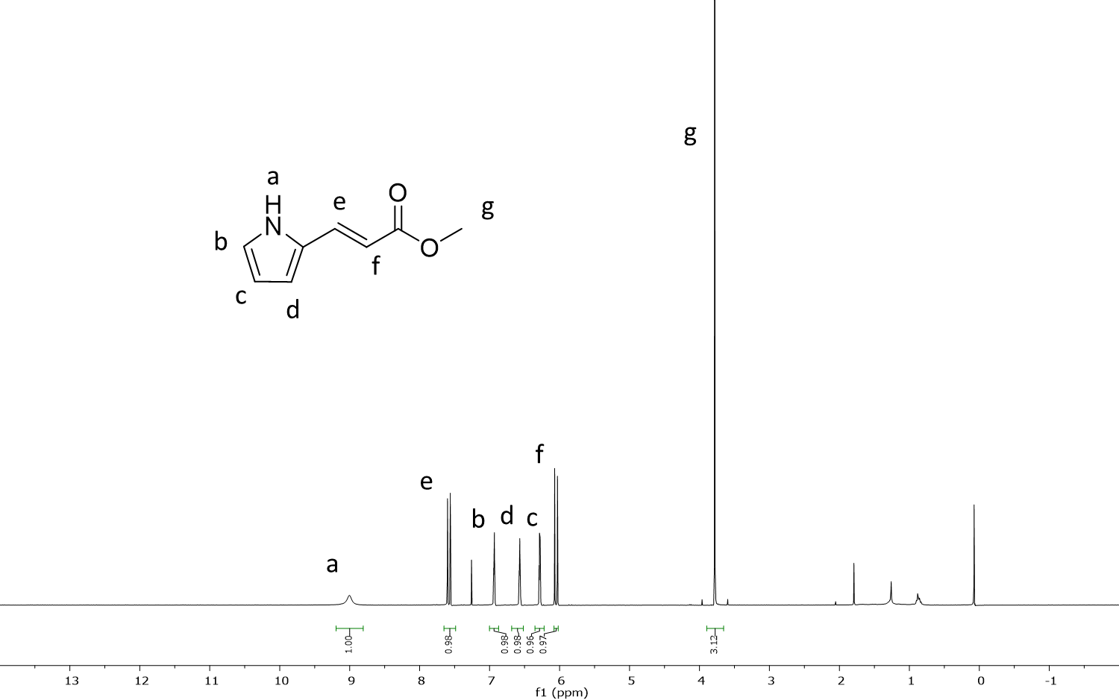
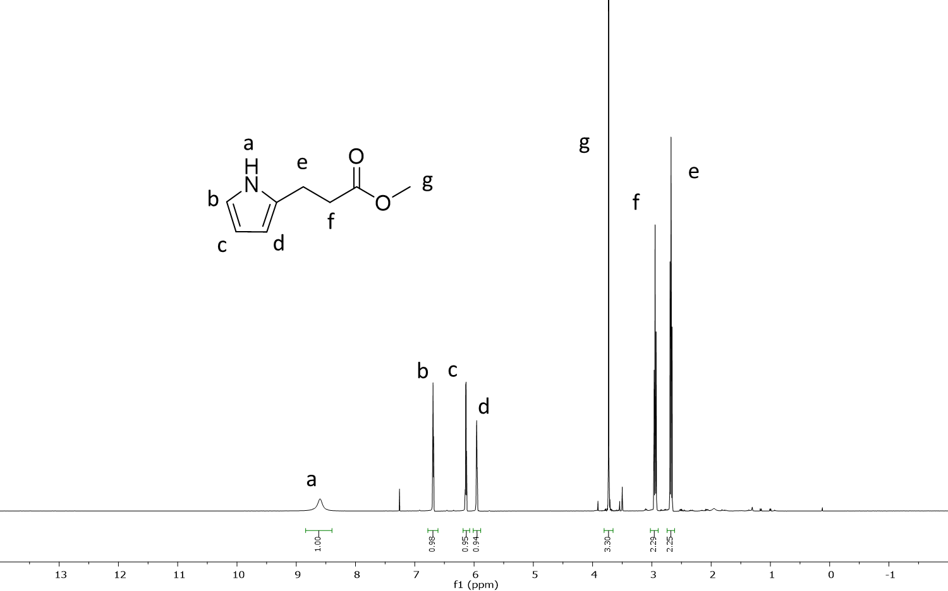
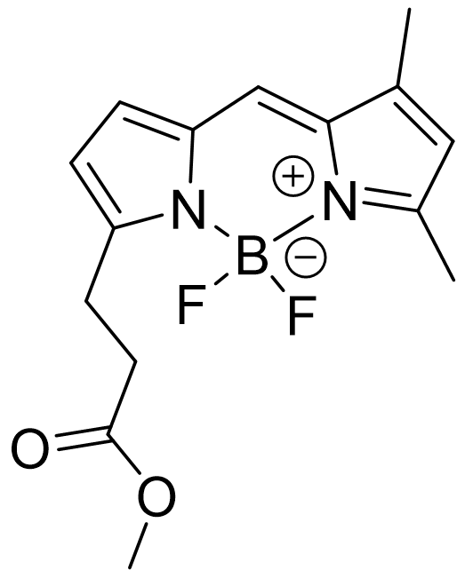
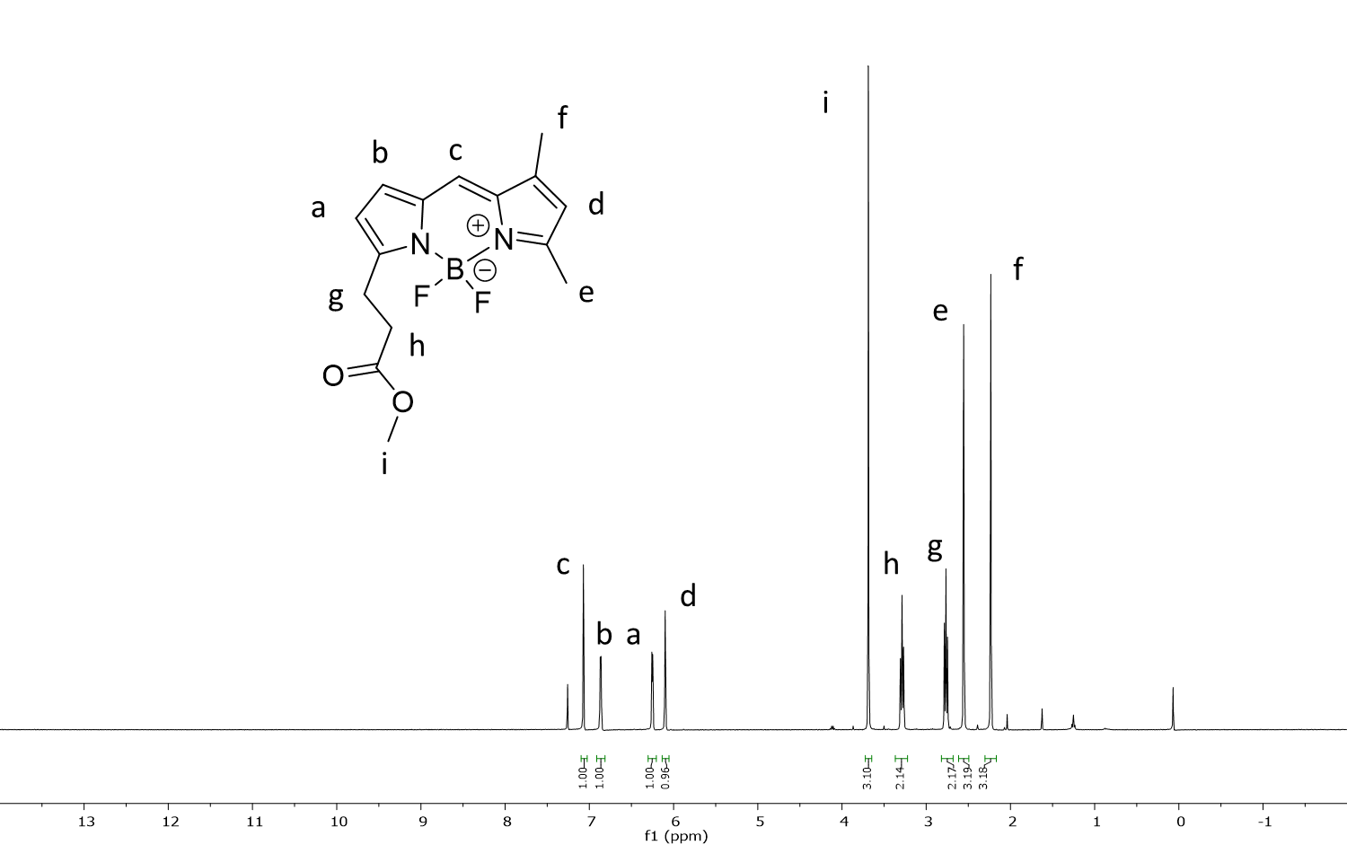
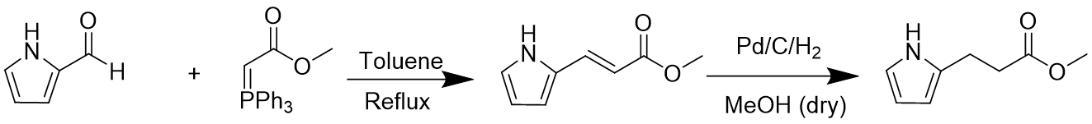
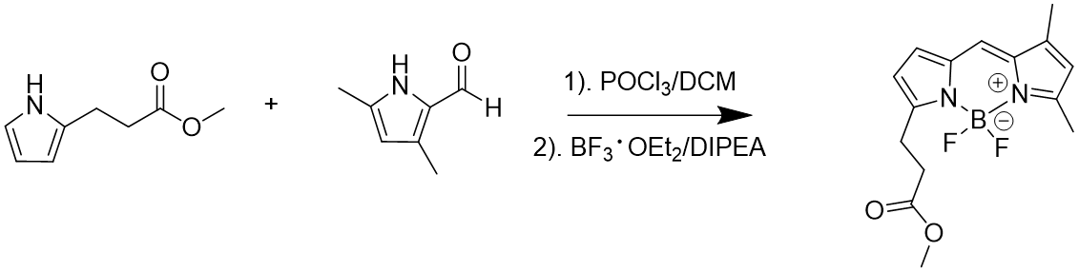
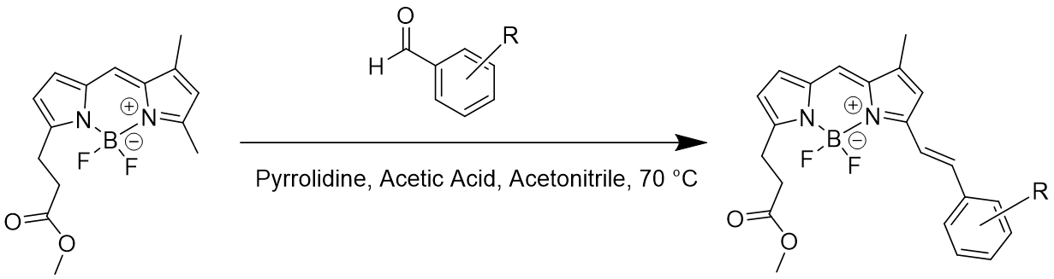
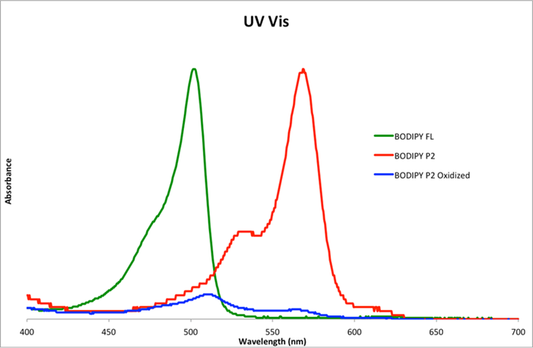
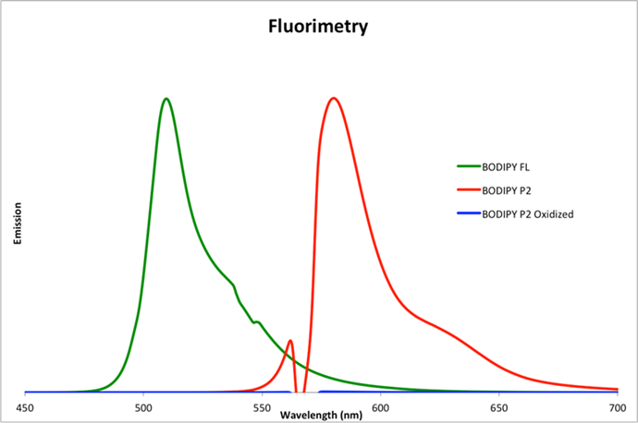


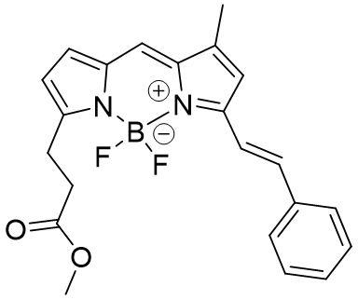
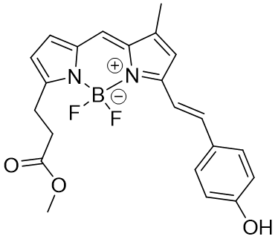
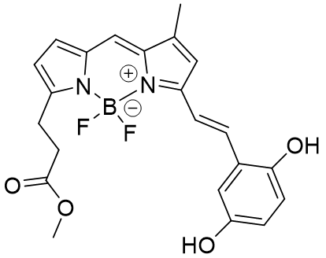
Synthesis of Functionalized BODIPY Dyes for Use as Fluorescent Probes
Joseph Mancinelli, Justin Cole, Ruiwen Chen, and Erik B. Berda. Department of Chemistry, University of New Hampshire. April 18th, 2018.
Introduction
Methods and Results
Future Work
  Reactions of atoms and molecules occur at scales substantially too small to visualize. Scanning electron microscopy and other high resolution visualization techniques have allowed the study of structures on the nanometer scale.¹ However, these techniques are unrealistic for biological and solution-based applications due to the conditions to which the samples are exposed. This research focuses on the synthesis of fluorescent dyes with a redox-active pendant groups that modulate fluorescence. These dyes can be used to visualize chemical processes on the single molecule scale.^{2,3,4} The dyes chosen were BODIPY dyes which are known for their high UV extinctions, sharp fluorescence peaks, and ease of synthesis.^{5,6} The structure of these dyes (Figure 1) allows for easy tunability at any of the numbered sites on the BODIPY core. The BODIPY targeted in this project was BODIPY-FL, a well-known dye containing desired functionalities (Figure 2).
  The future of this project will consist of continued synthesis of the precursor dye, BODIPY-FL. After further isolation of BODIPY-FL, Knoevenagel condensation will continue to be used to synthesize the remaining redox active dyes BODIPY-S2 (Figure 11) and BODIPY-Q2 (Figure 12).
Scheme 2. Proposed redox chemistry to alter fluorescence.
Figure 4. Real-world visualization of target dyes.
Figure 11: BODIPY-S2.
Figure 12: BODIPY-Q2.
Upon isolation of BODIPY-S2 and BODIPY-Q2, continued UV-Vis and fluorimetry studies will be used to study the effect on fluorescence of the oxidation and reduction of the pendant groups.
Figure 5: ¹H NMR of product formed after Wittig reaction.
Figure 6: ¹H NMR of product formed after hydrogenation.
Summary and Conclusions
Figure 1. Classic BODIPY core
Figure 2. Target BODIPY-FL
Successful synthesis of each product in the BODIPY-FL scheme was proven using ¹H NMR, and each product was isolated in considerable yield. One of the target redox-active dyes, BODIPY-P2 was also isolated. The yield for this was low due to the scale of the reaction being 100 milligrams. BODIPY-P2 dye exhibited sharp fluorescence peaks, and upon oxidation of the pendant group, the fluorescence was turned off. However, subsequent reduction of the dye yielded an insoluble material, and it could not be determined if fluorescence was re-established.
The goal of this project was to isolate and modify BODIPY-FL with redox-active functionalities (Figure 3) and study the variation of fluorescence. After proof of concept, the BODIPY dye will be attached to a polymer for further use as a probe.
Synthetic Route
84%
Quantitative
Figure 7: ¹H NMR of isolated BODIPY-FL.
Figure 8: ¹H NMR of isolated BODIPY-P2.
Acknowledgements
37%
The author would like to thank the Army Research Office for support through award W911NF-14-1-0177, and NIST for support through award 70NANB15H060 as well as Dr. Erik Berda, Dr. Justin Cole, and Ruiwen Chen for their help and support on the project, the UNH Chemistry Department, and the Instrumentation Center.
Scheme 1. Proposed synthesis to functionalized BODIPY.
References
Iwata, K.; Yamazaki, S.; Mutombo, P.; Hapala, P.; Ondráček, M.; Jelínek, P.; Sugimoto, Y. Nature Communications, 2015, 6, 7766.
Oleynik, P.; Ishihara, Y.; Cosa, G. J. Am. Chem. Soc., 2007, 129, 1842-1843.
Belzile, M.-N.; Godin, R.; Durantini, A. M.; Cosa, G. J. Am. Chem. Soc., 2016, 138, 16388-16397.
Gidi, Y.; Götte, M.; Cosa, G. J. Phys. Chem B, 2017, 121, 2039-2048
Loudet, A.; Burgess, K. Chemical Reviews, 2007, 107, 4891-4932.
Ulrich, G.; Ziessel, R.; Harriman, A. Angewandte Chemie International Edition, 2008, 47, 1184-1201.
Figure 3. Targeted BODIPY dyes: S2, P2, and Q2 (left to right).
Figure 9: UV-Vis study of isolated BODIPY-P2.
Figure 10: Fluorimetry study of BODIPY-P2.

