Slide 1

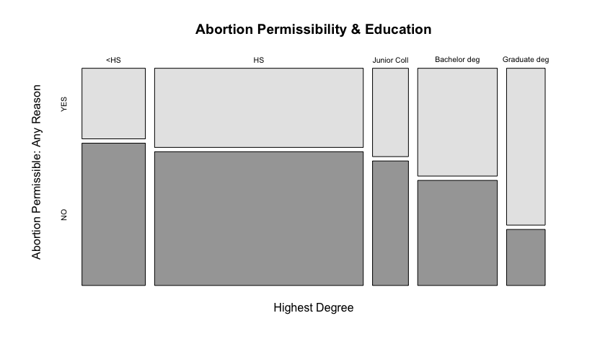
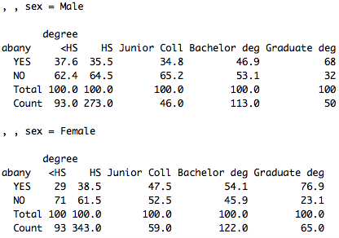
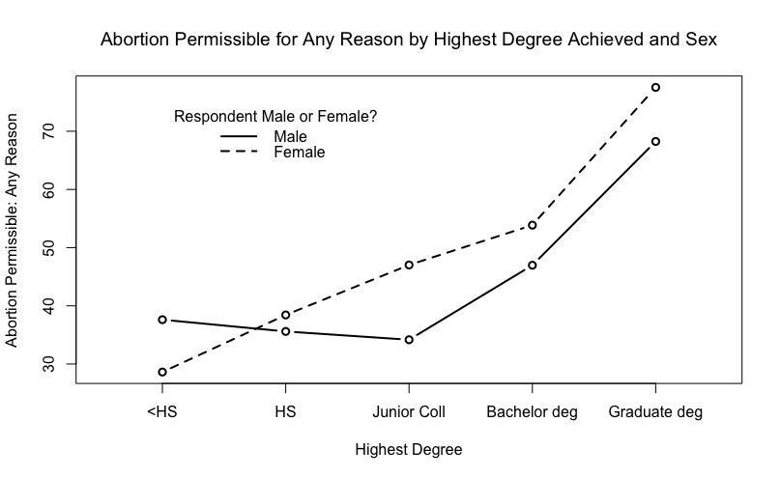
The More You Know, Comparing Education Levels and
Permissibility of Abortion For Any Reason
Elizabeth Pardy
Department of Political Science
Introduction
Results
Discussion
There are many influential factors that affect an individual’s views towards abortion. This study looks at the relationship between increased education levels of individuals and the increased chances they would be accepting of abortion for any reason. As suggested by Marsiglio and Shehan, obtaining higher degrees of education increases exposure to new perspectives as well as departure from traditional familial norms.
Research Question: Does an individual’s chance of accepting abortions obtained for any reason increase as their education level increases? And if so, is the chance greater among women or among men?
Education Level and its Effects on Permissibility of Abortion Among Males and Females
By running a cross-tabulation, the permissibility of abortion for any reason increased from those obtaining less than a high school education to those with graduate degrees by 22% from 62%-84%.
P-value: 2e-13***
P-value less than 0.05% = statistically significant.
When controlled for sex, the relationship between increasing education and abortion permissibility was consistent however, much higher for women (~48% increase) than for men (30.4% increase).
P-value for men: 0.005835***
P-value for women: 1.382e-07***
P-value less than 0.05% = statistically significant.
Further Questions:
Is the increase among women based on what they are learning or changing lifestyles with a focus on their lives without children?
What about junior college makes it stray from the consistent trend?
Hypotheses
Hypothesis 1: In a comparison of individuals, those having higher levels of education will be more permissible of women obtaining an abortion for any reason.
Hypothesis 2: In a comparison of individuals, females having higher education will be more permissible of women obtaining an abortion for any reason than men with higher education.
Data & Methods
My data comes from the 2012 General Social Survey, a random sample of 1,974 adults, 18 years and older. The study was conducted by the National Opinion Research Center. Variables were analyzed in Rstudio.
Variables:
Abortion Permissible: Woman Wants For Any Reason
Respondent’s Highest Degree
Respondent’s Sex
Tests Used:
Cross tabulation of abortion permissibility and education level, then controlled for sex.
Chi-squared test to analyze p-values for determining statistical significance.
References
1. Edwards, B. C., Pollock III, P. H. (2018). An R Companion to Political Analysis. New York, NY. Sage Publications.
2. Jensen, R. E. (2007) Using Science to Argue for Sexual Education in U.S. Public Schools: Dr. Ella Flagg Young and the 1913 “Chicago Experiment”. Retrieved from Sage Publication Journals.
3. Marsiglio, W., Shehan, C. L., (1993) Adolescent Males’ Abortion Attitudes: Data from a National Survey. Retrieved from JSTOR.
4. Rinderknecht, L. (2006) Supporting Attitudes on Abortion With the Influence of Education. Retrieved from Oregonstate.edu.
      For more information: erp1006@wildcats.unh.edu

