Slide 1
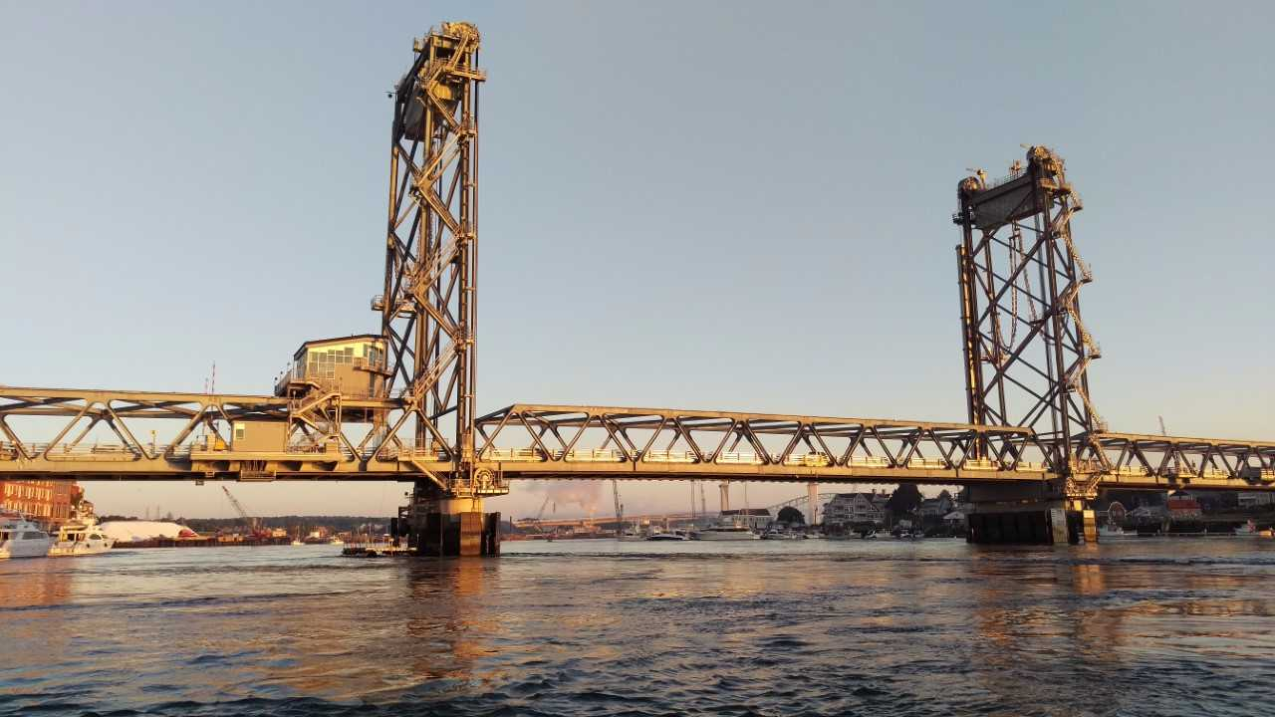
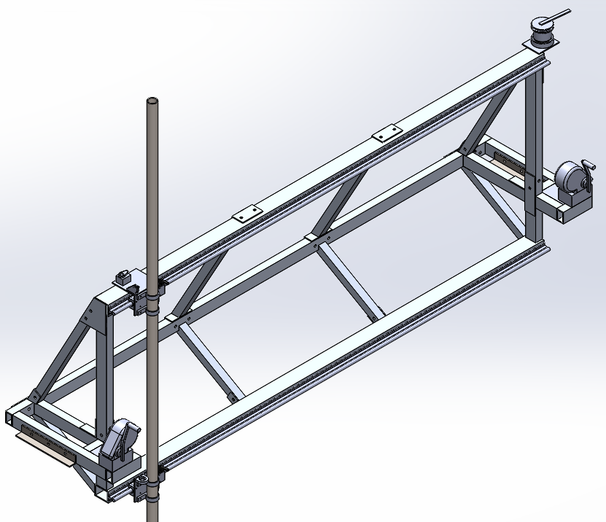
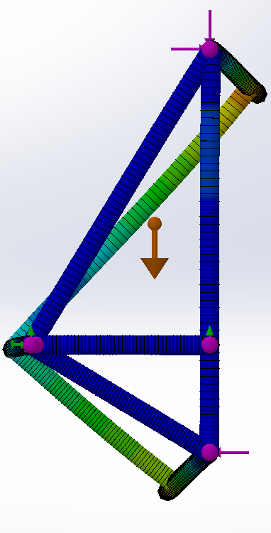
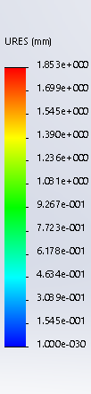
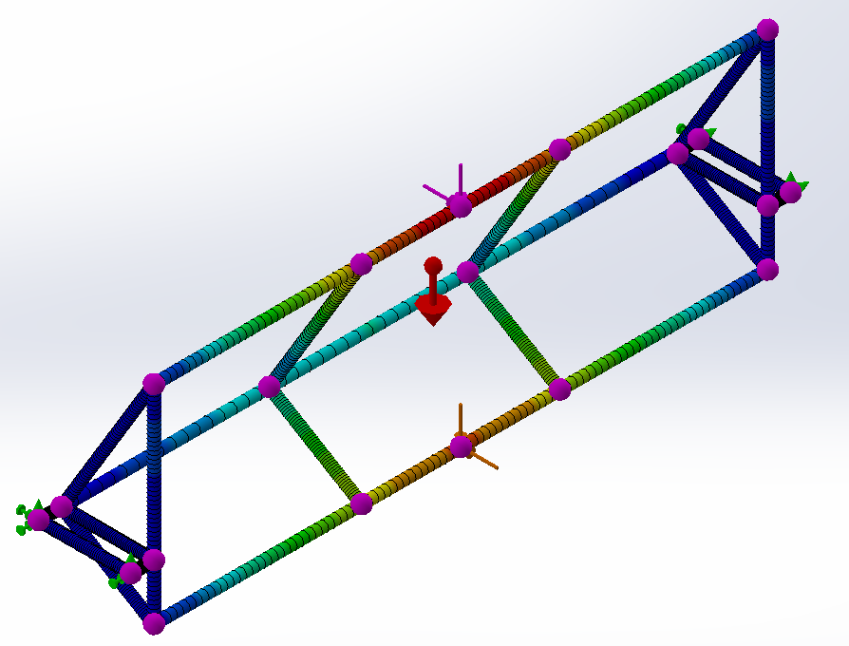
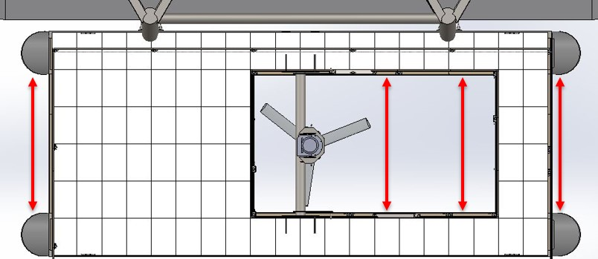
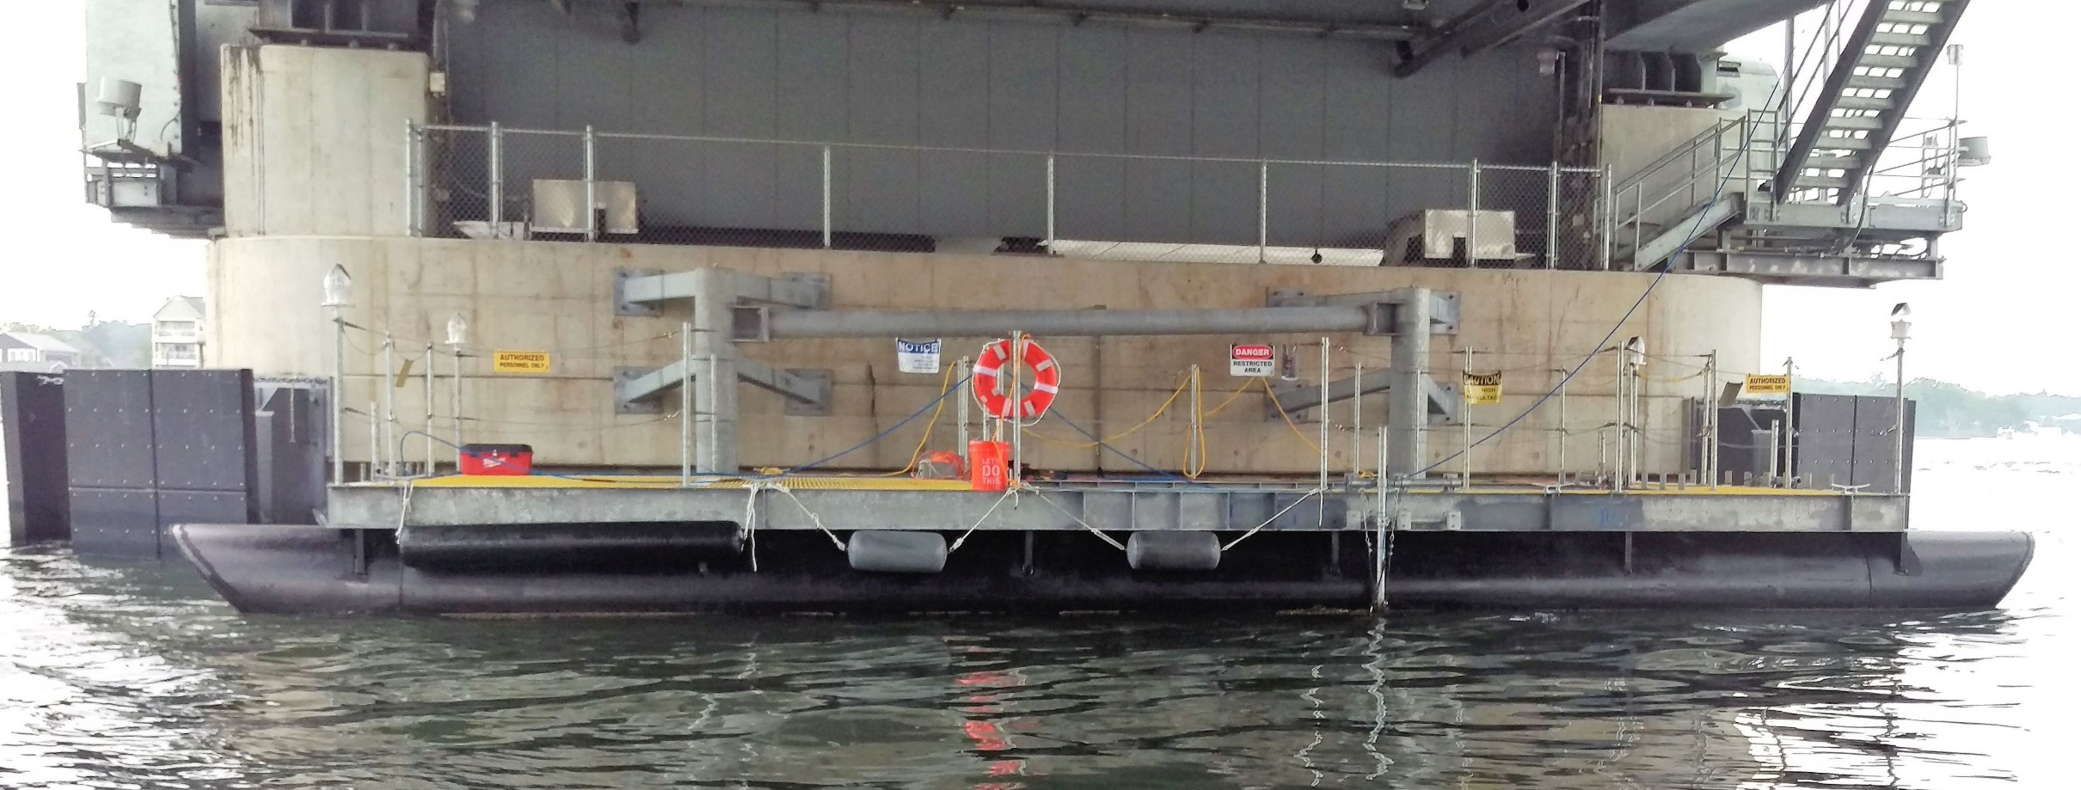
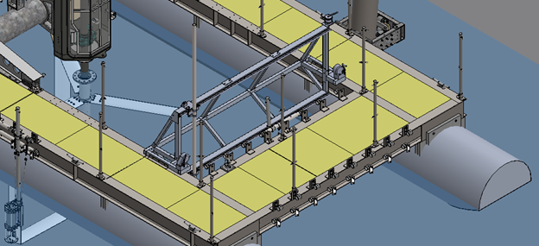
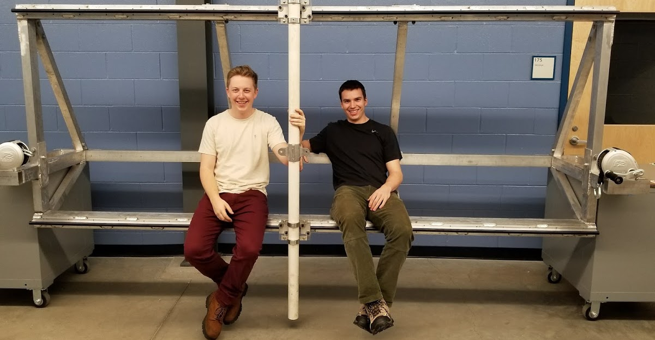
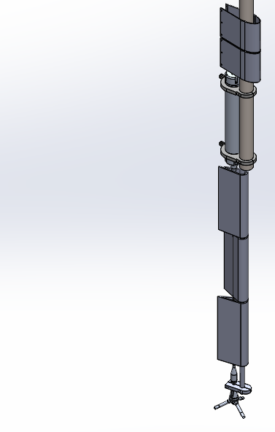
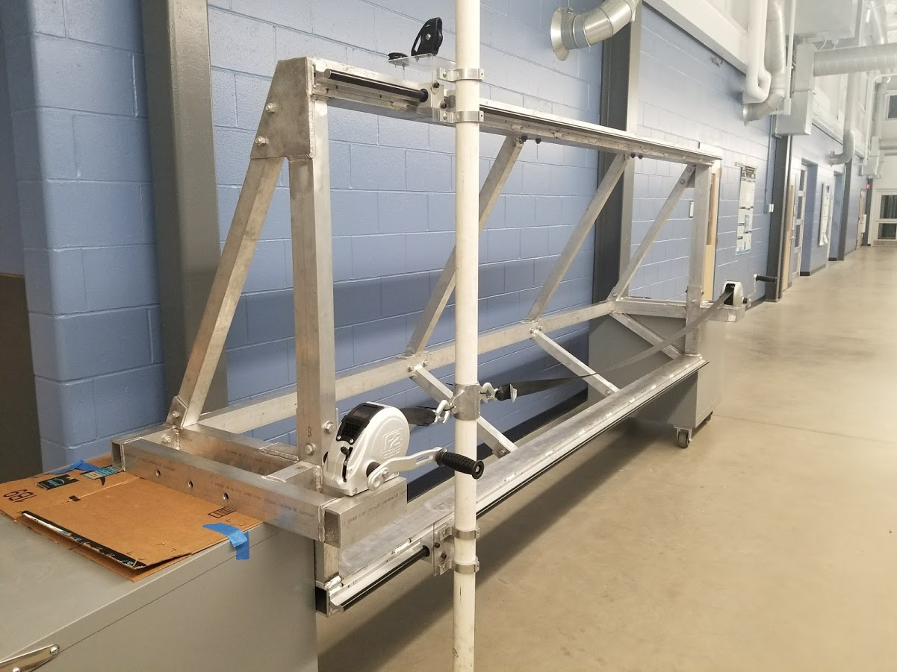
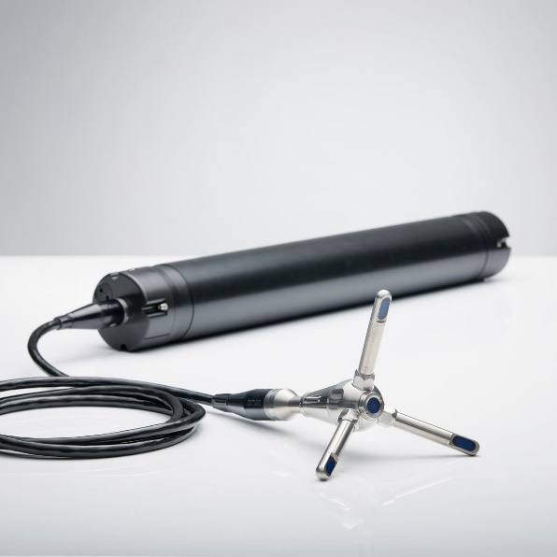
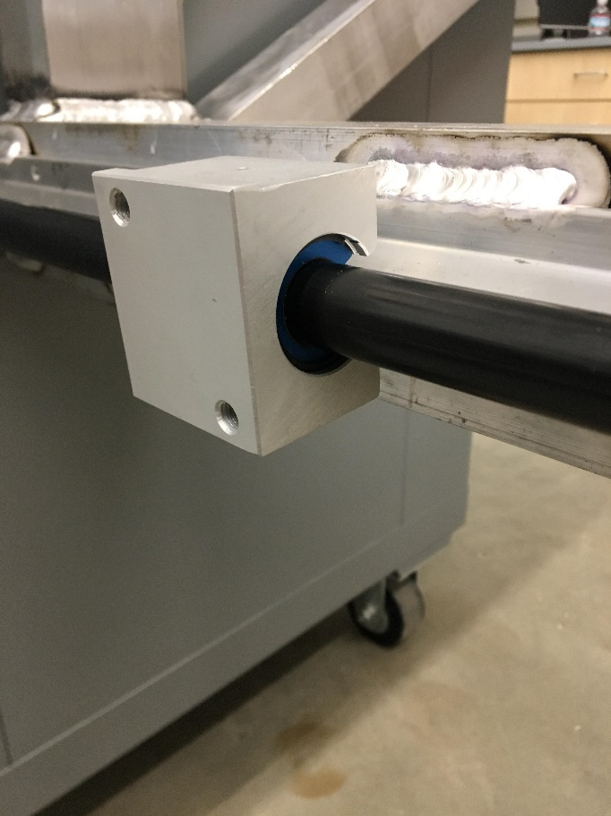
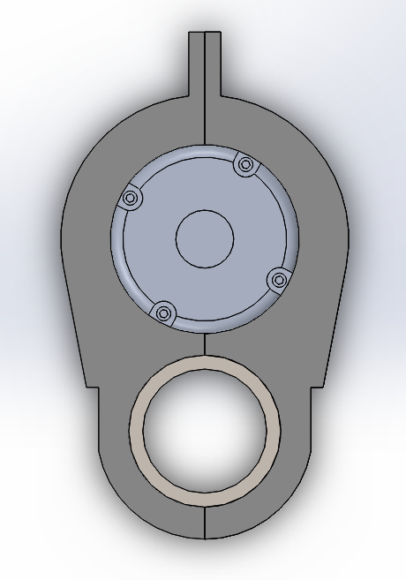
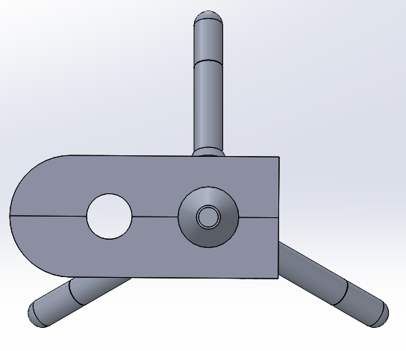
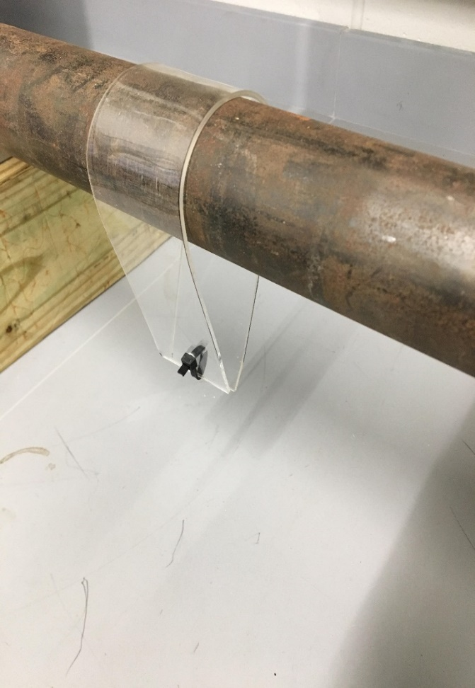
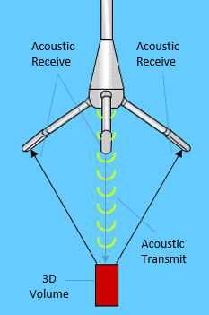


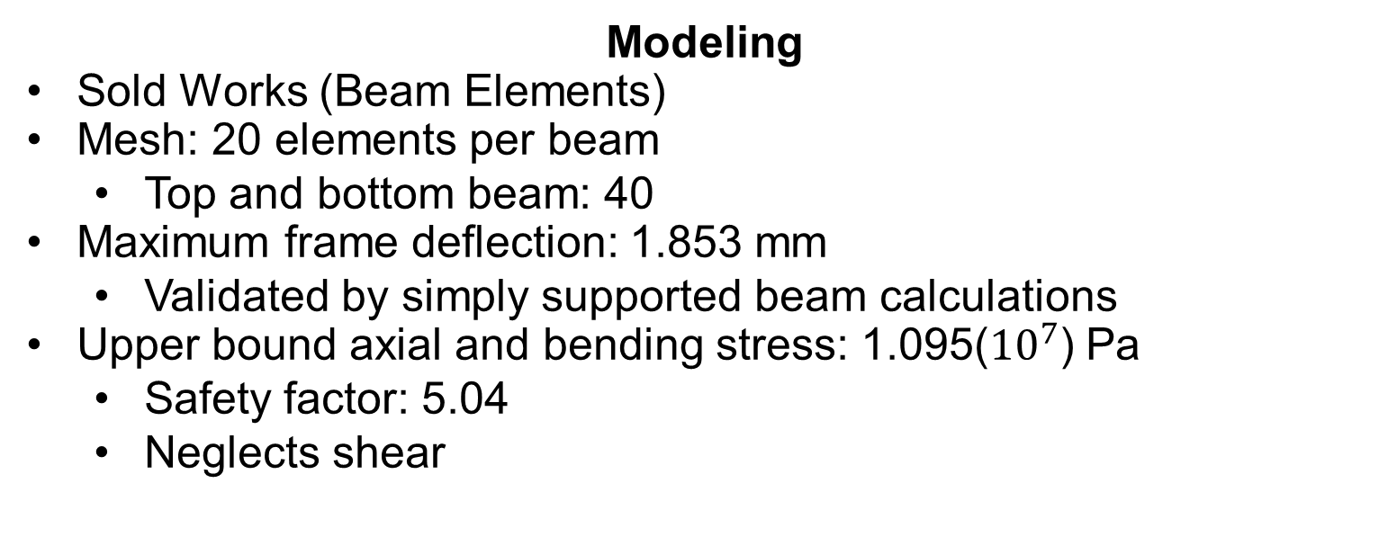
The Living Bridge Project: ADV Traversing System and Measurements
Project Members: Garrett Caisse, Kevin Strohschneider
Advisors: Professor Martin Wosnik, Kaelin Chancey, Ian Gagnon
Department of Mechanical Engineering
Tech 797 Ocean Projects
The Living Bridge Project Background
6
Frame Modeling and Design
The Living Bridge Project is focused on creating a smart, self sustaining bridge at the Memorial Bridge connecting Portsmouth, New Hampshire to Kittery, Maine. Sensors monitoring the structural performance, as well as estuarine sensors, are installed at the test site. These sensors will be powered by a tidal turbine mounted to a floating platform attached to the Portsmouth side pier.
Modeling
Sold Works (Beam Elements)
Mesh: 20 elements per beam
  Top and bottom beam: 40
Maximum frame deflection: 1.853 mm
  Validated by simply supported beam calculations
Upper bound axial and bending stress: 1.095(${10}^{7}$) Pa
  Safety factor: 5.04
  Neglects shear
Strut
Traversing Directions
5
Project Objectives
Design
6063 structural aluminum
Weight: 242.12 Pounds
7 Segments
Bolted to platform I-beam via angled mounts
The project goal is to design, fabricate, and implement an ADV traversing system for flow measurement. The project utilizes an acoustic Doppler velocimeter (ADV) to create a detailed map of the inflow and wake of the tidal turbine. The bridge pier creates complex flow that cannot be characterized by previously installed instruments.
Deformed deflection model. Deformation scale: 100:1
Deflection Scale
Undeformed deflection model using beam elements feature
Corrosion Considerations
Isolated dissimilar metals when possible
Galvanic potentials of dissimilar metals must be considered:
  Aluminum: -.75 to -1 Volts
  Galvanized (Zinc): -1 to -1.1 Volts
  Stainless Steel: 0 to -0.1 Volts
Diagram of Platform. System mounting locations shown with red arrows.
Reynolds Number | 13182 | Vertical Load (Top Rail) | 275 N
Drag Coefficient | 0.5 | Horizontal Load (Top Rail) | 700 N
Drag on Strut | 350 N | Vertical Load (Bottom Rail) | 275 N
Maximum Strut Deflection | 2.5 cm (0.98 in) | Horizontal Load (Bottom Rai) | 1050 N
Design Table
Dimensions: 142.5” x 51” x 32”
Total weight estimate: 400 Pounds
Strut length: 180”
Track length: 129.5”
Distance between shaft centers: 48”
3
Platform at Memorial Bridge test site
Model of ADV traversing system mounted to moon pool of platform
Acoustic Doppler Velocimeter
(ADV)
Sub Systems
ADV Mount
Rail Assembly
Nortek Vector
3D velocity measurements
Sampling volume diameter: 15 mm
Sampling height: 5-20 mm
Sampling rate: up to 64 Hz
Velocity range: up to 7 m/s
1 meter cable extension
1
2
3
1
Secure ADV to pipe, utilizing mounting depressions
Streamline ADV body, as well as extension
Cable extension with prong mount
¾ inch extension to minimize prong deflection
HDPE mounts isolate dissimilar metals
Aluminum alloy base material
RC70 ceramic coated finish
Lightweight, alternative to steel shafting
Vibration resistant
Frelon GOLD lined plain bearings
Self-lubricating, low maintenance
21.75 pounds each
Maximum compressive loading
  4167 pounds (18541 N)
Maximum tensile loading
  1250 pounds (5562 N)
Nortek Vector
Flow Direction
Design Criteria
4
Mount to pre-existing floating platform without major modification
Traverse 3 meters (9.8 feet) across moon pool
Move vertically 3.3 meters (10.8 feet) from free surface to bottom of turbine
Lock into place at each measurement location
Withstand loading caused by 3 meter per second current and a 0.5 meter design wave
Safely secure instrument
Minimize ADV movement/vibration
  Minimal strut deflection
  Reduce vortex shedding
  Streamline bodies
Survive multiple days in harsh ocean environment
Maneuverable with 2 people
  No section > 100 pounds (45 kg)
  Easily load/unload onto platform, UNH Vessel
Assemble on platform in less than 1 hour
Move to next measurement point in under 1 minute
Discrete measurement locations with high resolution (5 cm)
Strut Extension - ADV mount
Strut - ADV mount
Pillow block on 20mm shaft
Frame assembly during initial mock up
Fairings
Driving Systems
Upcoming Work
2
4
5
6
Streamline body to minimize drag
Reduce vortex shedding
  Vortex shedding may cause uneven, cyclic loading system
Formed using acrylic sheet
  0.093 inches thick
  12 inch tall sections
Heated to working temperature and formed over mold
Clamped over strut and clipped together
Sections rotate independently to account for misaligned flow
Horizontal
Manual system
2 marine trailer winches, located on either side
Visually aligned to proper mounting position
Locked into place by track brakes
Vertical
Manual system
Self tailing sailboat winch, located on top corner of frame
Line runs through sailing pulleys to bottom of strut
Must start at lowest position, winch up during measurement cycle
Initial full assembly with all components in lab
Simulated load testing on strut, traversing testing under load
Tow tank testing at Chase, ocean engineering building
Dry run at test site without ADV
Initial flow measurements at site, finalize measurement duration
Design and implement bow and stern mounts
Diagram of ADV measurement principal
3” acrylic fairing around 2” nominal diameter pipe

