Slide 1


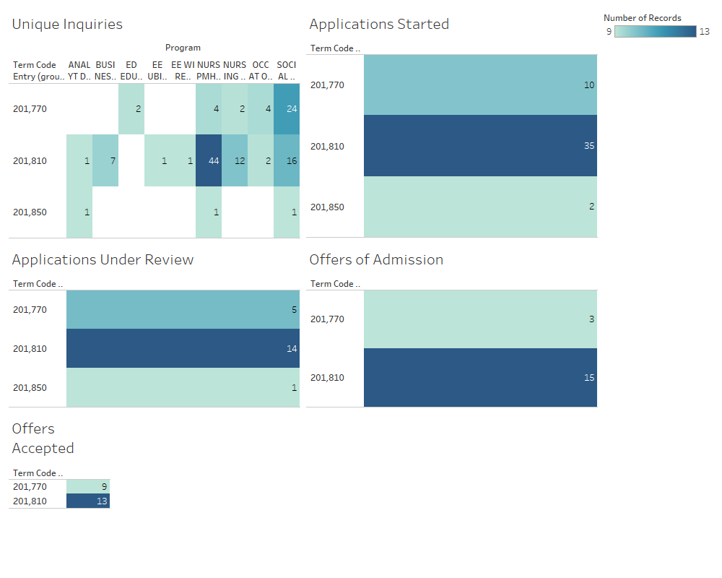

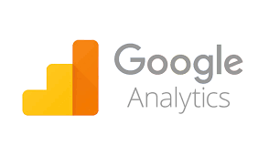
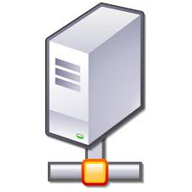



UNH Online Performance Dashboard
Kenny Picard, Mitchell Stack
UNH CEPS, University of New Hampshire, Durham, NH 03824
Introduction
Dashboard
Technologies Used
With the recent growth of UNH Online, the need to analyze data is higher than ever. Currently, UNH Online is using multiple tools to analyze the data they need. This is very time consuming and having data spread out in multiple places makes analyzing the data more difficult.
Tableau
Banner
Webi
Google Analytics
Future Work
Setting up a schedule for data to be pulled automatically via a live connection from tableau to the server.
Incorporating social media data to the dashboard.
Solution
A Central dashboard for visualizing data from many data-sources. The data will be coming in from the various tools into a server for the data to be held on. A live connection from the server to Tableau will be created allowing for data to be pulled automatically on a set schedule. Tableau then visualizes the data in an easily customizable dashboard.
System Architecture
Advisors
Tracey Cosker
Ann Surman
Phani Kidambi

