Slide 1



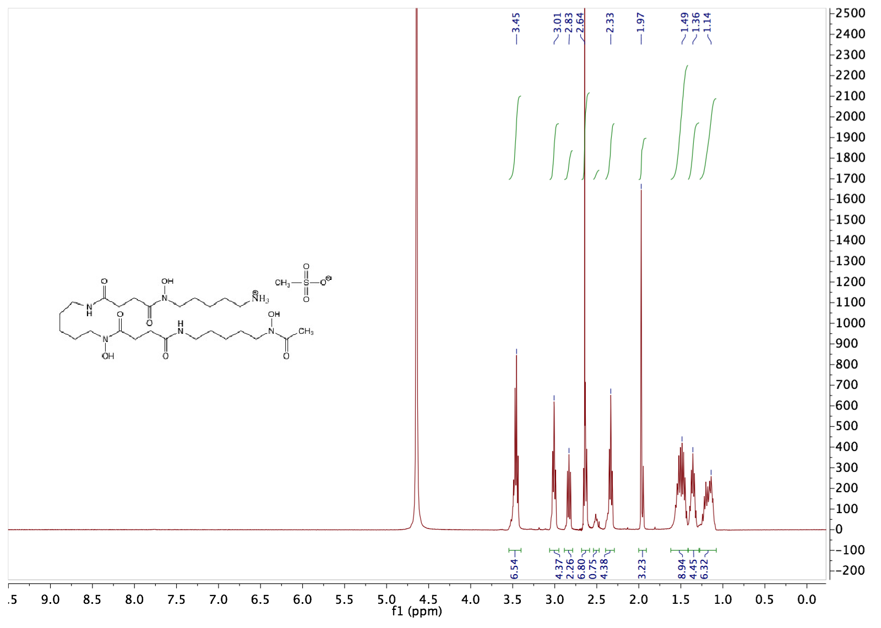
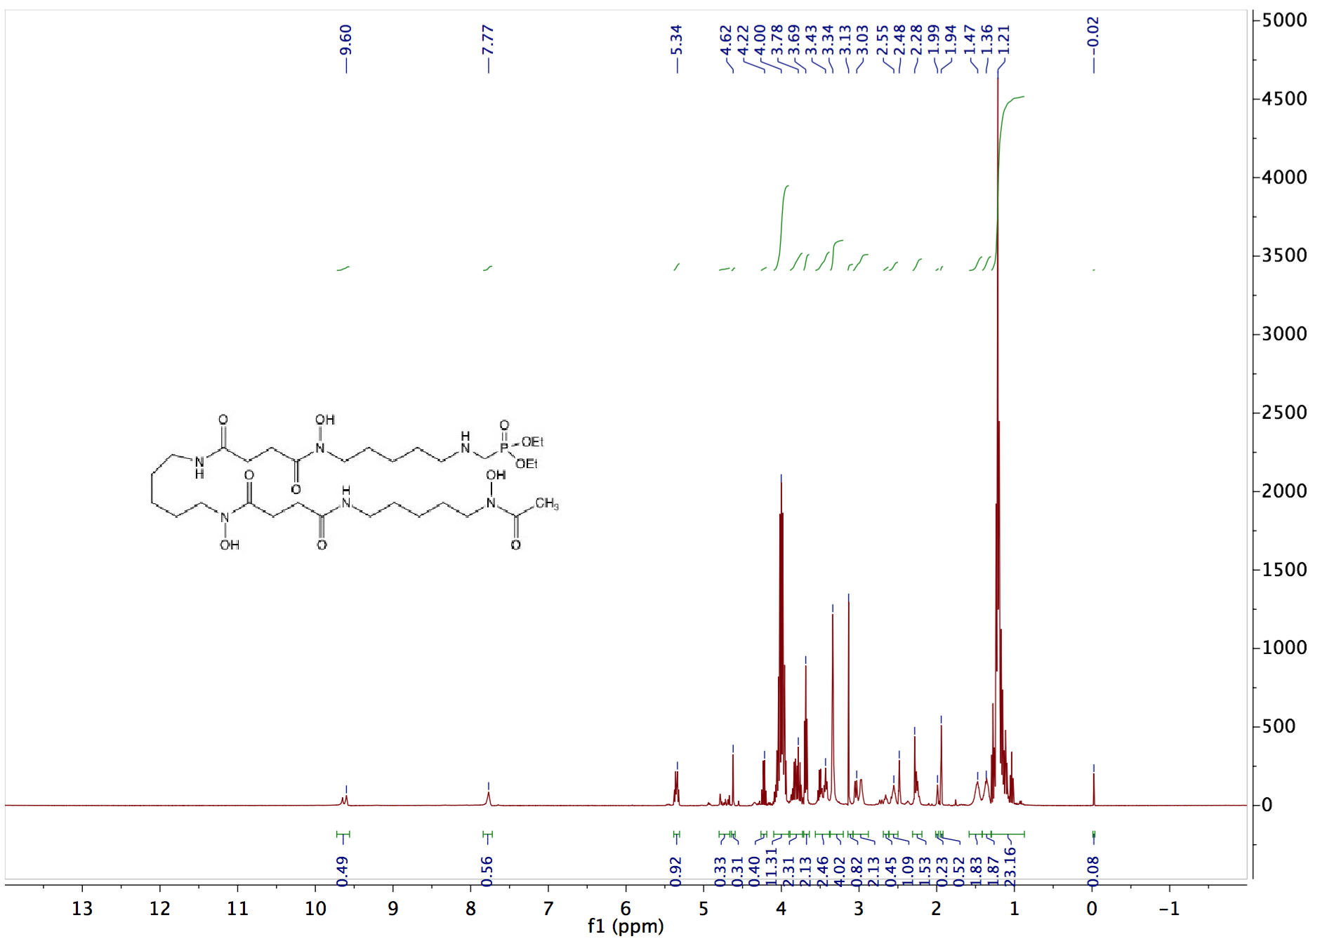
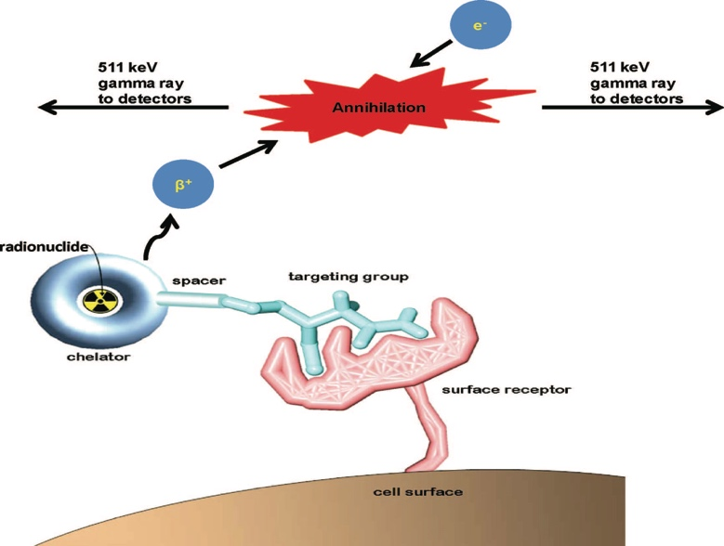
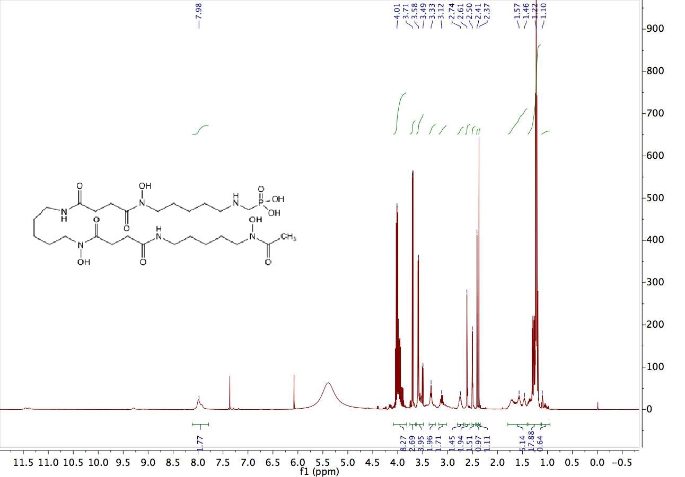
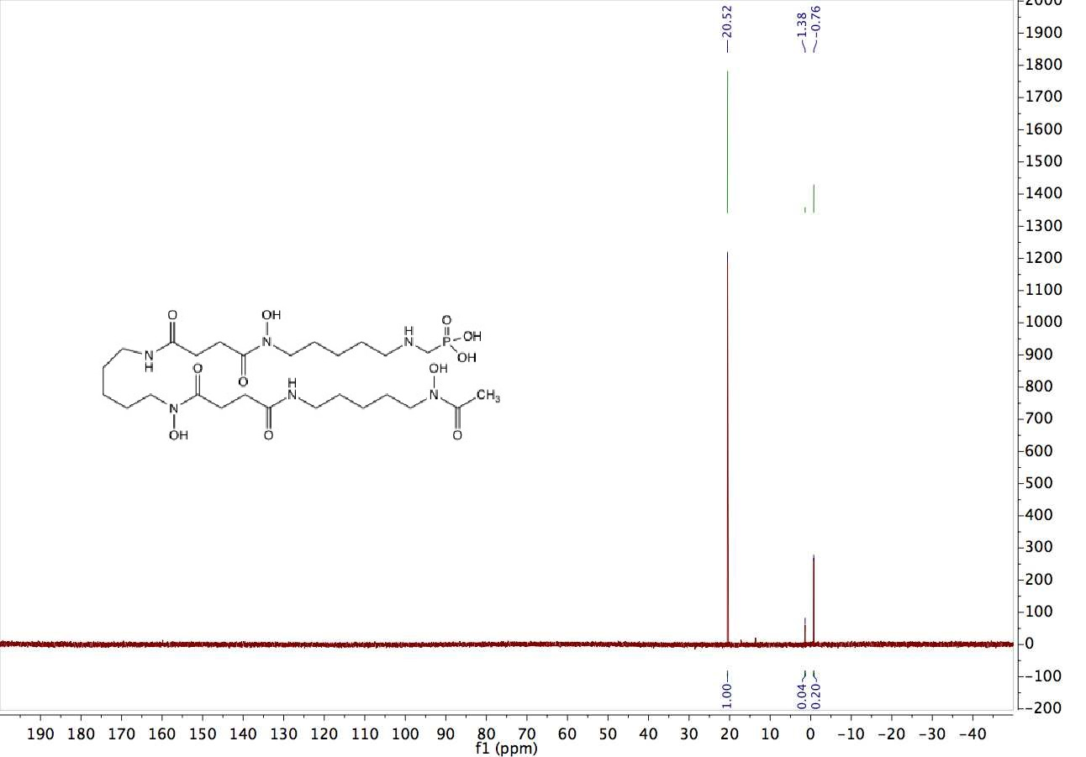
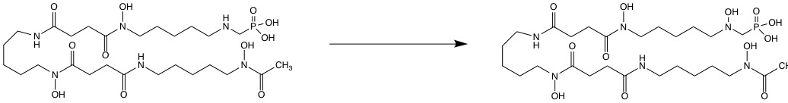
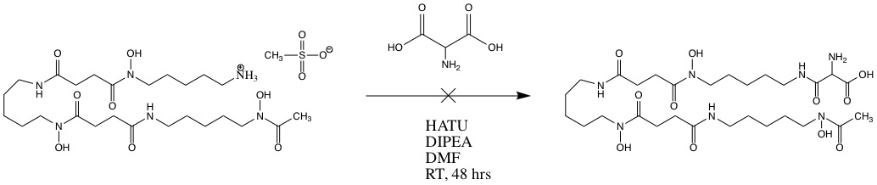
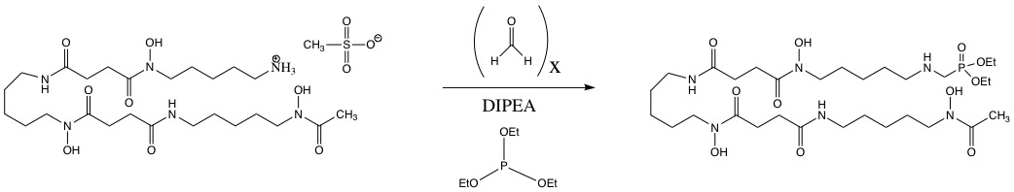
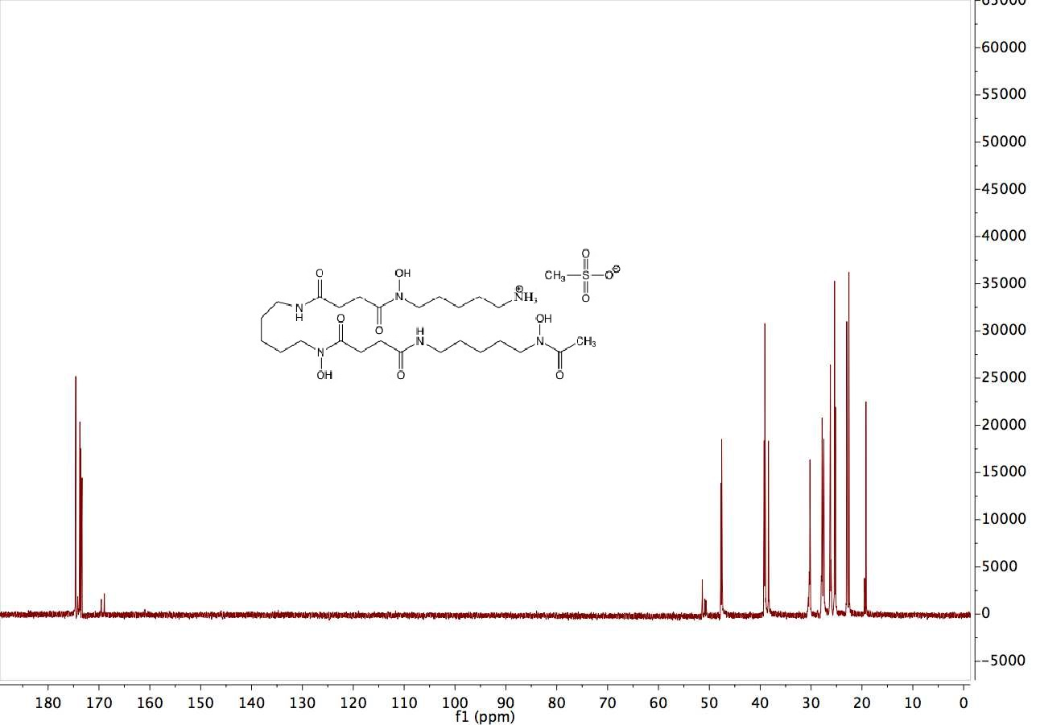
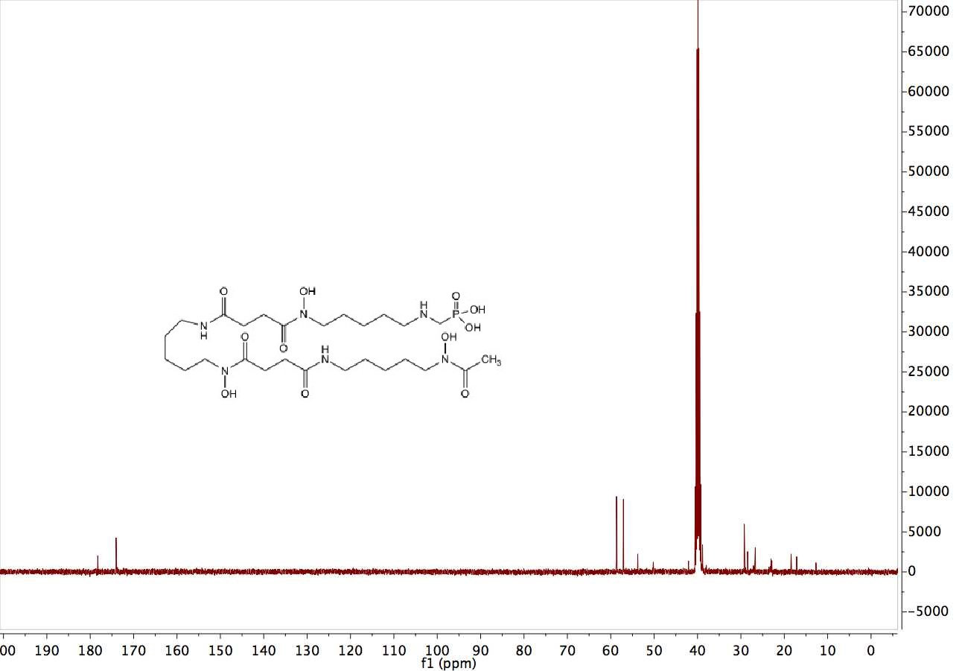
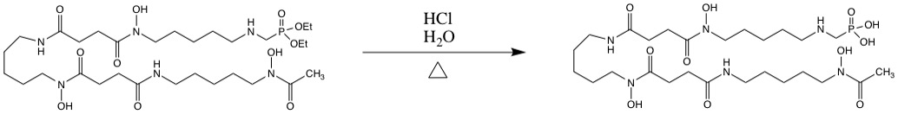
DESIGN, SYNTHESIS, AND CHARACTERIZATION OF A NOVEL OCTADENTATE
AMINOPHOSPHONATE LIGAND FOR ⁸⁹Zr-IMMUNO-PET IMAGING
Brady Barron, Dr. Mahmoud Abdalrahman, Dr. Roy Planalp
Department of Chemistry, University of New Hampshire, Durham, NH 03824
Introduction
Relevant Data/NMR Spectra
Results/Conclusions
Positron Emission Tomography (PET) has recently emerged as a noninvasive, antibody-based imaging method clinically used to diagnose and assist in the treatment of diseases such as cancer. Of the currently used positron-emitting radionuclides, ⁸⁹Zr is ideal for labeling proteins because its long half-life matches the pharmacokinetics of immunoglobulins. The current chelator used in the clinic, desferrioxamine (DFO), effectively binds to six of the eight coordination sites of Zr(IV) but leaves two sites open for other weakly chelating biological ligands to fill (ex. H₂O). In order to limit patients’ exposure to bone-seeking radiation, DFO must be extended with an oxygen-rich bidentate ligand that will strongly bind to the remaining two coordination sites of the oxophilic Zr(IV) cation. The design, synthesis and characterization of a novel octadentate derivative of DFO is explored to maximize the stability of the complexed ⁸⁹Zr radionuclide. If successfully synthesized, the novel octadentate chelators have advantages and the potential to replace the currently employed hexadentate DFO chelator.
DFO has been extended via a phosphonate moiety, and the resulting ligand is currently 7-coordinate. The ³¹P NMR spectrum of the crude phosphonate ester product has a strong peak at 24.45 ppm which corresponds to a similar, known phosphonate compound found in the literature.² Similarly, the ³¹P NMR spectrum of the hydrolyzed phosphonate ester product (Figure 5) shows a strong peak at 20.52 ppm which also corresponds to a similar, known phosphonate compound found in the literature.³ Because DFO is a large molecule with no symmetry, characterization of the novel derivatives has been challenging. Therefore, ³¹P NMR has been the primary method utilized for characterization. Because ³¹P NMR is not sufficient, we are currently employing COSY and HSQC NMR to aid the characterization of these complex molecules.
Figure 2. ¹H NMR of the starting material, desferrioxamine mesylate.
Figure 3. ¹H NMR of the crude phosphonate ester.
Future Work
Future work will involve the addition of a functional hydroxyl group at the secondary amine closest to the phosphonate moeity so that the novel ligand may eventually bind to all eight of Zr(IV)’s coordination sites. Once complexed to Zr, stability constants for this complex will be measured to prove that stability increases when the hexadentate ligand is extended to be octadentate.
Figure 1. The figure depicts the mechanism of PET and illustrates the annihilation of beta particles upon collision with electrons.¹
Attempted Reactions
Figure 5. ³¹P NMR of the hydrolyzed phosphonate ester.³
Scheme 4. Addition of a functional hydroxyl group at the secondary amine closest to the phosphonate moeity.
Figure 4. ¹H NMR of the hydrolyzed phosphonate ester..
Acknowledgements
Scheme 1. HATU coupling of aminomalonic acid to DFO to form DFO-8.
I would like to acknowledge my research advisor, Dr. Roy Planalp, and Dr. Mahmoud Abdalrahman for without them this project would not be possible. I would also like to acknowledge the rest of the Planalp Group including Aaron Chung, Matthew Reuter, Evangelos Rossis, and Luke Fulton.
Scheme 2. Synthesis of the α-aminophosphonate ester via a Kabachnic-Fields (phospha-Mannich) reaction.
References
T. J. Wadas, E. H. Wong, G. R. Weisman, C. J. Anderson. Coordinating radiometals of copper, gallium, indium, yttrium and zirconium for PET and SPECT imaging of diseases. Chem. Rev. 2010. 110, (5).
G. Courtois, L. Migniac. A facile synthesis N- alkylaminomethylphosphonates. Synth. Comm. 1991. 21, 2, 201-209.
A.A. Prishchenko, M.V. Livantsov, O.P. Novikova, L.I. Livantsova, V.S. Petrosyan. Synthesis of new organophosphorus-substituted mono- and bis(trimethylsilyl)amines with PCH2N fragments and their derivatives. Hetero. Chem. 2010. 21, 2, 71-77.
Scheme 3. Hydrolysis of the α-aminophosphonate ester.
Figure 6. ¹³C NMR of the starting material, desferrioxamine mesylate.
Figure 7. ¹³C NMR of the hydrolyzed phosphonate ester.

Slide 2

This poster template provided courtesy of
UNH ESRC Poster Printing Services
Trust us to make your poster look GREAT!
Website: http://posters.unh.edu
Poster Guide: http://goo.gl/1E7TJY
DELETE THIS SLIDE BEFORE PRINTING

