Slide 1

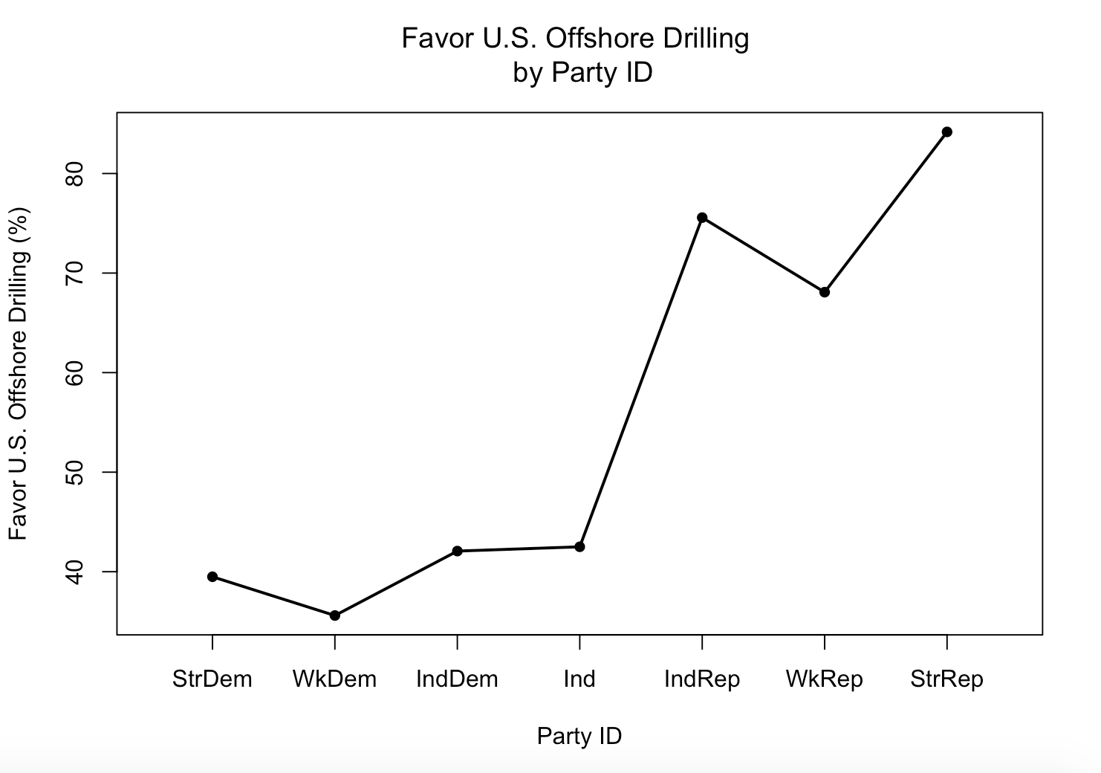
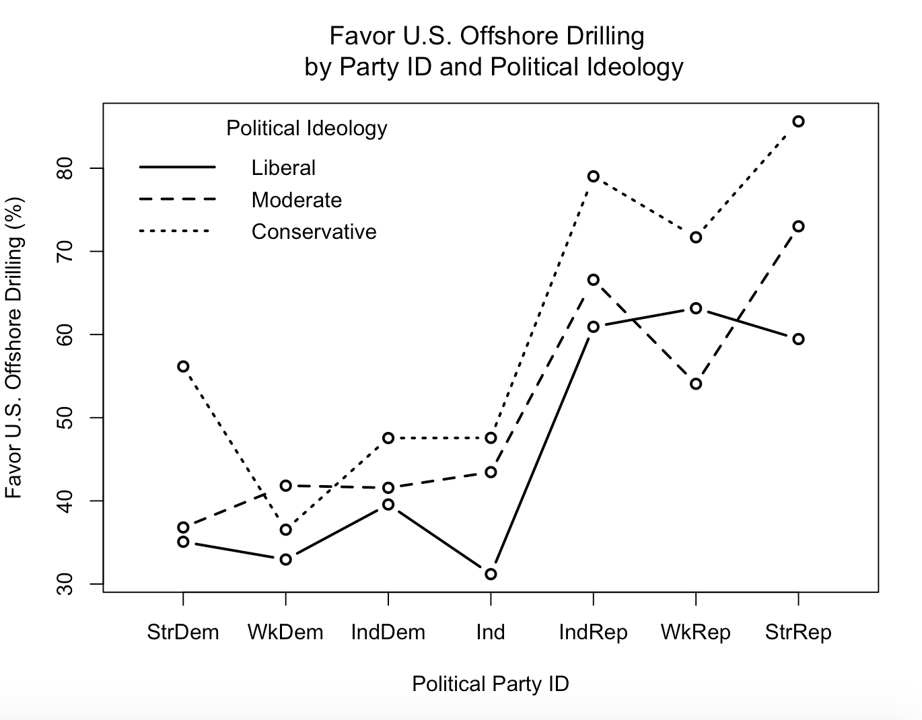
The Politicization of Offshore Drilling
Elizabeth Sibson, Department of Political Science, University of New Hampshire
Introduction
Results
analysis
Many studies have found that there is a discrepancy between those who identify with the Republican party and the Democratic party on environmental issues.
  They also found that political ideology has more effect on an individual’s environmental views than party identification.
The environmental impacts of offshore drilling have come to be a leading aspect of the environmental movement after accidents like BP’s “Deepwater Horizon” spill in the Gulf of Mexico in 2010.
With new policy initiatives that would increase the amount of offshore drilling for the United States it is important to understand where there may be opposition.
Figure 1
Figure 1: Republicans are more likely to favor U.S. offshore drilling than Democrats.
  Independent Republicans are more likely to favor U.S. offshore drilling than weak Republicans (75% versus 68%).
  Weak Democrats are the least likely (out of all Democrats, including independent Democrats) to favor U.S. offshore drilling (35%).
Figure 2: Political ideology does not drastically affect the relationship between the party identification and favoring U.S. offshore drilling.
  It has the most effect on moderate weak Democrats and liberal weak Republicans.
How strong is the relationship between the independent and dependent variables?
  Probability (p-value)= <2e-16
  Chi-Square test: 808.478
  Somers’ D: 0.221327
  Relatively strong relationship
conclusions
Figure 2
Political party identification affects an individual’s view on U.S. offshore drilling.
Political ideology (liberal, moderate, or conservative) has a small effect on an individual’s views on U.S. offshore drilling.
Research questions
Are Republicans more likely to favor U.S. offshore drilling than Democrats?
  Are individuals with a strong attachment to the Republican party more in favor than those who have a weaker attachment or are independent?
  Are individuals with a strong attachment to the Democratic party less in favor than those who have a weaker attachment or are independent?
Literature
Buttel, Frederick, and William Flinn. "The Politics of Environmental Concern: The Impacts of Party Identification and Political Ideology on Environmental Attitudes." Environment and Behavior, vol. 10, no. 1, 1978.
Cruz, Shannon. "The Relationships of Political Ideology and Party Affiliation with Environmental Concern: A Meta-Analysis " Journal of Environmental Psychology, vol. 53, no. 81-91, 2017.
Dunlap, Riley, and Kent Van Liere. "The Social Bases of Environmental Concern: A Review of Hypotheses, Explanations, and Empirical Evidence." The Public Opinion Quarterly, vol. 44, no. 2, 1980.
Hamilton, Lawrence, et al. "Flood Realities, Perceptions, and the Depth of Divisions on Climate." Sage, vol. 50, no. 5, 2016.
Pollock, Philip, and Barry Edwards. An R Companion to Political Analysis. CQ Press, California, 2018.
Hypothesis
How does the control variable affect the relationship between the independent and dependent variables?
  Control: political ideology (libcon3)
  Cramer’s V Liberal: 0.17
    Chi-Square: 55.609
    P-value: 6.746e-05
  Cramer’s V Moderate: 0.18
    Chi-Square: 36.871
    P-value: 0.002242
  Cramer’s V Conservative: 0.35
    Chi-Square: 335.4
    P-value: < 2.2e-16
In a comparison of individuals, Republicans are more likely to favor U.S. offshore drilling than Democrats.
Variables (from National Election Survey dataset)
  Independent variable: party identification Dependent variable: favor/oppose U.S. offshore drilling
Photo acknowledgment: https://www.studentenergy.org/topics/offshore-oil

