Slide 1

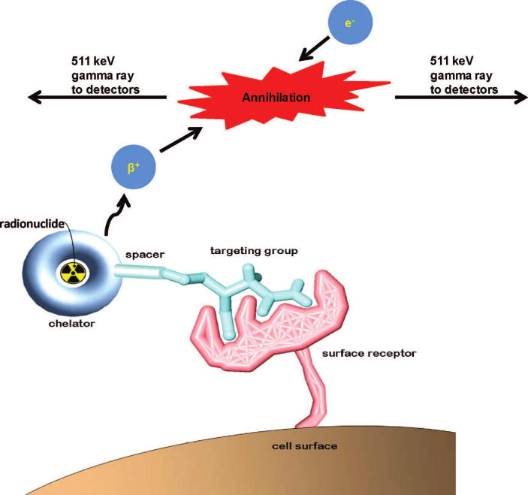
Synthesis of DFO Bifunctional Octadentate Ligand for the Chelation with ⁸⁹Zr and conjugation with antibodies for ⁸⁹Zr-immuno-PET-imaging.
Evangelos Rossis, Dr. Roy Planalp
University of New Hampshire, Department of Chemistry
_{er1@wildcats.unh.edu}
Introduction
Formation of 4-nitro-2-acetoxy benzoic acid
Conclusion
Zirconium-89 metal displays near ideal physical and chemical properties for developing a new radioimmunoconjugate for positron emission tomography (PET).¹ PET is an important, actively researched method of diagnostic imaging.² The half-life of zirconium is long enough for the antibody targeting group to attach with the tumor cells, which requires over 24 hours in vivo.³
Acylation of the amino group
The formation of an amide bond between a carboxylic acid moiety and an amino group is the core reaction of this synthesis. The activated ester is attacked by the nucleophile amino group of the deferoxamine (DFO) under basic conditions to form the bifunctional deferoxamine derivative which will serve as a chelator for the metal and the connector for the antibody.
Activation of the carboxyl moiety
Dicyclohexylcarbodiimide (DCC) has been used as a condensation reagent for coupling since 1955 and is still much in use today. DCC was applied in solution of 4-nitro-2-acetoxy benzoic acid in combination with N-hydroxysuccinimide (HOSu) additive, to yield the activated ester. Upon proton exchange of the carboxyl with the DCC for the formation of O-acyl isourea intermediate, which was followed by coupling with HOSu for the formation of the active ester.
Initially we started with 2-hydroxy-4-nitro benzoic acid, which would later undergo a protection with acetyl chloride for the formation of the 4-nitro-2-acetoxy benzoic acid in order to avoid a side reaction between the activation reagent (DCC) and the hydroxy group in the aromatic ring.
The first step of the synthesis of DFO derivative, which is to form the activated N-hydroxysuccinimide derivative was successful with high-yielding and the product was characterized with ¹H NMR and ¹³C NMR.
Future Work
The ultimate goal of this project is the synthesis of the DFO octadentate derivative, which could later form the Zirconium complex. The complex would then be tested for its stability in cellular environments. The collected data will then be compared with the already existing zirconium complexes. Some of the already existing complexes with zirconium are EDTA and DTPA.³
73%
D
Figure 1. Description of the fundamental principle of positron emission tomography (PET). As the targeting group interacts with the cell’s surface receptor.⁴
A
B
C
Figure 2. ¹H NMR of 4-nitro-2-acetoxy benzoic acid
9
5
7
8
9
1
2
3
4
6
Figure 3. ¹³C NMR of 4-nitro-2-acetoxy benzoic acid
Formation of the active ester
Figure 6. Zirconium complex with octadentate bifunctional ligand.
We have recently demonstrated that through activation of the carboxylic acid synthetic route, 4-nitro-2-acetoxy benzoic acid can be efficiently transformed into N-hydroxysuccinimide ester .
The synthesis of the octadentate ligand was expected to be completed through the following pathway.
68%
I would like to thank Dr. Planalp for his directions and suggestions in this project. I would like to acknowledge Luke Fulton for his guidance and suggestions, as well as Aaron Chung, Brady Barron, and Matthew Reuter. I would like to thank Barbara and Dhimiter Rossis for their support for all these years.
D
1
10
A
B
C
2
3
4
5
6
8
9
11
Acknowledgements
7
Figure 4. ¹H NMR spectrum of N-hydroxysuccinimide ester.
Figure 5. ¹³C NMR spectrum of N-hydroxysuccinimide ester.
References
Holland J.P., Divilov V., Bander N.H., Smith-Jones P.M., Larson S.M., Lewis J.S. ⁸⁹Zr-DFO-J591 for immunoPET imaging of prostate-specific membrane antigen (PSMA) expression in vivo. J Nucl Med. 2010; 51(8): 1293-1300. doi: 10.2967/jnumed.110.076174
Wadas T.J, Wong E.H., Weisman G.R., Anderson C.J. Coordinating radiometals of copper, gallium, indium, yttrium, and zirconium for PET and SPECT imaging of disease. Chem Rev. 2010; 110:2858-902.
Deri A.M., Zeglis B.M., Francesconi L.C., Lewis J.S. PET Imaging with Zr: From Radiochemistry to the clinic. Nucl Med Bio, 2013; 40(1):3-14.
Figure 7. Pathway for the synthesis of octadentate DFO derivative.

