Slide 1

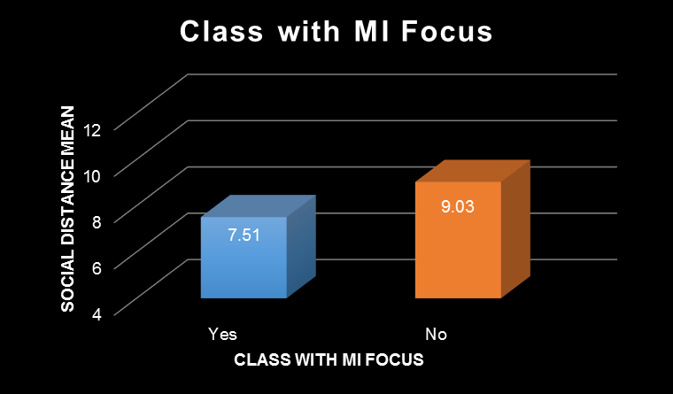
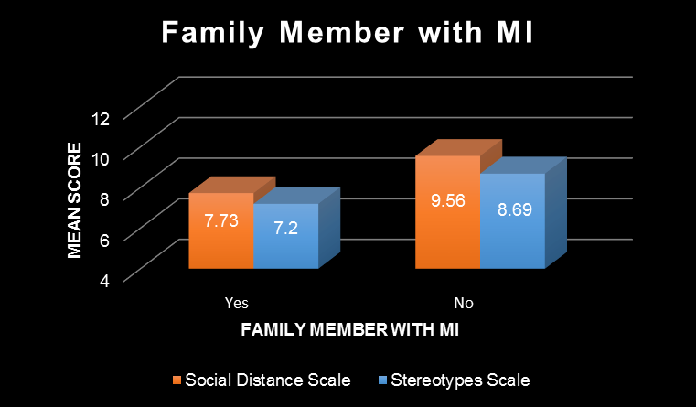
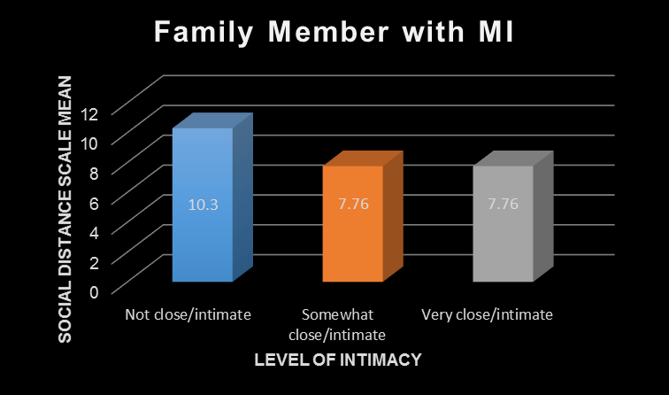
Social Work Education and Mental Health Stigma
Dana K. Prisloe
Department of Social Work, University of New Hampshire
Introduction
Results
Results
1 in 5 American adults (43.4 million people) experience some form of mental illness (MI) annually.¹
Less than 40% of people with a MI receive mental health treatment.²
There is a key link between MI and suicide. Suicide is the second-leading cause of death for ages 10-34.³
MI is a stigmatized condition, manifested through negative stereotypes, prejudices, and discrimination against individuals with an MI.⁴
Stigma has been associated with a decreased quality of life, fewer job opportunities, and refusal to seek treatement for fear of being ascribed to a stigmatized group.⁵
Stereotypes and myths about MI promote stigma. In a 2015 study,
  70% of respondents believed people with schizophrenia were dangerous.⁶
  45% of respondents believed people with depression were unpredictable.⁶
  Yet violence would be reduced by less than 5% if MI was eliminated.⁷
Anti-stigma strategies include education and contact. Research shows that learning about MI and stigma, in addition to working with people with MI, promotes disclosure of MI and acceptance.⁸ This helps mitigate the negative consequences of stigma.
Hypothesis #1:
  There was a significant difference in desire for social distance (t = -2.5, p < .05) based on whether or not one had taken a class where the main focus was MI. Respondents who had not taken a MI-focused class expressed more desire for social distance.
  There was no difference in stereotype adherence based on whether or not one had taken a class where the main focus was MI.
Hypothesis #2:
  There was a significant difference in desire for social distance (t = -2.4, p < .05) based on whether or not one had a famiy member with a MI. Respondents without a family member with MI expressed more desire for social distance.
  There was also a significant difference in stereotype adherence (t = -2.0, p < .05) based on whether or not one had a family member with a MI. Respondents with a family member with a MI held less stereotyped beliefs about MI.
  There was not a significant difference in desire for social distance or stereotype adherence based on whether or not one had a friend with a MI.
  There was a significant difference in desire for social distance based on the level of intimacy (F=4.0, p<.05) one had with their family member who had a MI. The more intimate the relationship, the less desire there was for social distance.
Hypothesis #3:
  There was a moderate correlation (r=.37) in the expected direction. As people desire more social distance from individuals with a MI, they hold more negative stereotypes.
Hypotheses
Individuals who receive mental health focused education will have less desire for social distance and will disagree with stigmatizing stereotypes.
Individuals that have a close relationship with someone with a mental illness will express less desire for social distance and will disagree with stigmatizing stereotypes.
Individuals that adhere to stigmatizing stereotypes will desire more social distance from people with a mental illness.
Discussion
This study suggests that contact with people with MI is likely to reduce desire for social distance and stereotyped beliefs. The more intimate the relationship, the less likely there will be MI stigma.
Education and knowledge about MI somewhat reduced desire for social distance, but did not affect stereotype beliefs. Such inconclusive results are consistent with previous studies and more research on this correlation would be beneficial.
The positive correlation between desire for social distance and stereotype beliefs is consistent with previous research and reinforces the idea that these two factors influence each other and contribute to MI stigma.
This data analysis focused on social work students, who are gatekeepers between MI clients and treatment services. Engaging in future research and practicing anti-stigma strategies are in accordance with the NASW Code of Ethics.
While our findings showed a correlation between intimate relationships and stigma, and MI education and stigma, more research in additional university settings would be needed to solidify those results.
Social desirability bias should be considered. Participants will decrease their endorsement of stereotypes if they suspect it is measuring prejudice. Most people do not wish to appear unfavorably, and will choose the “correct” response.⁴
Further research on education strategies can help understand effective ways to teach about MI and whether it effectively reduces stigma.
Methods
Participants (N=92) completed an online survey and consisted of students enrolled in the UNH Department of Social Work’s BSSW and MSW programs. An email from department staff was sent to all students asking for their participation.
Level of contact with people with MI was measured by a combination of questions. They were asked separately if they had a friend or family member diagnosed with an MI. Those who responded affirmatively were asked to rate the level of intimacy in the relationship.
MI education was measured by asking students if they completed a UNH class where MI was the main focus.
Social distance was measured by five questions assessing an individual’s desire to include people with MI in their social network. Answers were summed to create a total social distance scale score (α=.84), with a possible range from 5 to 20. Higher scores indicated greater desire for social distance.
Adherence to stereotyped beliefs was measured by four questions assessing the extent to which respondents link a label (e.g. bipolar disorder, schizophrenia, major depression) with various characteristics (e.g. dangerous, violent, aggressive, etc.). Answers were summed to create a total stereotype scores (α=.86), with a possible range from 4 to 16. Higher scores indicated a greater belief in stereotypes.
      Faculty advisor Cory M. Morton, Ph.D., M.S.W.
      Assistant Professor
      Department of Social Work
      For more information contact: dkp2000@wildcats.unh.edu

