Slide 1

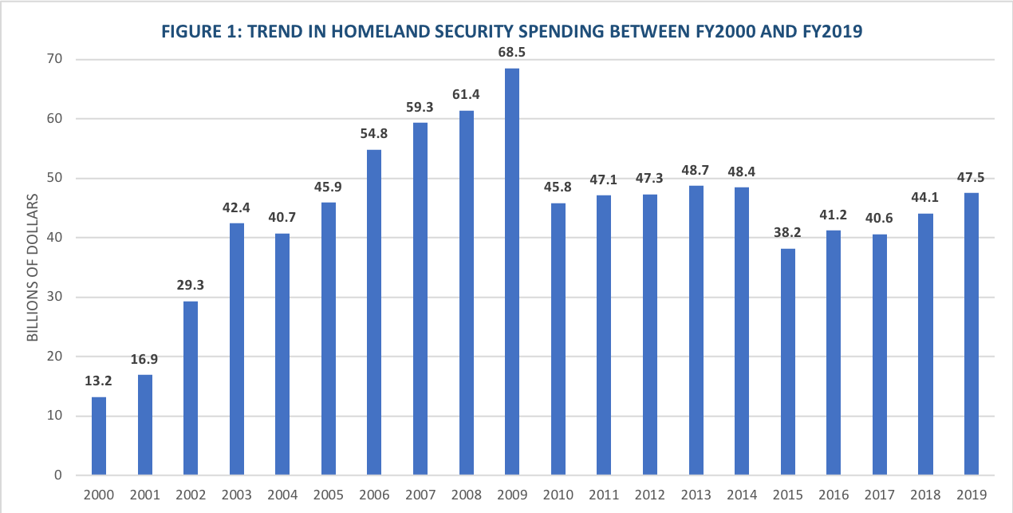
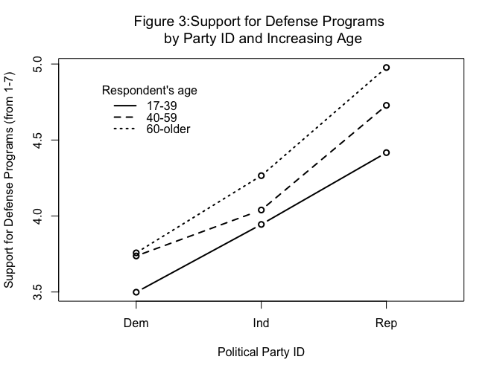
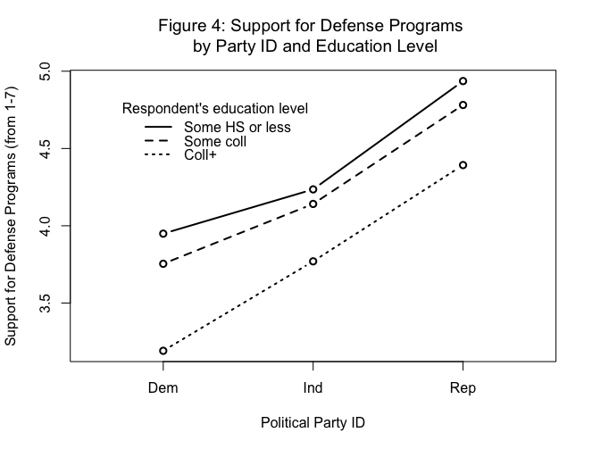
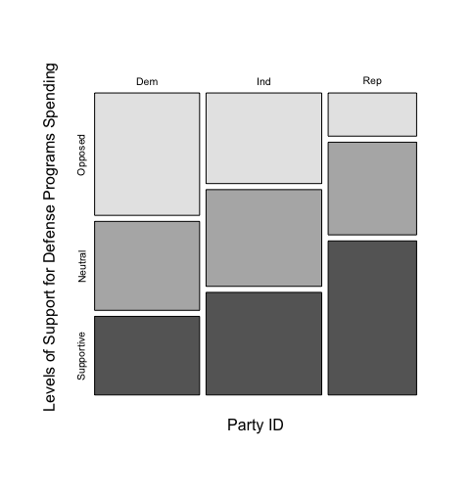


Public Response to the Increase and Decrease of the Federal Budget
in Homeland Security and Defense Programs
Chiara Vercellone
Dante Scala, Faculty Advisor
Department of Political Science, University of New Hampshire
Research Question
How is the constantly changing federal spending budget on homeland security and national defense programs perceived by the population depending on an individual’s political values and party identification?
Background Information
U.S. Government financing of defense programs:
Raising taxes during active war time
Budget Trade-Offs
Deficit Spending
In 2001, the funding for defense and homeland security expenses was $16.9 billion, but within one year there was an increase of $12.4 billion (Figure 1).
Since the 9/11 attacks in 2001, defense expenditures have increased by 58%⁵. In former Secretary of State Donald Rumsfeld’s words:
“this dramatic increase in defense spending has been necessary because when the Cold War ended, a defense drawdown took place that went too far and overshot the mark.”
In 2017, the Department of Homeland Security had received $40.6 billion in funding – almost $28 billion less than what was received in 2009³.
In 2018, the budget for Homeland Security and Defense Programs was re-evaluated after President Donald Trump’s demands⁵.
Currently, it has been requested to Congress that the 2019 Federal Budget grants $47.5 billion to the Department of Homeland Security– showing an increase of $6.9 billion since 2017³.
To analyze the possible existence of political party ID
bias toward support of the federal budget designated
to Homeland Security and Defense programs across
the United States.
Hypothesis: In a comparison of individuals,
Republicans will be more likely to support federal
spending on H.S. and Defense programs more than
Democrats will.
Methods
As previously stated, the facts from the past seventeen years show that there is a correlation between political party ID and support for Homeland Security and Defense programs.
The data was obtained through the NES (2012 National Election Study) dataset which randomly sampled 5,916 citizens of voting age.
Participants in the study were divided between Democrats, Republicans and Independents.
Analysis of data was used through R Software.
Results
FIGURE 2: RELATION BETWEEN POLITICAL PARTY ID
AND SUPPORT FOR DEFENSE PROGRAMS SPENDING
Figure 2 shows that, there is indeed, a relationship between party ID and level of support for defense and H.S. programs spending:
14.9% of Republicans were opposed to these programs being undercut from the federal budget while more than half of the republican respondents supported the funding.
Democrats showed almost 43% of the respondents disagreed with the funding of these programs.
To further prove the hypothesis, age and education were controlled factors. When controlling for age (Figure 3):
It was observed that the older Republican respondents were more prone to favor on a scale of 1 to 7 federal spending on H.S. and defense programs (1=opposed and 7=supportive).
Figure 4 showed controlled education:
It was observed that those respondents with a high school degree or less supported more the spending on defense programs than those with higher levels of education.
42.2%
31.3%
14.9%
32%
30.7%
33.4%
35.4%
53.1%
27.1%
Objectives
NOTE: Support for Welfare programs’ spending by party ID was also analyzed and it showed Republicans opposed to it by almost 70% while a 73% of Democrats thought it should increase or stay the same.
A chi-square test was applied to prove the accuracy of the hypothesis.
A high chi-square value was obtained with a low p-value of <2e-16 – which proved the null hypothesis wrong.
  Null hypothesis: any possible correlation between party ID and support for defense and H.S. programs doesn’t exist.
A SomersD test proved the relationship between both variables is of moderate strength.
By knowing our respondent’s party ID we can improve our prediction of what they will support by 25%.
Analysis
1
References
¹Austin, Andrew D. and Levit, Mindy R. Trends in Discretionary Spending. Congressional Research Service, Washington D.C. 2010
² De Rugy, Veronique. Working Paper: Facts and Figures About Seven Figures of Homeland Security Spending. Mercatus Center at George Mason University. 2008
³Department of Homeland Security Budget in Brief: Fiscal Year 2000-2019. U.S. Department of Homeland Security
⁴Homeland Security Digital Library. Security After 9/11: Strategy Choices and Budget Tradeoffs (A Briefing Book). Center for Defense Information, Washington D.C.
⁵Heo, UK and Bohte, John. Who Pays for National Defense? Financing Defense Programs in the United States 1947-2007. Journal of Conflict Resolution. Vol. 56, No.
3: 413-438. Sage Publications, 2012
2

