Slide 1
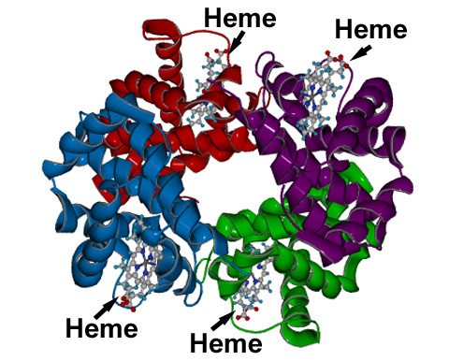
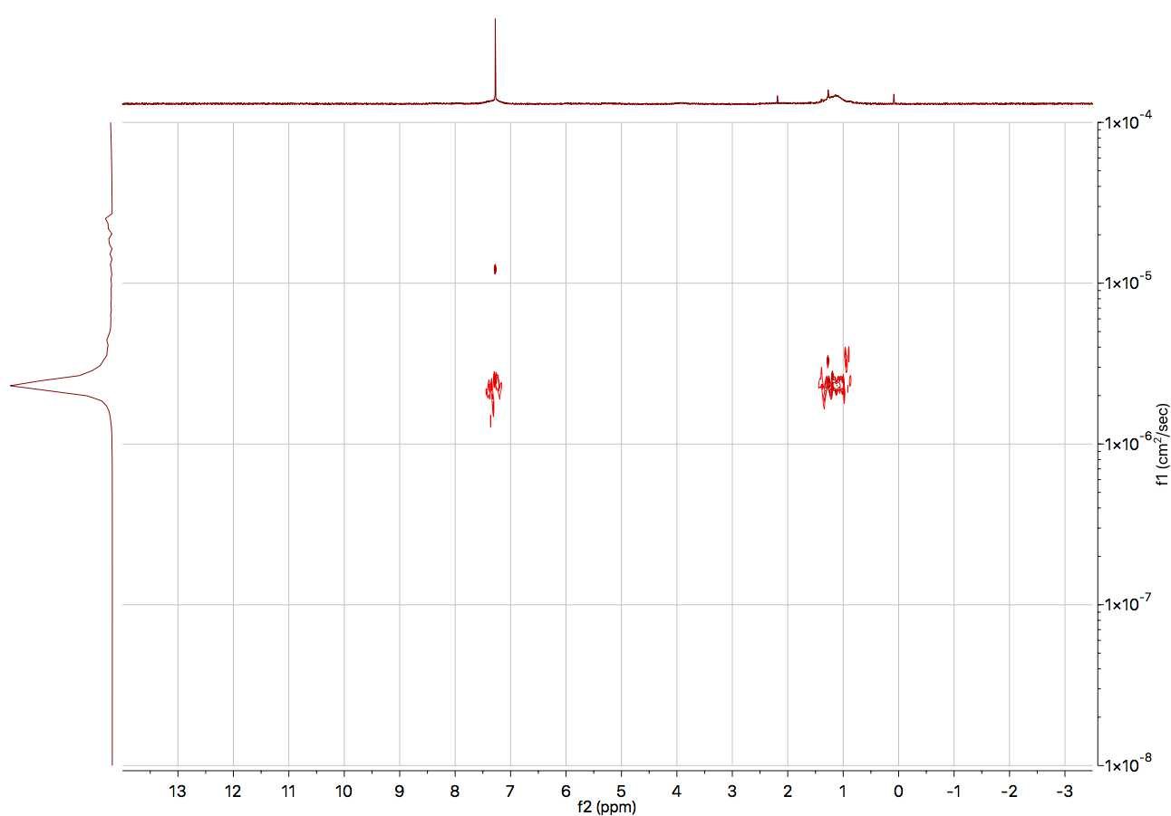
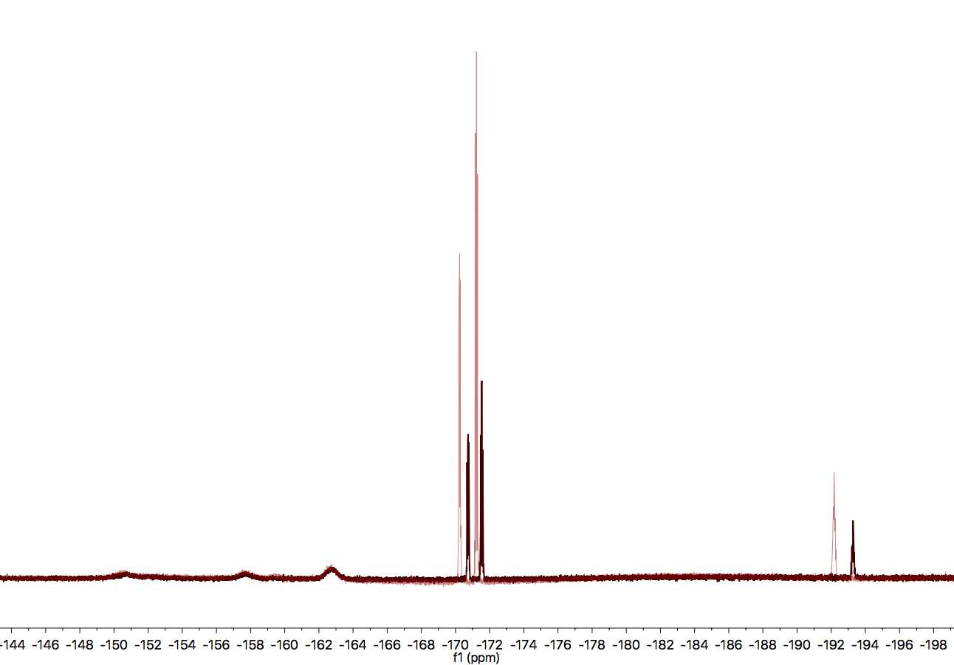
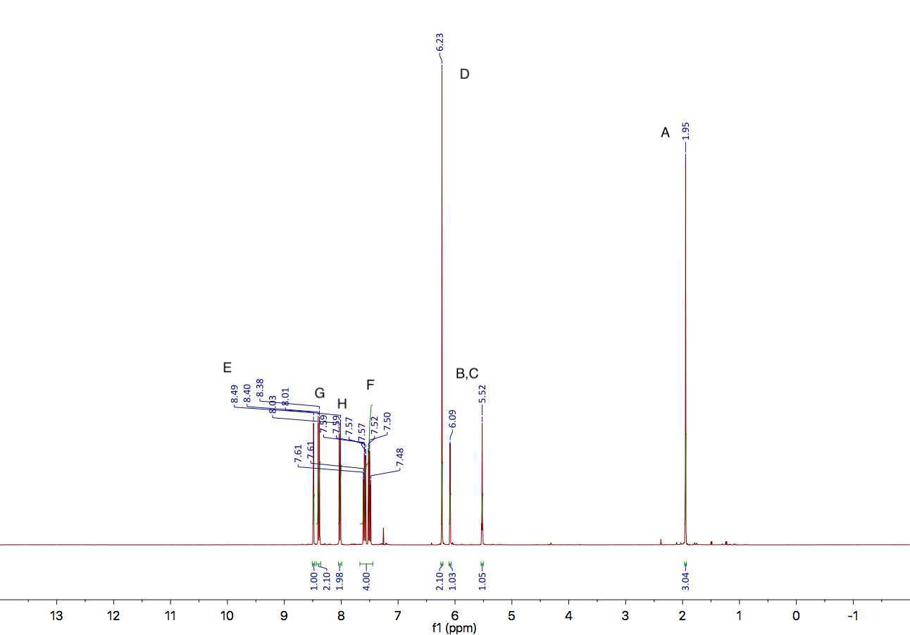
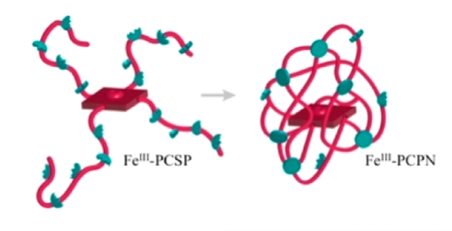
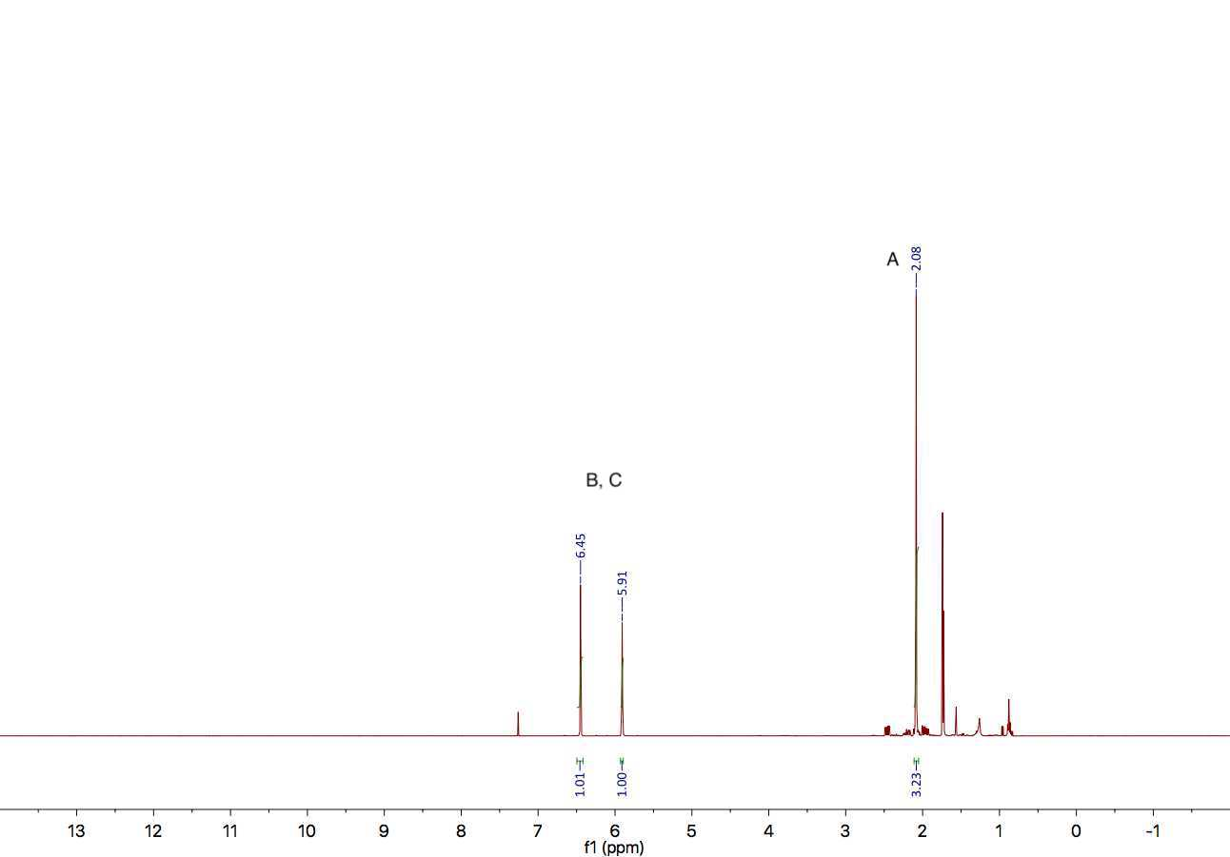
Synthesis and characterization of porphyrin-cored polymer nanoparticles that incorporate hydrogen bonding to model hemes
Drew Verrier, Brian Patenaude, Sam Pazicni
University of New Hampshire, Department of Chemistry
_{drv2000@wildcats.unh.edu}
Introduction
PCSP Synthesis and Modification
Heme proteins are a crucial part of biology that have a multitude of functions including electron transfer, small molecule sensing, and molecular oxygen transport, like in hemoglobin. Some important characteristics of the heme protein hemoglobin include the porphyrin-based iron heme cofactor which includes the primary coordination sphere of the heme iron, and the folded protein surrounding it which includes the secondary coordination sphere. The primary coordination sphere denotes the moieties directly bound to the heme iron, and the secondary coordination sphere denotes moieties adjacent to those directly bound. It is this secondary sphere that this research is concerned with, since it is believed that this is what primarily tunes the reactivity of the iron while the primary sphere mainly dictates function and is not easily changed.¹
Scheme 1: polymerization of monomer units and subsequent post-polymerization modification using isopropyl amine.
Figure 1: Structure of porphyrin-cored star polymer (PCSP)
Figure 2: Heme groups in hemoglobin (obtained from Wikipedia)
2 Hours
24 Hours
Monomer Synthesis
B, C
A
D
G
F
F
G
Porphyrin-cored polymer nanoparticles (PCPNs) offer a unique approach to replicate the secondary coordination sphere of heme iron to give a more representative model.² Using reversible-addition fragmentation chain transfer (RAFT) techniques, a co-polymer of anthracenylmethyl methacrylate and pentafluorophenyl methacrylate was synthesized.
H
F
E
F
H
Figure 5: DOSY of por(amma-co-IPAMA) in d₆-DMSO
Figure 6: ¹⁹FNMR showing replacement of PFPMA with isopropyl amine in d₆-DMSO.
Future Work
Iron will be inserted into the porphyrin core via an Fe(II)Br₂ reaction. Following this, the porphyrin-cored star polymer (PCSP) will be collapsed via a photodimerization of the anthracene monomer units using 350nm light into a porphyrin-cored nanoparticle. After this step, hydrogen bonding studies will be conducted to observe how different hydrogen bonding environments affect the heme iron reactivity. This will be done through the axially bound ligands on the iron. Continuing studies would including different incorporations of amine replacement to measure how the concentration of amine dictates hydrogen bonding efficacy. Along with this, different primary amines will be tested, such as hexylamine and ethylene glycol amine. These different amines offer various hydrogen bonding environments for the heme so that reactivites under different conditions can be observed.
Figure 3: ¹HNMR of AMMA in CDCl₃
A
B, C
Figure 7: Collapse of PCSP into a nanoparticle
These were chosen as functionalizable monomers susceptible to crosslinking and post-polymerization using primary amines, respectively. The goal of this research is to use this synthetic heme model to observe how different hydrogen bonding environments affect the heme iron reactivity.³
Acknowledgements
References
Kyle Rodriguez
The Hamel Center for Undergraduate Research for the Summer Undergraduate Research Fellowship (SURF)
UNH Chemistry Department
UNH Instrumentation Center
Graham Beaton, Mathew Currier, Sarah Lachapelle
Rodriguez, K. J. Dissertation. University of New Hampshire, 2017.
Cole, J. P.; Hanlon, A. M.; Rodriguez, K. J.; Berda, E. B. Protein-like Structure and Activity in Synthetic Polymers. J. Polym. Sci. Part A Polym. Chem. 2017, 55 (2), 191–206.
Rodriguez, K. J.; Hanlon, A. M.; Lyon, C. K.; Cole, J. P.; Tuten, B. T.; Tooley, C. A.; Berda, E. B.; Pazicni, S. Porphyrin-Cored Polymer Nanoparticles: Macromolecular Models for Heme Iron Coordination. Inorg. Chem. 2016, 55 (19), 9493–9496.
Figure 4: ¹HNMR of PFPMA in CDCl₃

