Slide 1

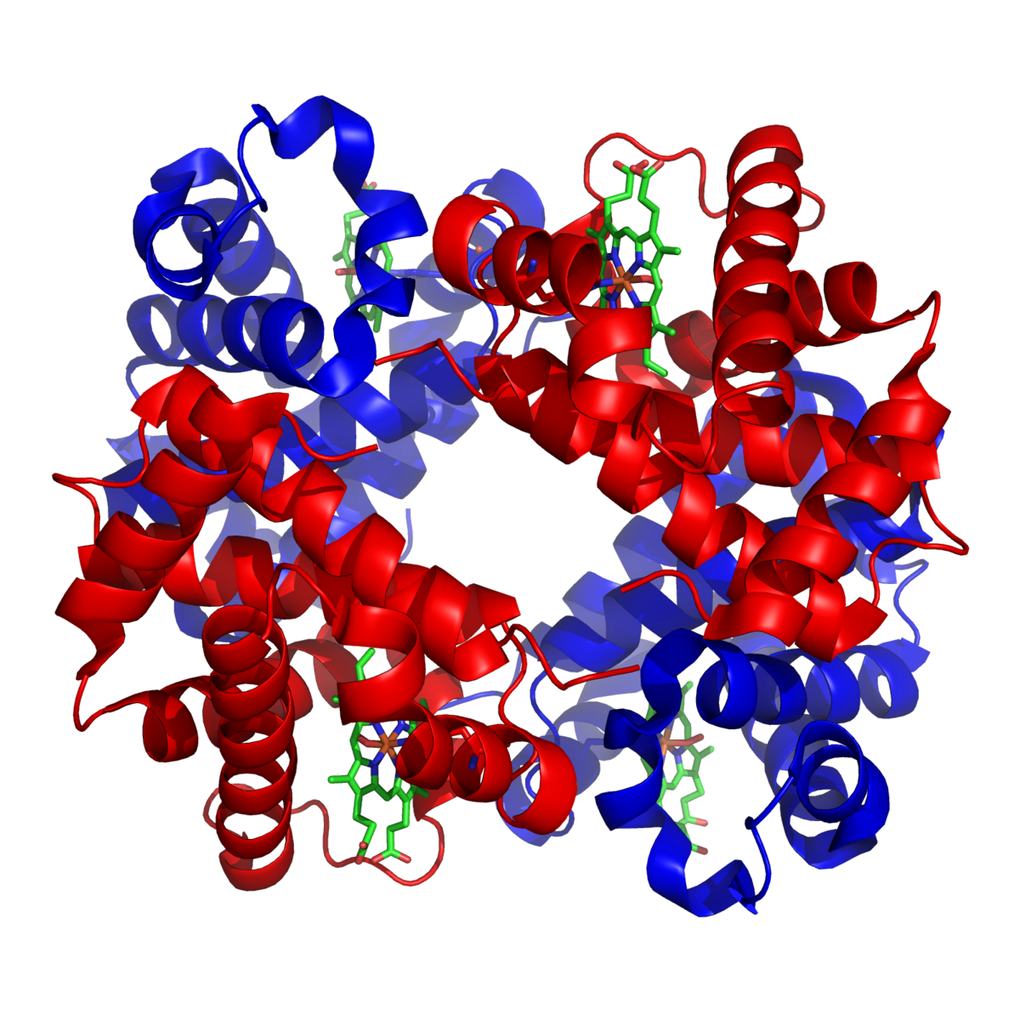
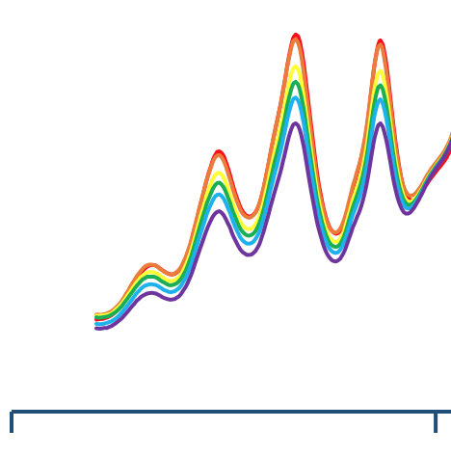
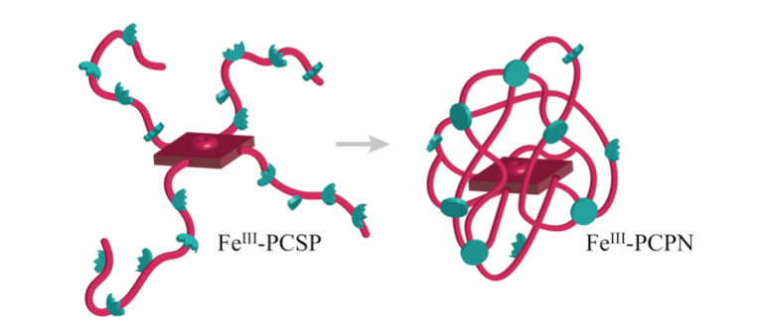
Probing the macromolecular environment of porphyrin-cored nanoparticles using exogenous ligands
Sarah Lachapelle, Brian Patenaude, Samuel Pazicni
skl1010@wildcats.unh.edu, Department of Chemistry, University of New Hampshire, Durham, NH
Spring 2018
Heme proteins have a wide range of biochemical functions. These functions include electron transfer, catalysis, and the transportation of oxygen molecules throughout the blood, such as in the well-studied molecule hemoglobin, pictured in figure 1.¹ Metal cofactors in proteins include two coordination spheres. The first of which, referring the molecules directly attached to the metal center, is primarily responsible for the function of the protein. While the second sphere, referring to the molecules
A multistep synthesis was performed to produce Por(MMA-co-AMMA)₄ with varying amounts of the polymer chain substituents methyl methacrylate (MMA) and anthracenylmethyl methacrylate (AMMA) (scheme 1). These star polymers were characterized by DOSY prior to and following the collapse into nanoparticles via a photodimerization of the anthracene units (figures 2 & 3).
Scheme 1. Synthetic Route to Por(MMA-co-AMMA)₄ by reacting MMA and AMMA with a porphyrin cored chain transfer agent.
The collapse of Por(MMA-co-AMMA)₄ was monitored via UV-Vis spectroscopy (figure 3). The reduction of the anthracene signal indicated the collapse was successful. The DOSY characterization showed a shift in the diffusion coefficient, representative of a change in the Stokes radius upon collapse (figures 4 & 5).
Figure 3. UV-Vis spectrum of Por(MMA-co-AMMA)₄ collapse in THF with a close up of the change in absorbance from approximately 300 to 400 nm.
To further construct the calibration curve needed to characterize the porphyrin cored nanoparticles, polymethyl methacrylate standards are to be independently characterized with gel permeation chromatography (GPC) to complement the DOSY analysis. Porphyrin-cored star polymers with chains consisting of anthracenylmethyl methacrylate and pentafluorophenyl methacrylate are to be synthesized, as seen in scheme 2.
Scheme 2. Synthetic Route to Por(PFPMA-co-AMMA)₄ by reacting PFPMA and AMMA with a porphyrin cored chain transfer agent.
This system will used as a template for subsequent primary amine replacement of the pentafluorophenyl methacrylate with isopropyl, hexylamine, and ethyleneglycol amine groups afford amide groups that serve as hydrogen bond donors. Studies will be performed binding imidazole and carbon monoxide groups to the iron center to interrogate the effect of the various hydrogen bonding environments provided by the amide substituents, monitored by UV-Vis spectroscopy.
A successful collapse of the porphyrin-cored star polymers was observed using two independent methods; UV-Vis spectroscopy and diffusion NMR (DOSY). The DOSY data will form the basis of the calibration curve used to characterize future polymers which will allow for the investigation of second coordination sphere interactions with ligand binding to the iron(III) center.
Fanelli, A. R.; Antonini, E.; Caputo, A. Advances in Protein Chemistry. 1964, 73–222.
Rodriguez, K. J., Hanlon, A. M., Lyon, C. K., Cole, J. P., Tuten, B. T., Tooley, C. A., Pazicni, S. (2016). Porphyrin-Cored Polymer Nanoparticles: Macromolecular Models for Heme Iron Coordination. Inorganic Chemistry, 55(19), 9493–9496.
Rodriguez, K. J. Modeling Secondary Coordination Sphere Interactions in Heme Proteins: From Small Molecule Ligands to Macromolecular Porphyrin-Cored Polymer Nanoparticles, University of New Hampshire, 2017.
Introduction:
Results and Discussion:
Future Work:
adjacent to the primary sphere, has the ability to influence the protein’s reactivity.² This project aims to model the secondary coordination sphere interactions through the investigation of macromolecular porphyrin-cored nanoparticles.
Figure 1. Three dimensional representation of the heme protein hemoglobin.¹
300
400
Experimental Design:
Figure 4.
DOSY characterization of Por(MMA-co-AMMA)₄ prior to the collapse in d₆-DMF.
Conclusions:
Figure 5.
Plot of the change in diffusion coefficient peak of Por(MMA-co-AMMA)₄ over the increments of the collapse in d₆-DMF.
Figure 2. The collapse of the porphyrin-cored star polymer into a porphyrin-cored nanoparticle via photodimerization.
hv
References:
Figure 3. The 4πs-4πs crosslinking photo dimerization of the anthracene units present on the porphyrin-cored star polymer.³
Acknowledgments:
I would like to thank Brain Patenaude, Drew Verrier, Matthew Currier, and the University of New Hampshire Department of Chemistry for their support.

