Slide 1

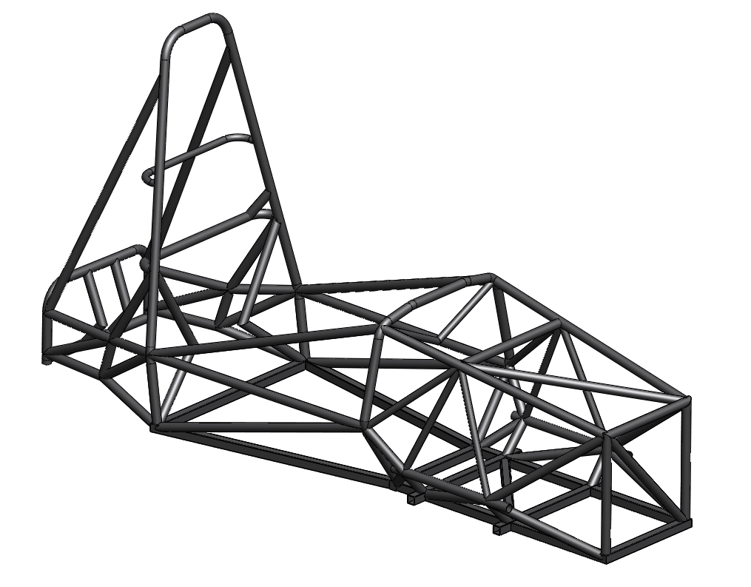
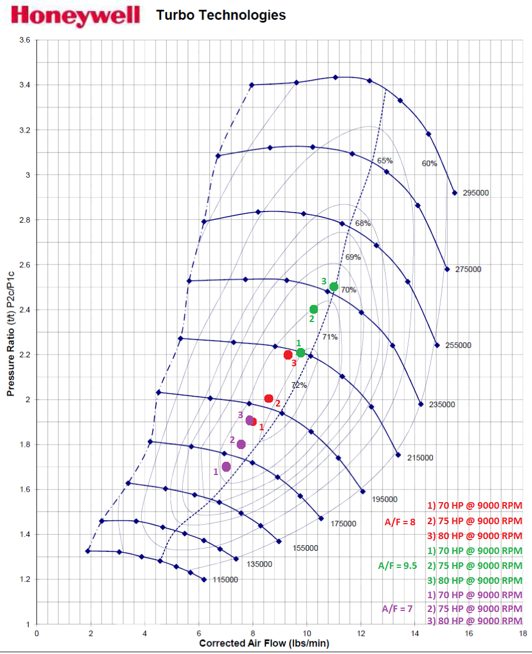
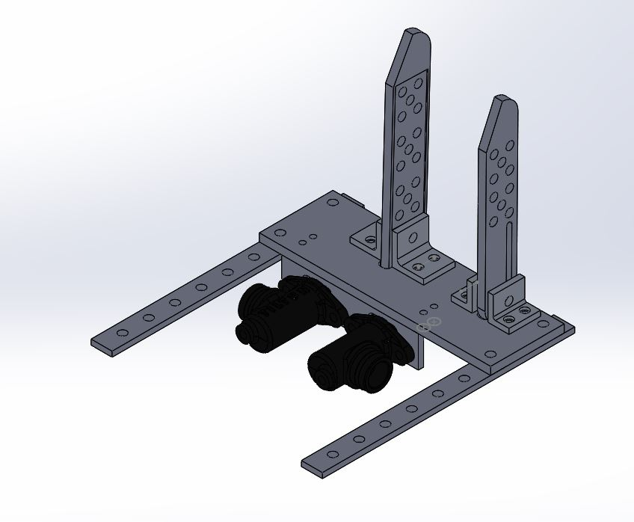
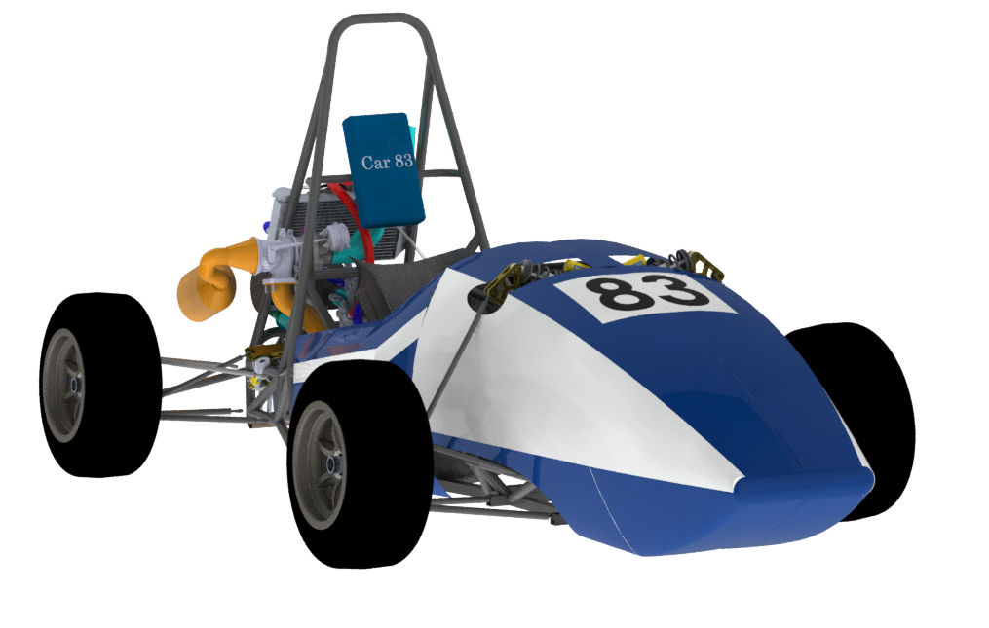
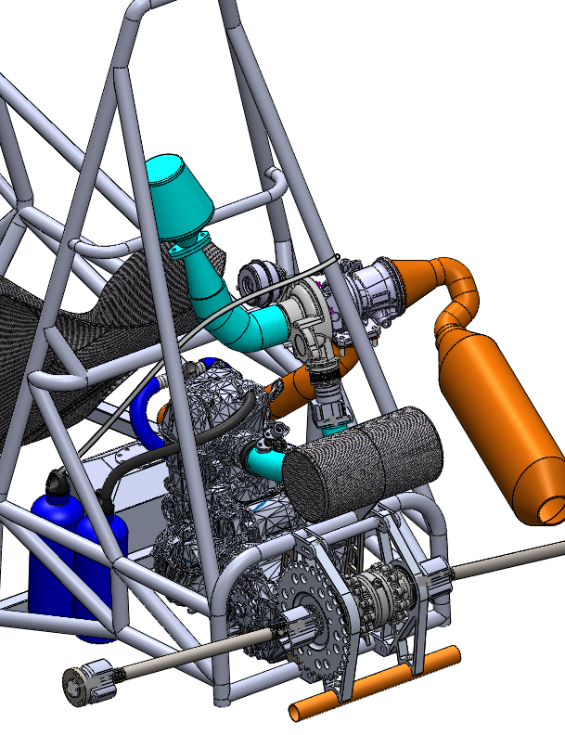
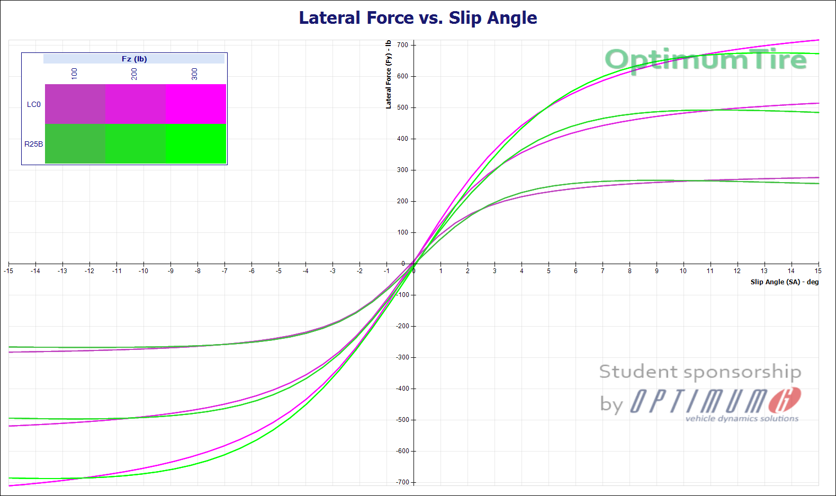
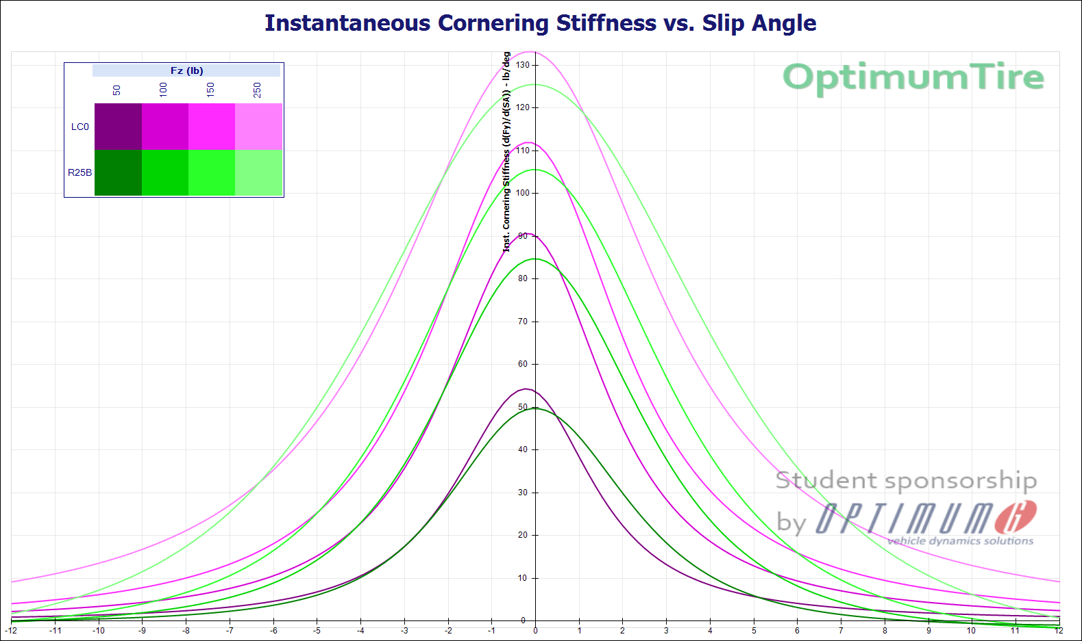
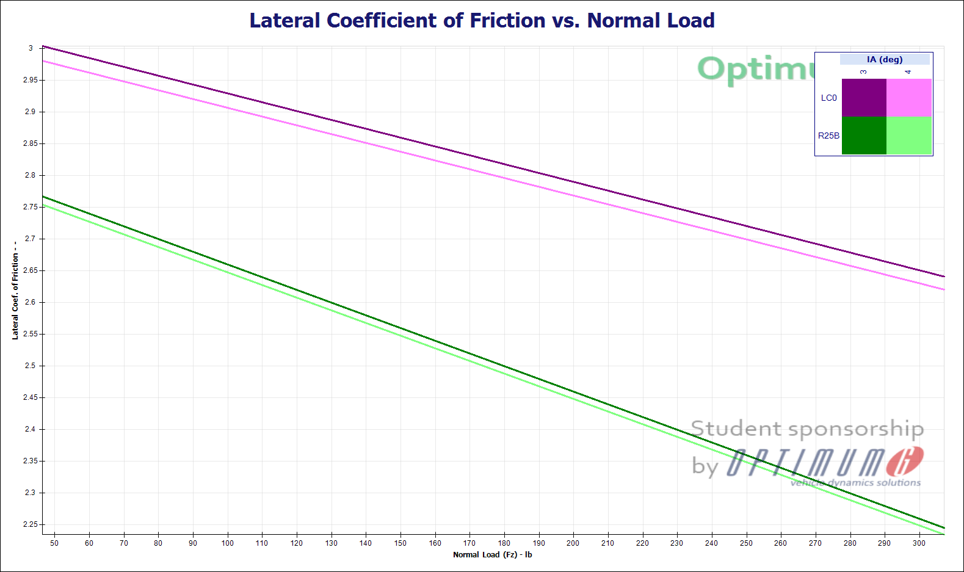
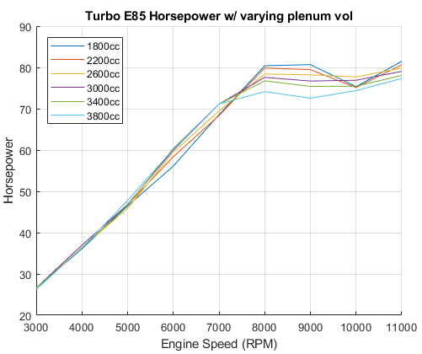
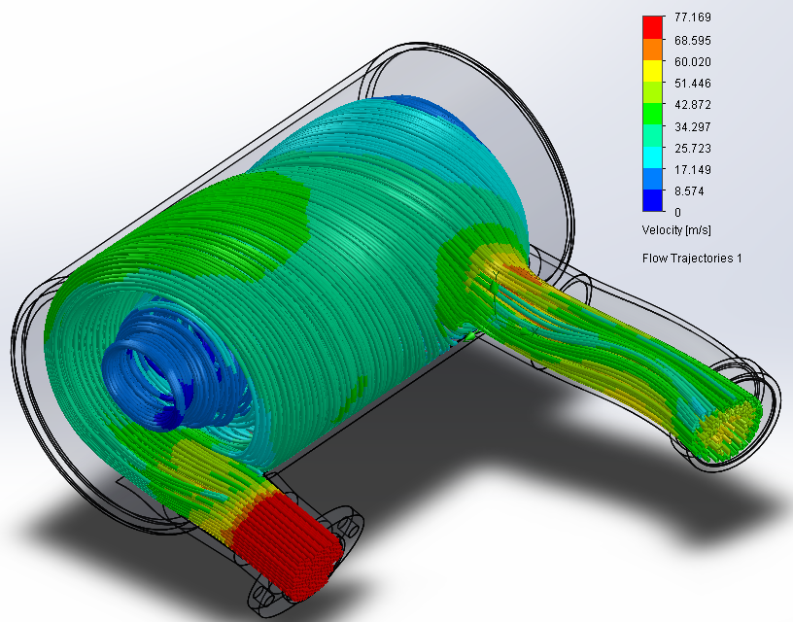
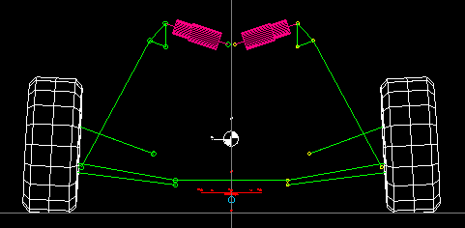
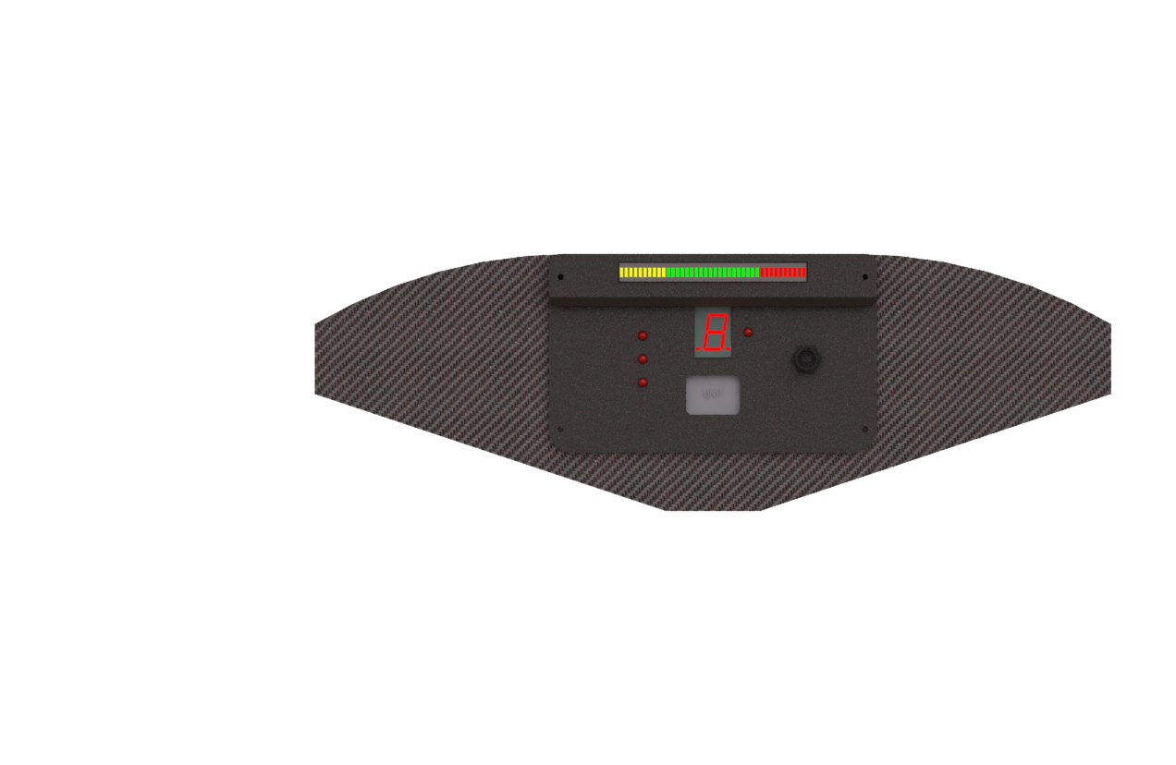
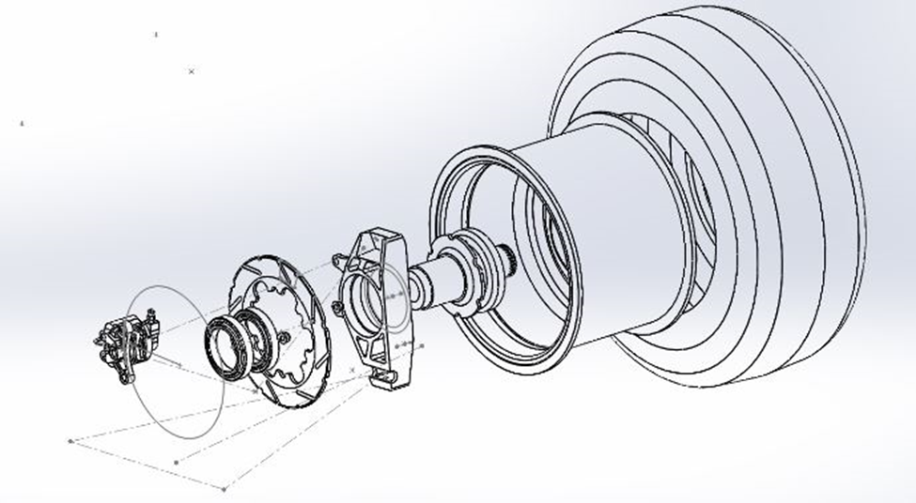
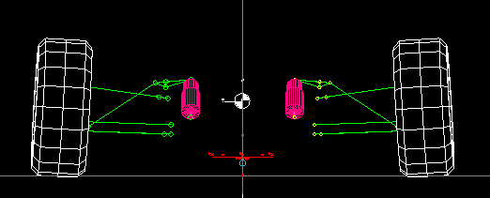
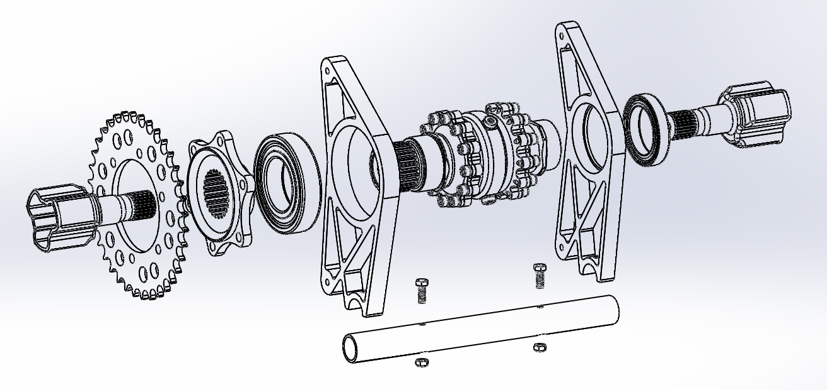
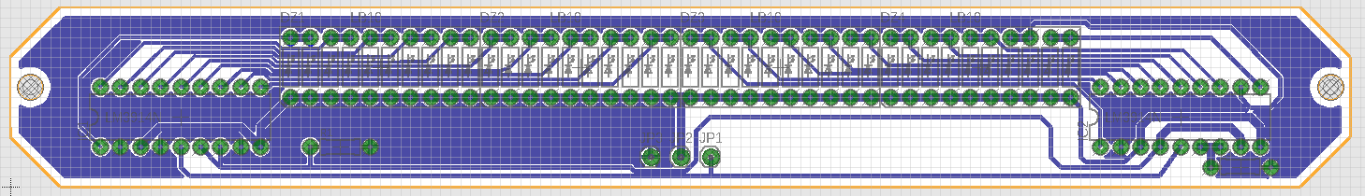

Frame
Engine & Drivetrain
Redesign of frame to reduce engine bay size due to smaller engine to minimize frame weight
Lowered the center of gravity by .5” lowering roll hoops resulting in a COG of 9.73” vertically
Frame design simulated in SolidWorks for stress and strain of 1020 cold rolled steel, manufactured and TIG welded by students
Total mass of 68 pounds with a torsional rigidity of 1450 N-m/degree
Engine: 2017 KTM 450 SX-F:
  449.9 cc Displacement
  Stroke: 63.4mm, Bore: 95mm
  12.75:1 Compression Ratio
  AT Power 36mm Throttle Body
  Rekluse COREEXP 3.0 Auto Clutch
Honeywell Garrett MGT1238Z Turbocharger
  0.38 A/R ratio
  Capable of up to 150 HP
  Lightweight at 5.58 kg
  Dual water/oil cooling system
  Integrated wastegate and recirculation valve
Drivetrain:
  Adjustable differential carrier for chain tensioning
  Tunable Drexler differential
  12/36 tooth drive ratio chosen to optimize usable powerband
Presented By:
Scott Bednarz Trevor Bednash Kyle Carmichael
Steven Farrell Erik Garcia Brendan Grenier
Yagoub Hashim Hunter Lamphere Keith Nason
Brian Rainville Jacob Savoie Nathan Soucy
Controls
Adjustable pedal placements:
  Two pedal system: Throttle and Brake
  Designed to accommodate the 95th percentile male
  Must withstand 2000N force from the driver
Cast Iron Brake Rotors with GB moto calipers:
  Made from cast iron featuring better thermal properties
  than low carbon steel
  Brakes feature floating rotor setup with slots for ventilation
Installed clutch on shifter:
  Implemented hydraulic clutch to reduce risk of stalling
  Installed push-pull cable to lighten shifting mechanism
MGT12 Compressor Map
Intake:
  Completely redesigned plenum with uniaxial layup for stiffness.
  Different internal volumes tested on dynamometer, 2200cc volume determined to optimal
  Improved fuel combustion efficiency by changing injector location and spray pattern
  Custom 19mm restrictor to conform to competition rules
Exhaust:
  Larger diameter tubing to increase flow velocity while keeping full system under 10 lbs.
  Factory FMF 4.1 RCT muffler to abide by noise regulations
Wheels & Tires
LC0 Hoosier Tires and lightweight OZ Magnesium wheels weigh 11 pounds each
Car #083 Model
Suspension
Reduced un-sprung weight to the four suspension corners
  Uprights machined from 7075-T6 Al. to increase ultimate tensile strength by 55% from 6061-T6 Al.
  Redesigned rear corner suspension, eliminating linkage bending and reduced forces on A-Arm members to allow for a lighter design
Incorporated Adjustability
  Easy suspension tuning with adjustable ride height, spring pre-load, tire camber, and toe angle
Improved cornering
  Widened front and rear track width by 1.5 inches
  Improved theoretical front to rear frequency response for increased driver response and handling
Packaging Layout
Electrical System
Fuel System:
  Converted to run E85
  45 lbs/hr (470cc) injector
  Completely redesigned from previous iteration
Computerized Dash Box
  Engine RPM LED display, single digit gear indicator display, LCD, warning lights, USB plug for downloading data
CAN bus communication for reliable communications between modules
Engine Control Unit
  Microsquirt ECU, monitors engine conditions and adjusts fuel and ignition
  Monitors intake temperature and pressure, coolant temperature, crank position, exhaust gas
  Enables RPM limits for launch control and flat shifting using clutch position
Printed Circuit Boards designed and made for reliable and well-packaged wiring connections
Wiring Harness
  SAE J1128 wire suited for automotive applications, with sealed connectors
Throttle Controller
  Module utilizes pedal positions with throttle position as feedback
  Adjustable parameters for response and idle position
Projected power curve
Flow simulation of 2200cc plenum
Front suspension modeling in Lotus software
Dash plate with computer box
Electronic board design of LED RPM display
Exploded view of suspension
Rear suspension modeling in Lotus software
Exploded View of Differential Assembly
Special Thanks to: Sheri Millette, Tracey Harvey, Sheldon Parent, Lauren Foxall, Hitchiner Manufacturing, Diamond Casting, Service Credit Union, B&B Excavating, UNH Parents Association, Todd Gross, Scott Campbell, Sheldon Parent

