Slide 1

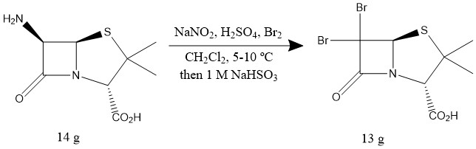
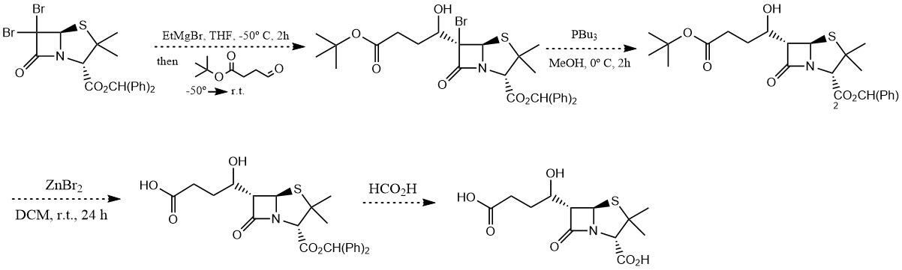
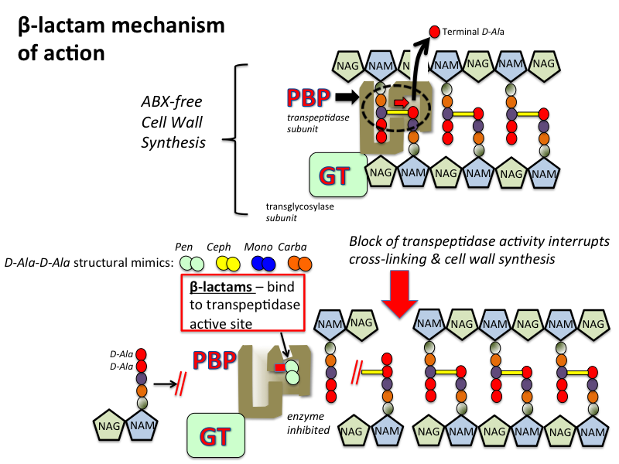
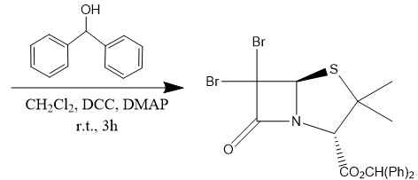
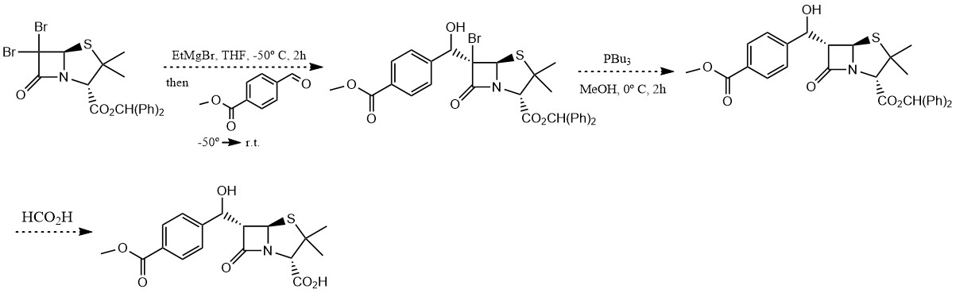
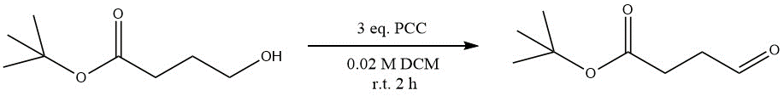
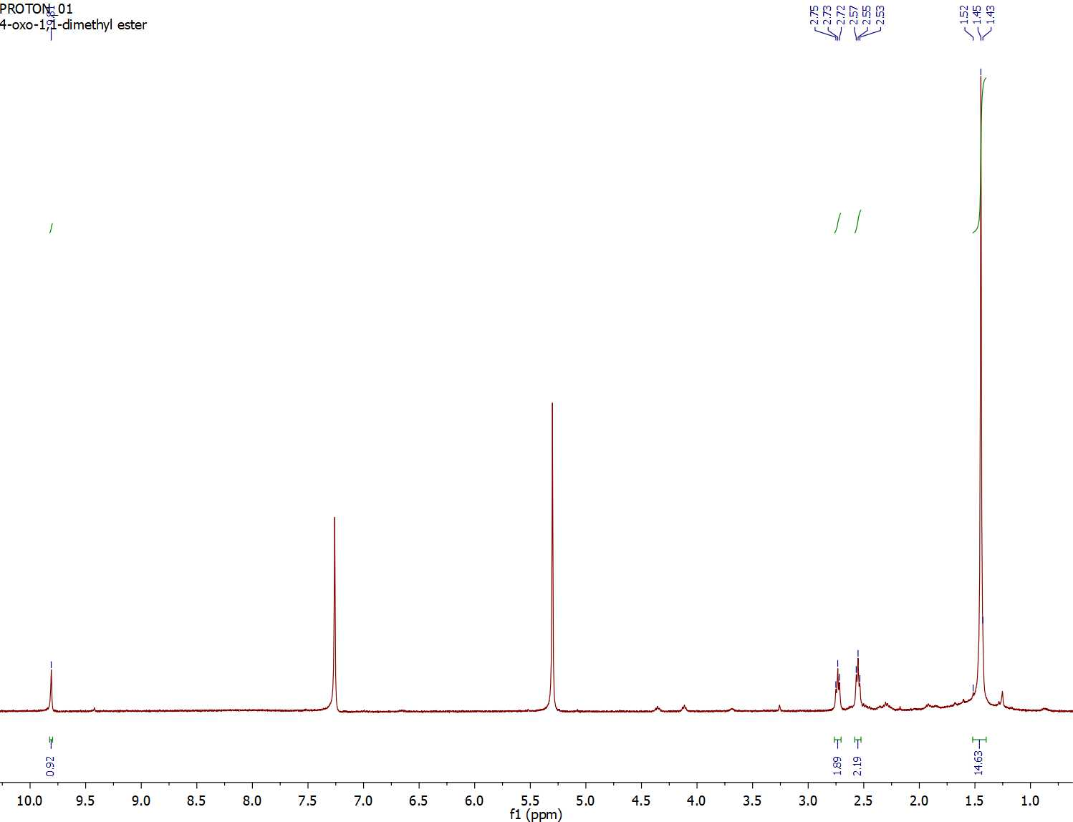
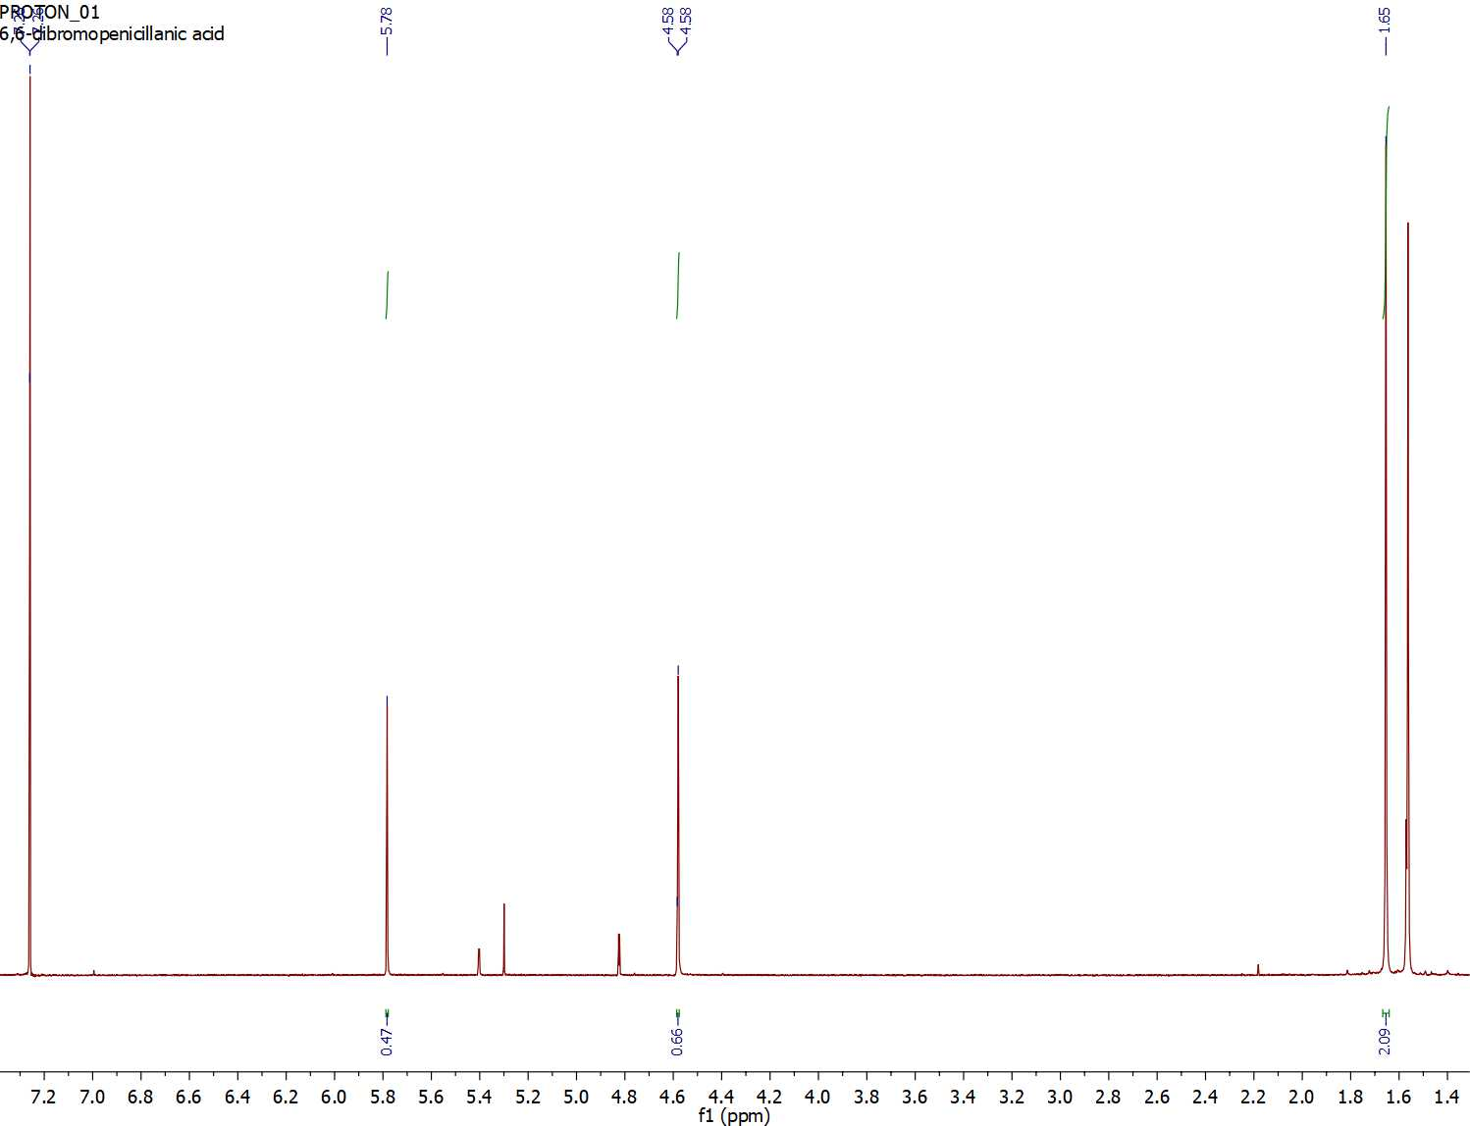
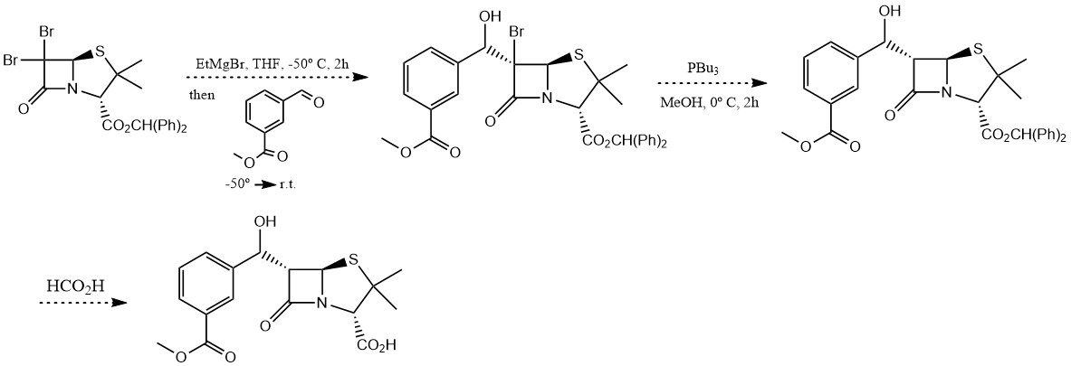
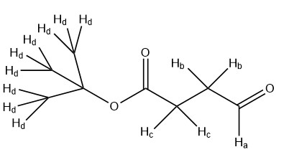
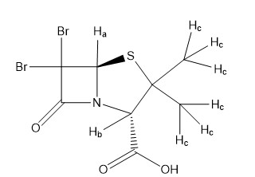
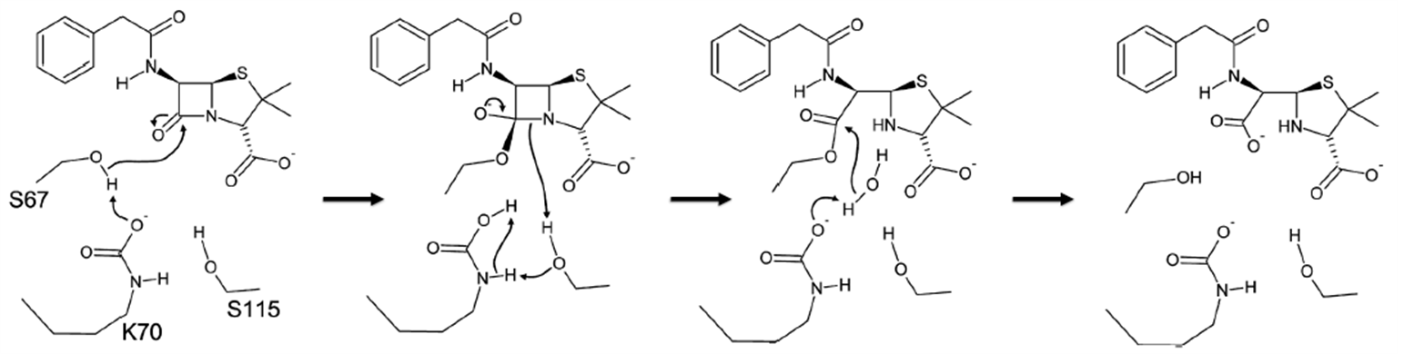
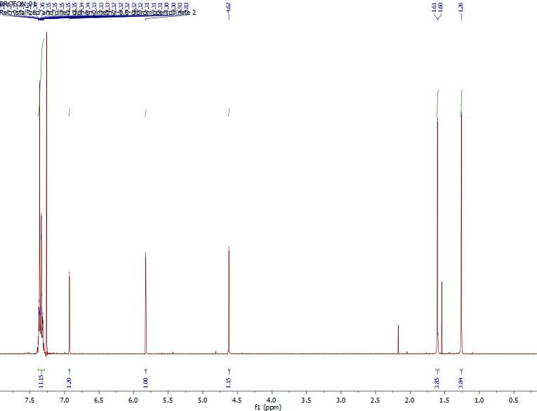
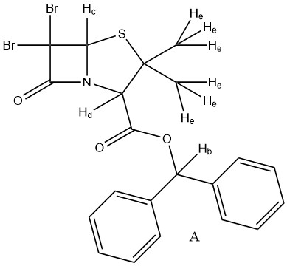
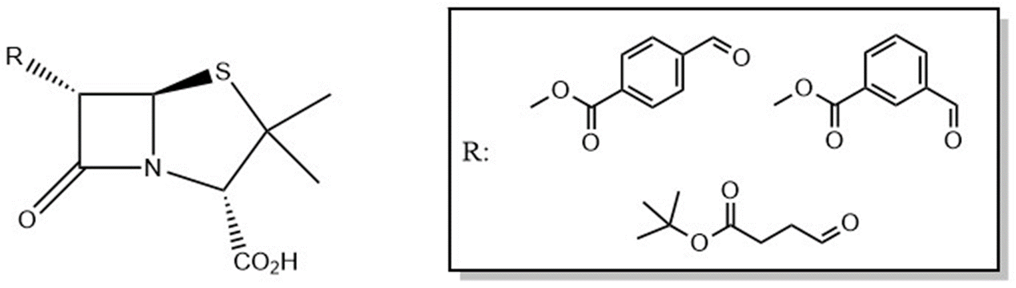
Deactivation of Carbapenem-Hydrolyzing Class D β-Lactamases (CHDLs) Through the Modification of C6-Substituted Penicillin Derivatives
Alyssa Bangrazi, University of New Hampshire
Deisy Pena Romero, Ph. D., University of New Hampshire
Background
Experimental
Future Research
Gram-negative bacteria, which is responsible for various infectious diseases such as E. coli, the plague and certain types of pneumonia, has recently begun threatening the global public health.¹ The bacteria excretes an enzyme known as a Penicillin Binding Protein (PBP) which contains an active site capable of promoting bacterial cell wall synthesis (figure 1).²
Scheme 1: Synthesis of 6,6-dibromopenicillanic acid.⁸
Figure 1: The enzyme, Penicillin Binding Protein, cross links the bacterial cell wall to promote cell wall synthesis.³
Scheme 4: Grignard reaction of diphenylmethyl-6,6-dibromopenicillinate using Butanoic acid.
β-lactam antibiotics work by binding to the active site of the PBP to inhibit their role in this process (figure 2).²
Scheme 2: Synthesis of diphenylmethyl-6,6-dibromopenicillanic acid.⁹
Figure 2: β-lactam antibiotics bind to the active site of PBPs, inhibiting their role in bacterial cell wall synthesis.³
H⁺
Scheme 3: Oxidation of Tert-butyl 4-hydroxybutanoate to Butanoic acid.
Results
Scheme 5: Grignard reaction of diphenylmethyl-6,6-dibromopenicillinate with para(methoxycarbonyl) benzaldehyde.¹⁰
To combat this, the bacteria excretes another enzyme known as a β-lactamase. This enzyme is capable of inactivating three major classes of antibiotics, penicillin, cephalosporin and carbapenem, through a hydrolysis reaction (figure 3).
A
B
C
H⁺
Figure 3: The inactivation of penicillin through the hydrolysis of the four-membered β-lactam ring by a class D β-lactamase.
A
B
C
D
Scheme 6: Grignard reaction of diphenylmethyl-6,6-dibromopenicillinate with meta(methoxycarbonyl) benzaldehyde.¹⁰
Previous research was conducted at the Grand Valley State University which studied the crystal structure of class D β-lactamase OXA-1 containing a carboxylysine-70 (KCX-70).⁶ KCX-70 hydrogen bonds with the hydroxyethyl chain at C6 of the carbapenem antibiotic doripenem, showing that modifications in the C6 position are ideal due to the groups close proximity.⁶
Additionally, research was performed at the University of Siena which studied crystal structure of OXA-46 with bound tartrate.⁷ The structure showed that lysine, the group which is responsible for the hydrolysis reaction, exists in its decarboxylated state;⁷ which suggests that electrostatic effects may prevent the negatively charged carboxylysine from forming when an anion is present.⁷
Figure 4: 400 MHz ¹H NMR of Butanoic acid in CDCl₃.
Figure 5: 400 MHz ¹H NMR of 6,6-dibromopenicillanic acid in CDCl₃.
References
National Institute of Allergy and Infection Diseases. NIH, 2016
Michigan State University. MSU, 2011
Tulane University. TUSOM, 2016
Antunes, N.T. et al. Antimicrob. Agents Chemother, 2014, 10, 1128.
Leonard, D. A. et al. Acc. Chem. Res. 2013, 46, 1021.
Schneider, K. D. et al. Biochemistry 2009, 48, 11840-11847.
Docquier, J. D. et al. Antimicrob. Agents Chemother. 2010, 54, 2167-2174.
Volkmann, R. A. et al. J. Org. Chem. 1982, 47, 3344-3345.
Wei L. X. et al. Synthesis. 2004, 442-446.
Testero, S. A. et al. Org. Lett. 2009, 11, 2515.
Research Objectives
Acknowledgements
c
Dr. Marc Boudreau
Dr. Charles Zercher
Dr. Deisy Pena Romero
MJ Ohoueu
Jon Fifer
Bill Butler
Stacie Stuut
Nick Arnista
Junfu Chen
Tim Tetrault
UNH Department of Chemistry
UNH Instrumentation Center
My Fellow Chemistry Majors
C
E
A
B
C
D
To modify C6-substituted penicillin derivatives by synthesizing analogues with anionic functional groups.
To inhibit CHDLs either by preventing the lysine carboxylation or interfere with the enzyme’s role in catalysis of hydrolysis of β-lactam antibiotics.
Contact Information
Figure 5: 400 MHz ¹H NMR of diphenylmethyl-6,6-dibromopenicillanate in CDCl₃.
Email: ab2015@wildcats.unh.edu
Phone: (603) 988-7550

