Slide 1

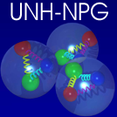
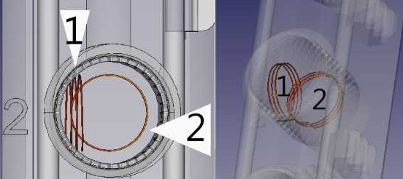
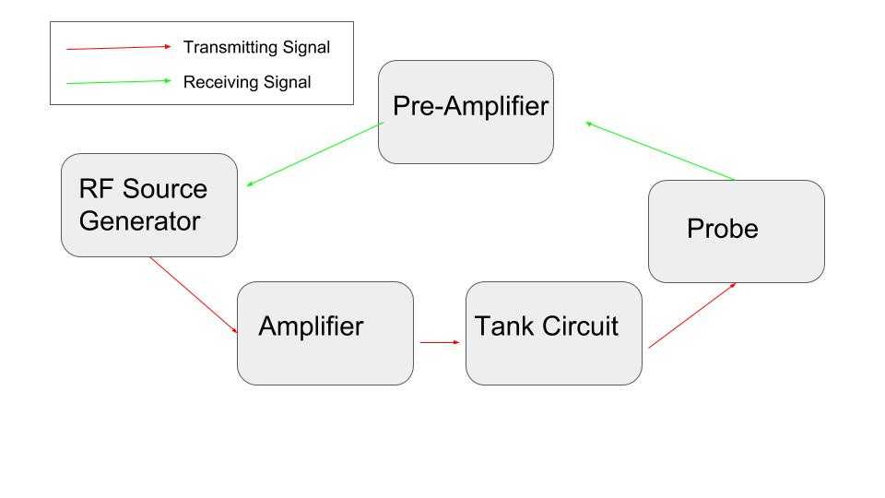
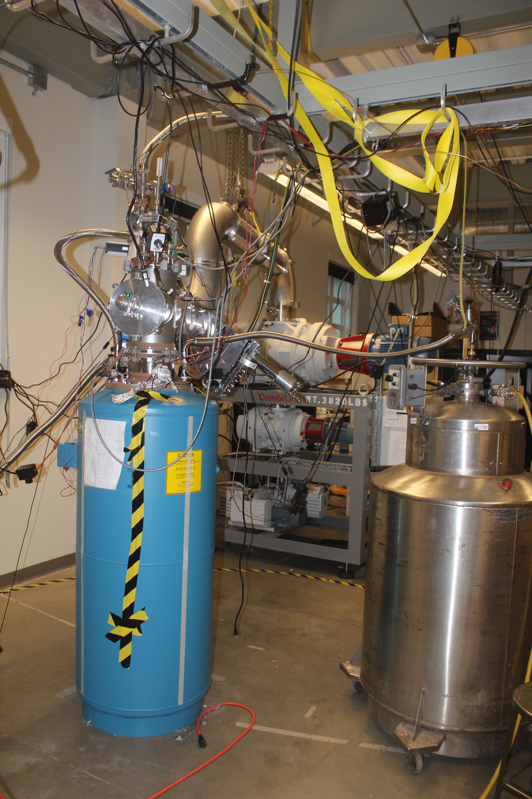
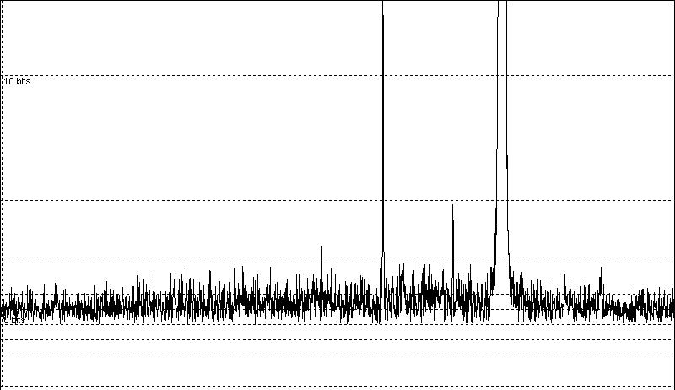
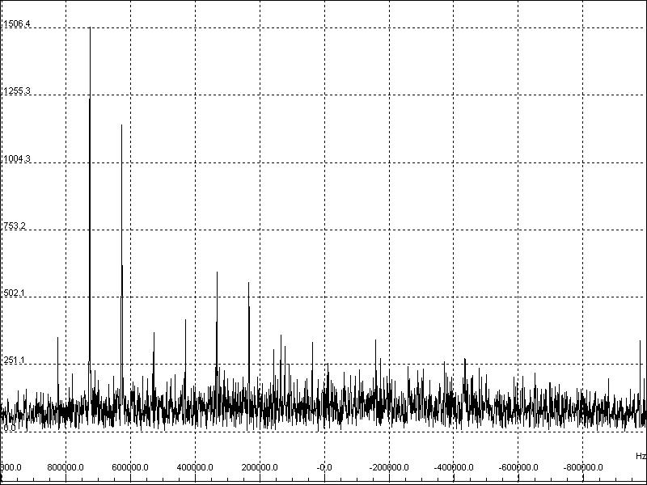
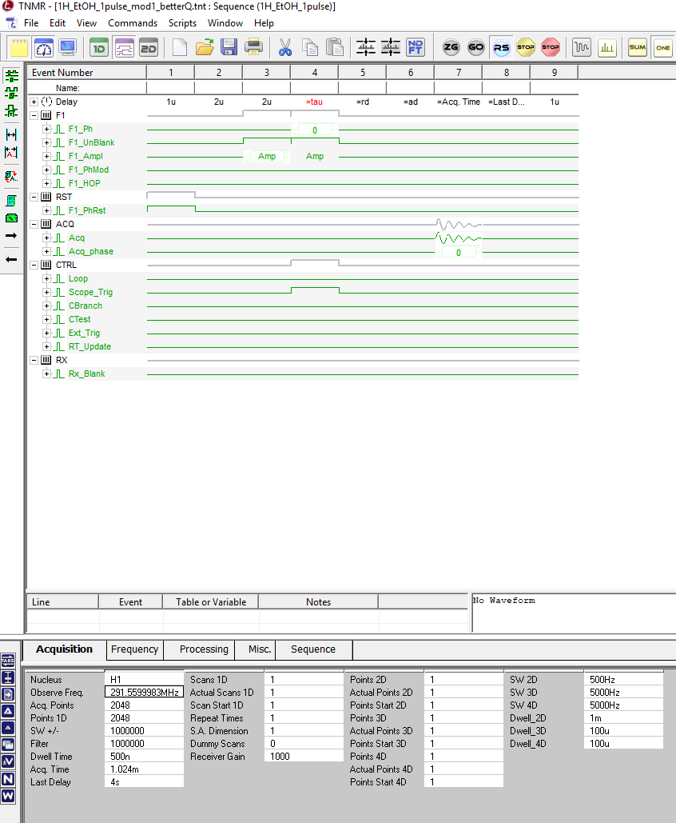
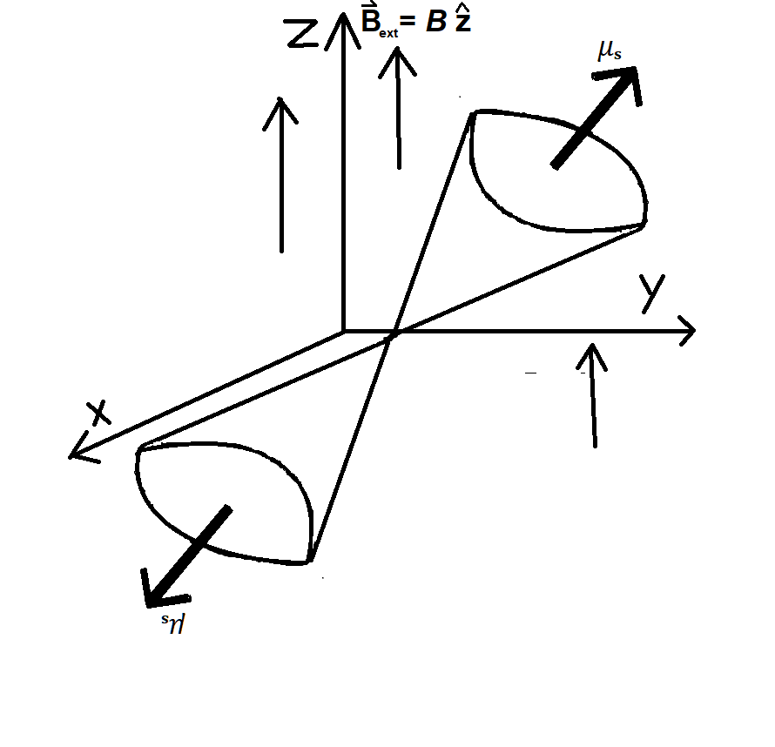
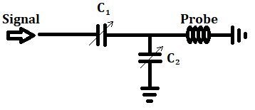
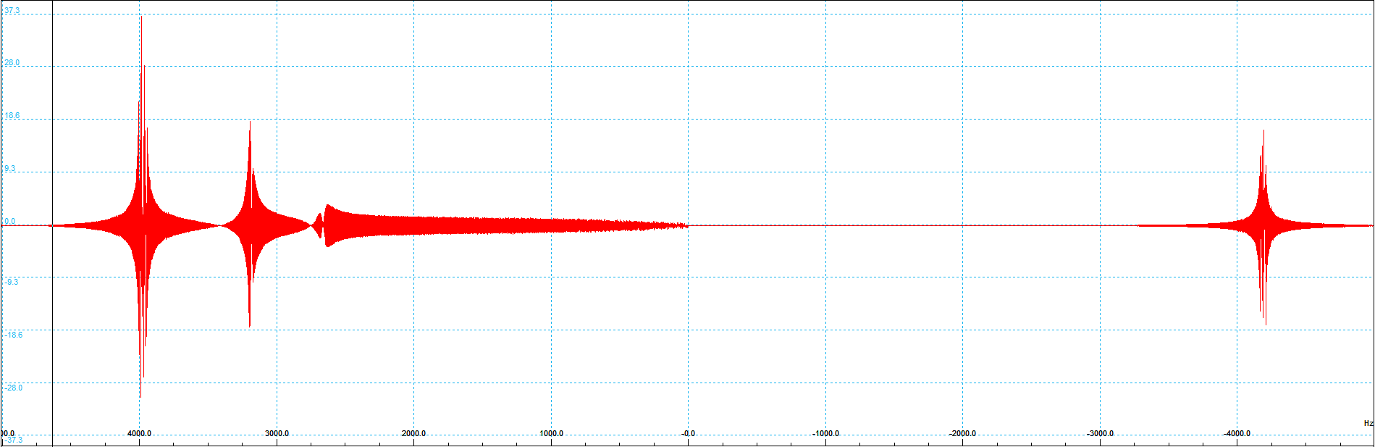

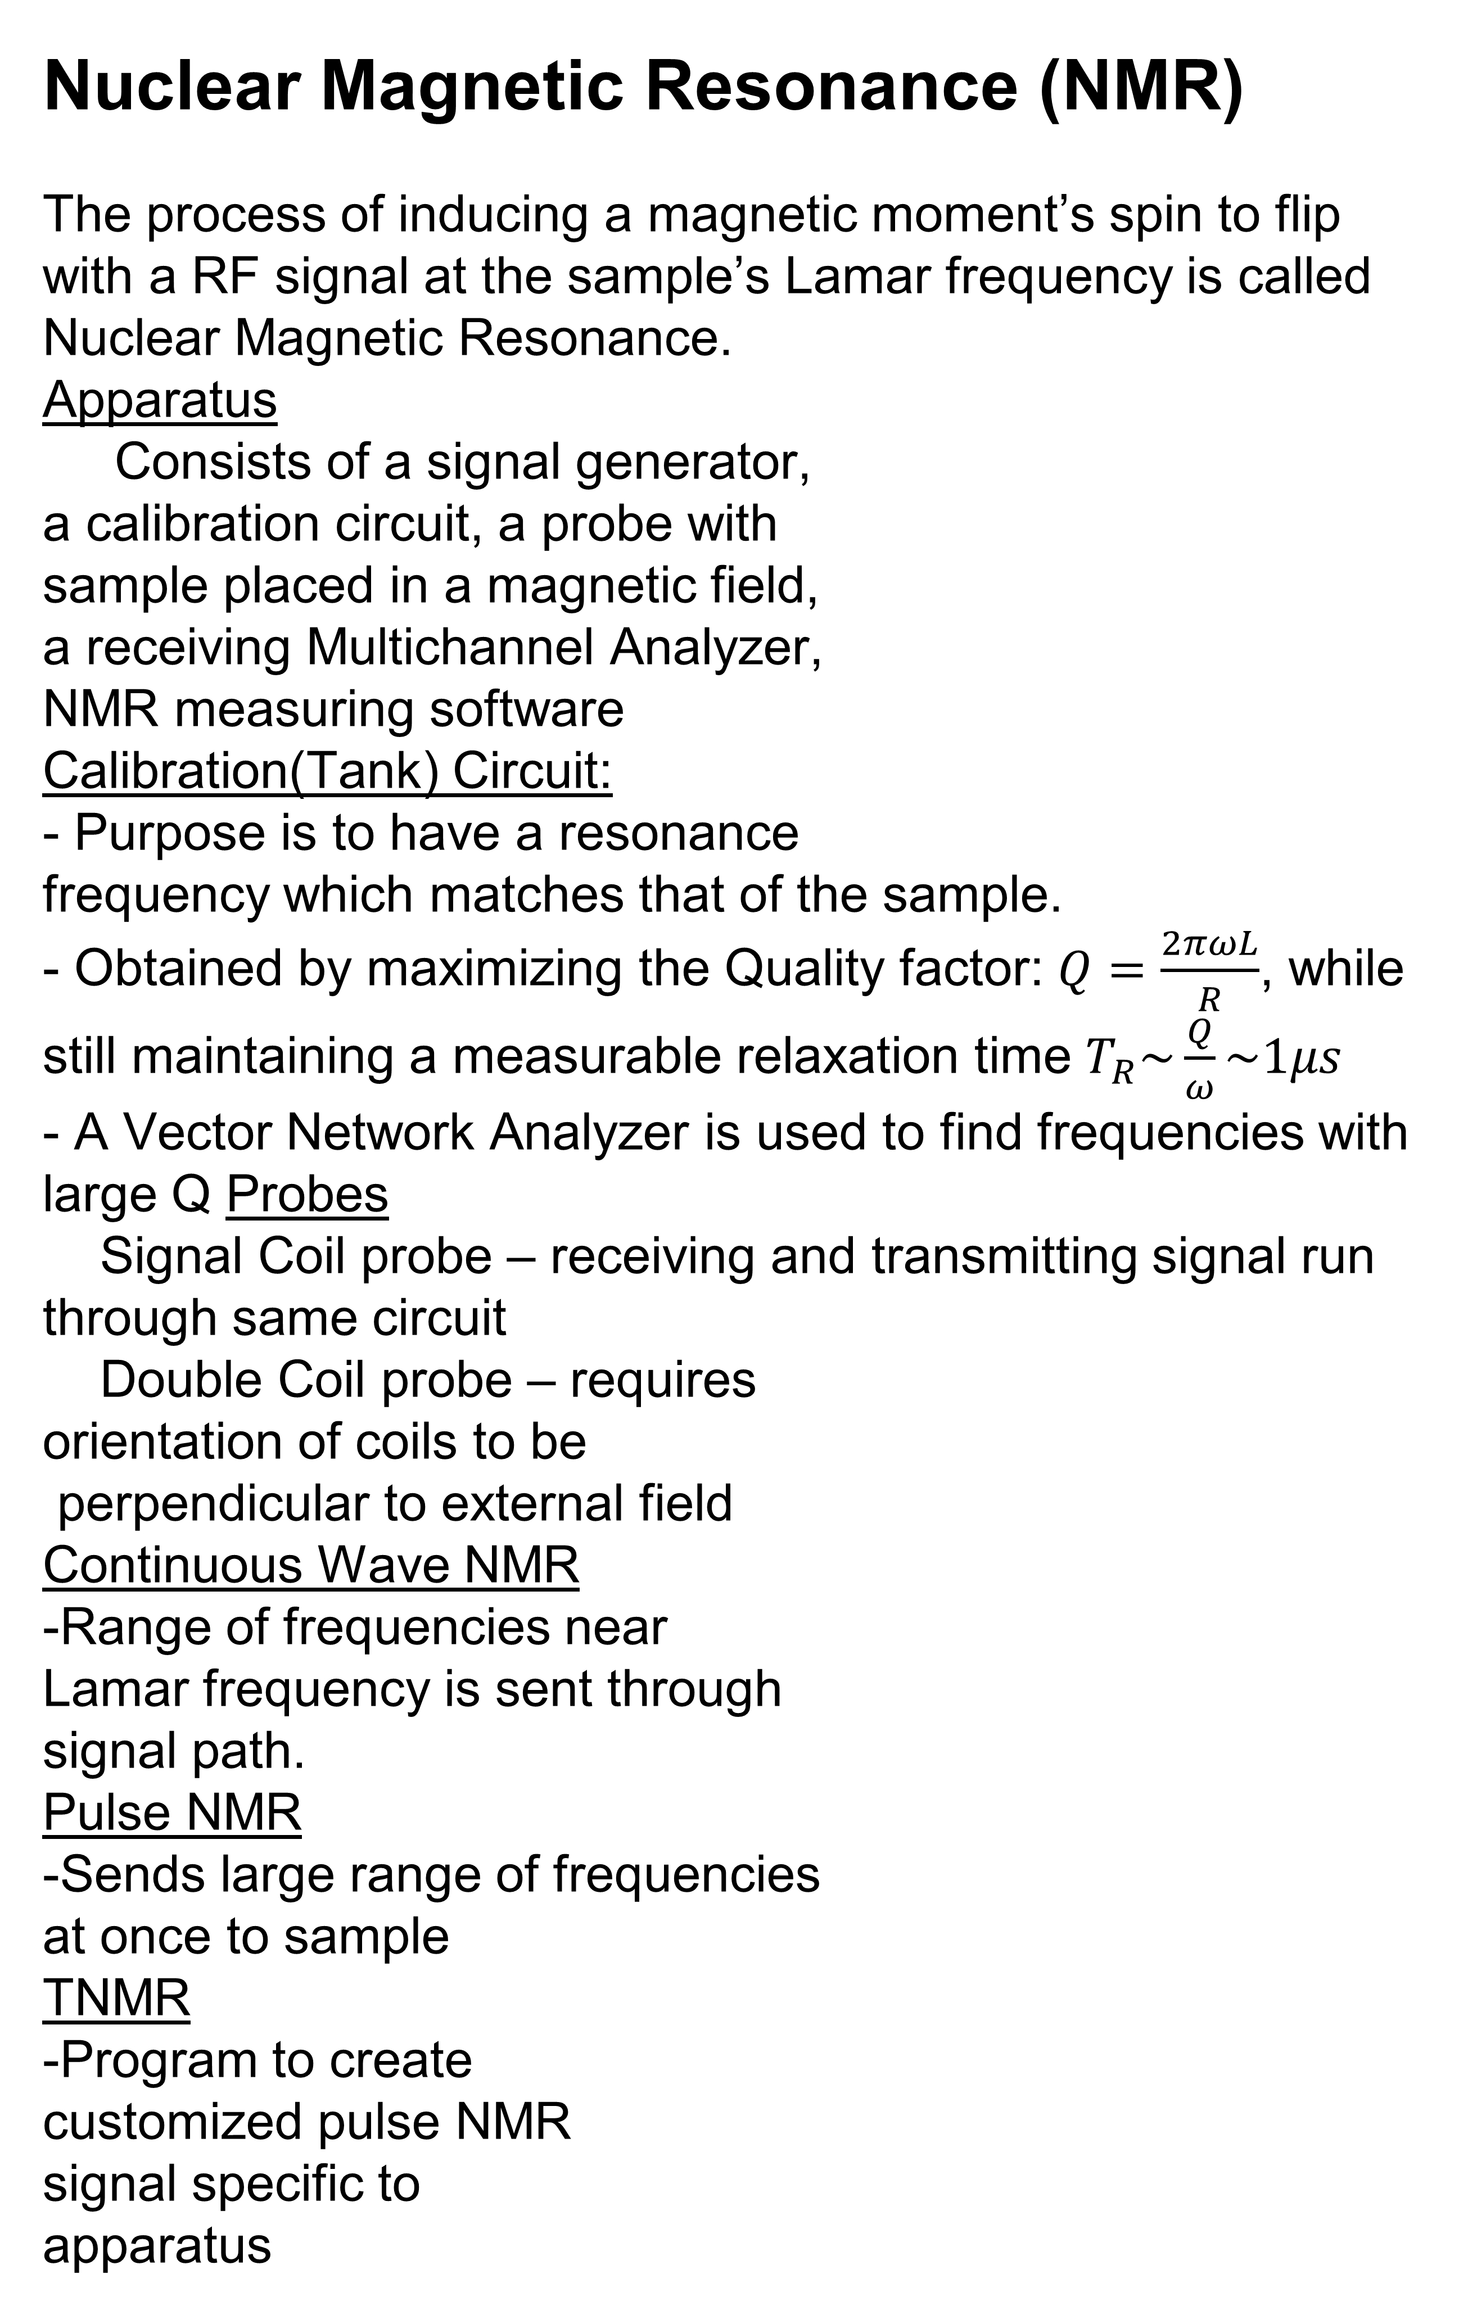
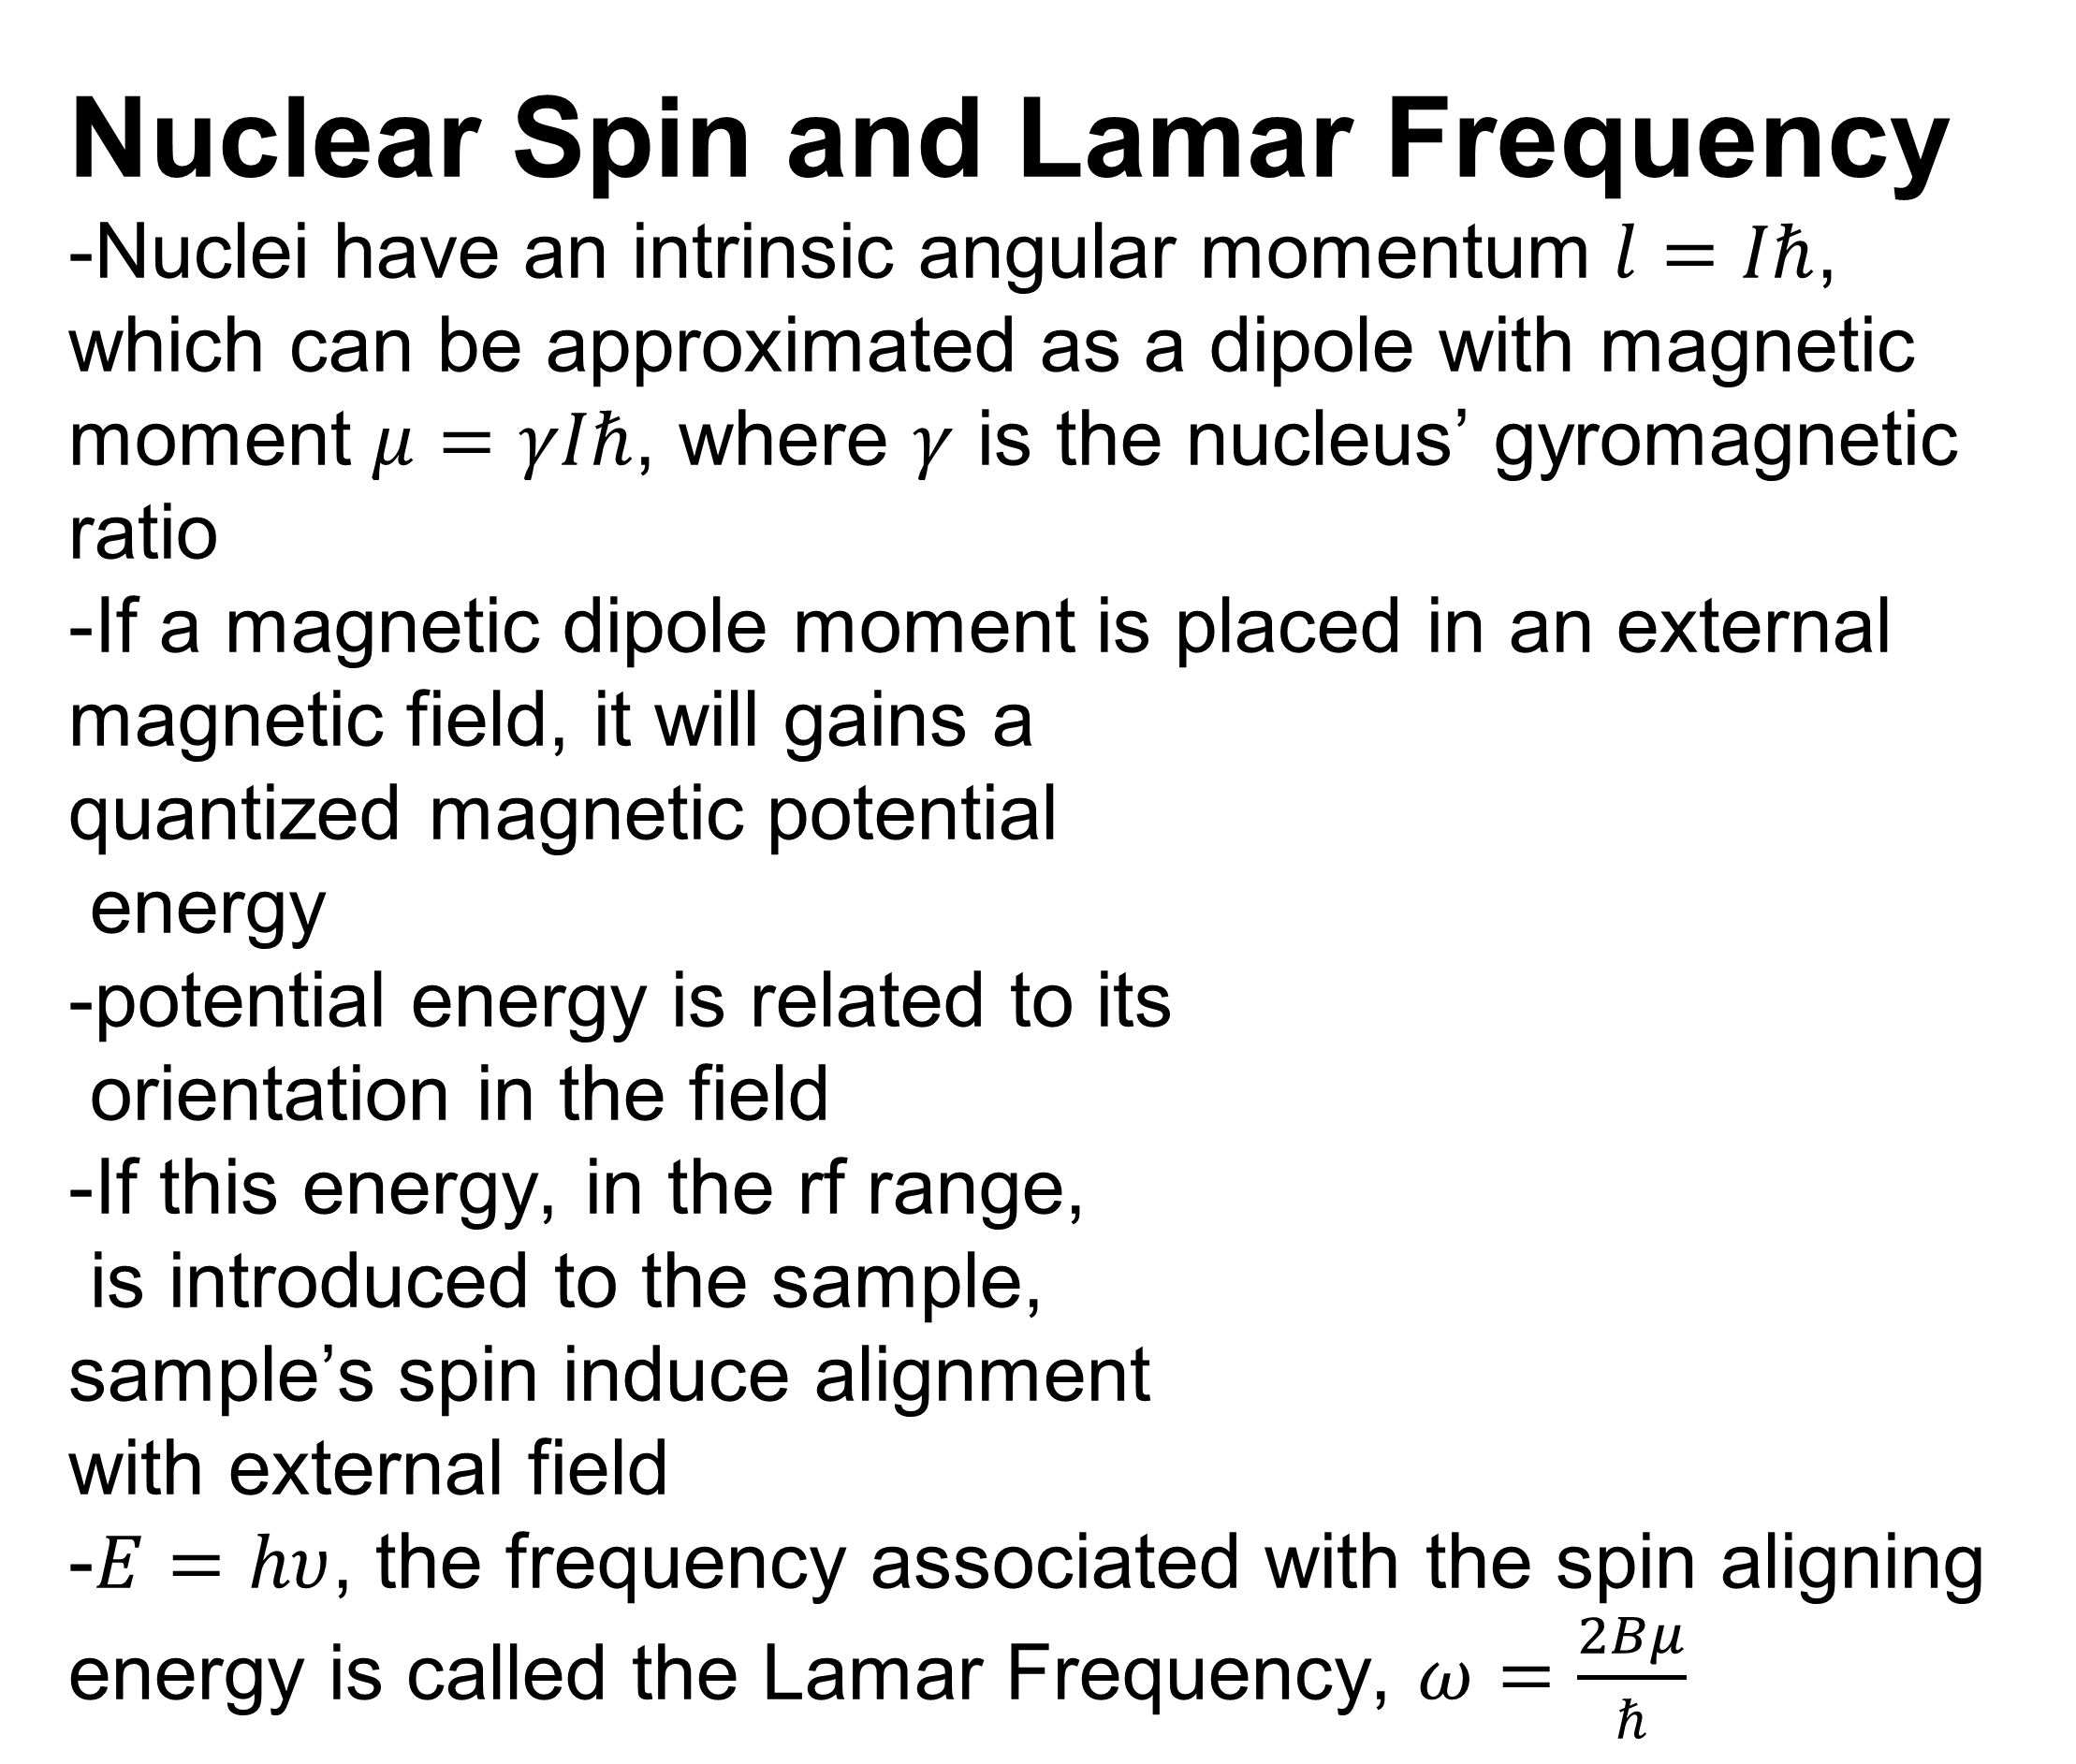
Pulse NMR in the Dynamic Nuclear Polarization Experiment
Abstract
-Measuring the scattering results of a Tensor Polarized Target sample will provide new information about the spin properties of nucleons, specifically information about the ‘Spin Crisis’.
-The Dynamic Nuclear Polarization experiment’s goal is to create this target.
-To ensure the target is polarized, Nuclear Magnetic Resonance (NMR) must be performed on the polarized material to measure the sample’s spin-decay, providing evidence that it was polarized.
-Pulse NMR, a new method, is used for this measurement, versus CW NMR
N. Lajoie Dr. E. Long , Dr. K. Slifer
Pulse NMR in the DNP
- From Wednesday April 11th – Friday April 13th 2018,
the DNP lab turned on its 7T magnet and tested equipment for creating it’s Tensor Polarized Target
Including NMR.
-CW NMR was performed
around the frequencies
212.31MHz (5 Tesla Field)
and 297.99MHz
(7 Tesla Field)
with 3D printable plastic samples.
-Pulse NMR was performed in the frequency ranges of 277.62MHz – 297.99MHz (B-Field 6.42Telsa – 7Tesla)
Nuclear Magnetic Resonance (NMR)
The process of inducing a magnetic moment’s spin to flip with a RF signal at the sample’s Lamar frequency is called Nuclear Magnetic Resonance.
Apparatus
Consists of a signal generator,
a calibration circuit, a probe with
sample placed in a magnetic field,
a receiving Multichannel Analyzer,
NMR measuring software
Calibration(Tank) Circuit:
- Purpose is to have a resonance
frequency which matches that of the sample.
- Obtained by maximizing the Quality factor: $Q=\frac{2πωL}{R}$, while still maintaining a measurable relaxation time $T_{R}\sim \frac{Q}{ω}\sim 1μs$
- A Vector Network Analyzer is used to find frequencies with large Q Probes
Signal Coil probe – receiving and transmitting signal run through same circuit
Double Coil probe – requires
orientation of coils to be
perpendicular to external field
Continuous Wave NMR
-Range of frequencies near
Lamar frequency is sent through
signal path.
Pulse NMR
-Sends large range of frequencies
at once to sample
TNMR
-Program to create
customized pulse NMR
signal specific to
apparatus
  The Dynamic Nuclear Polarization Experiment (DNP)
-All information about nuclei, nuclei decays, and their constituents’ properties are found through scattering experiments
-Two types of targets used:
Non- Polarized Target
Vector Polarized Target
- DNP experiment’s goal is
to create a new type of target:
Tensor Polarized Target (TPT)
- Using other experiments,
TPTs will provide new information about the
nuclear spin of sea quarks
Figure 6: DNP NMR Probe in Target Stick
Figure 3: Signal Pathway
Figure 8: Signal Candidates (288.62MHZ)
Figure 7: Signal Candidates (285.62MHZ)
Figure 1: DNP Experiment Apparatus
Pulse NMR Improvements
Conclusion: Though Pulse NMR Proved to be an time effective way to measure NMR different frequencies, the search for a signal continues
Tank Circuit
-Adding a variable capacitors to tune the Quality factor and resonance frequency of circuit.
-Higher quality factor at different frequency ranges
provides a larger region
for measurement
Single Coil Probe with
Duplexor:
-Adding Diodes to prevent
transmitted signal from
entering receiving channel of apparatus
Nuclear Spin and Lamar Frequency
-Nuclei have an intrinsic angular momentum $l=Iℏ$, which can be approximated as a dipole with magnetic moment $μ=γIℏ$, where $γ$ is the nucleus’ gyromagnetic ratio
-If a magnetic dipole moment is placed in an external magnetic field, it will gains a
quantized magnetic potential
energy
-potential energy is related to its
orientation in the field
-If this energy, in the rf range,
is introduced to the sample,
sample’s spin induce alignment
with external field
-$E=hυ$, the frequency associated with the spin aligning energy is called the Lamar Frequency, $ω=\frac{2Bμ}{ℏ}$
Figure 4: TNMR Sequence Editor
Figure 8: Sample Tank circuit
Figure 2: Magnetic Dipole Moment in $ℝ^{3}$
References:
Experimental Pulse NMR, E. Fukshima (V.C.)
Figure 5: Pulse NMR Transmission used in DNP Experiment

