Slide 1
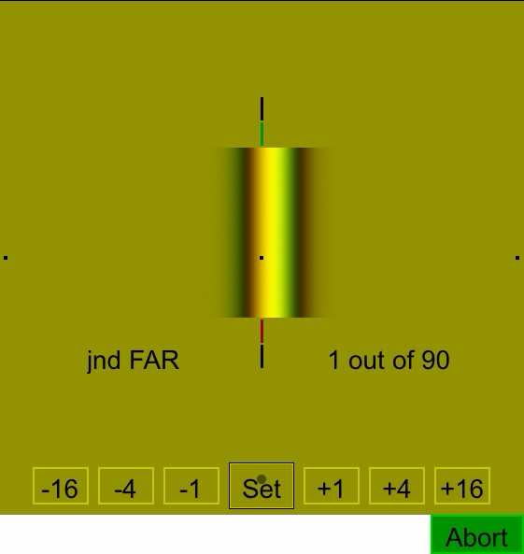
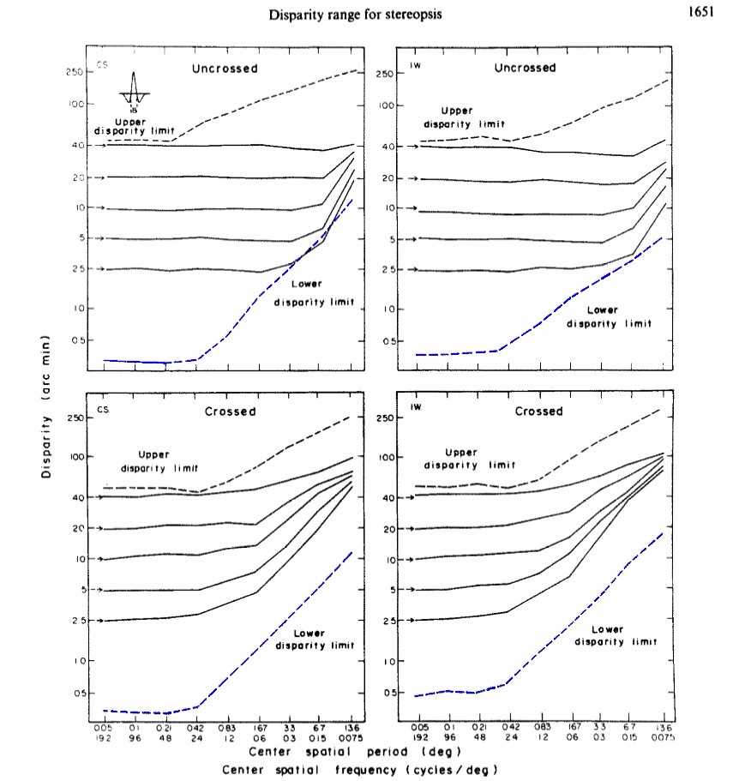
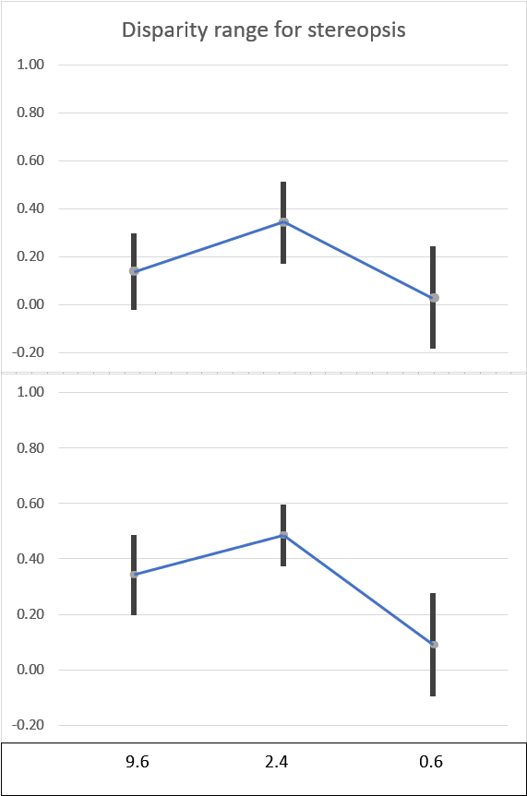
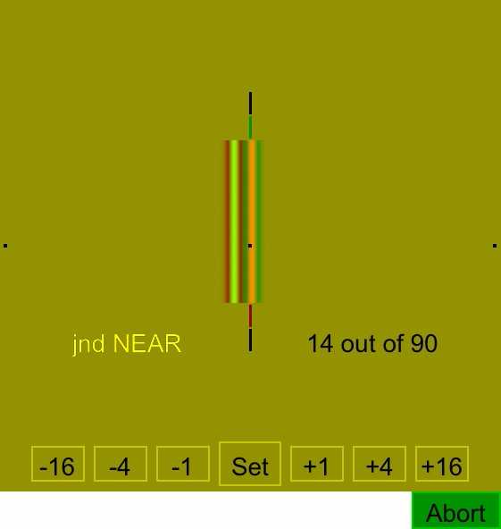
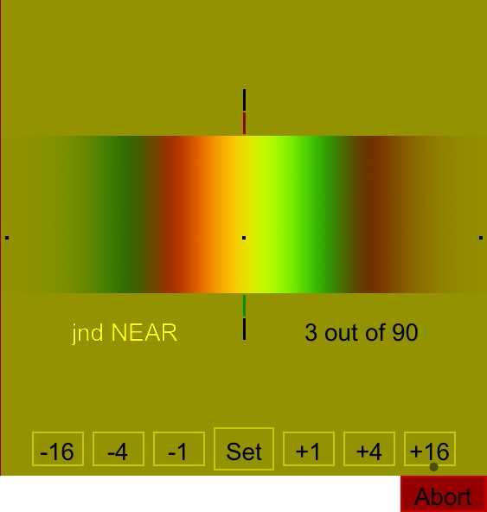
The Effects of Spatial Frequency on Stereoacuity: A Replication of Schor and Wood
Abby Oostendorp, Michael Palazzolo, Sophie Topouzoglou, Joseph LaBarre, Andrew Kitt, and Wm Wren Stine | University of New Hampshire
Problem / Question
Results
Stereoacuity gets worse when spatial frequency is below 2.7 cycles per degree (Schor &Wood, 1983).
Their experiment focused on local stereopsis. We intend to measure stereoacuity across spatial frequencies for global stereopsis.
However, first we need to replicate their work with computer generated stimuli given they used oscilloscopes.
Disparity (arc min)
Central spatial frequency (cycles/degree)
Methods
Conclusion
Replicating Schor and Wood, we used difference-of-Gaussian stimuli that have narrow spatial frequency bandwidths.
Stimuli were presented using an iMac at a distance of 125 cm to minimize pixilation effects.
Stereo pairs of images were presented to each subject with both crossed and uncrossed disparities at each spatial frequency. 90 trials per session were run for up to ten sessions per subject.
We replicated Schor & Wood for high and medium spatial frequencies but not for low spatial frequencies.
This difference may be caused by the relative inexperience of our subjects in depth perception tasks compared to the highly trained observers in the Schor and Wood experiment.
The method of adjust allows for criterion effects.
Works Cited
Schor, I. and Wood, Clifton M. (1983) Disparity range for local stereopsis as a function of luminance spatial frequency. Vision Res. 23(12), 1649-56.

