Slide 1

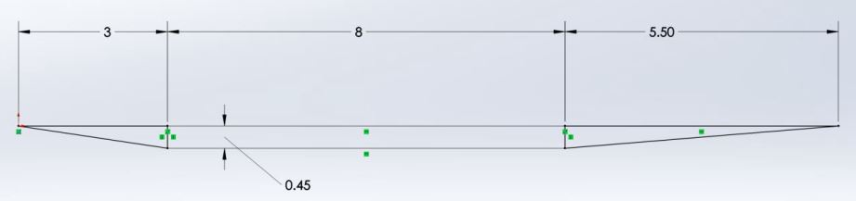
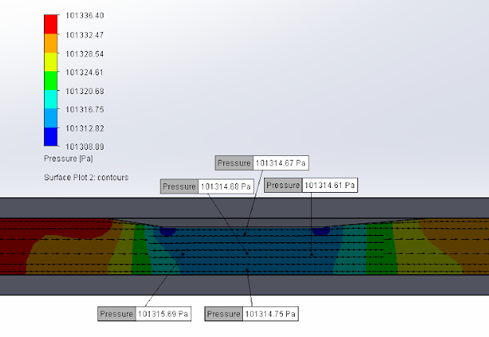
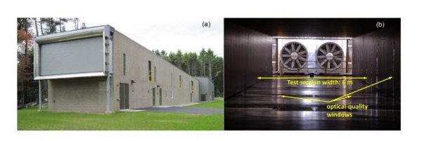
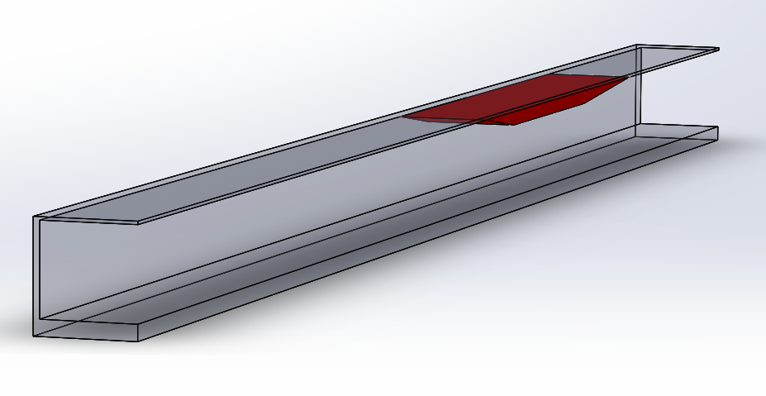
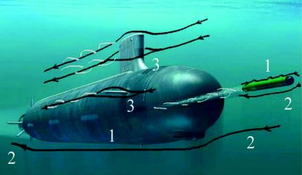
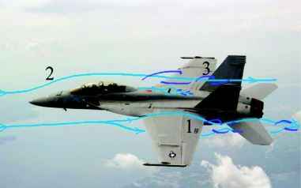
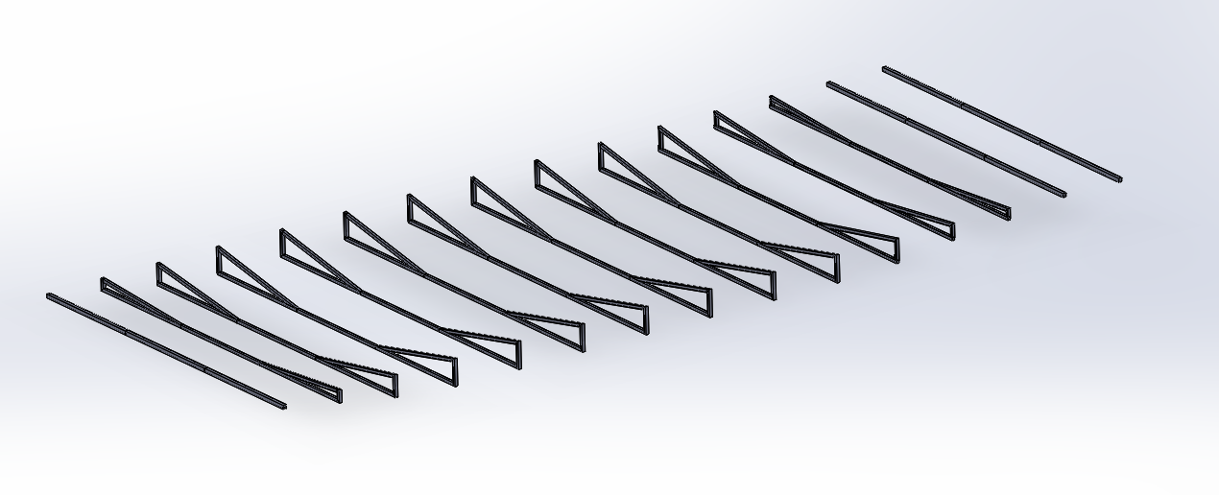
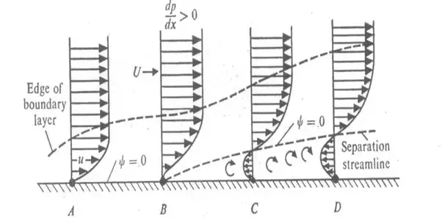
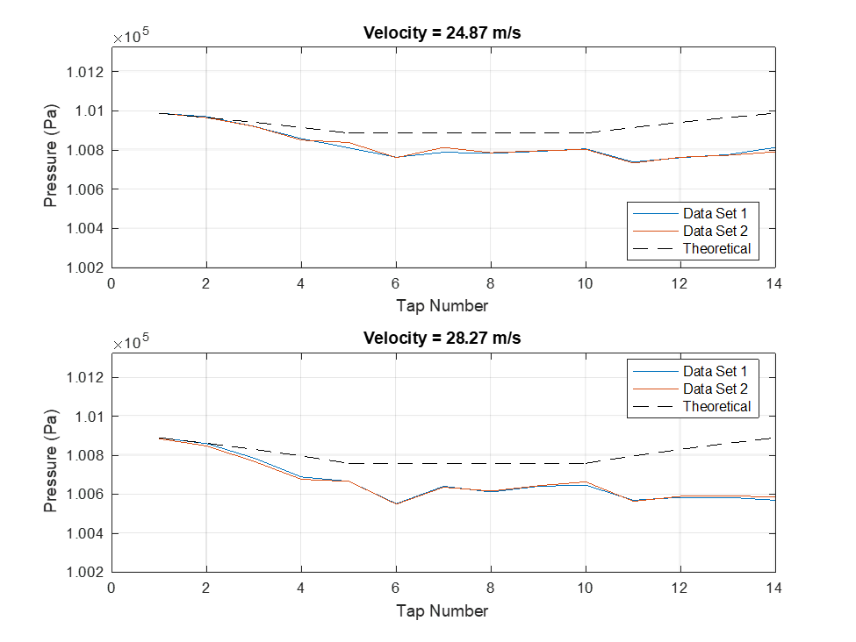
Generating Non-Equilibrium Boundary Layers at High Reynolds Numbers
Project Members: Kyle Reisert and James Ripley
Advisors: Prof. Chris White and Prof. Joe Klewicki
Objective: Design a ramp insert for the UNH Flow Physics Facility (FPF) to produce a streamwise pressure gradient that in turn generates non-equilibrium (i.e. complex) boundary layer flow along and downstream of the expansion ramp.
Figure 4: Schematic of insert side view with required dimensions.
Design Criteria (3 sections, total length 16.5m, width 6m)
(i) contract cross-sectional area of FPF from 2.85m to 2.4m over 3m.
(ii) maintain cross-section area of FPF constant at 2.4m over 8m.
(iii) expand cross-sectional area of FPF from 2.4m to 2.85m over 5m.
Figure 1: a) An outside view of the UNH FPF, the largest boundary layer wind tunnel of its kind in the world. b) An interior view of the FPF.
Motivation: Boundary layer flow of practical interest to the Navy includes the flow around a submarine or the flow around the airfoil of a fighter jet. The aerodynamic/hydrodynamic performance of these applications are greatly influenced by non-equilibrium effects in the boundary layer.
Figure 7: A SolidWorks Flow simulation for inside the FPF with insert at an 8 m/s inlet velocity. Shown is the resulting pressure gradient. The flow velocity increased to 10.2 m/s after the contraction.
SolidWorks Simulation: Above is a SolidWorks simulation of the flow over the insert when placed on the UNH FPF ceiling. The image shows the resulting pressure gradient based on an inlet flow rate of 8 m/s. The colors correspond to differing pressure values and the arrows correspond to the flow direction. The red represents atmospheric conditions and the dark blue represents 101,309 Pa. The other colors are intermediate values. The overall pressure drop created by the insert was 27.51 Pa over the 3m front ramp.
Figure 5: Model of the insert inside of the FPF wind tunnel.
Small Scale Testing: A small scale model was made out of plywood for testing in the UNH student wind tunnel in Kingsbury Hall. Pressure taps were inserted to measure the pressure along the center of the model. Additionally an oil film test was performed to test for separation of flow at the beginning of the flat section.
Figure 2: The complex flow lines related to the movement of Naval vehicles are shown. Non-equilibrium effects have a large impact on these movements.
Boundary Layers: Boundary layers form as fluid flows across a surface. They are caused by shear stress imposed on the flow by the wall.
Figure 6: SolidWorks model of the final aluminum frame design. These beams would be supported at each wall.
Final Design: Skeletal frame of square square aluminum tubing with a body of rigid polystyrene foam. These materials were chosen with the goal of reducing deflection, as they are lightweight and rigid. Reducing the deflection of the insert frame was very important, as large deflection values would yield undesirable spanwise pressure gradients.
The 6m span posed a challenge with regards to reducing deflection, as supports can only be placed at the walls. This became especially difficult at the leading and trailing edges of the insert, where wall area for supports became scarce.
For the final design, deflection was reduced to:
5mm at the leading edge
0.3mm in the 8m flat section
6mm at the trailing edge
Figure 3: Diagram of boundary layers with and without flow separation.
Non-equilibrium effects (caused by imposed pressure or strain) modifies momentum transport and turbulence production in often unpredictable ways.
Figure 8: Small scale model pressure tap results recorded at two different velocities and plotted against the theoretical pressures.

