Slide 1
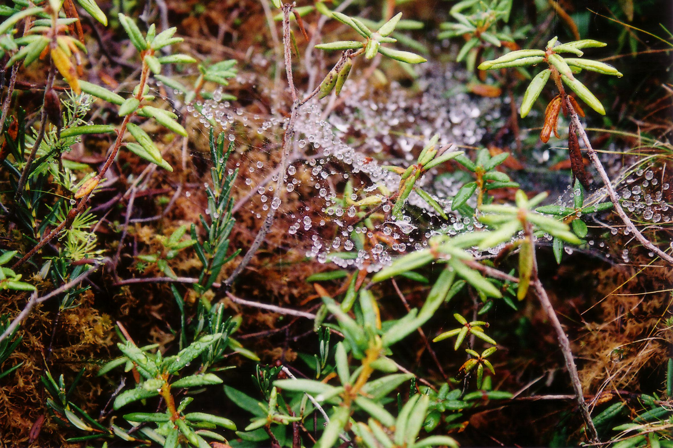
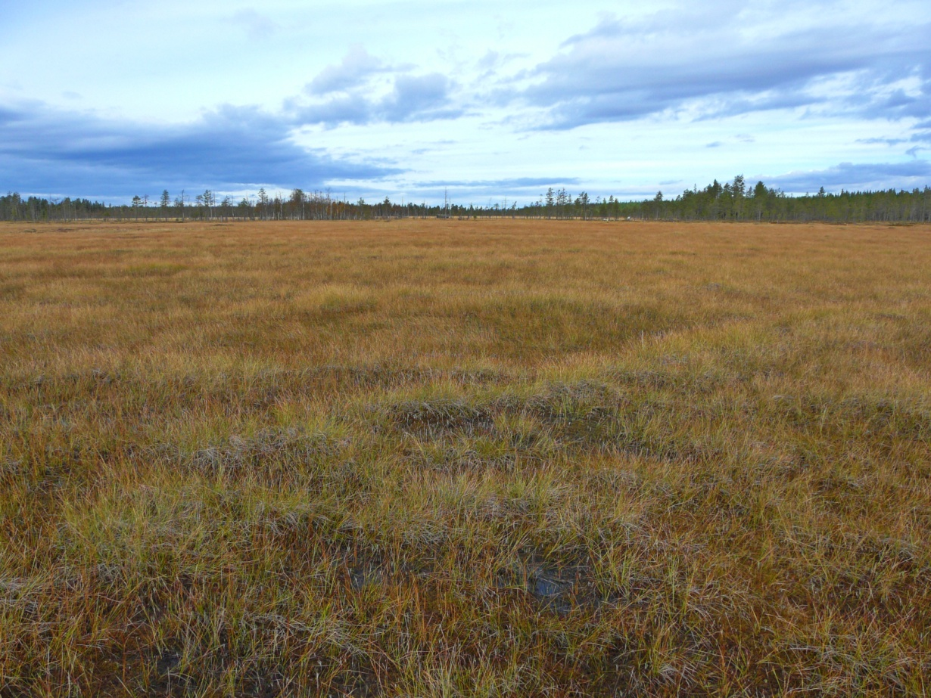
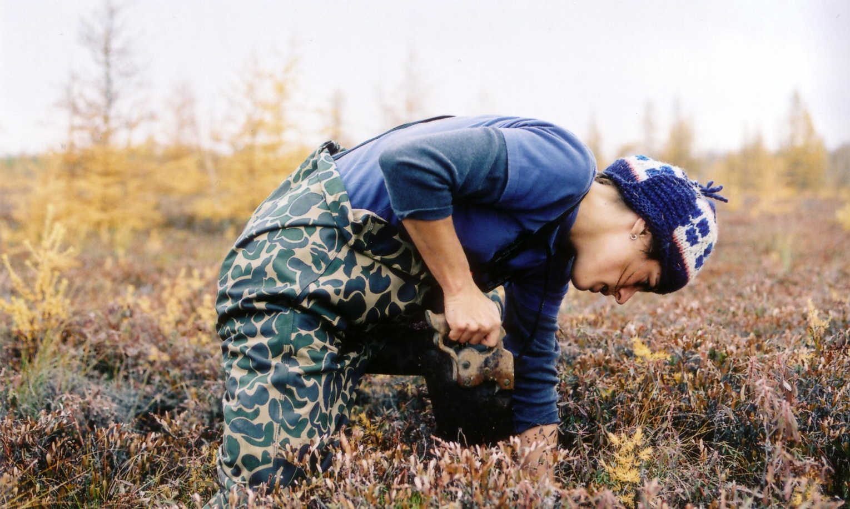
Exploring the limits of peatland stability using a peat accumulation model
Julie Talbot, Steve Frolking
Earth System Research center, University of New Hampshire, Durham, USA
julie.talbot@unh.edu
Introduction
Results
Northern peatlands are likely to be exposed over the 21st century to a rate of change in climatic conditions and a frequency of disturbances not previously experienced in the Holocene. Northern peatland carbon stocks are large and potentially vulnerable, since several key climatic variables that are expected to change (i.e., precipitation, potential evapotranspiration, temperature, growing season duration, fire, permafrost thaw) influence peatland net carbon exchange, either directly or via hydrological or vegetation feedbacks. However, the vulnerability of peatlands to external forcing is not well understood, and the widespread persistence of peatlands through the Holocene indicates that they have a relatively high degree of inherent stability. We test the impact of different disturbances on peatland stability (as indicated by the continued capacity of peatlands to accumulate carbon) and we explore the role of vegetation characteristics in mitigating the impact of these disturbances.
Peat accumulation was simulated for a bog and a fen subjected to different disturbance scenarios. All simulations were driven by a stochastic precipitation model constrained by a precipitation reconstruction for southern Quebec (Muller et al. 2003), with an average of 900 mm per year over the 8500 years of simulation.
Base case - bog
Bog development scenario leading to an accumulation of 5.5 m of peat (310 kg C m⁻²). The peat gets “enriched” in moss as it gets buried down the profile, due to the recalcitrant nature of moss litter (especially Sphagnum) . Mosses account for 36% of total cumulative NPP, but for 62% of remaining peat mass at the end of the simulation.
Same parameterization as (a), but where all vascular plant productivity is allocated to aboveground components, showing that roots seem to “record” climate variations better than aboveground biomass. Peat accumulation is 15% less (in kg C m⁻²) than in (a).
Same parameterization as (a), but a gradual drying is imposed starting at year 6000 (linear increase in evapotranspiration reaching 25% by year 8500). This leads to a halt in peat accumulation, with an overall 18% reduction in accumulated C by the end of the simulation compared to (a).
Same parameterization as (c), but where moss die-off accompanies the onset of drying (moss NPP replaced by vascular NPP). This scenario indicates that moss can be an important component factor in the resiliency of peatlands when facing drying. Peat accumulation is reduced by 28% compared to (a) and 12% compared to (c).
Base case - fen
Persistent fen (from rich to poor) development scenario, leading to an accumulation of 4.5 m of peat (233 kg C m⁻²). The precipitation driver is similar to the bog scenario, but the impacts of periodic droughts are more severe in terms of peat loss, although the recovery from these losses is also faster.
Same parameterization as (e), but a gradual drying is imposed starting at year 6000 (linear increase in evapotranspiration reaching 25% by year 8500). The system continues to accumulate carbon at a steady rate for the first 1000 years of gradual drying, but once a threshold is reached and a period of lower precipitation occurs, the destabilization is very fast, leading to a 15% overall reduction in accumulated C by year 8500.
Peatlands are a good example of self-regulating ecosystems, as they can exhibit remarkable stability over several millennia, both in terms of vegetation structure and productivity, and carbon accumulation. Vegetation reconstructions (for example Hugues and Barber, 2003) show such vegetation composition stability, but also show that peatlands can experience rapid changes in their structure and function, such as the fen-bog transition. Hence, peatlands could experience rapid changes in the future given the right set of conditions.
No roots
Drying @ yr 6000
Drying @ yr 6000
The Holocene Peat Model (HPM)
Summary
Allocating all vascular plant biomass to aboveground parts reduces peat accumulation.
Increased shrub plant growth in drier periods is recorded in peat over time because of the root litter input – there is no such record when only aboveground biomass is considered.
Mosses, especially Sphagnum species, seem to be crucial to prevent peat loss in dry conditions in bogs.
Peat accumulation in the simulated fen is more sensitive to dry periods, although the potential for fast recovery is higher because of the high productivity of fen plant assemblages.
For all scenarios, the deeper peat is relatively isolated from the ‘recent’ climate and other perturbations.
Future work
Including temperature as a driver and nutrient dynamics.
Improving fen representation, including the dynamic, process-based modeling of the fen-bog transition.
Testing for a number of sites in different climatic settings and at different stages of development.
HPM (Frolking et al. 2010) is a one-dimensional model simulating peat accumulation at an annual time step as the net balance between above- and below-ground productivity and litter or peat decomposition. The basic model structure is two coupled differential equations that simulate the dynamic interaction between accumulating peat and accumulating water, based on the annual plant litter input, decomposition and annual water balance. The model is driven by time series of annual precipitation.
The litter inputs are disaggregated in different plant functional types (currently up to 13, including different types of bryophytes, grasses, forbs, sedges, shrubs and trees). The litter input and relative contribution of the plant functional types are determined based on peat depth (as a proxy for nutrient status and acidity) and water table depth.
Drying @ yr 6000, no moss
Moss fraction of remaining peat
Water table depth relative to peat surface
References
Frolking S, Roulet NT, Tuittila E, Bubier JL, Quillet A, Talbot J, Richard PJH. 2010. A new model of Holocene peatland net primary production, decomposition, water balance, and peat accumulation. Earth System Dynamics 1:1-21.
Hugues PDM, Barber KE. 2003. Mire development across the fen-bog transition on the Teifi floodplain at Tregaron Bog, Ceredigion, Wales, and a comparison with 13 other raised bogs. Journal of Ecology 91: 253-264.
Muller S, Richard PJH, Guiot J, Debeaulieu J, Fortin D. 2003. Postglacial climate in the St. Lawrence lowlands, southern Québec: pollen and lake-level evidence. Palaeogeography, Palaeoclimatology, Palaeoecology 193: 51-72.

