Slide 1

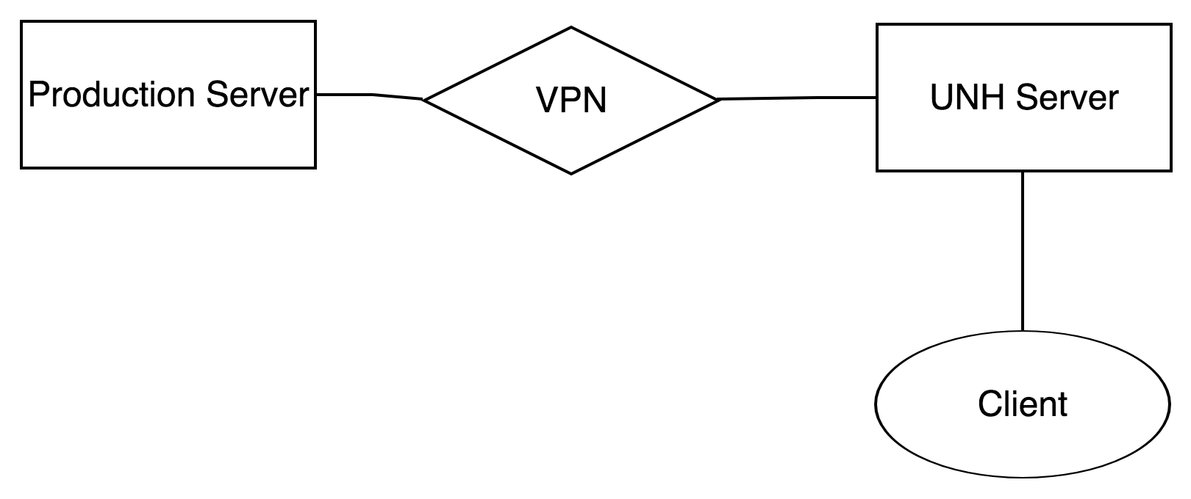
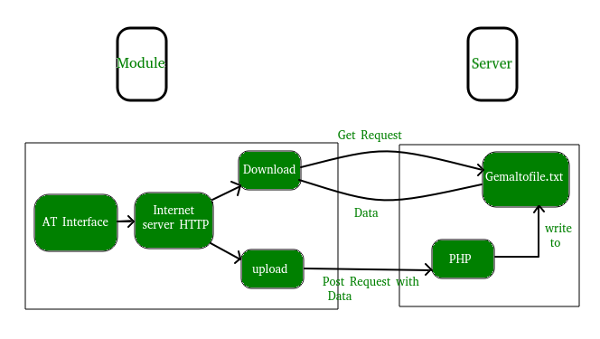

Living Bridge Alert System
Zachary Girard
Advisors: Ian Gagnon, Collette Powers
background
Flo chart
Results
The Living Bridge Project aims to convert the Memorial Bridge in Portsmouth, NH into a self-diagnosing, self-reporting, self-sustaining “Smart Bridge.” To do this the bridge has been outfitted with sensors monitoring the bridge structure and a platform, which houses instruments that monitor the tidal currents in the river below. The platform will eventually include a tidal turbine, which will generate energy from the current.
SMS Gateway Domain:
Allows a computer to send or receive a Short Message Service transmission to or from a telecommunications network.
EX: server.sendmail( <number>@vtext.com)
Simple Mail Transfer Protocol (SMTP):
An internet standard for electronic mail transmission.
EX: to =[‘person1@example.com”]
Problem
Obtaining the data
There is no active monitoring of the system.
Data reporting is only passive.
Goal is to create an alert system that actively monitors the sensors.
Interface: A point where two systems meet and interact.
What is HTTP?
Enables communication between clients and servers.
Get: to request data from the server.
“This project was partially funded by the National Science Foundation under award IIP-1430260.”

