Slide 1

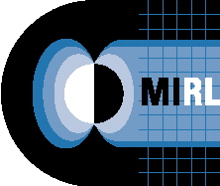
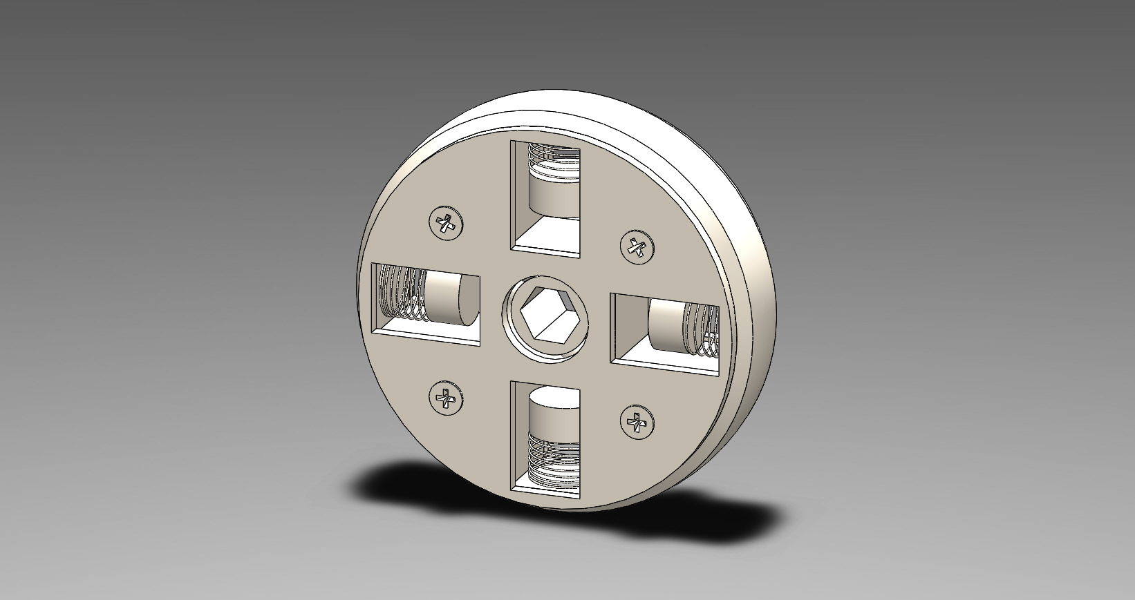
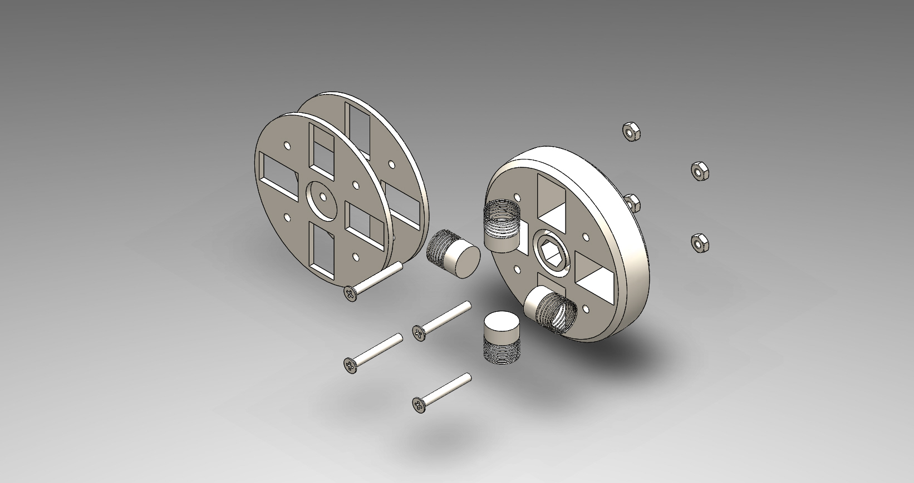
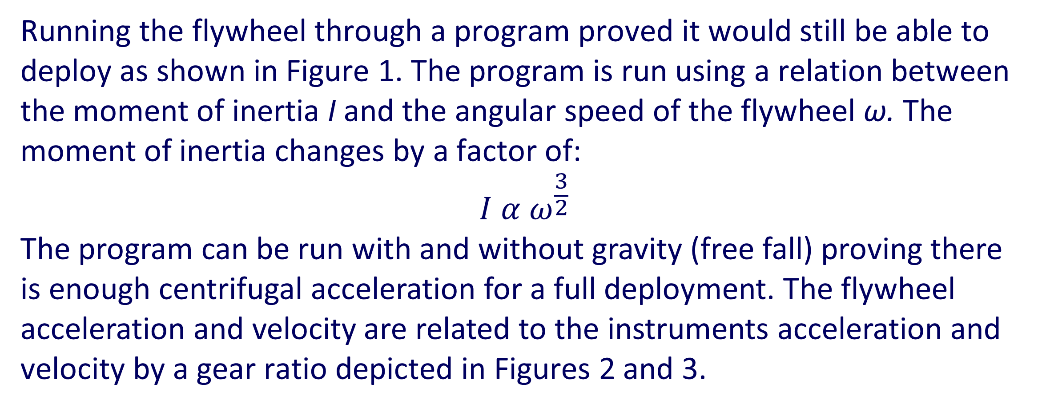
Design of Variable Moment of Inertia Flywheel
Derek Phillips
Advisor: Professor Marc Lessard
Magnetosphere and Ionosphere Research Laboratory, University of New Hampshire
Purpose
The purpose of this project was to create a newer, more efficient way to deplete deployment energy from the instruments aboard a sounding rocket. Using a Variable Moment of Inertia (VMI) flywheel, instrument energy can be depleted separately with the added flexibility of heavier instruments and faster spin rates on rockets. This translates to more reliable data and low maintenance changes for the instrument housing.
Test Results
Flywheel Design
A prototype was designed to show the idea behind the flywheel. The main idea of the design is the weight-spring combination. As the flywheel is accelerated centrifugal force is created from the rotation causing the weights to compress the springs. The compression causes the moment of inertia of the flywheel to increase until it reaches an equilibrium. The equilibrium is based on the input torque of the instrument, the compression constant of the spring and the mass of the weights used. The assembled fly wheel is shown in Figure 4 and an exploded view in Figure 5.
Running the flywheel through a program proved it would still be able to deploy as shown in Figure 1. The program is run using a relation between the moment of inertia I and the angular speed of the flywheel ω. The moment of inertia changes by a factor of:
$$I α ω^{\frac{3}{2}}$$
The program can be run with and without gravity (free fall) proving there is enough centrifugal acceleration for a full deployment. The flywheel acceleration and velocity are related to the instruments acceleration and velocity by a gear ratio depicted in Figures 2 and 3.
Background
As a sounding rocket is propelled upward it will shed the skin that holds the instruments to allow them to deploy. The instrument utilizes centrifugal force created from the rotating rocket as a means for deployment. The current braking system for the instrument is a bumper to absorb deployment energy. The bumper causes impulses in the data at the end of deployment causing the instrument to be effective in a limited range of spin rates, instrument mass and instrument length. When a VMI flywheel absorbs deployment energy separately it allows for a smoother, more reliable deployment which translates into better data and the ability to use a range of instruments.
Figure 4: Prototype of assembled VMI flywheel
Figure 5: Exploded view of VMI flywheel
Figure 1: Angular displacement of the instrument
SIGMA
Design Objectives
The system was designed to improve on old braking methods.
Conclusion
When the VMI flywheel depletes instrument energy separately the instruments, the instruments can accomplish more reliable data during a launch. The small addition to the rocket benefits every instrument on board with low maintenance required. Since the VMI flywheel has succeeded in the initial testing, it will be constructed in the Magnetosphere and Ionosphere Research Lab to be tested on real instruments. The testing will help develop the program models to accommodate future missions.
Previous design:
Impulse at end of deployment
Rubber bumper
Locking latch
New design:
Reliable and smooth deploy
Deplete energy separately from instrument
Simple
Figure 2: Wheel speed v. Time graph
Figure 3: Wheel Acceleration v Time graph

