Slide 1



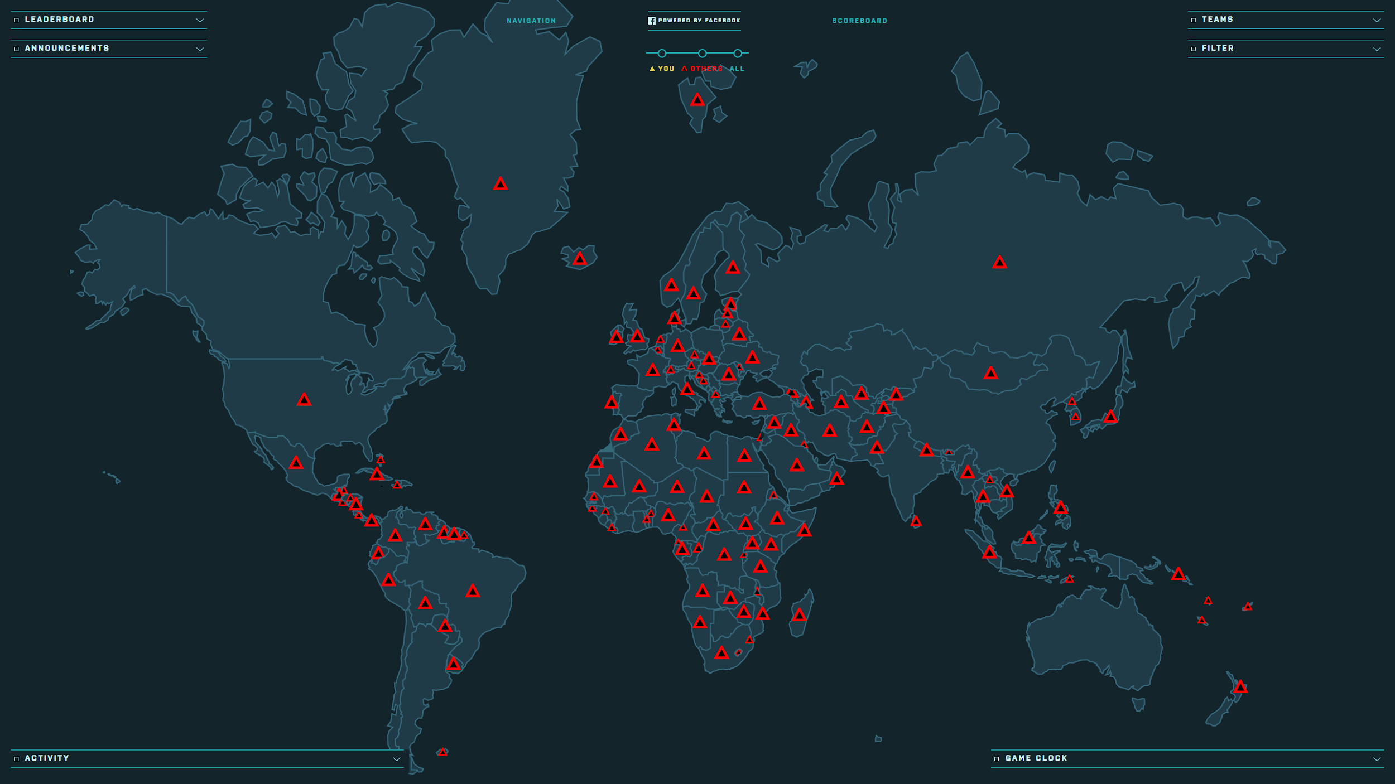
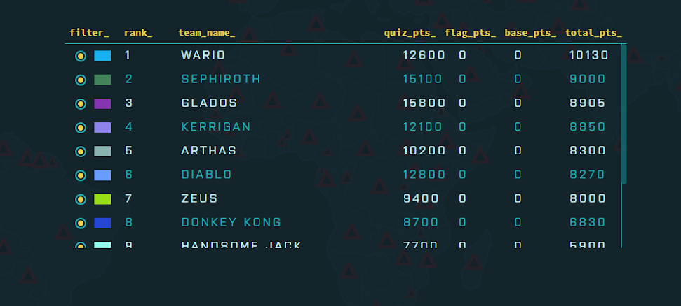



Facebook Capture the Flag:
NECCDC Game Masters
James Bowden & Zachary Ivey
Sponsor: Ken Graf
Department of Computer Science, University of New Hampshire
Introduction
Results
Discussion
During the New England Collegiate Cyber Defense Competition or the NECCDC, twelve teams of ten competed to “conquer the world”. Each question that they answer correctly captures the respective country, awarding them points, in addition to incrementing points from holding bases
On March 18th 2018, NECCDC Game Masters held the Capture the Flag competition.
The event ran for an hour.
12 teams of 8 to 10 students competed.
Team Wario won with 10130 point, Second place was taken by team Sephiroth with 9000 points.
Facebook Capture the Flag or FBCTF has some limitations:
It only allows for one question to be entered in at a time.
The process for entering in a question is long and tedious.There close to 180 countries.
If you use the same country in two different questions or bases, it will crash the game.
Methods
The provisioning script was created to automate the installation and start up of FBCTF servers, so that future FBCTF events can be created easier.
The question import script was created to automate inserting questions from a self validating CSV file to the MySQL Database.
The System Manager Script was written to automatically create a base out of any new server.
Goals
Participants to network with people outside of their schools.
To test their Cyber Security knowledge.
Participants to have a fun time competing against each other.
Contacts
      For more information contact:
      James Bowden: Jmb2017@wildcats.unh.edu
      Zachary Ivey: Zji2001@wildcats.unh.edu
.

